Slide 1


The Effectiveness of Human Factor
Safety Initiatives
at
Lisheen Mine
- A Case Study -
All Island Safety Conference
Brendan Morris
Past President – IMQS
Managing Director – LTMS Ltd

Slide 2
The Effectiveness of Human Factor Safety Initiatives at Lisheen Mine - A Case Study
Contents
Introduction
Safety Graph & Bird Triangle
Visible Felt Leadership Programme
Planned Task Observations
Safety Improvement Action Teams
Alcohol and Drug Testing
Behaviour Based Systems
Mine Rescue
Family Safety Day
LTMS Limited IMQS

Slide 3
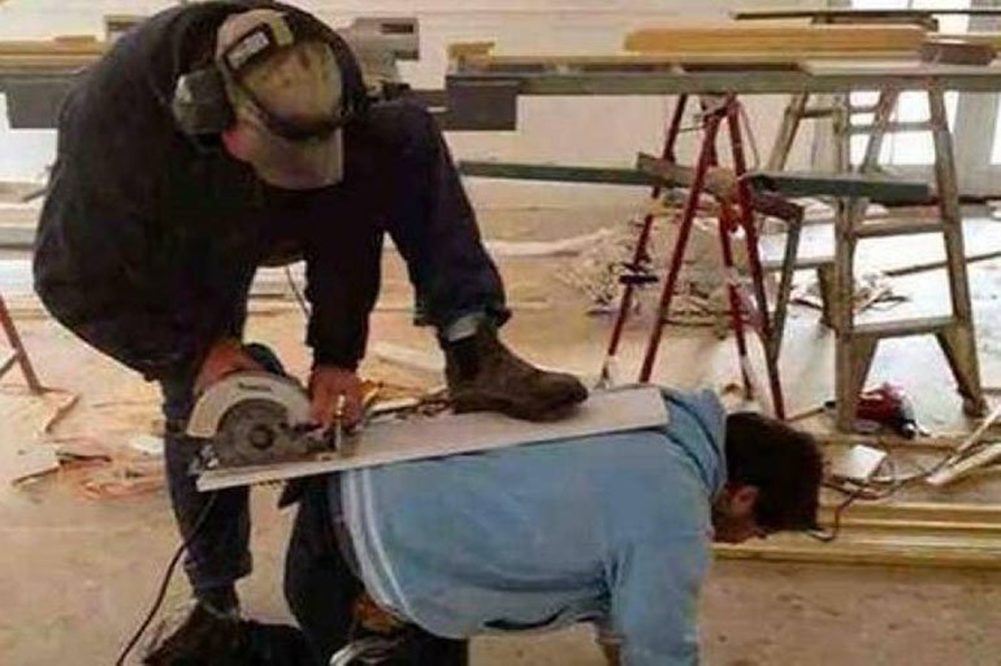
The Effectiveness of Human Factor Safety Initiatives at Lisheen Mine - A Case Study
LTMS Limited IMQS

Slide 4
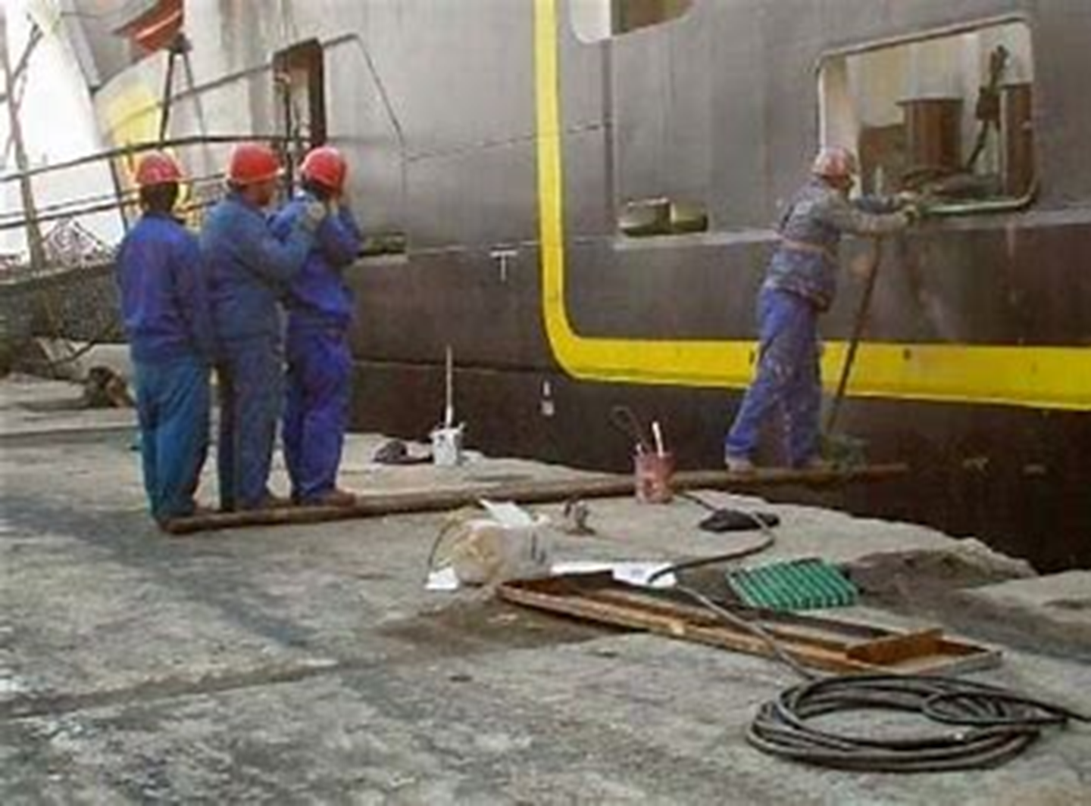
The Effectiveness of Human Factor Safety Initiatives at Lisheen Mine - A Case Study
LTMS Limited IMQS

Slide 5
The Effectiveness of Human Factor Safety Initiatives at Lisheen Mine - A Case Study
Introduction
The Lisheen Mine was in operation from 1999 to 2015, when it closed due to depletion of resources. An ore extraction ratio of >95% was achieved.
The mine then went through a ‘closure rehabilitation’ process, which was completed in 2018.
The site is now entering ‘After Care’ mode
In 2006, at a rate of approximately one Lost Time Injury per month and 80-100 total injuries per month, the Lisheen Management team implemented a programme of safety initiatives with a target of Zero Harm. The link between Total Injuries and Lost Time Injury Rate is well established through the Bird Triangle
This presentation covers some of the Human Factor Safety Initiatives, which were implemented and which we believed were of significant benefit in the journey to zero harm
LTMS Limited IMQS

Slide 6
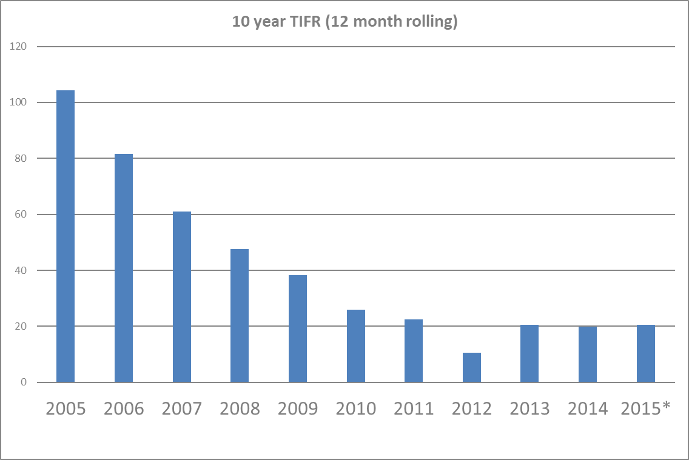
The Effectiveness of Human Factor Safety Initiatives at Lisheen Mine - A Case Study
Safety Improvement Graph – Lisheen Mine
Total Injury Frequency Rate
LTMS Limited IMQS

Slide 7
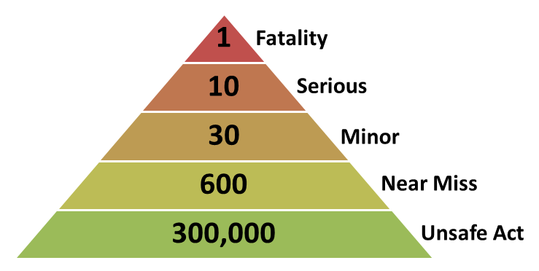
The Effectiveness of Human Factor Safety Initiatives at Lisheen Mine - A Case Study
Bird Triangle
LTMS Limited IMQS
Notes:
20 is reasonably good, but needs improvement
Per 1 Million manhours
Reporting improved and more minor items were reported

Slide 8
The Effectiveness of Human Factor Safety Initiatives at Lisheen Mine - A Case Study
Visible Felt Leadership (VFL)
LTMS Limited IMQS

Slide 9
The Effectiveness of Human Factor Safety Initiatives at Lisheen Mine - A Case Study
Visible Felt Leadership (VFL)
Felt leadership is a public proclamation of an organization’s commitment to caring about people
Felt Leadership
Leading by Example
Demonstrating Care and Visibility
Zero Tolerance
Not accepting unsafe acts or conditions
No exceptions to following laws, rules and regulations
Safe Production
One without the other is not viable for a successful business
Zero Harm
Preventing accidents, incidents, damage or business loss
LTMS Limited IMQS

Slide 10
The Effectiveness of Human Factor Safety Initiatives at Lisheen Mine - A Case Study
Visible Felt Leadership (VFL)
VFL was introduced at Lisheen in 2005, when a team of managers were trained through the Dupont system in the process. Following a successful initial phase, the programme was rolled out in 2006. The programme continued until closure in 2015.
Programme
All Managers and Supervisors had targets for VFL safety visits
  Senior Managers - 4 per month
  Frontline Supervisors – 8 per month
  Senior Staff (engineers, geologists, accountants, etc.) - 2 per month
A standard format was followed, looking for both Satisfactory and Unsatisfactory findings
Acknowledge and talk about good and bad observations that are identified
Record findings – leading indicators
Have a meaningful conversation with people about safety issues that you observe and listen to their issues on other safety issues
No discussion on production
LTMS Limited IMQS

Slide 11
The Effectiveness of Human Factor Safety Initiatives at Lisheen Mine - A Case Study
Visible Felt Leadership (VFL)
  Statistics
  Publish statistics monthly
  Carry out quarterly blitz programmes based on statistics
    Leading Indicators
    Issues raised by employees
  Ensure that all stakeholders are participating
LTMS Limited IMQS

Slide 12
The Effectiveness of Human Factor Safety Initiatives at Lisheen Mine - A Case Study
Visible Felt Leadership (VFL)
Results
Many findings and trends identified - leading indicators
After a slow start, employees engaged and they began to point out safety issues such as equipment and ground control issues. New ideas for safety were also suggested.
Managers and Supervisors were obligated to fix the problems following discussions
Employees expected feedback – important to ensure that this happened
Positive safety discussions
LTMS Limited IMQS

Slide 13
The Effectiveness of Human Factor Safety Initiatives at Lisheen Mine - A Case Study
LTMS Limited IMQS

Slide 14
The Effectiveness of Human Factor Safety Initiatives at Lisheen Mine - A Case Study
Planned Task Observation
LTMS Limited IMQS

Slide 15
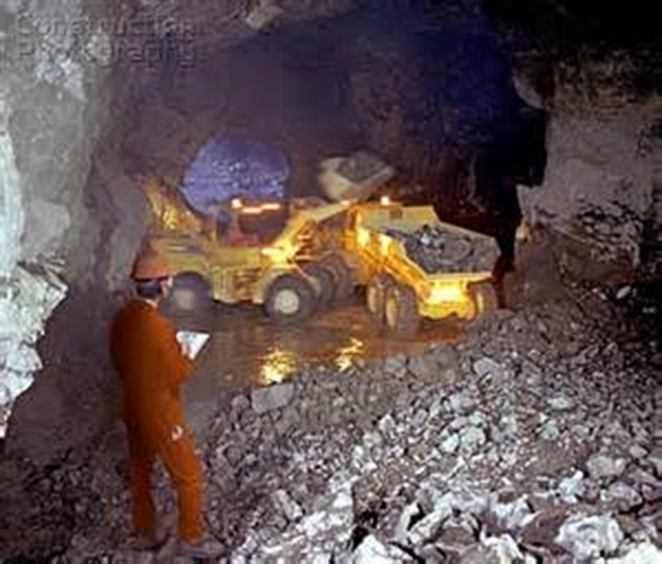
The Effectiveness of Human Factor Safety Initiatives at Lisheen Mine - A Case Study
Planned Task Observations
A Planned Task Observation (PTO) is process whereby a task is specifically observed to enable the observer to know whether or not a worker is performing all aspects of a specific task the correct way. It is a formal observation which is recorded in a manner sufficient for review following the observation.
Lisheen had a process of carrying out PTOs for Safe Operating Procedures (SOP).
All PTOs were developed from SOPs and as such the observations are very focussed.
LTMS Limited IMQS

Slide 16
The Effectiveness of Human Factor Safety Initiatives at Lisheen Mine - A Case Study
Planned Task Observations
The observee is informed prior to the PTO that he/she will be observed and as such can apply their full knowledge to the task.
Actions or conditions outside of the SOP are then identified
Following the PTO, the results are discussed between the observer and observee and the following can be carried out;
Full compliance can be acknowledged
Shortfalls can be rectified
Changes to the SOP can be made based on discussions
Leading Safety Indicators can be identified and recorded
The whole process was based on positive engagement between the observer and observee
Each supervisor had a target number of PTOs to carry out each month
LTMS Limited IMQS

Slide 17
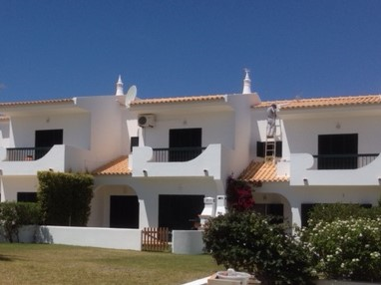
The Effectiveness of Human Factor Safety Initiatives at Lisheen Mine - A Case Study
LTMS Limited IMQS

Slide 18
The Effectiveness of Human Factor Safety Initiatives at Lisheen Mine - A Case Study
Safety Improvement Rapid Action Teams
LTMS Limited IMQS

Slide 19
The Effectiveness of Human Factor Safety Initiatives at Lisheen Mine - A Case Study
Safety Improvement Rapid Action Teams
This process was started in 2008, with a format which had been used successfully at Anglo American operations, who were the owners of Lisheen at that time.
The concept was to introduce rapid action teams to make fast and effective changes in key areas that can effect safety
LTMS Limited IMQS

Slide 20
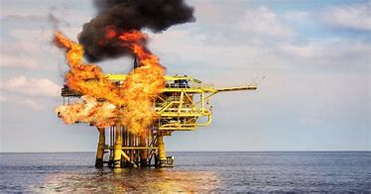
The Effectiveness of Human Factor Safety Initiatives at Lisheen Mine - A Case Study
Safety Improvement Rapid Action Teams
A professor at Harvard Business School and world-renowned change expert, Dr. John Kotter introduced his eight-step change process in his 1995 book, "Leading Change."
‘Burning Platform’
For Change
LTMS Limited IMQS

Slide 21
The Effectiveness of Human Factor Safety Initiatives at Lisheen Mine - A Case Study
Safety Improvement Rapid Action Teams
The concept for each team was as follows:
Select a team leader, normally a mid- level manager/supervisor
Select a ‘Godfather’, from senior management, to whom the team report
Select a team made up of people from a vertical slice of operations; 8 to 10 people, good, bad and indifferent
Issue formal team invitations
Initial team meeting – 3 to 4 hours. Godfather present only at start and end of meeting, to set the scene and then hear the results of the meeting
Select topics for action from the group, which can have impact
LTMS Limited IMQS

Slide 22
The Effectiveness of Human Factor Safety Initiatives at Lisheen Mine - A Case Study
Safety Improvement Rapid Action Teams
Present to ‘Godfather’ at the end of the meeting
Agreement from Godfather to proceed on each topic – This automatically gives full support from the full management team
Set up structure for team: responsibility, measurement, reporting, etc.
Project length 8-12 weeks
Reporting – weekly on dedicated notice boards across the site
Meetings – weekly then biweekly
Objective is to complete all actions in the time frame
Summary when project is complete
LTMS Limited IMQS

Slide 23
The Effectiveness of Human Factor Safety Initiatives at Lisheen Mine - A Case Study
Safety Improvement Rapid Action Teams
Example of a topic chosen
Site wide housekeeping programme
Identify key areas across the site and underground
Train team members on assessment and scoring system
Assess, photograph and apply a score to each site
Agree timeline for improvement
Re-assess, photograph and re-score each site
Post results & photos on special Rapid Action Team Boards across the site
LTMS Limited IMQS

Slide 24
The Effectiveness of Human Factor Safety Initiatives at Lisheen Mine - A Case Study
Safety Improvement Rapid Action Teams
Key Notes
By using a vertical slice for team members, all employees felt they could contribute
Using some ‘less agreeable’ employees, sometimes (but not always) changed their attitude, through a sense of inclusion
Some topics were very successfully completed and others with less success
The process eventually ran out of steam after a number of projects, but was re-ignited in 2011
The process was considered to be a very good success
LTMS Limited IMQS

Slide 25
The Effectiveness of Human Factor Safety Initiatives at Lisheen Mine - A Case Study
LTMS Limited IMQS

Slide 26
The Effectiveness of Human Factor Safety Initiatives at Lisheen Mine - A Case Study
Drug and Alcohol Testing
LTMS Limited IMQS

Slide 27

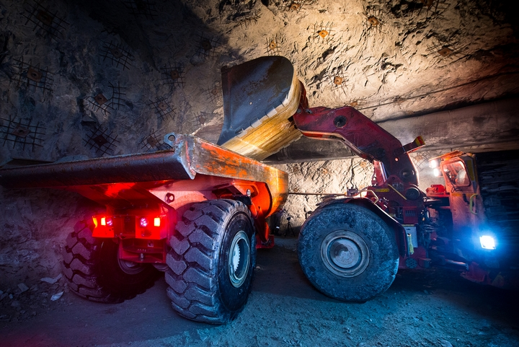
The Effectiveness of Human Factor Safety Initiatives at Lisheen Mine - A Case Study
Drug and Alcohol Testing
We wanted to ensure that nobody worked on site or operated large equipment with alcohol or drugs in their system
LTMS Limited IMQS

Slide 28
The Effectiveness of Human Factor Safety Initiatives at Lisheen Mine - A Case Study
Drug and Alcohol Testing
  An alcohol testing policy was introduced at Lisheen in 2009
  The objective was to reduce the risk from people under the influence of alcohol
  The programme was discussed and agreed with all staff and unions – initially there was resistance and significant engagement was necessary
  A qualified person was hired to be present at random times at the entrance to the site, to carry out testing. (a retired Garda)
  All personnel, including visitors required to draw a ball – 1 in 5 chance for testing
  Very good success in early months – a small number of people identified, with low recidivism rates
  Later changed to test all people entering the site at all times
  Managers and Supervisors trained in understanding of blood alcohol levels and discussion with offenders
LTMS Limited IMQS

Slide 29
The Effectiveness of Human Factor Safety Initiatives at Lisheen Mine - A Case Study
Drug and Alcohol Testing
  The system was as follows, based on a legal alcohol limit of 0.8mg/l:
  0.0 – Pass
  0.0 – 0.2 mg/l – Stop, wait in carpark and return in one hour and re-check
  0.2 – 0.5 mg/l – go home, return tomorrow, start with a discussion with supervisor
  >0.5mg/l – taxi arranged to take home, return tomorrow, start with a discussion
  Repeat offenders managed as required
  Changed to test all people entering the site
  Managers and Supervisors trained in understanding of blood alcohol and discussion
  All contractors informed, but initially the compliance level was not as effective as the employees.
LTMS Limited IMQS

Slide 30
The Effectiveness of Human Factor Safety Initiatives at Lisheen Mine - A Case Study
Drug and Alcohol Testing
  The alcohol testing system was extended to drug testing in 2014, but due to technical issues associated with the actual drug tests and their results, this part of the programme was never fully operational.
  However, employees knew that they could be randomly tested for drugs from 2014 onwards. If time had allowed, this would have been implemented.
  Without a doubt the alcohol testing was a huge success
LTMS Limited IMQS

Slide 31

The Effectiveness of Human Factor Safety Initiatives at Lisheen Mine - A Case Study
LTMS Limited IMQS

Slide 32
The Effectiveness of Human Factor Safety Initiatives at Lisheen Mine - A Case Study
Behaviour Based Systems
LTMS Limited IMQS

Slide 33
The Effectiveness of Human Factor Safety Initiatives at Lisheen Mine - A Case Study
Behaviour Based Systems
As Mine closure approached Management recognised that employee morale and focus may be an issue.
A climate survey was used to identify areas of concern.
A bespoke programme was developed by Lisheen staff (Production and Safety professionals).
The programme called ‘Keys to Safety’ or KTS.
KTS included a refresher on risk assessment and controls but focused on behaviour:
  Human cause of Errors (Slip / Lapse) – brain function.
  Decision making in the workplace.
  Reasons for working safely (not just compliance). Key 3
ZIP - Zero Incidence Protocol – Senior and Middle Management trained
LTMS Limited IMQS

Slide 34
The Effectiveness of Human Factor Safety Initiatives at Lisheen Mine - A Case Study
Safety Improvement Graph – Lisheen Mine
Total Injury Frequency Rate
Safety Plateau
LTMS Limited IMQS

Slide 35
The Effectiveness of Human Factor Safety Initiatives at Lisheen Mine - A Case Study
Mine Rescue
LTMS Limited IMQS

Slide 36
The Effectiveness of Human Factor Safety Initiatives at Lisheen Mine - A Case Study
Mine Rescue
Mine Rescue is the Emergency Services of underground mining
Mine Rescue teams at all large mines in Ireland
At Lisheen - Two teams of six persons with substitutes for a total of 16.
Highly trained in assessment and recovery services
Teams made up of a variety of people – miners, tradesmen, engineers, etc.
Trained to work under oxygen and in smoke filled conditions
Trained to a high level on First Aid
LTMS Limited IMQS

Slide 37
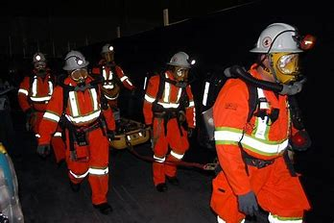
The Effectiveness of Human Factor Safety Initiatives at Lisheen Mine - A Case Study
Mine Rescue
LTMS Limited IMQS

Slide 38
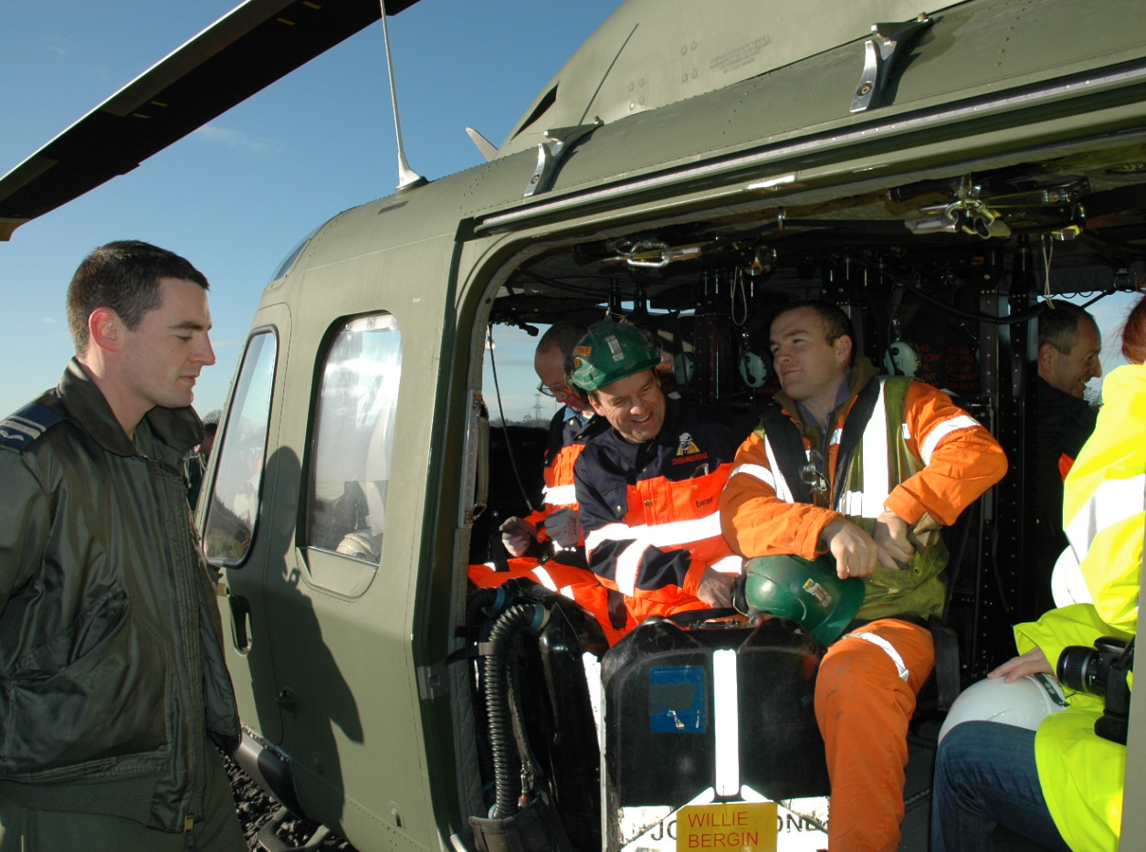
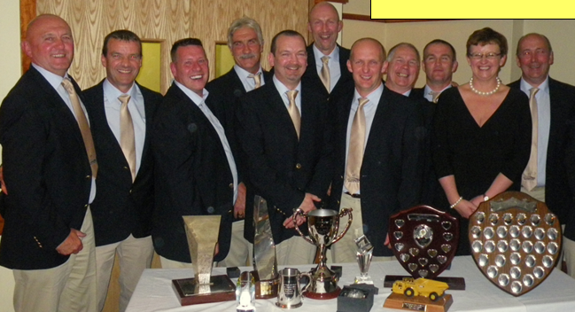
MINE RESCUE
16 trained members on 24-7 callout
Mutual Assistance arrangement in place with other mines & with Air Corps available for transport during an emergency
Ireland-UK Mine Rescue Competition
Overall winners 2012
2nd place 2013 & 2014
38

Slide 39
The Effectiveness of Human Factor Safety Initiatives at Lisheen Mine - A Case Study
Family Safety Expo
LTMS Limited IMQS

Slide 40
The Effectiveness of Human Factor Safety Initiatives at Lisheen Mine - A Case Study
Family Safety Expo
Lisheen Safety Expo – started in 2010
Day 1 – Employees
Day 2 – Family Day
Garda demonstrations
Fire demonstrations
Childrens competitions
Education centres – Health, Food, Sport
Final year 1,500 people attended the family day
LTMS Limited IMQS

Slide 41
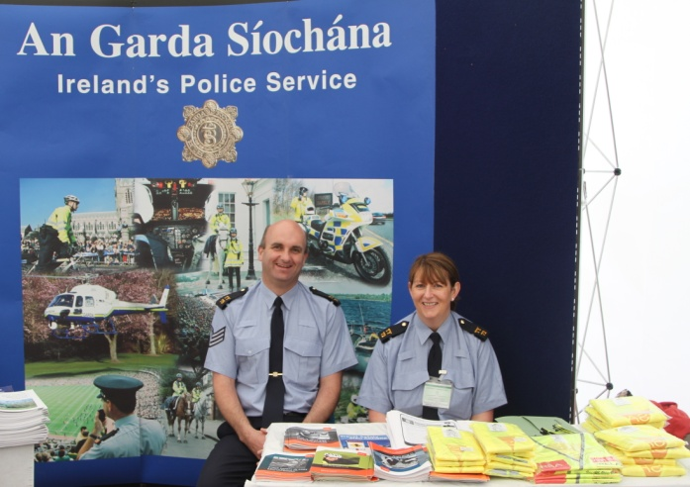
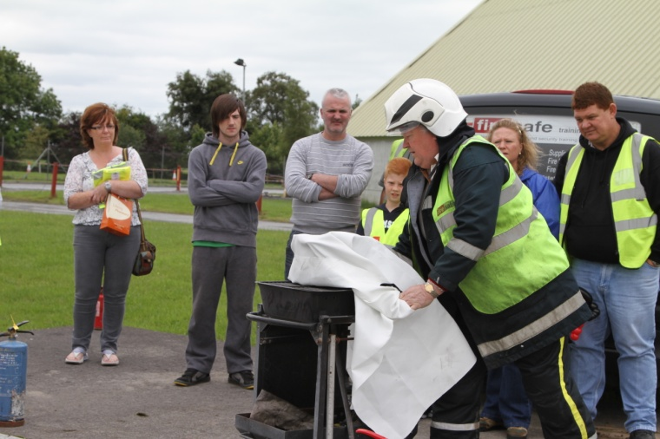
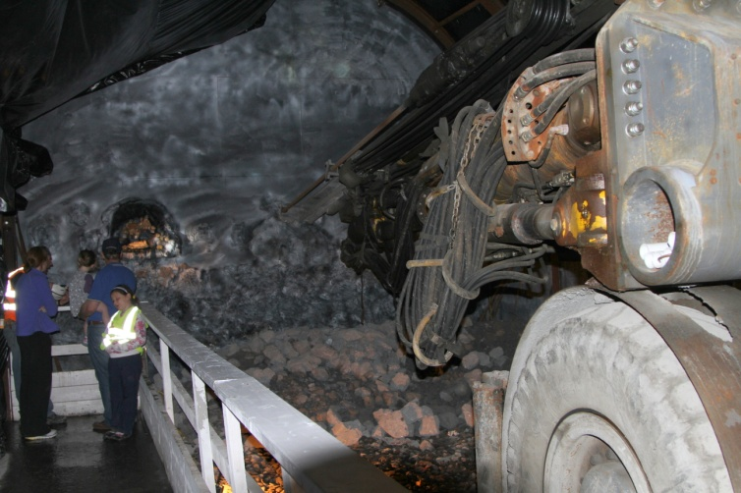
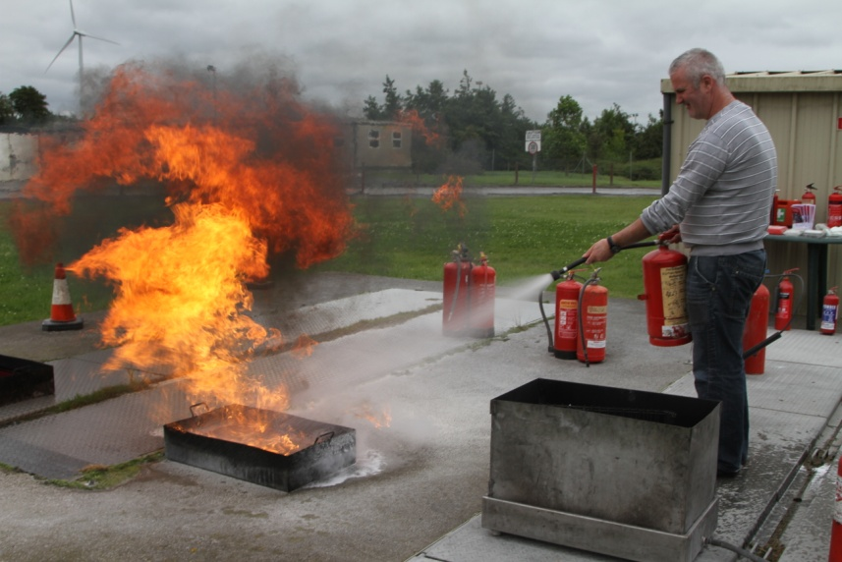
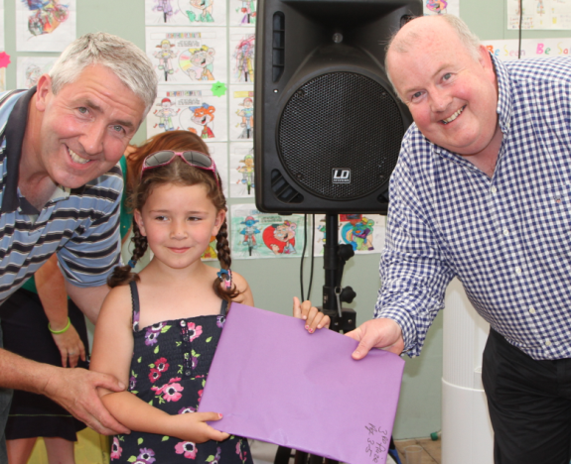
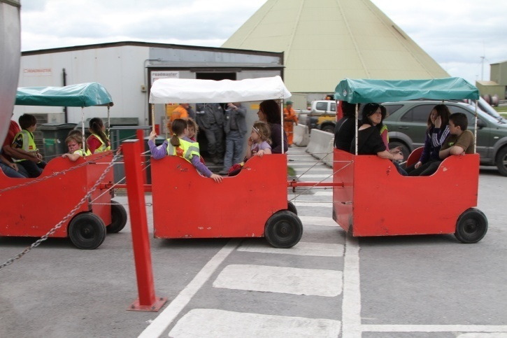
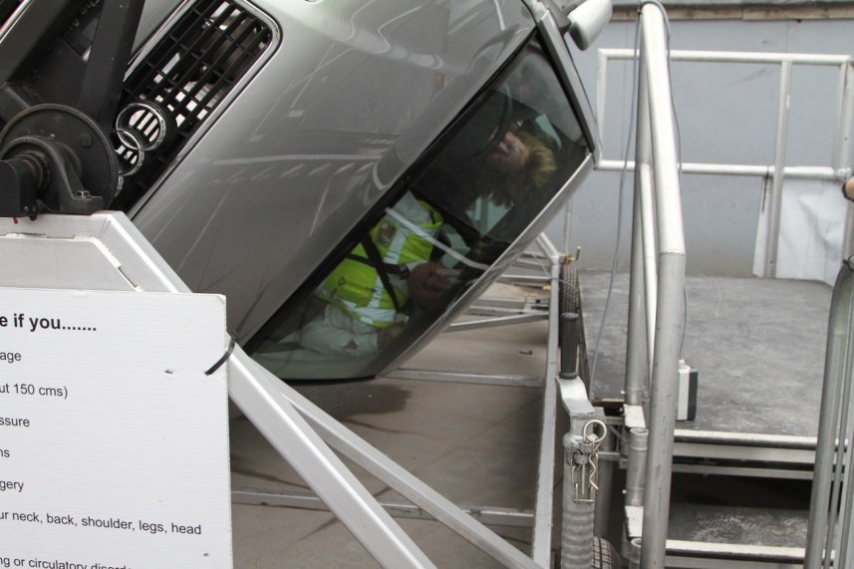
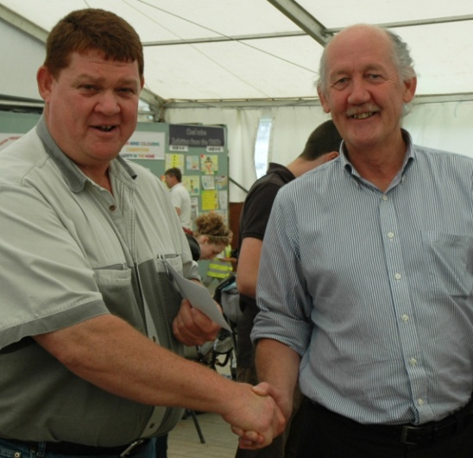
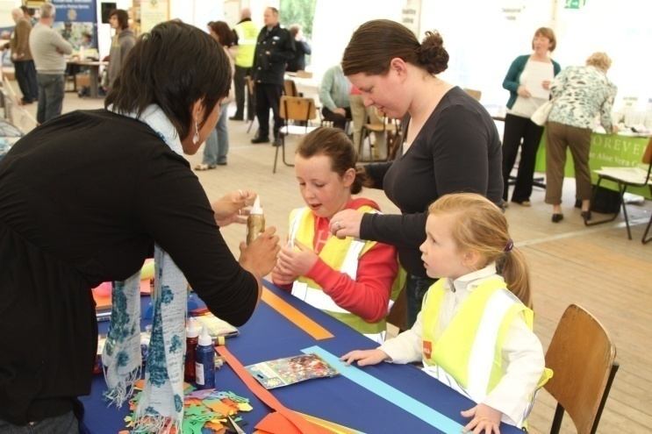
LISHEEN SAFETY EXPO
41

Slide 42
The Effectiveness of Human Factor Safety Initiatives at Lisheen Mine - A Case Study
Other Human Factor Safety Initiatives at Lisheen
Training and Retraining programmes
Lisheen Integrated Safety and Health and Environmental Systems – LISHEMS
  All supervisors had a LISHEMS Manual, specific to their position
  Included all relevant SOPs, PTOs, PIs, with targets, etc.
Planned Inspections
Change Management Process
Reward Innovative Ideas – Employees paid for good safety ideas
Incident Investigation – Fixed timelines for each stage with full engagement of all involved plus non-related people – management, unions, safety reps, etc.
LTMS Limited IMQS

Slide 43

The Effectiveness of Human Factor Safety Initiatives at Lisheen Mine - A Case Study
Summary
Safety initiatives which included the input of employees were very successful
People at the ‘coalface’ often have the best solutions for their own safety and therefore need to be included at all levels of safety management
LTMS Limited IMQS

