Slide 1

Bitumen Delivery and Storage
Gearoid Lohan
Hazards of Bitumen Delivery and Storage

Slide 2
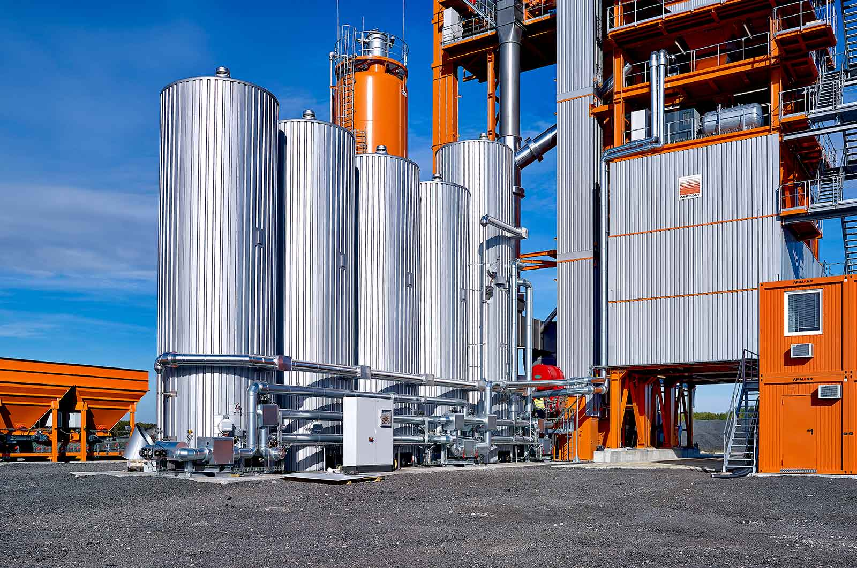
Overview
Bitumen regarded as a ‘safe product’
Inert at ambient temperature.
Low Volatility
Low water solubility
Highly durable

Slide 3
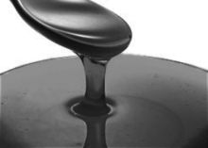
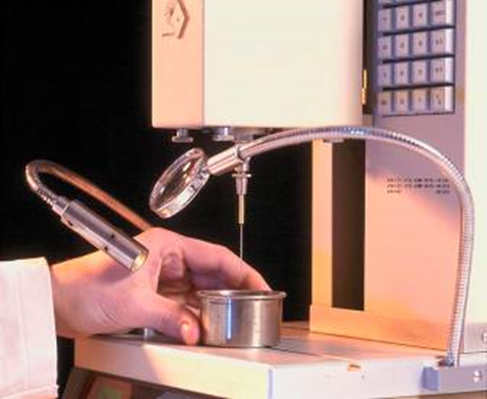
Bitumen Types and Grades
Penetration grade bitumens
40/60pen, 70/100pen, 160/220pen
Polymer Modified Grade Bitumens
Special Applications – Higher Temperatures
Oxidised / Blown Grade Bitumens
Clear Grade bitumen (Coloured Asphalt)
Other types
Emulsions
Hard Grades

Slide 4
Schematic of the Asphalt Value Chain
Shipping / Supply:
Crude is moved by ship or
Pipeline to refineries
Crude
Crude
Upstream:
Crude Exploration &
Production
Downstream: Refinery
Refined Products:
Bitumen
Modification
Processes
Asphalt
Asphalt
Bitumen
Transport
To work site
Asphalt
Plant
Or Emulsion Manufacture
Bitumen:
Supply & Distribution
Paving

Slide 5
Bitumen – The Hazards
High handling Temperature – Bitumen Burns.
Fire – Combustible
Contact with Water
Bitumen Overflow during off-loading
Pressure discharge
Vapour emissions (11oc drop – reduces fumes by 50%)

Slide 6
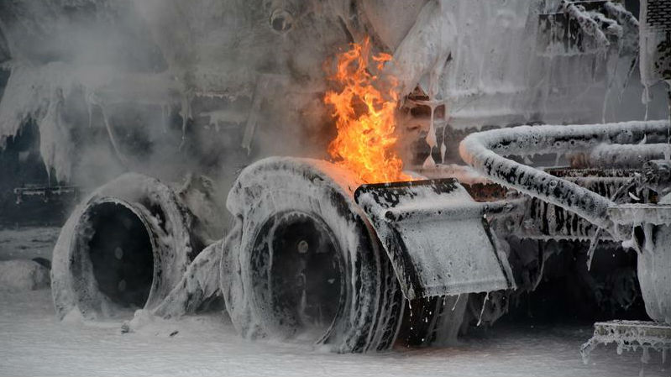
The Hazard - Fire
Flash Point > 230 oC (approximately)
Contact with Insulation (self ignition)
Overheating
Never use water – foam or dry powder to extinguish the fire.

Slide 7
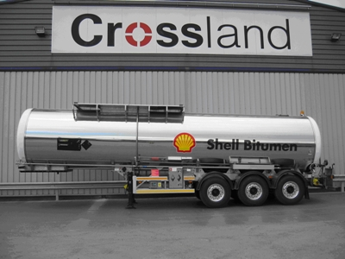
The Hazard – Bitumen Burns
locations
Hose
Overflow
Valve Blocked
Sampling
Treatment
Cool for 5 minutes (water)
Never attempt to peel off bitumen

Slide 8
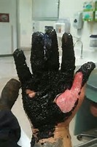
The Hazard – Pressure Discharge
50% of all accidents – during delivery.
Can lead to Bitumen Burns
Drench Shower
Bitumen Hoses –Testing, Flanges

Slide 9
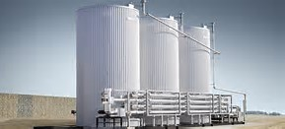
The Hazard – Bitumen Spills
Tank Gauges
High Level Alarms
Overflow pipe

Slide 10

Minimize the Risk
Drench Shower
PPE - within 6m of the delivery point.
Product storage temperature
Tank Labeling avoid product crossover
Level gauge maintenance
Bitumen First Aid – Bitumen Burns
Cool water (Drench Shower)
Leave bitumen in place
Do not bandage
Call emergency Services

Slide 11
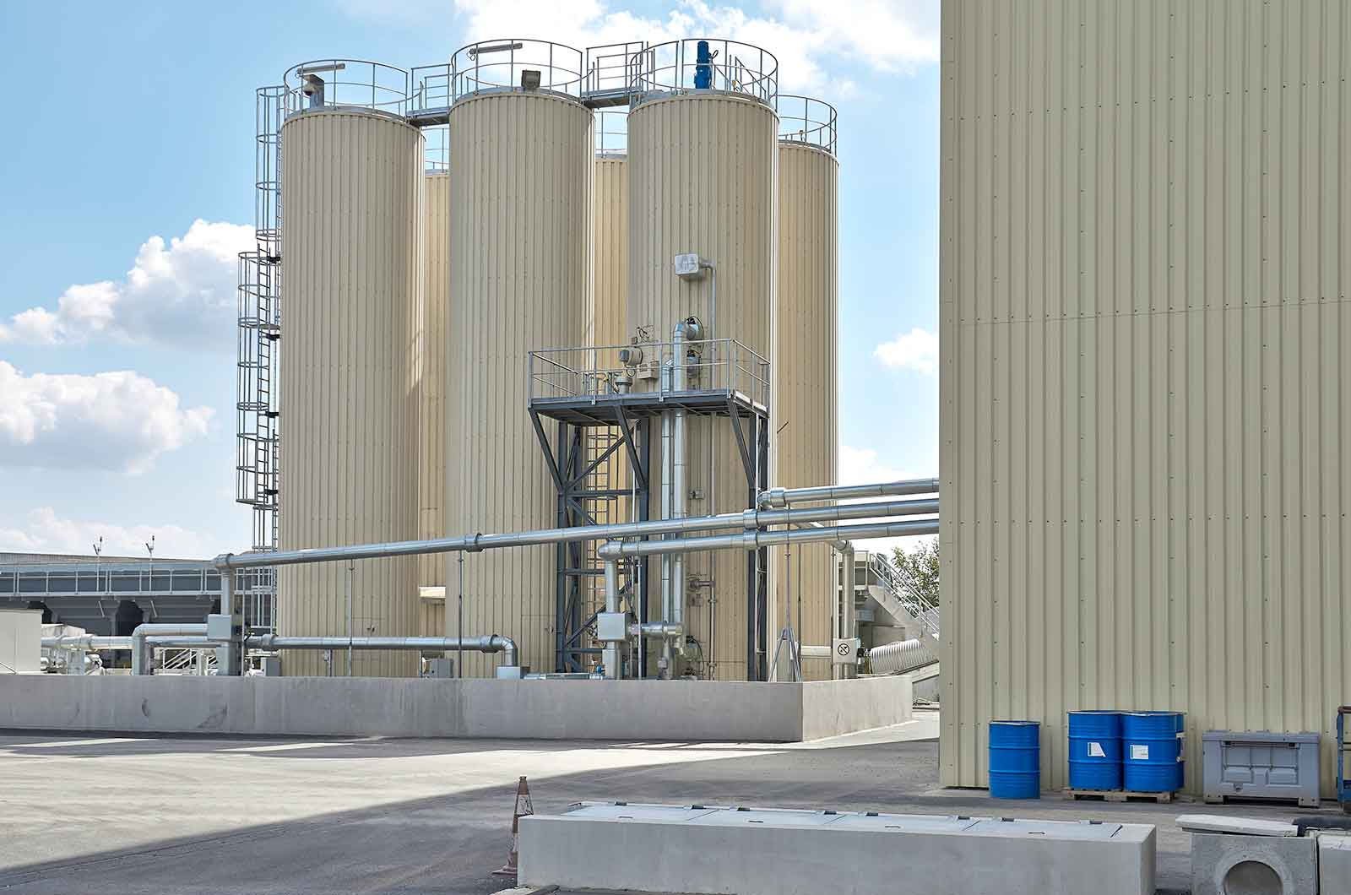
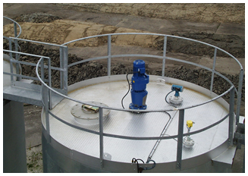
Bitumen HSE – What the Bitumen Tank Farm should have?
Off-loading Instructions
Adequate Lighting
Tank Labelling, Gauges, Alarms
Bitumen Burns poster
Bitumen Burns Guidance
Never mix penetration grade
with cutback
Adequate Turning Angle for Trucks

Slide 12
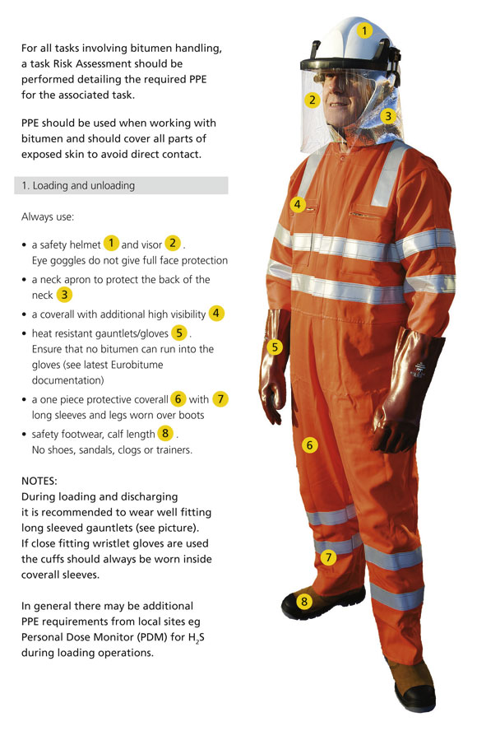
Bitumen PPE
Helmet, Visor and Neck apron
One piece Coverall - with High Vis
Heat resistant gloves
Foot protection

Slide 13
Bitumen HSE – What the Bitumen Tank Farm should have?
Adequate Turning Circle
Drench Shower
Fire Extinguisher
Material Safety Data Sheets
Emergency Plan
Tel No.s – Do you know where to go in the event of an emergency ?
Risk Assessment
Adequate Signage/Posters - Directions

