Slide 1



Presentation Title
All-Island Quarries
Safety Conference
19th November 2014
Dublin

Slide 2
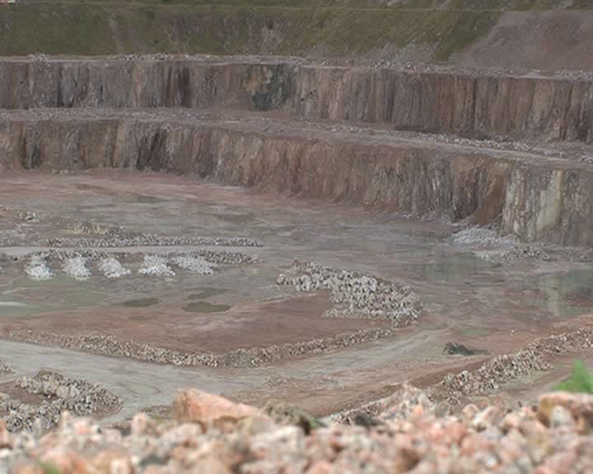
Safe & Successful Blasting
What does it Take?

Slide 3
Aim of Today
To give a general understanding of the requirements of blast specifications, to highlight what they should contain and to offer suggestions to help improve blasting techniques.

Slide 4
Why Produce a Specification?
To provide an adequately fragmented muck pile in the correct place.
To safeguard employees, locals and anyone else that the blast may affect.
?? WHY ??

Slide 5
Who Does it Affect?
Any one in the vicinity
Explosives Supervisor
Manager
Operator
Sentry
Shotfirer
Driller
?? WHY ??

Slide 6
It Starts with Drilling
Correct location gives design burdens
Correct burdens means simpler charging
Better fragmentation
Vibration control

Slide 7
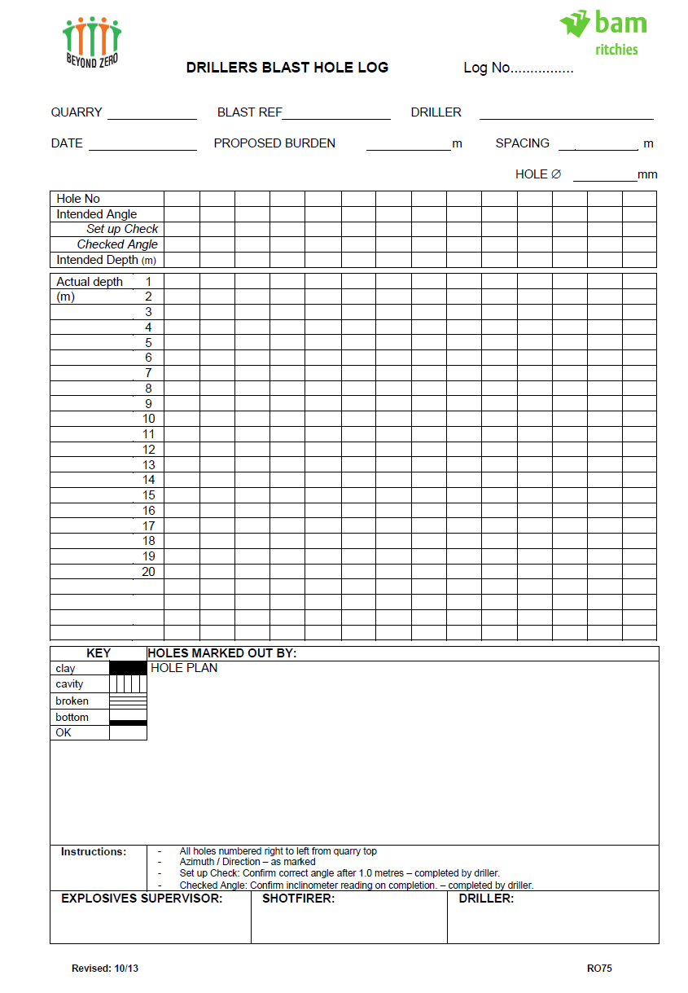
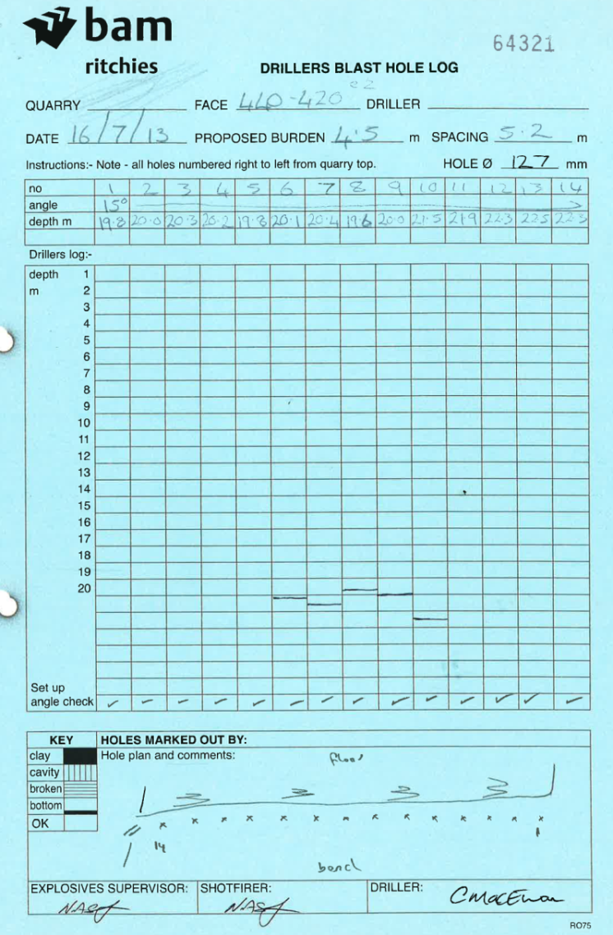
So, let’s start at the beginning.
Written Instruction to carry out work
Written response on findings
Must be used in producing specification.
Notes:
Legal onus on the Operator to ensure that ACOP standards are met. However ALL responsible blasting contractors will ensure ACOP standards are met – if not then, don’t use them.

Slide 8
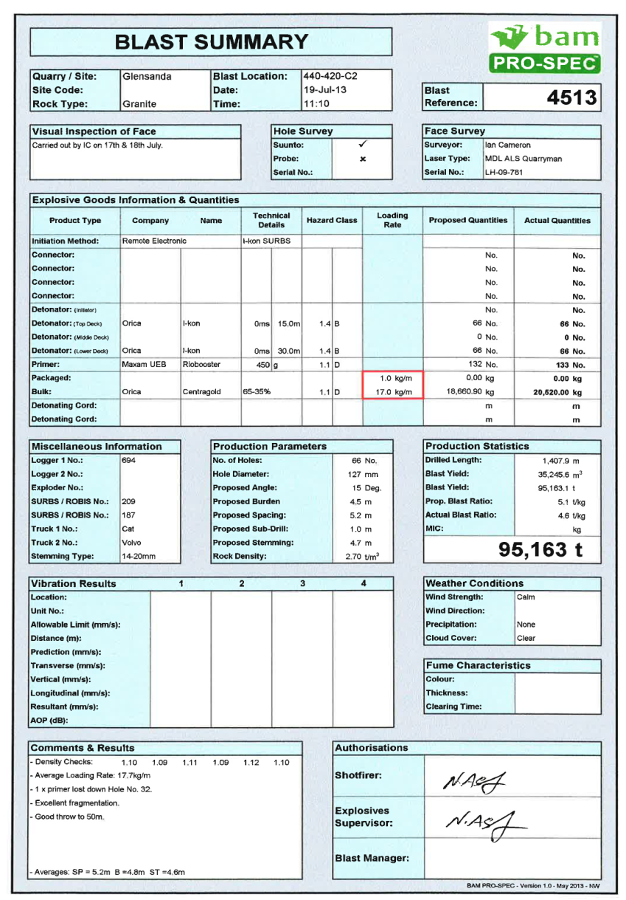
Bringing It All Together
Concise
Understandable by anyone using it
Approved
Auditable against standards
Contain the following:
Notes:
Quarries are forever under the watchful eye of JOE PUBLIC and NIMBY squads. Failure to ensure that an ‘adequate blast specification’ is prepared and followed may play in to the hands of local objectors. Flyrock incidents are NOT good for public perception.
A trawl of the BBC News website produced the following results.

Slide 9
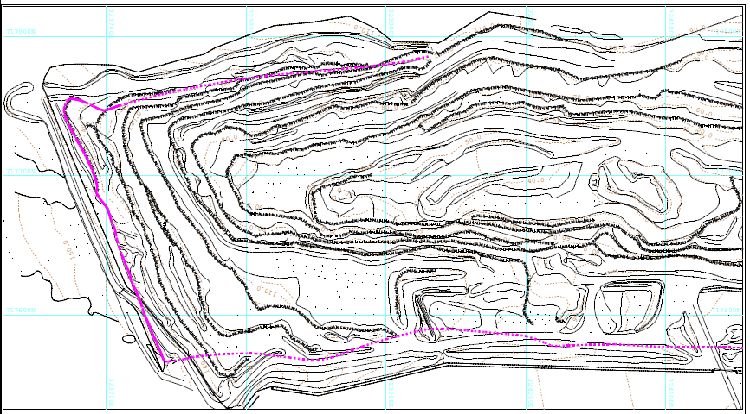
Plan of the Works

Slide 10
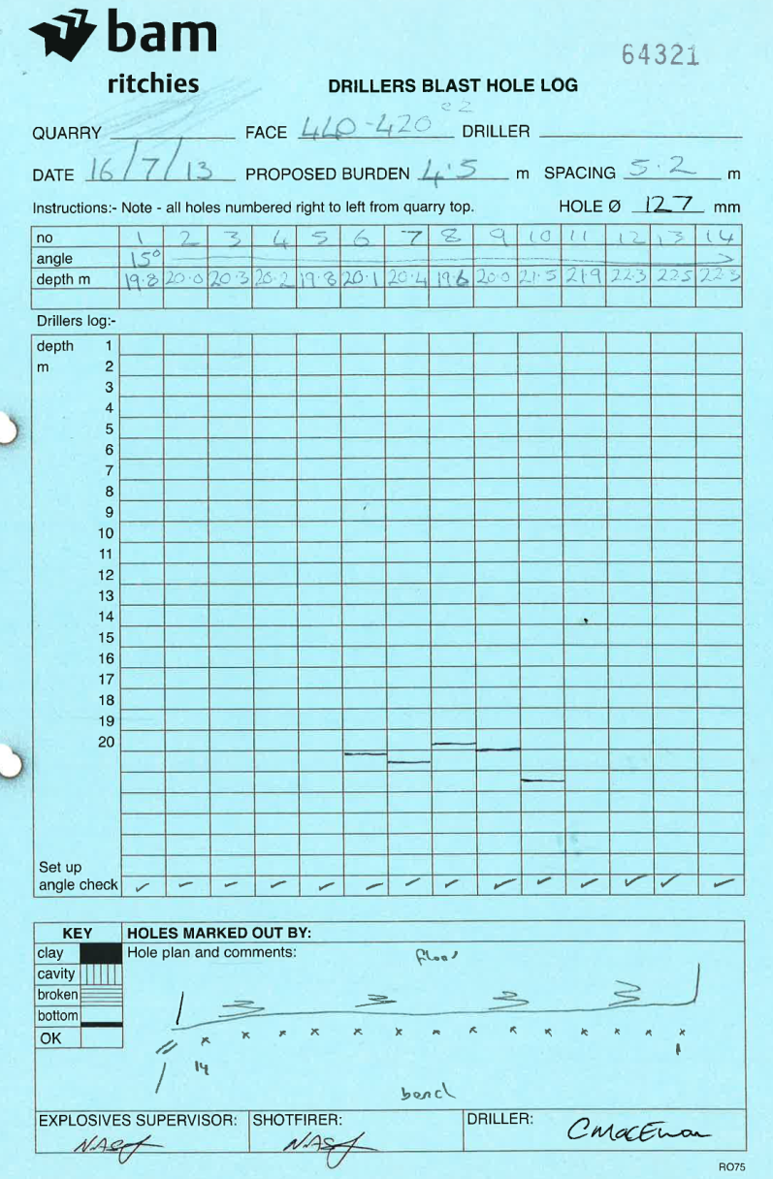
Drilling Information; intended

Slide 11
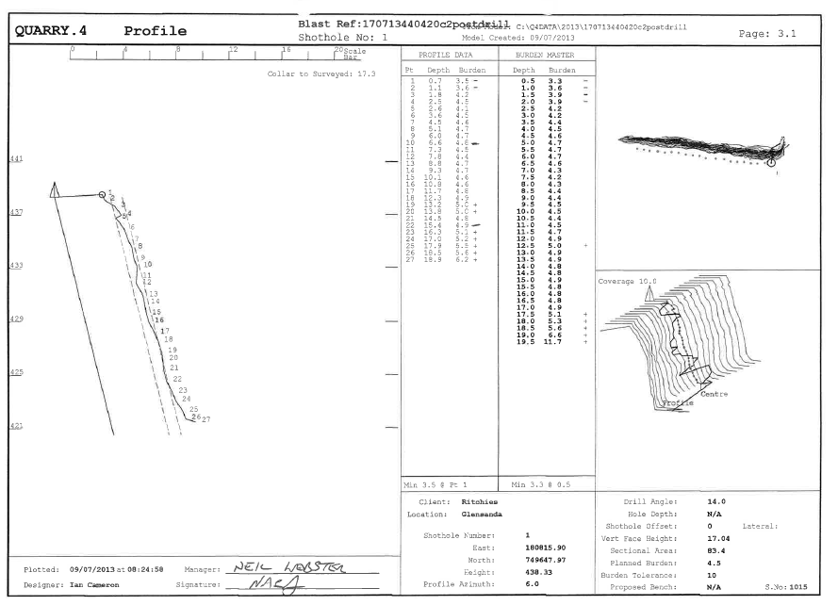
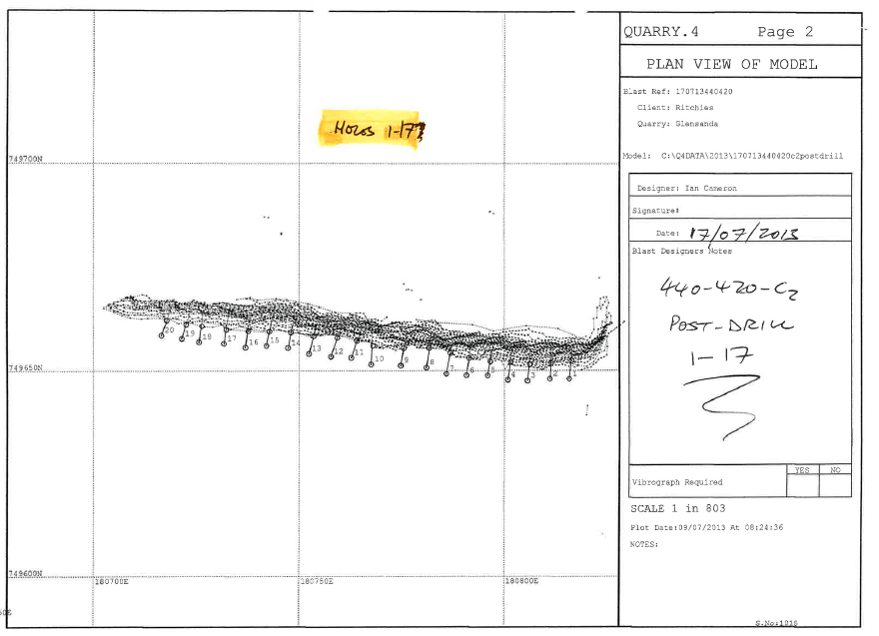
Location and hole identifier

Slide 12

Hole Geometry

Slide 13
Profile data

Slide 14
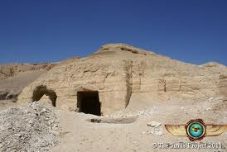
Geological Anomalies

Slide 15
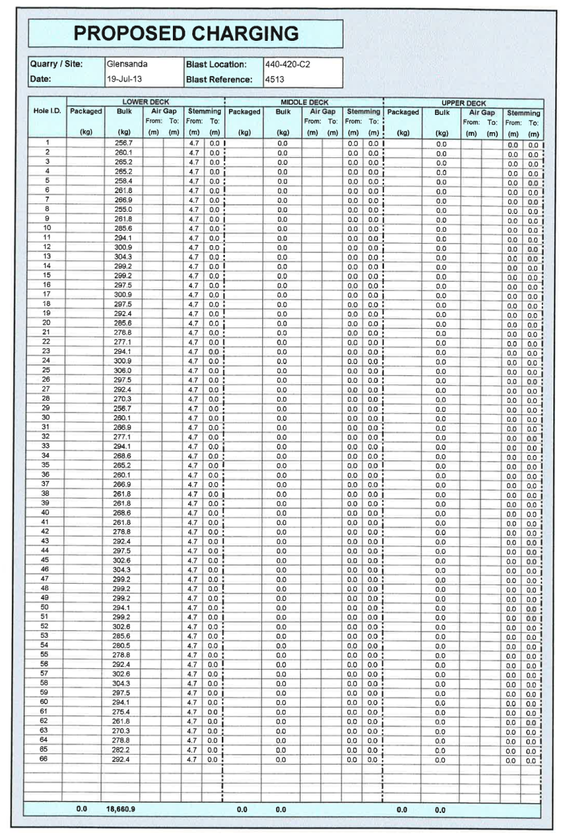
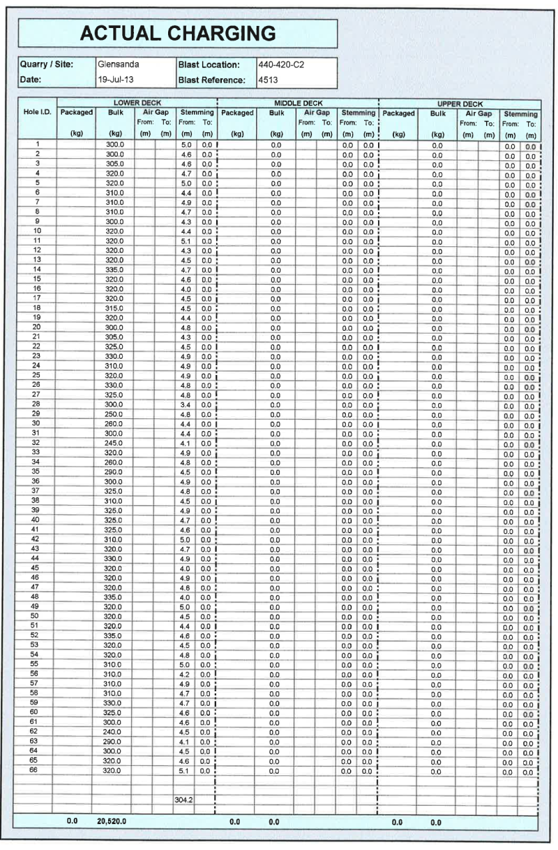
Charging Details

Slide 16
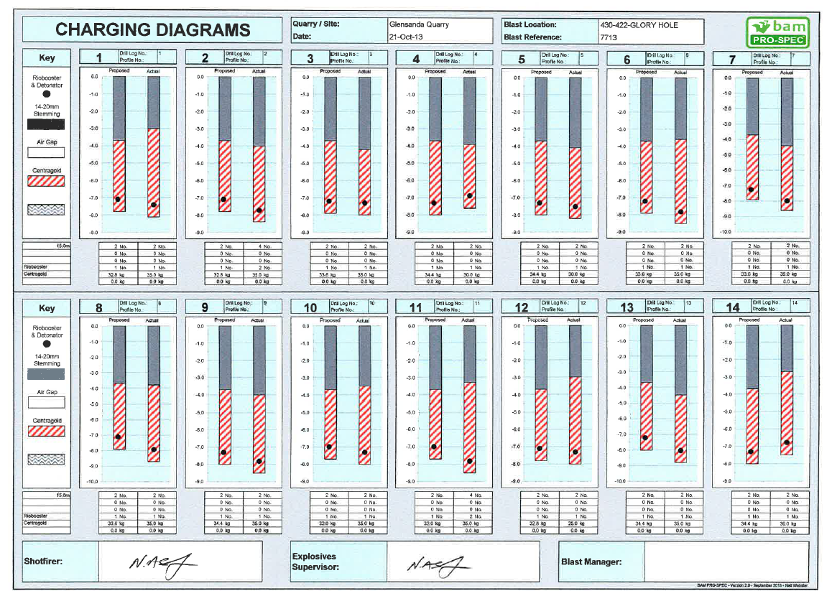
Explosive Location

Slide 17
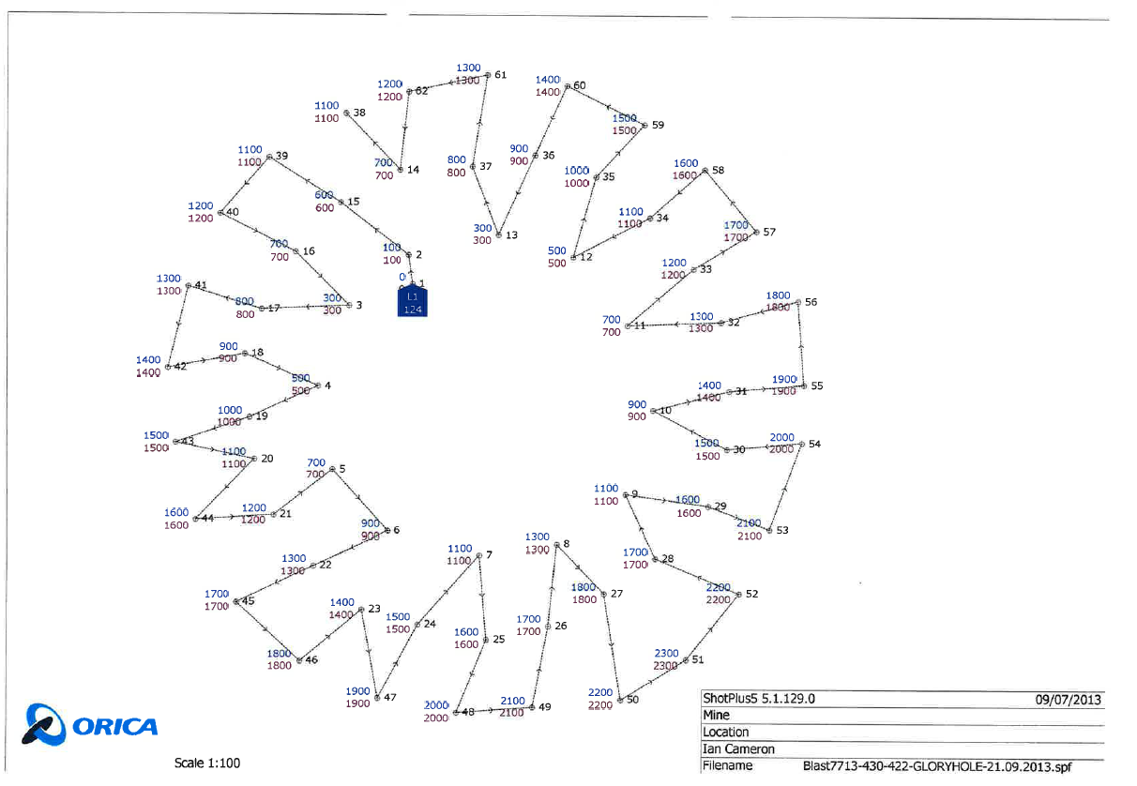
Initiation and Delay Sequence

Slide 18
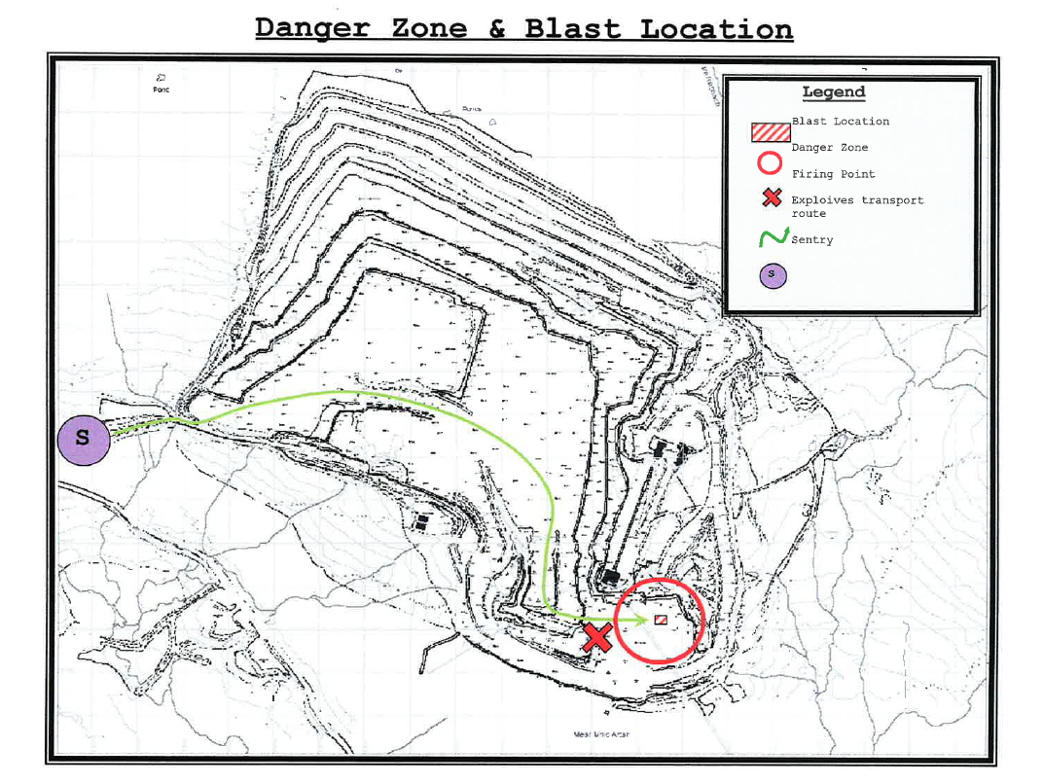
Danger Zone

Slide 19
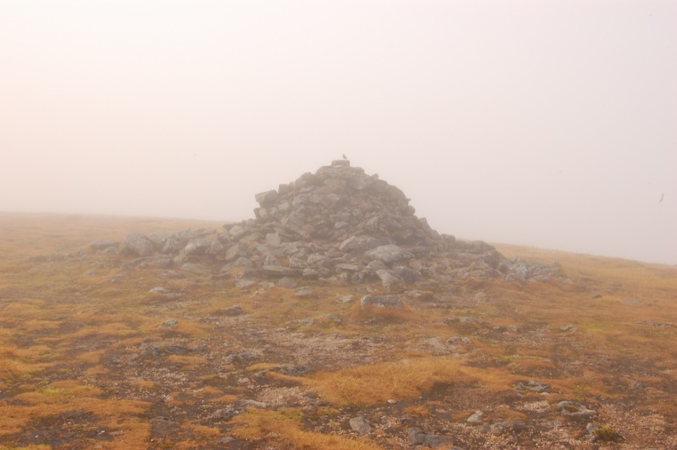
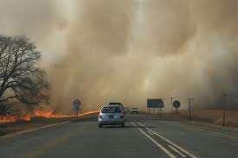
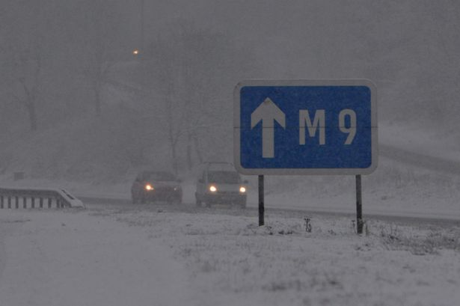
Visibility

Slide 20
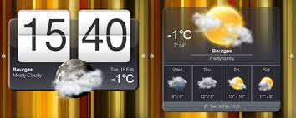
Date, Time and Weather Conditions

Slide 21
The Consequences of Getting it Wrong
Personal Injury
Material Damage
Operational Restrictions
HSENI/HSA Involvement, including FFI and court appearances
Loss of Reputation
Notes:
Why?? How accurate are current GPS systems?

Slide 22
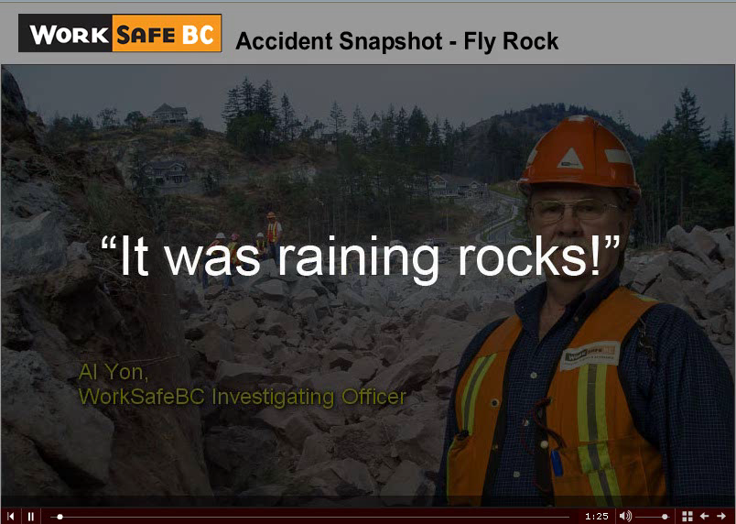
Notes:
This video shows a ‘construction’ blast, however the issues and results are the same. No-one in the UK is willing to provide examples of incidents – why not?

Slide 23
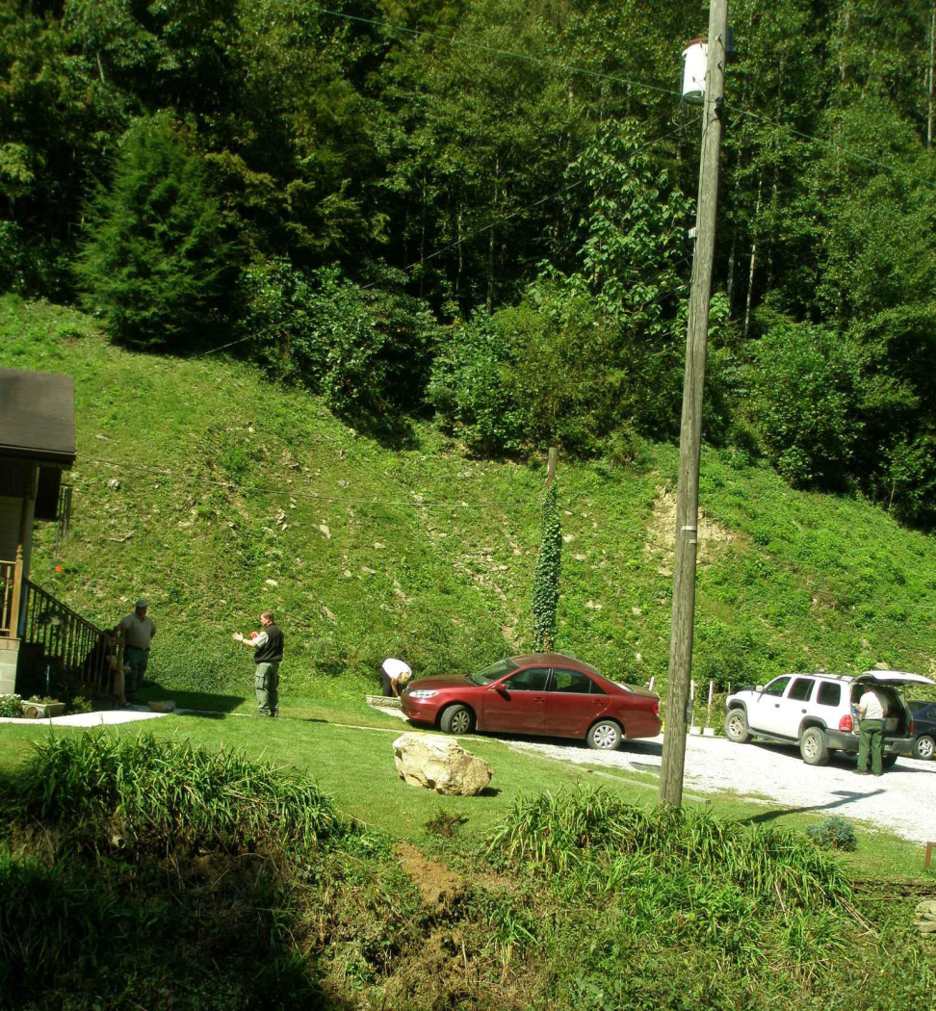
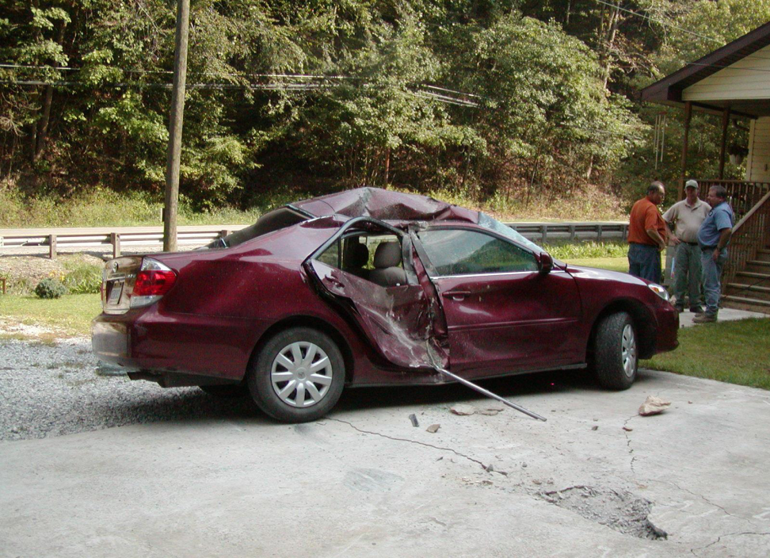
Notes:
First photo: Describe scene
Second photo: Describe damage

Slide 24
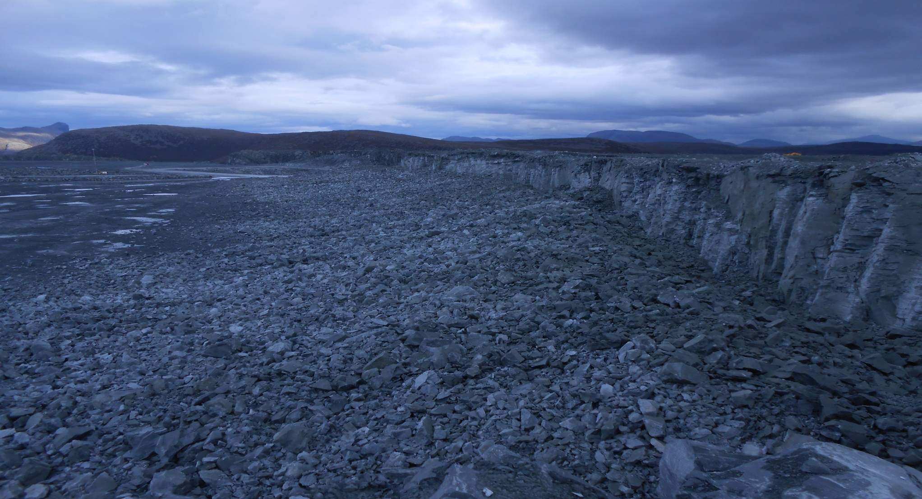
Get it Right……
(mention electronics & hybrid initiation, Ian)

Slide 25
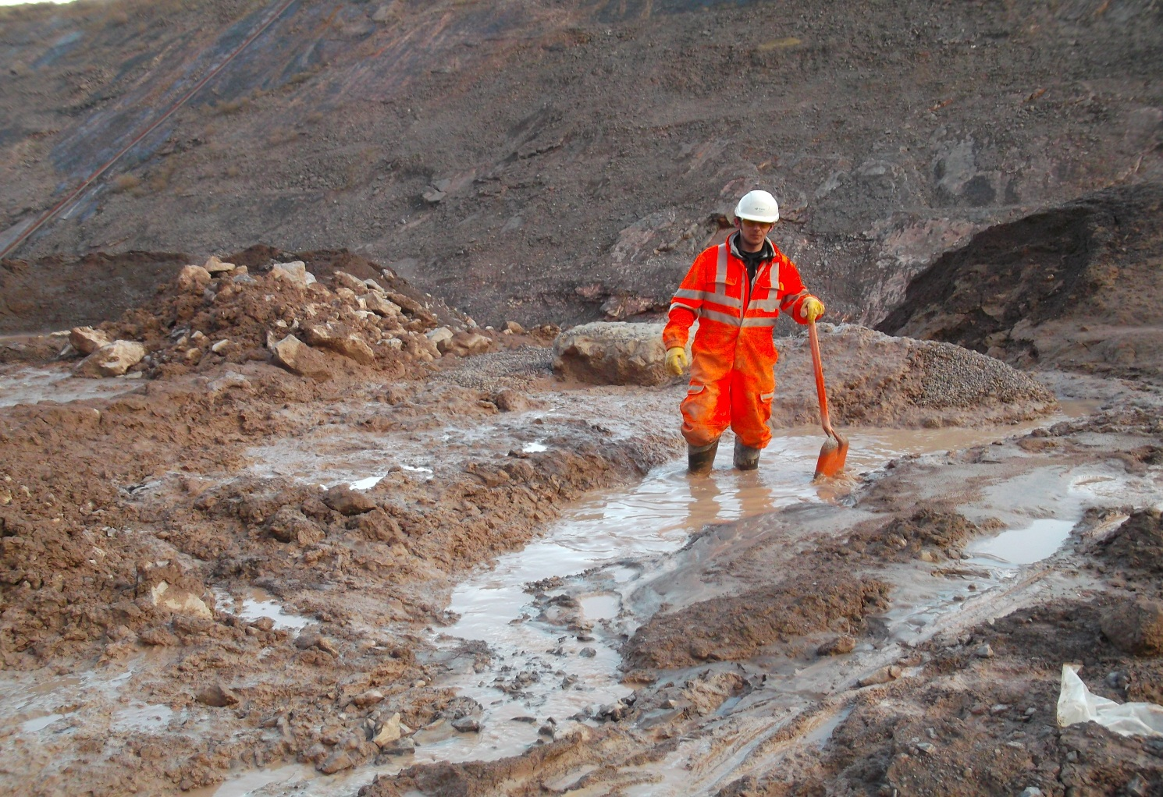
However; Help Required
There are 39 holes here somewhere!
Should we be here?

Slide 26

Surveying the Blast
The basic surveying concepts on which the theory of profile production by the face profiling software is common to several commercial products
Quarry 4
Quarry 6
Expertir
Quarry X
Notes:
Ensure everyone has a copy of Version 7 – January 2013

Slide 27
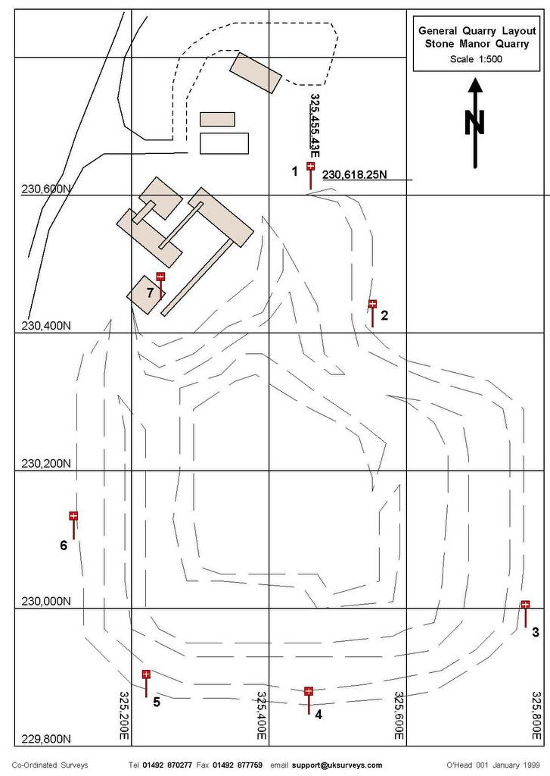
The Surveyors Grid System
The surveyors grid is a system that provides a method of positioning with reference to Eastings, Northings and Heights.
There are two types of grid system in common use in quarries
  National Grid
  Local Grid
Notes:
Describe Permanent Stations

Slide 28
Local Grid
  This grid system has normally been set up by surveyors for the use in the quarry only and therefore is unique to the quarry and tied to a Local Datum. Latest guidance suggests that this is no longer acceptable.
National Grid
  This is the grid system usually established by the national mapping organisation that covers the country with the elevation tied to the National Datum.(normally Sea Level)
Notes:
This allows EVERY point taken to have fixed co-ordinates, an Easting and Northing. The information is stored within the face profiling software and the RAW Data can be accessed, after an event, if required.
RAW data files should NOT be deleted – they may be needed during any investigation in to a blasting incident.

Slide 29
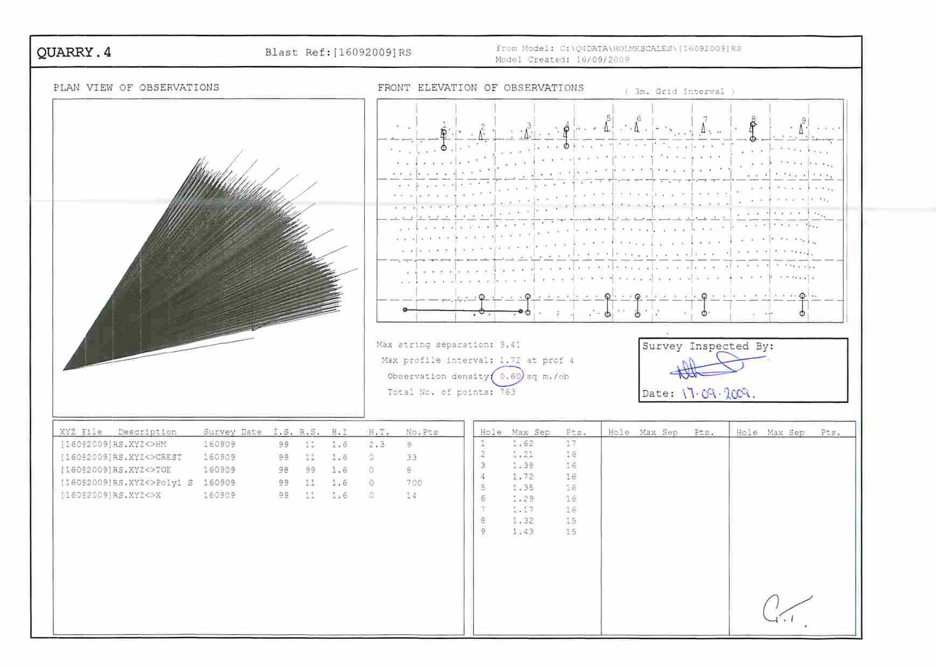
Quarry4 Survey Assessment
Notes:
Quarry4 Survey Assessment
Explain Observation Density AND how calculated

Slide 30
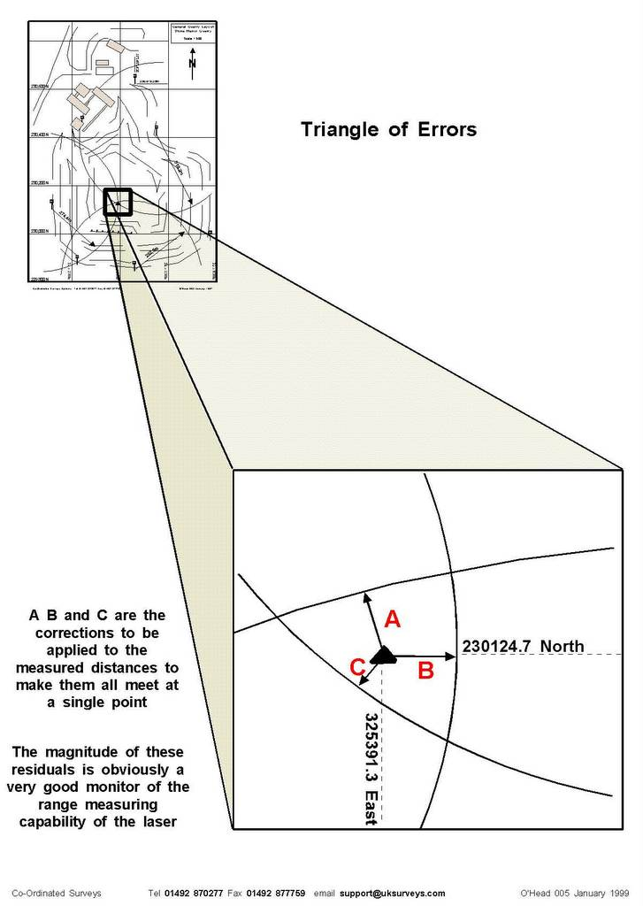
Residuals
When three stations are used the ‘circles’ do not meet in one exact location. This may be due to several factors
  The range is not perfect
  The targets may have moved slightly
  The co-ordinates produced by the surveyors are not perfect
They form what is known as a triangle of errors or residuals.

Slide 31
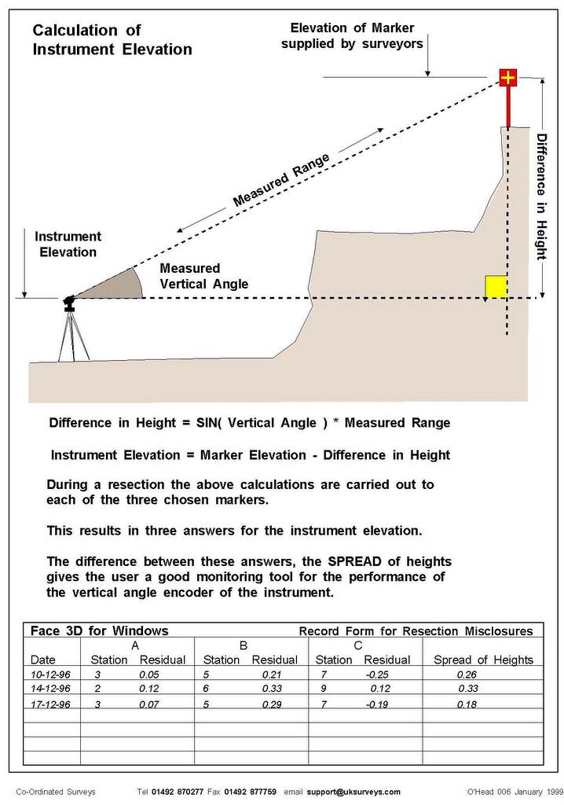
Spread of Heights
The vertical angle (+ive or –ive) is measured in degrees from the horizontal plane.
Quarry surveyor to provide co-ordinates and level for each survey station.
Points recorded
  Horizontal angle
  Vertical angle
  Range

Slide 32
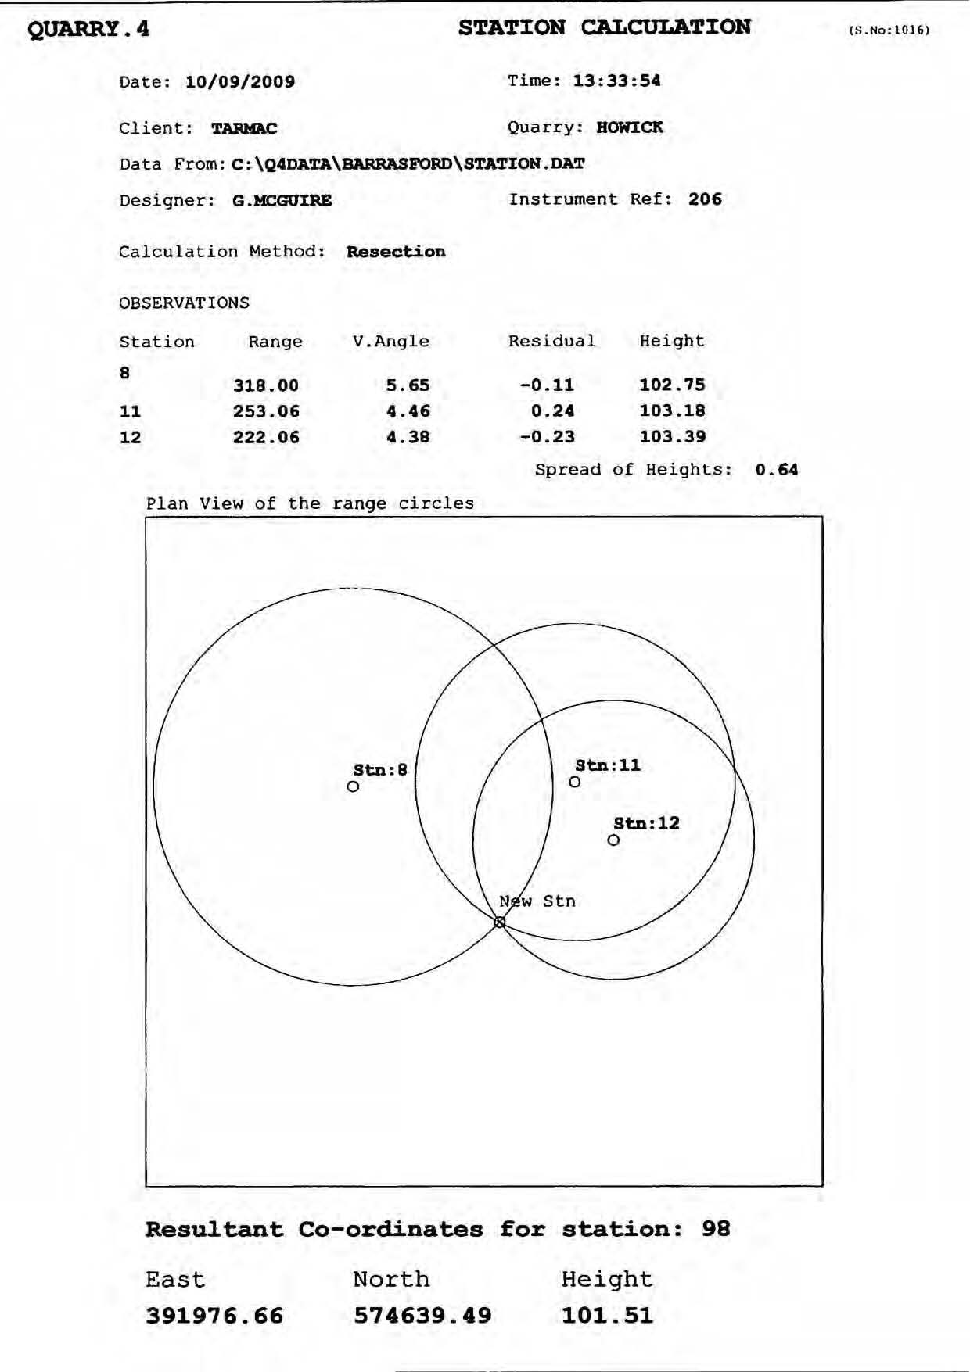
Accuracy Summary
A record of the residuals should be included with the survey results [0.3m max].
A record of the spread of heights should be included with the survey results [0.5m max].

Slide 33
If you observe residuals of more than 0.3m and/or a spread of heights exceeding 0.5m –
Then Check your Laser and Survey Stations
Or re-do the survey
There is something wrong
Notes:
Laser may need recalibrating or one or more of your permanent stations may have been moved or the wrong co-ordinates may have given by the quarry surveyors.
Recheck laser from the same position using alternative permanent stations. If the same error exists – Laser needs calibrating.
If okay then there is a problem with the permanent stations.

Slide 34
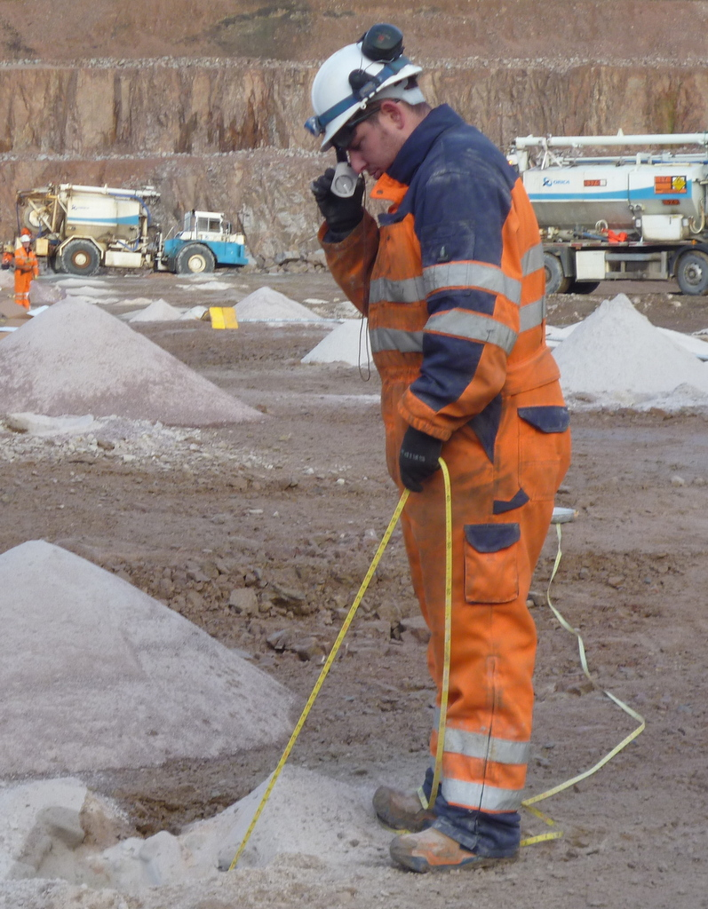
Hole Surveying: Torch & Suunto
Used correctly the basic torch and suunto can provide accurate hole angles and direction markers.
Mainly used in DRY holes.
Will indicate hole deviation & direction.
Notes:
Who’s responsibility is it to check drilled holes for angle and direction – NOT the driller’s

Slide 35
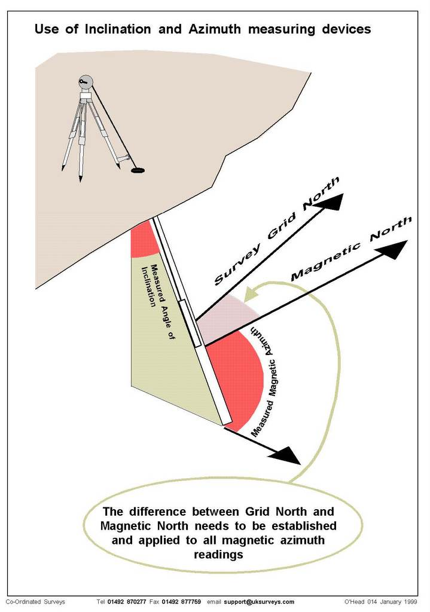
Probe
Most up to date in-hole measuring device.
Measures
  Horizontal angle
  Vertical angle
  Hole depth
Used where deviation is known or expected.
Used in WET holes
Site Magnetic Variation required.
Notes:
Drum mounted or cable

Slide 36
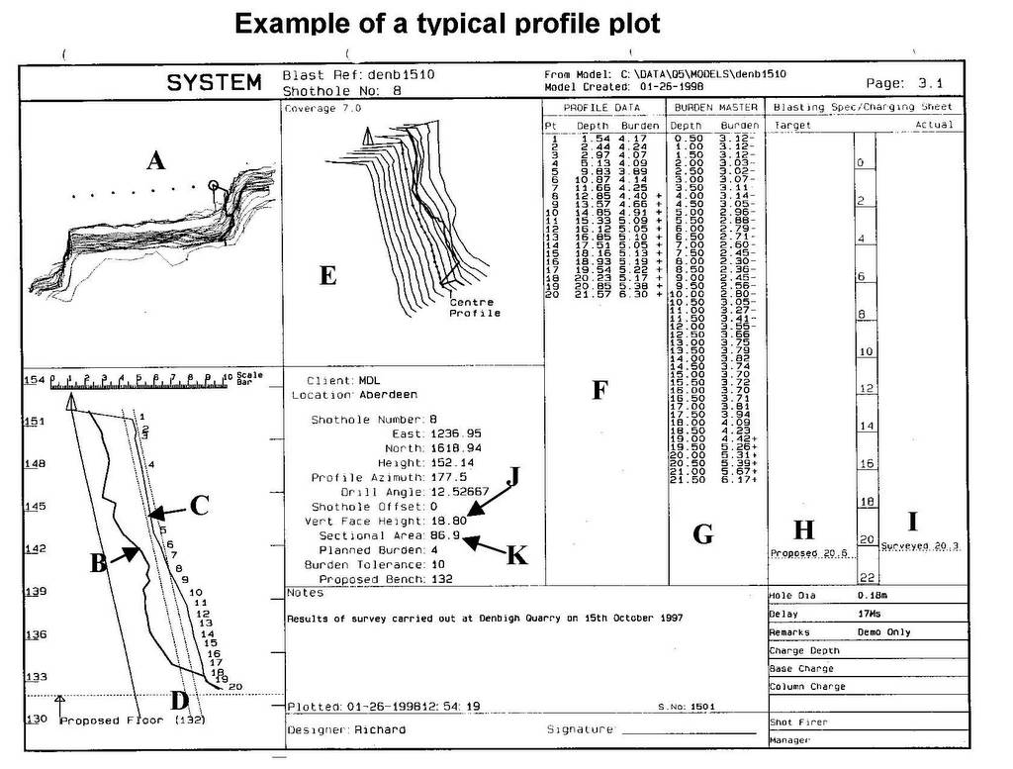
Notes:
Describe sections A to I

Slide 37
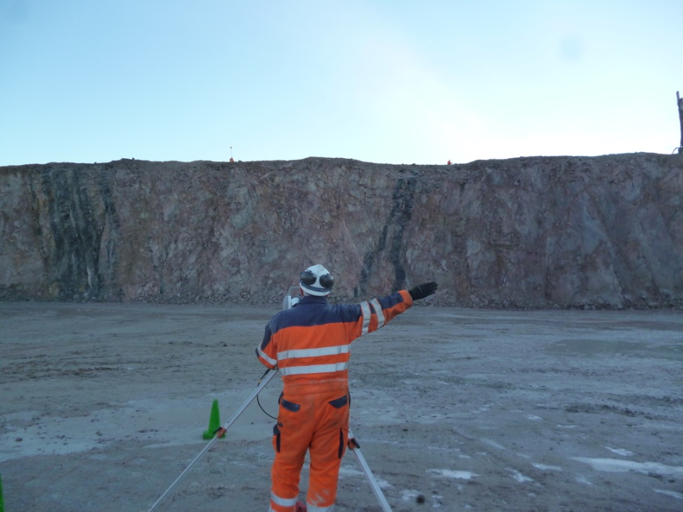
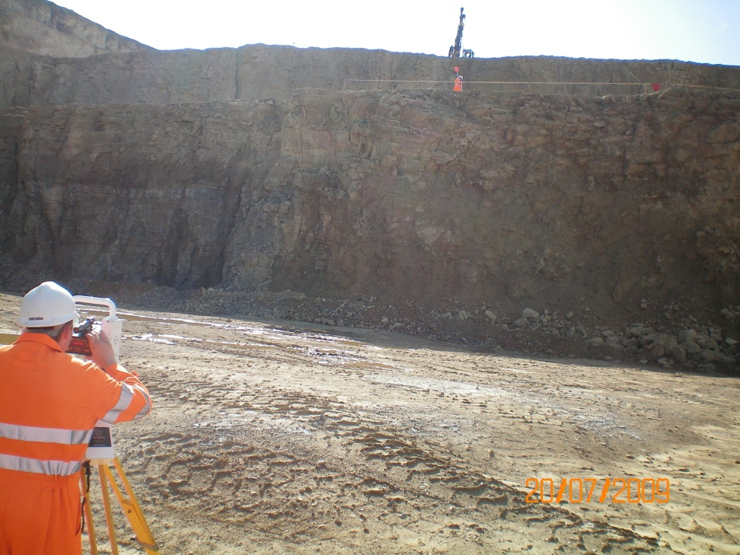
Good Survey Conditions

Slide 38
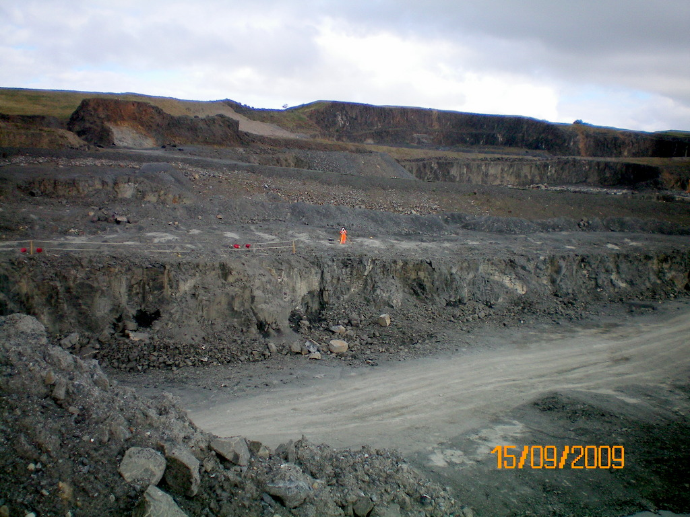
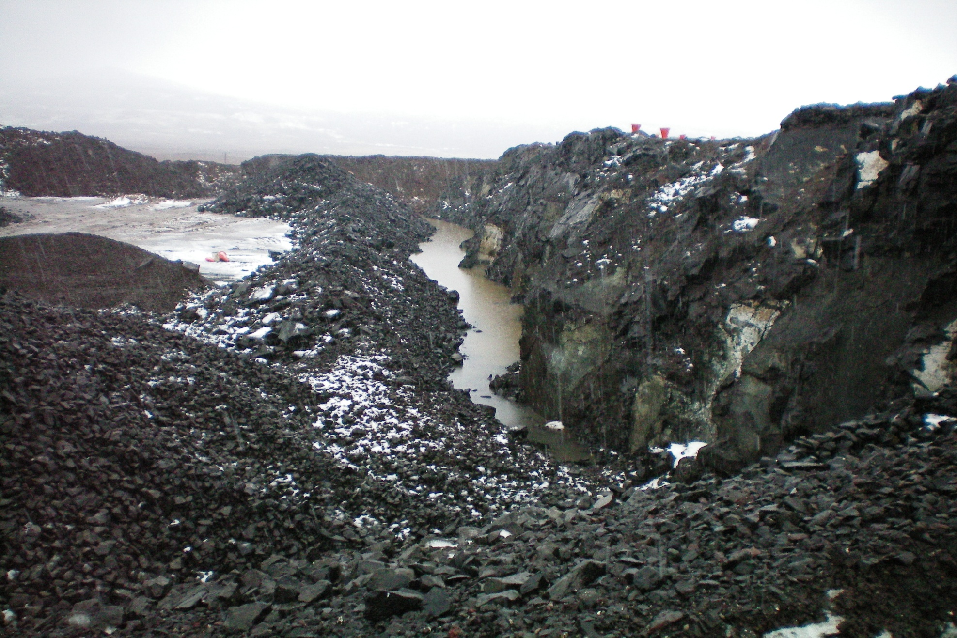
After Brayford: Not acceptable

Slide 39
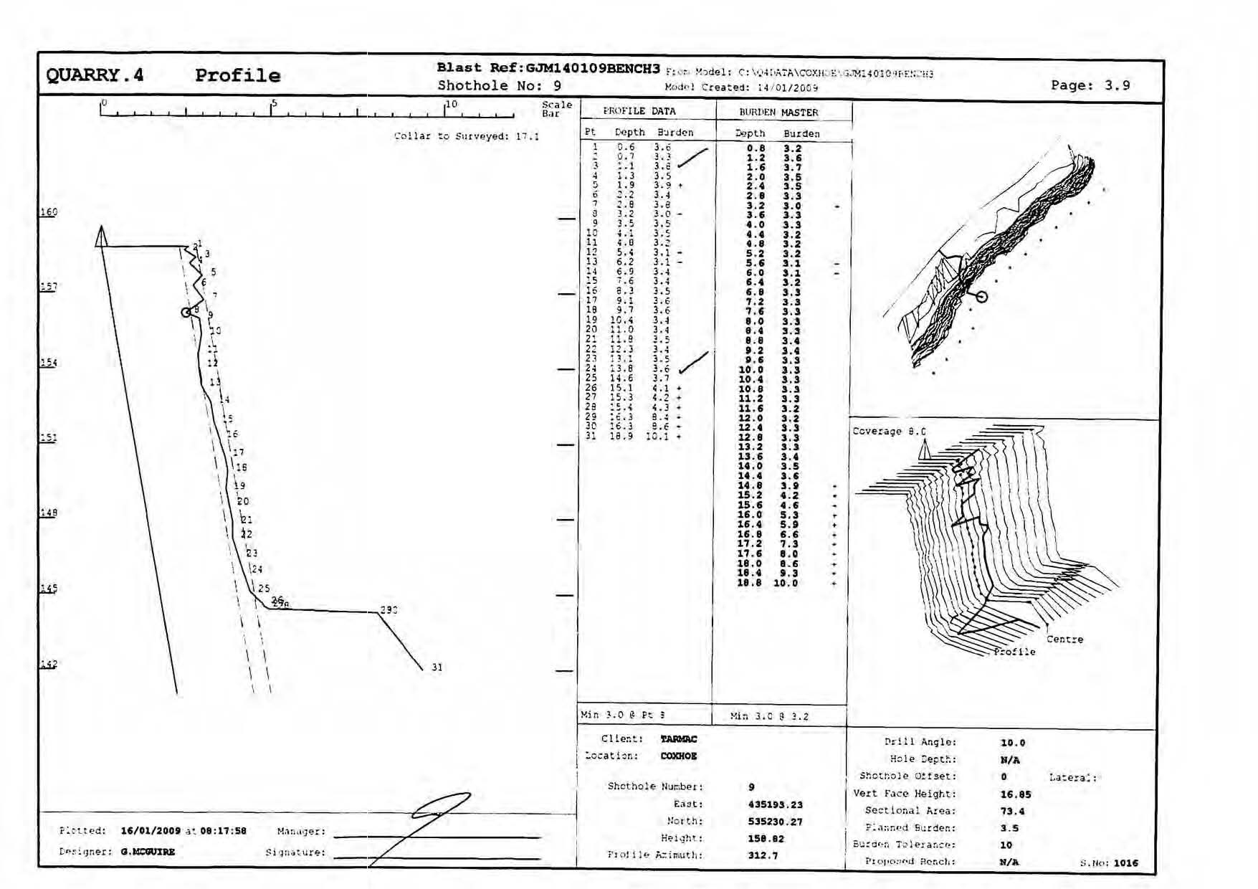
Quarry4 Profile
What is Here !!
Toe bund
Notes:
Quarry4 Profile
WHAT IS HERE – ‘reasonably practicable’ or ‘hindsight’: This is your call as Quarry Manager or Explosives Supervisor
Point of Interest – BAM Ritchies

Slide 40
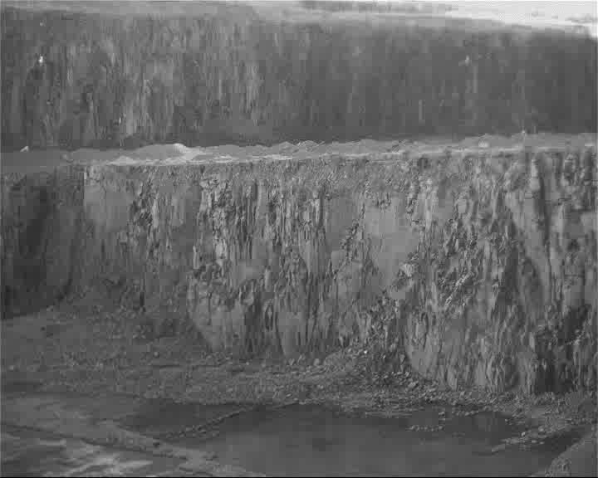
Blast Design & Bulk Emulsion

Slide 41
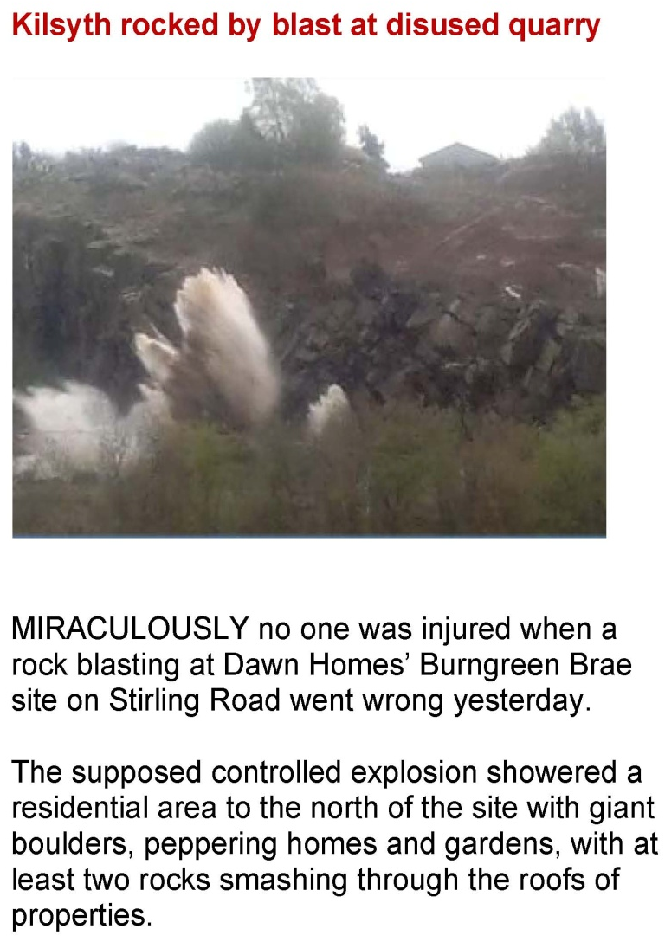
What is Different?
Loading rate
Uncontrolled gassing
Loss of product
Design for blast ratio
Be aware of lack of burden
3.5 x 3.5m pattern becomes 4.2 x 5.0m

Slide 42
A Glimpse of the future.

Slide 43
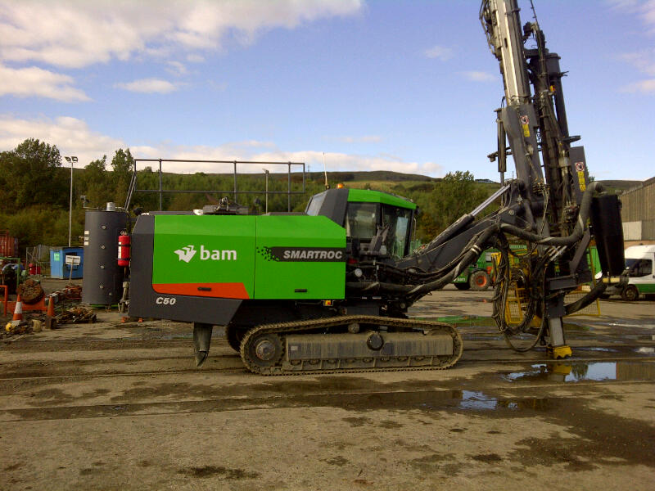
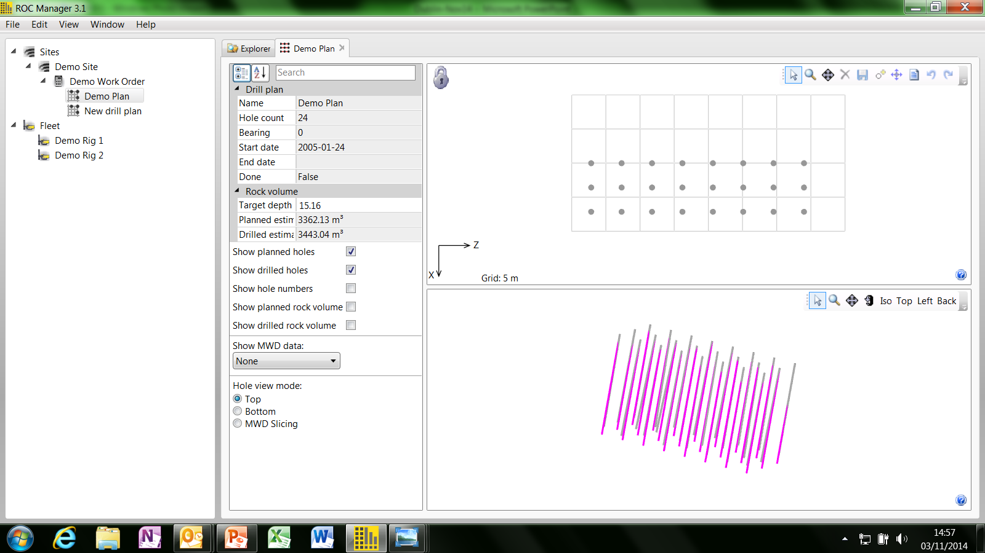
Measure While Drilling, (MWD)

Slide 44
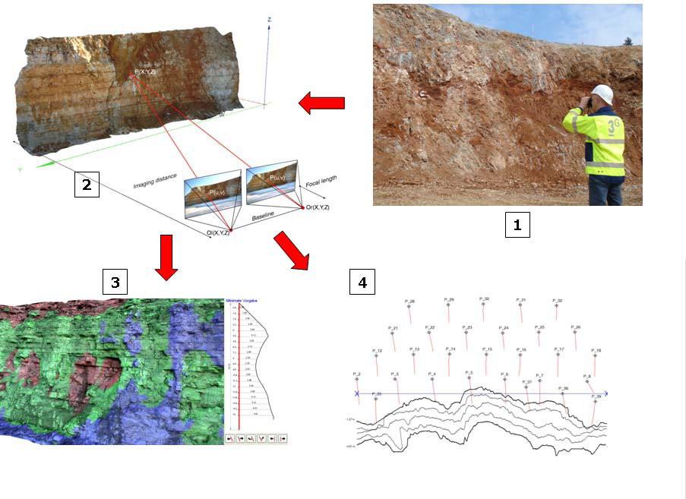
Notes:
Describe the process:
BlastMetriX3D principle: From a set of freehand taken photos, using a specially calibrated camera (1) a 3D image is computed (2); Burden information over whole area (3) is used to adapt the drill layout according to the actual bench geometry; the results are profiles, minimum burden diagrams, and a drill pattern (4).

Slide 45
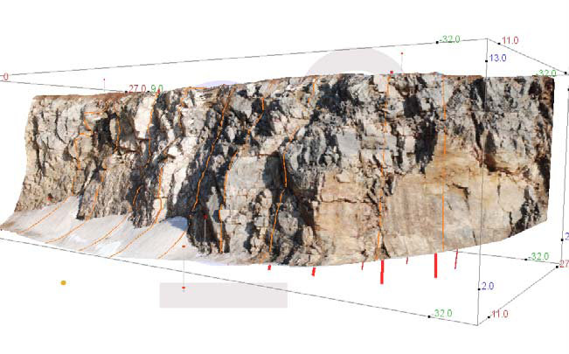
Blast Metrix
Notes:
3D image of a bench face around a corner together with planned boreholes and visualised profiles. The 3D image allows for a visual assessment of the rock mass quality, e.g. Identification of higher fractures areas or potential weaker joints.

Slide 46
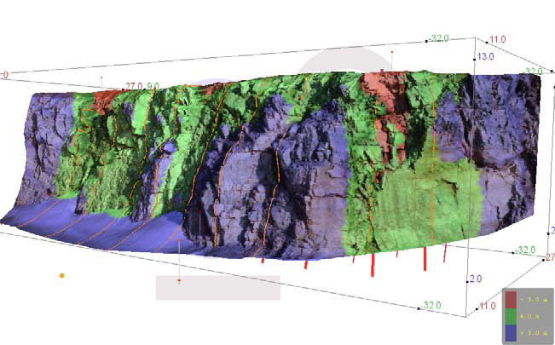
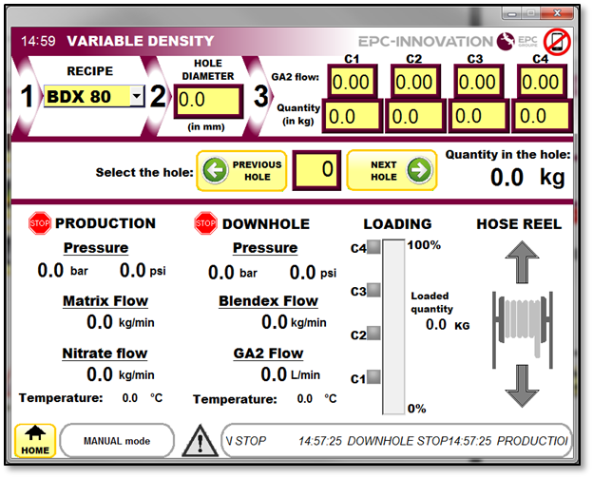
Notes:
A (configurable) colour coded visualisation of burden over the entire bench facilitates the identification of light burden zones (red)

Slide 47
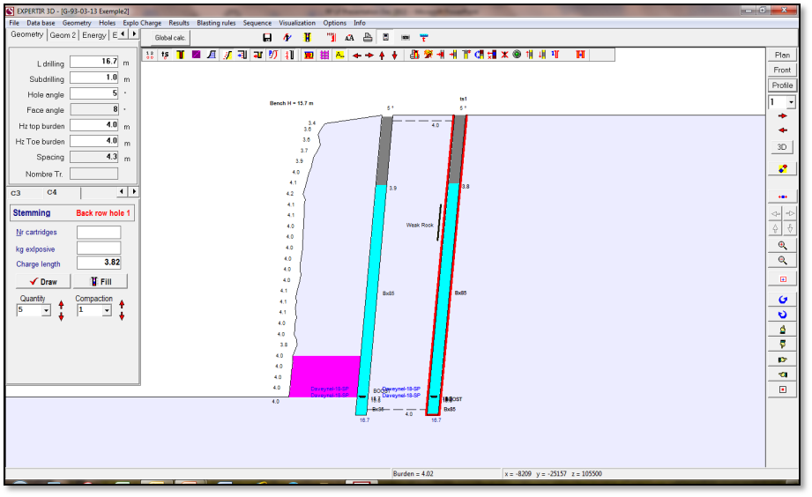
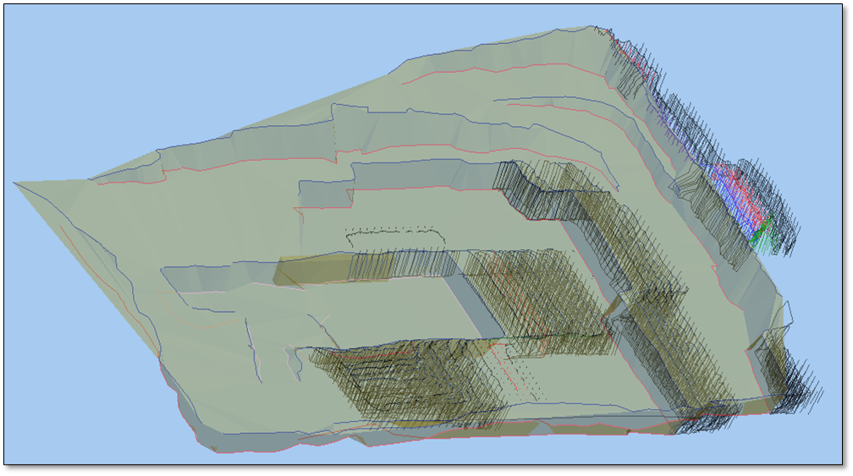
BIM allied to Track and Trace

Slide 48
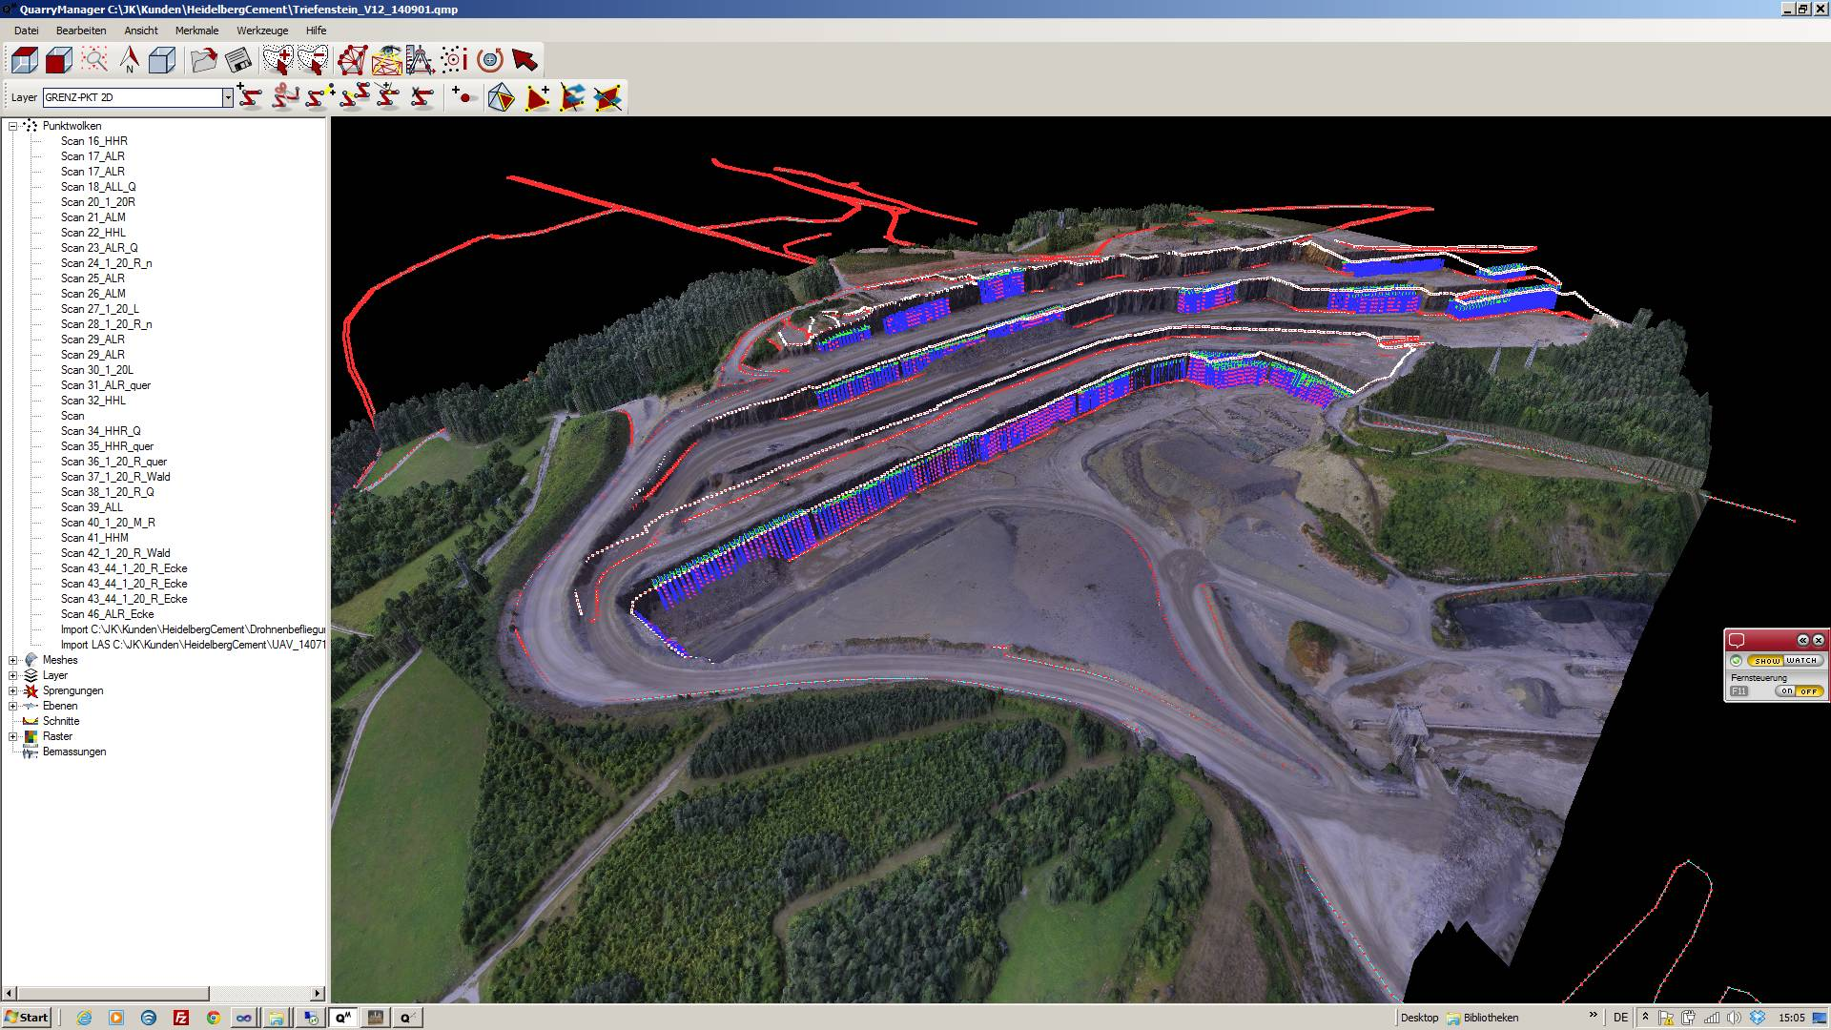
Quarry Detonator

Slide 49
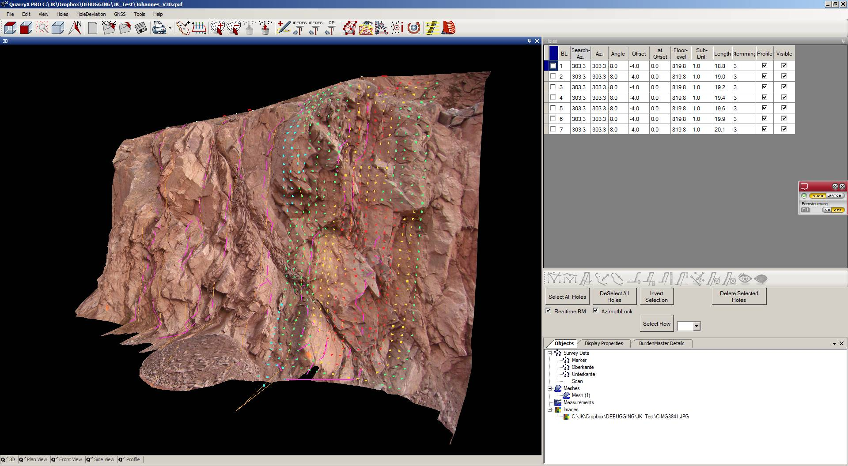
Quarry X: Import photographs
Notes:
Digital Imaging Burden Software in use with Blast Designer 32
Describe photo

