Slide 1
All Island Safety Conference
19th November –
Paul Pounsford, Daybreak Communications / MPA
Notes:
I would like to give you a very quick overview of fatalities and injuries over the last five years on former quarry sites.
The data is primarily drawn from press releases..

Slide 2
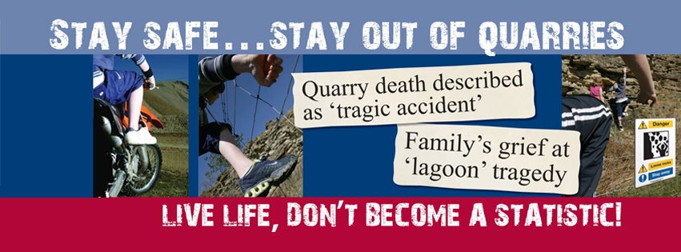
Stay Safe

Slide 3
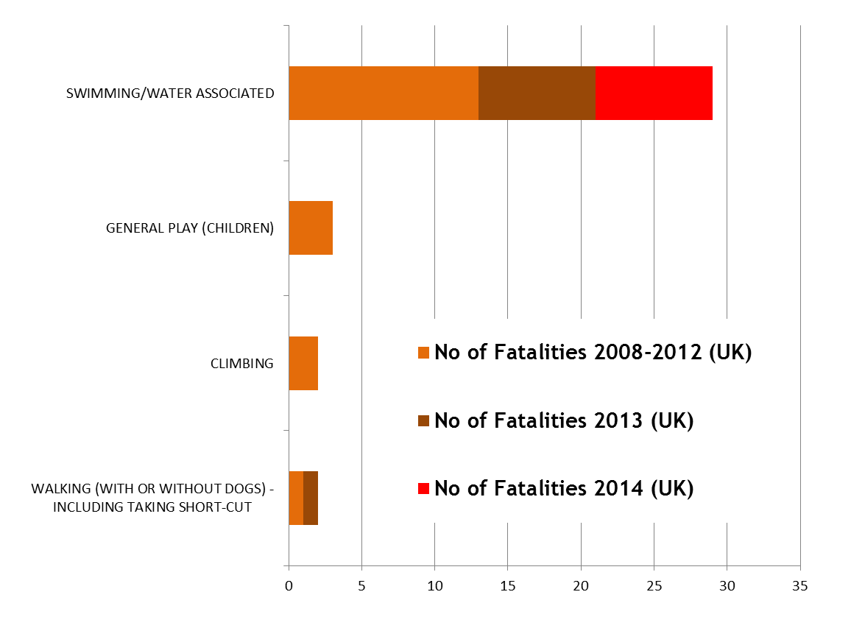
Activity associated with – 36 Fatalities
2008 to 2014
Notes:
There have been 36 fatalities in quarries involving the MEMBERS OF THE PUBLIC over the last 6 years – only 1 of these was in an active quarry.
These figures exclude suicides, deaths due to criminal activity, and fatalities in quarries that are managed diving facilities or restricted access climbing sites
Sadly 2013 and 2014, have been particularly bad years – this is I believe also reflects the extremely warm weather in both years.
As this graphic shows the majority of these deaths are water related. This includes people who have died falling down faces into water, tombstoning, falling off rafts. It also includes children involved in water related deaths.
Water is by far the most significant factor in terms of fatalities.
The other chidren’s deaths were either as a result of being crushed or falling.

Slide 4
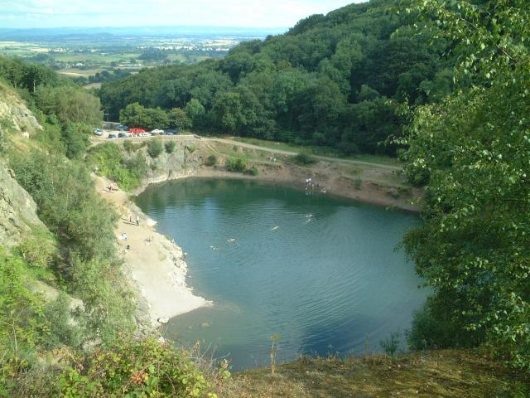
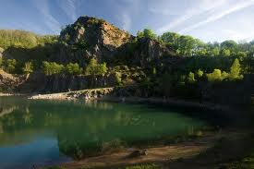
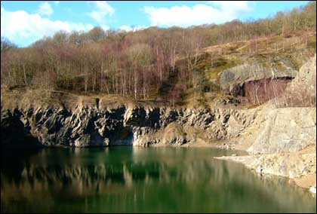
Gullet Quarry, Malvern
Double Fatality 2013 - Drowning

Slide 5
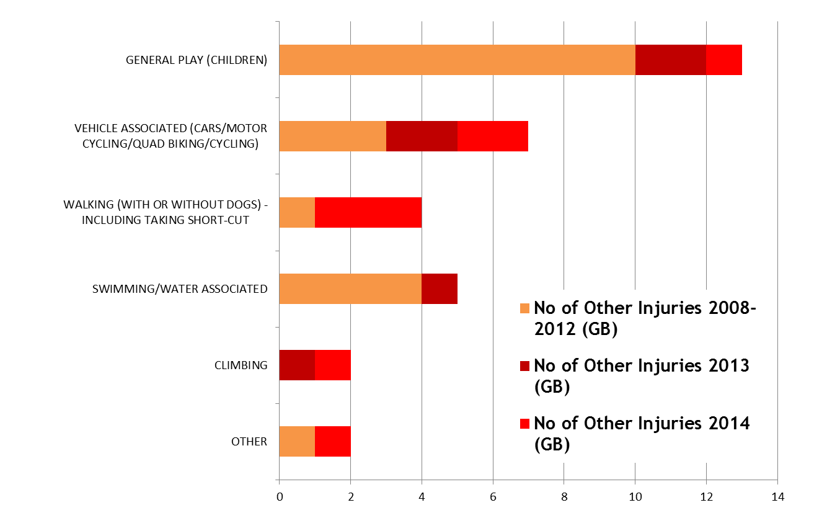
Activity associated with – 35 Non-fatal injuries 2008 to 2014
Notes:
We believe these figure are significantly understated simply because it is far more difficult to pick these statistics up. Although we believe we are accurate in terms of figures from MPA members
It is interesting to note relatively low incident of water associated injuries – probably because in most cases a near drowning does not an injury.
Some sectors shown are there because our surveys of managers responsible for active and non-active quarries show that they experience trespassers engaged in these activities.

Slide 6
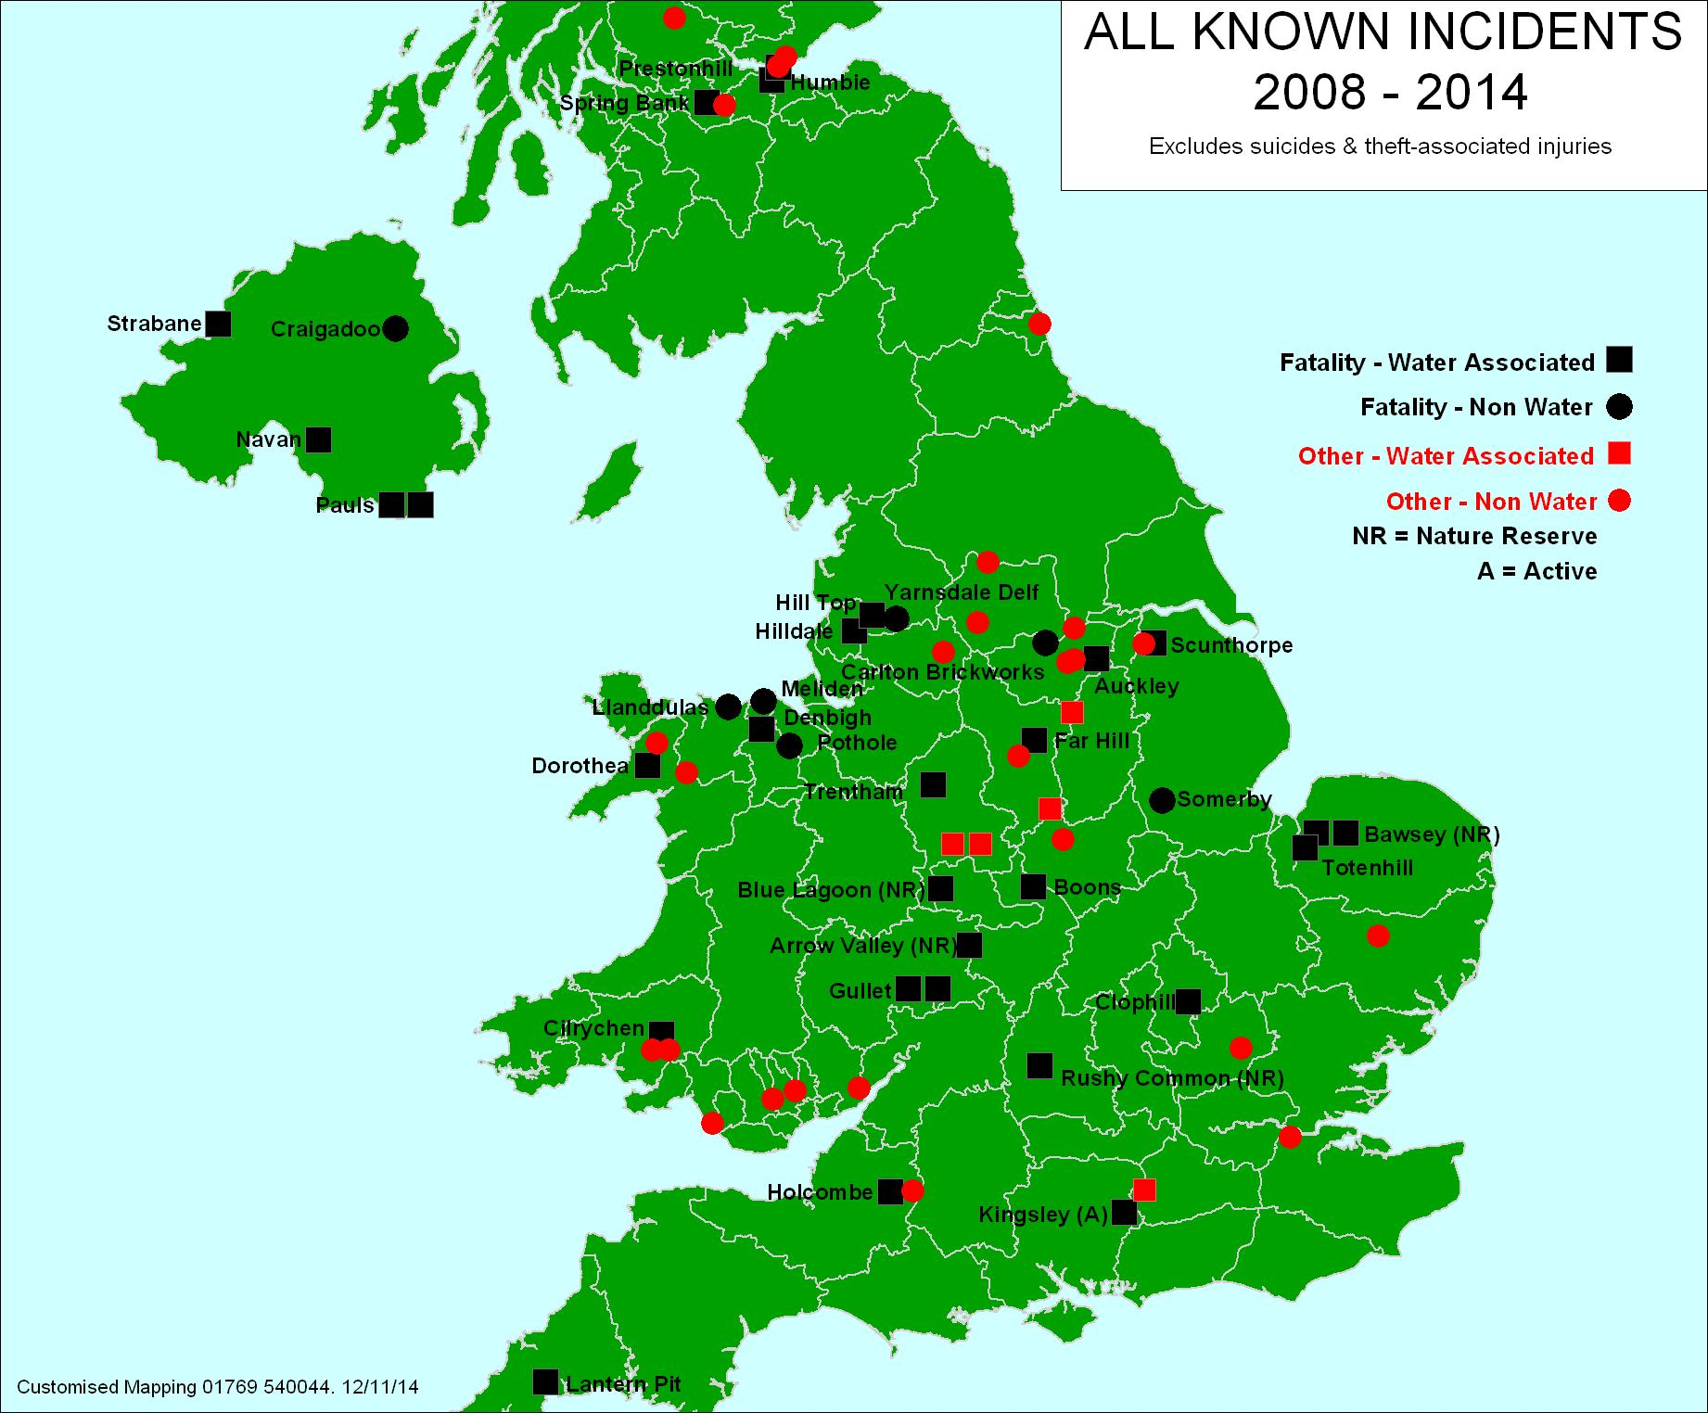
Notes:
Finally, this map demonstrates a point I made earlier. These former sites exist across the UK.
The majority of incidents tend to occur at sites that are either near an urban connurbation or at well known sites which people are prepared to travel to visit.

Slide 7
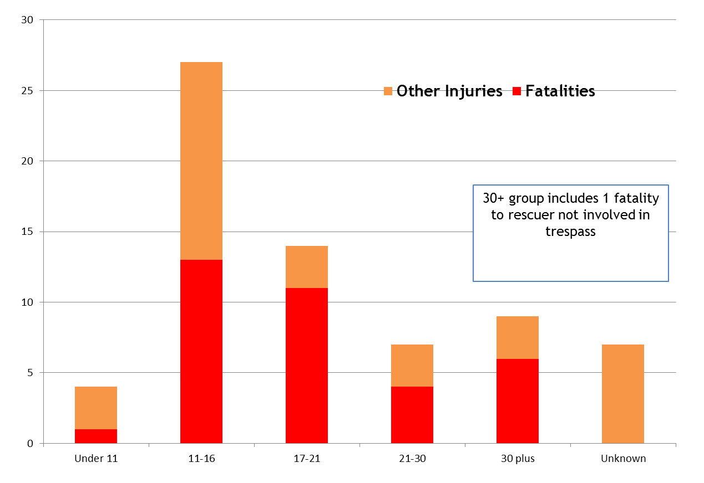
Age Distribution
Notes:
This breakdown of the age groups of those involved in fatalities or injuries show an all too familiar story.
It is the teenagers and particularly young males that are most likely to engage in activities that expose themselves to risk.

Slide 8
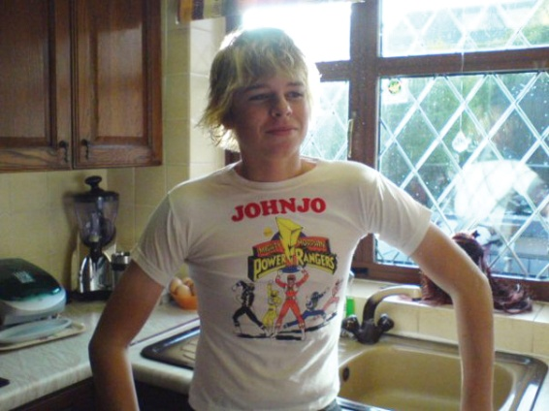
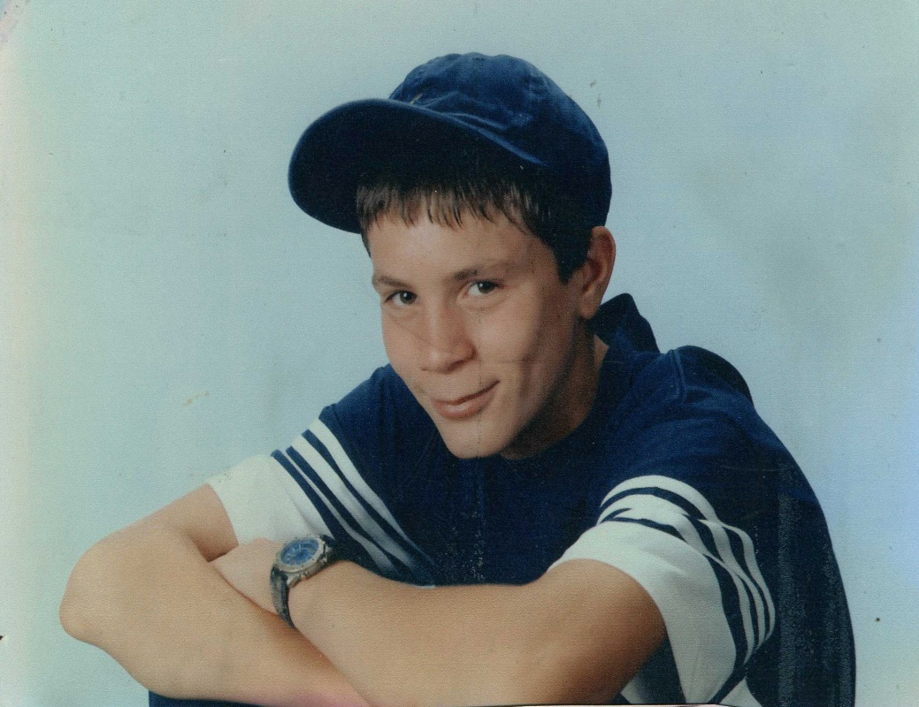

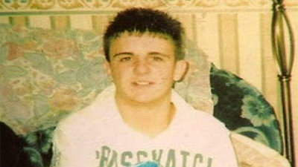

Slide 9
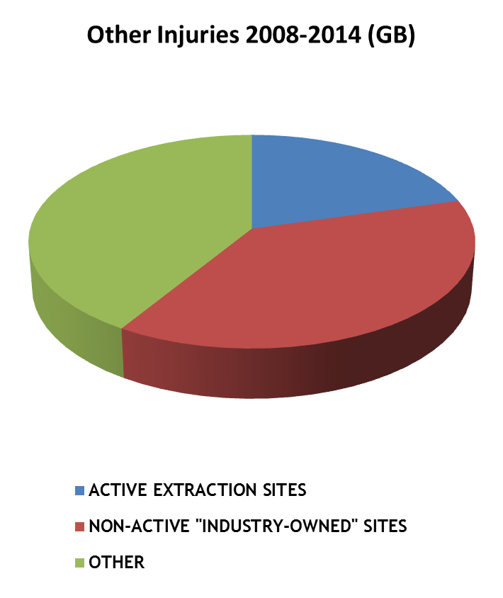
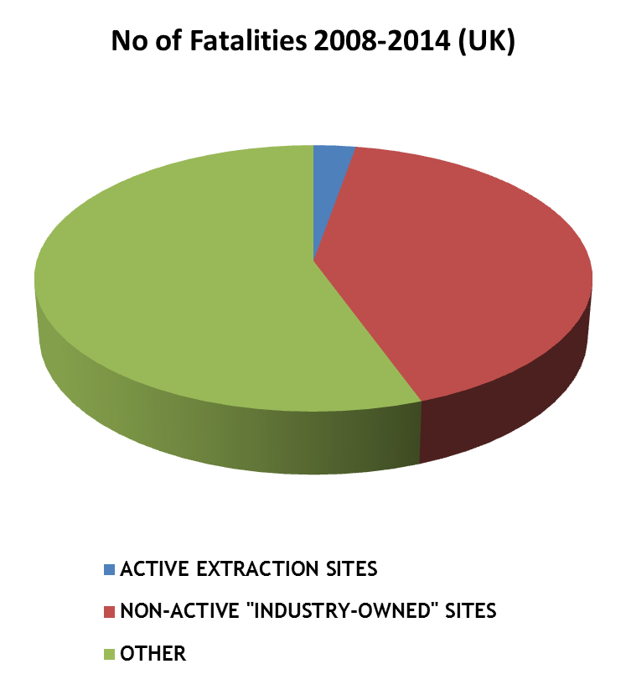
Site ownership
Notes:
As I mentioned earlier, only 1 of the 36 fatalities could be described as being in an active quarry.
This analysis shows that of the 36 fatalities, 15 were on non-active sites that were still owned by quarry operators both large and small operators – (both MPA members and non-members)
The remaining 21 were owned by a mixture of local authorities, developers, nature organisations, or other landowners

Slide 10
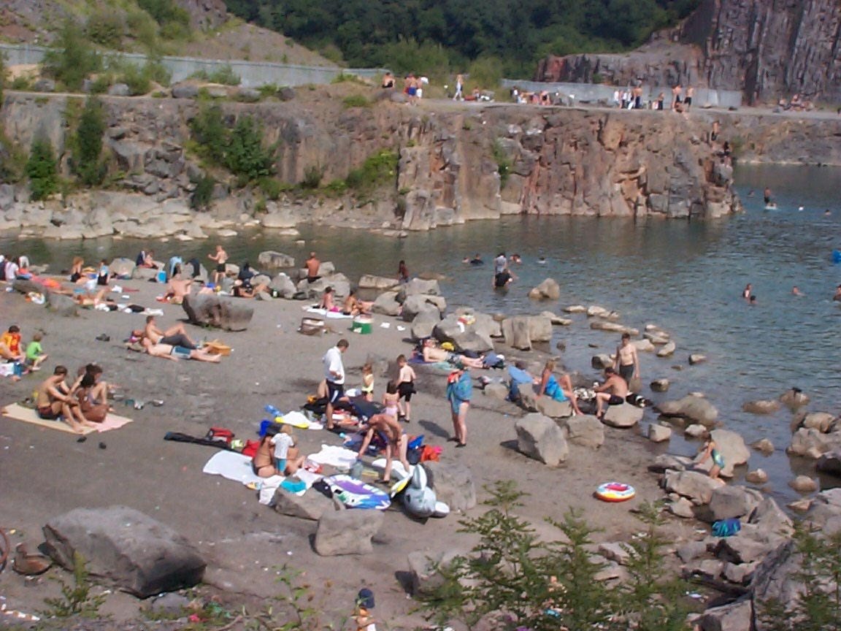
Water by far the most significant factor in fatalities
Predominantly disused sites
Many sites outside industry’s control
History of use for recreation by adults as well as teenagers / children
Many restored and abandoned sites open as a public amenity
Public do not understand the risks - inspite of warnings see as harmless fun

Slide 11
MPA Public Safety Summit – November 2013
6 fatalities over a two month period
To share information and discuss the way forward in managing public safety in quarries
Over 40 different organisations represented
Sports and environmental organisations, landowners, emergency services, local government, safety organisations and operators.

Slide 12
Outcome from summit
Fully engage MPA members
Ensure MPA member’s house in order
Water safety is a national issue
Provide leadership
Engage with organisations representing other site owners
Explore potential to develop sites as amenities
Raise public awareness – shared messages and collaboration
Gather better evidence
Local engagement
Evaluation of risk on a site by site basis
Public have responsibility for their safety
Review signage and safety devices

Slide 13
MPA Guidelines on public safety
Site responsibility
Risk assessments
Signs and fencing
Management and control
Community engagement
Site action plans
Site emergency plans
Handover of sites
Statistics
Supporting campaigns
Planning

Slide 14
Results from quarry managers survey 2013

Slide 15
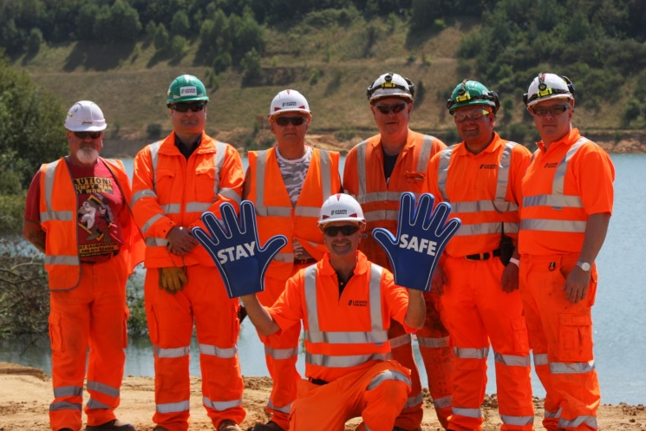
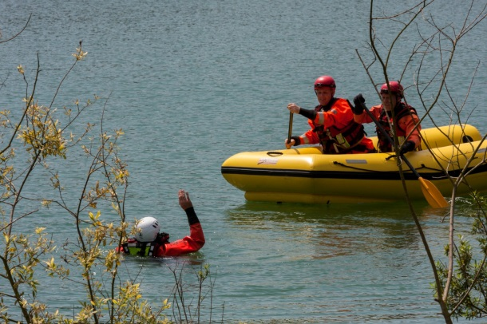
Stay Safe - Media
Focus on local radio, press & TV
Media events
Parent champions
Other stakeholders
Regional statistics
Maps
Local operator
Letters to editors

Slide 16

Stay Safe resources
Videos
Facebook page
Leaflets
Website
Educational resources
Guidance to quarry managers
Reminders to operators
Promotional aids

Slide 17
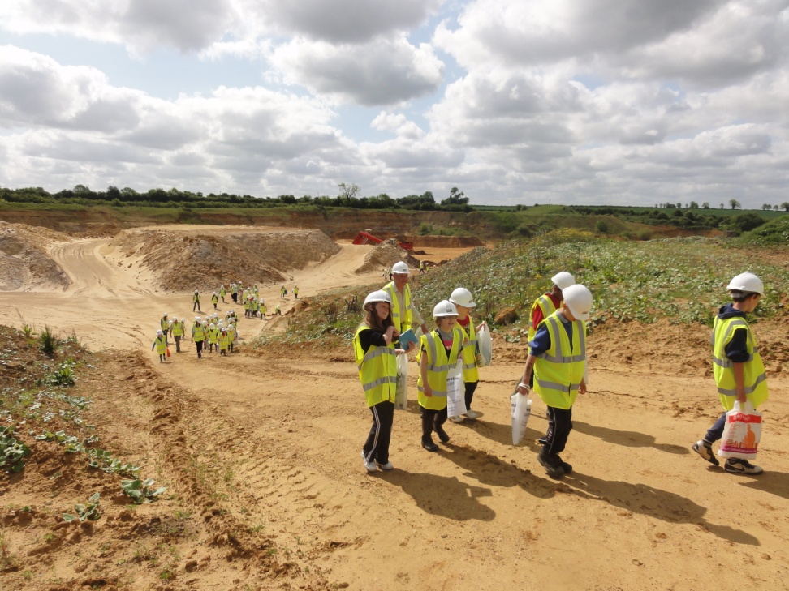
Community engagement
Schools visits
Quarry open days
Parish council
Youth workers
Neighbours
Local media
Emergency services

Slide 18
Other stakeholders
Inland Water safety Group
National strategy for water safety
WAID database
Emergency services
Sports Associations
Case studies
Other landowners
Local Authorities
Other operators
Planners

Slide 19
Stay Safe

