Slide 1
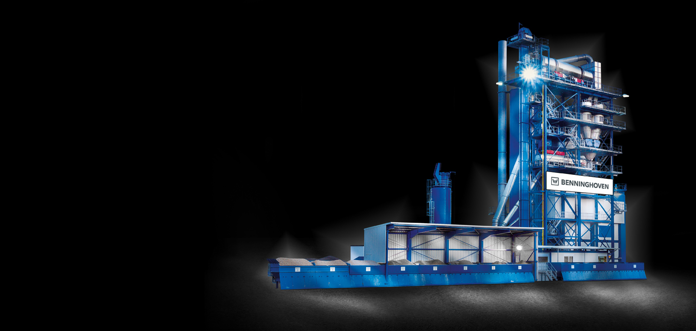
ECO - 2000: Process
Engineering
Semi Container Asphalt Mixing Plant

Slide 2
Training content
How is the plant designed
How is the plant working
What are the different sections
What are the technical data

Slide 3
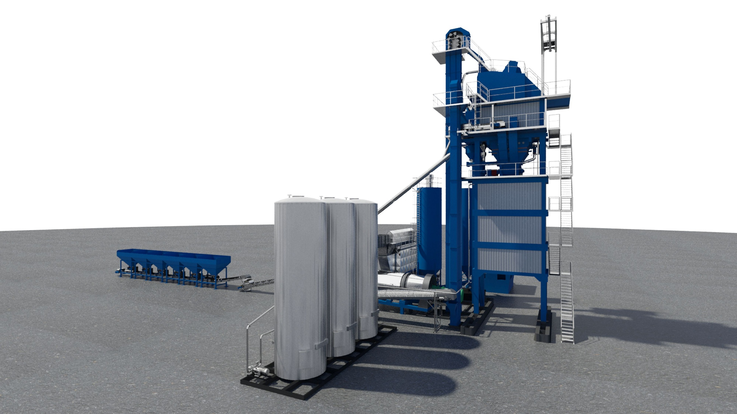
Process Engineering

Slide 4
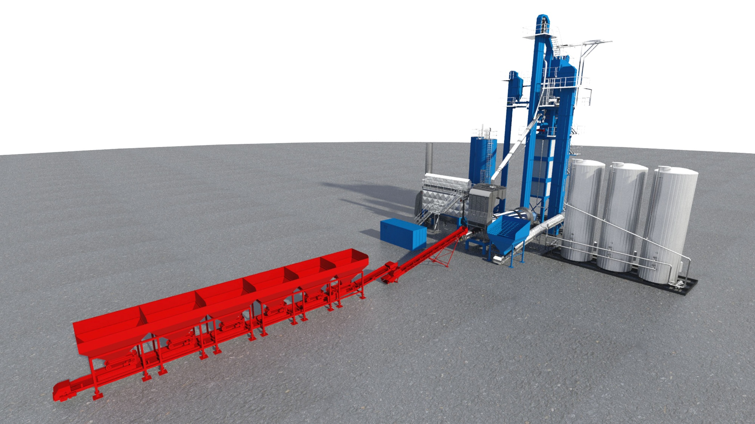
Material storage
Predosing

Slide 5
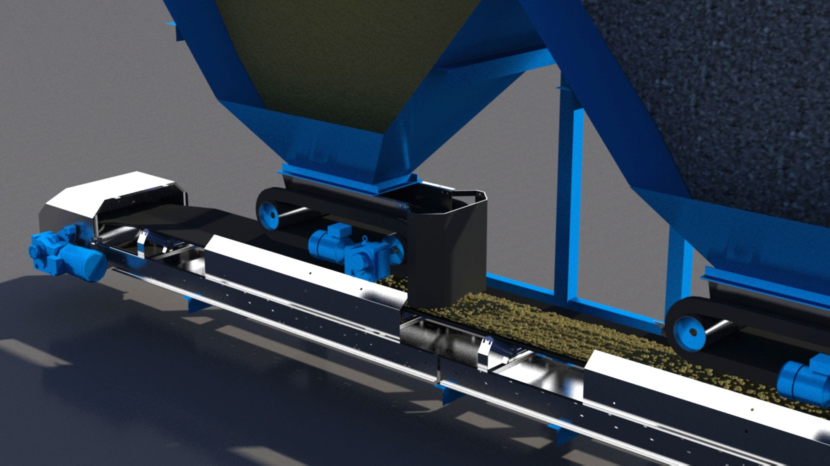
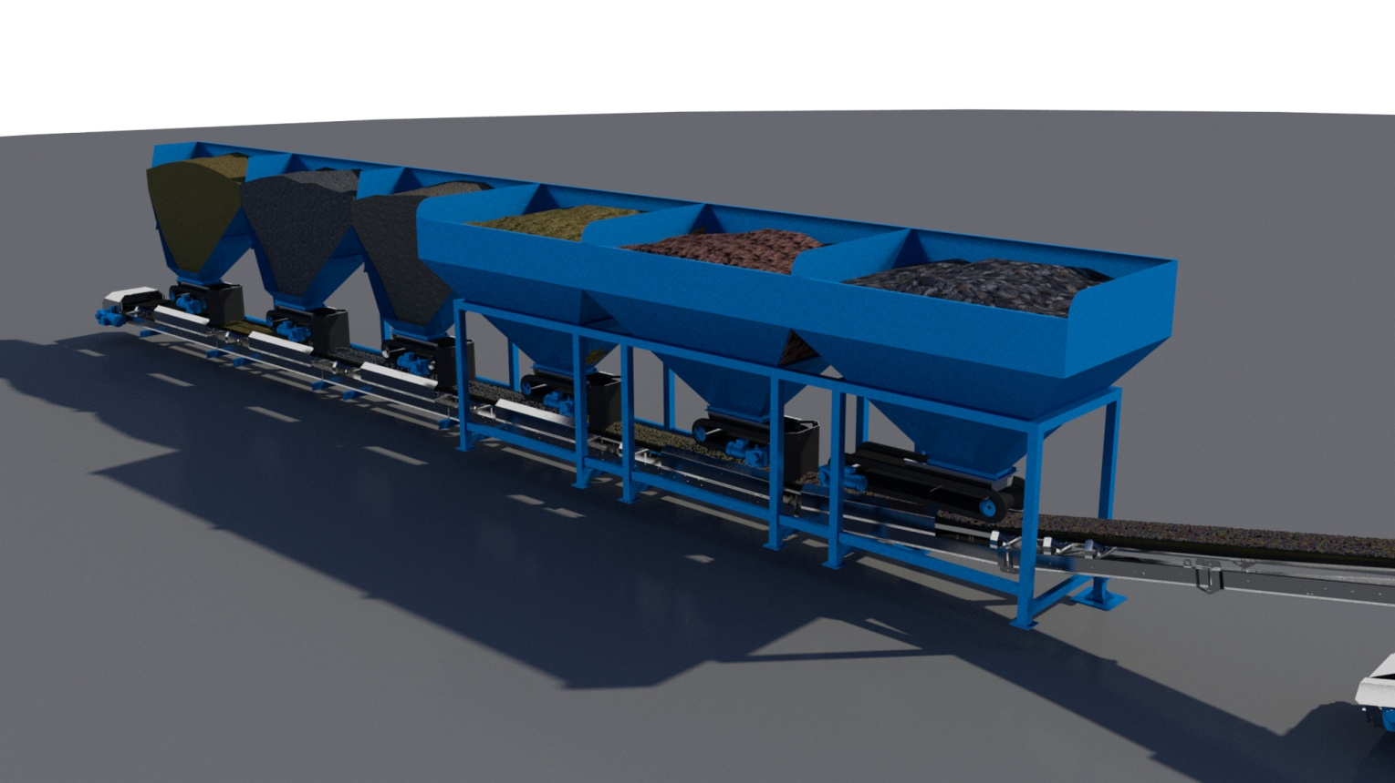
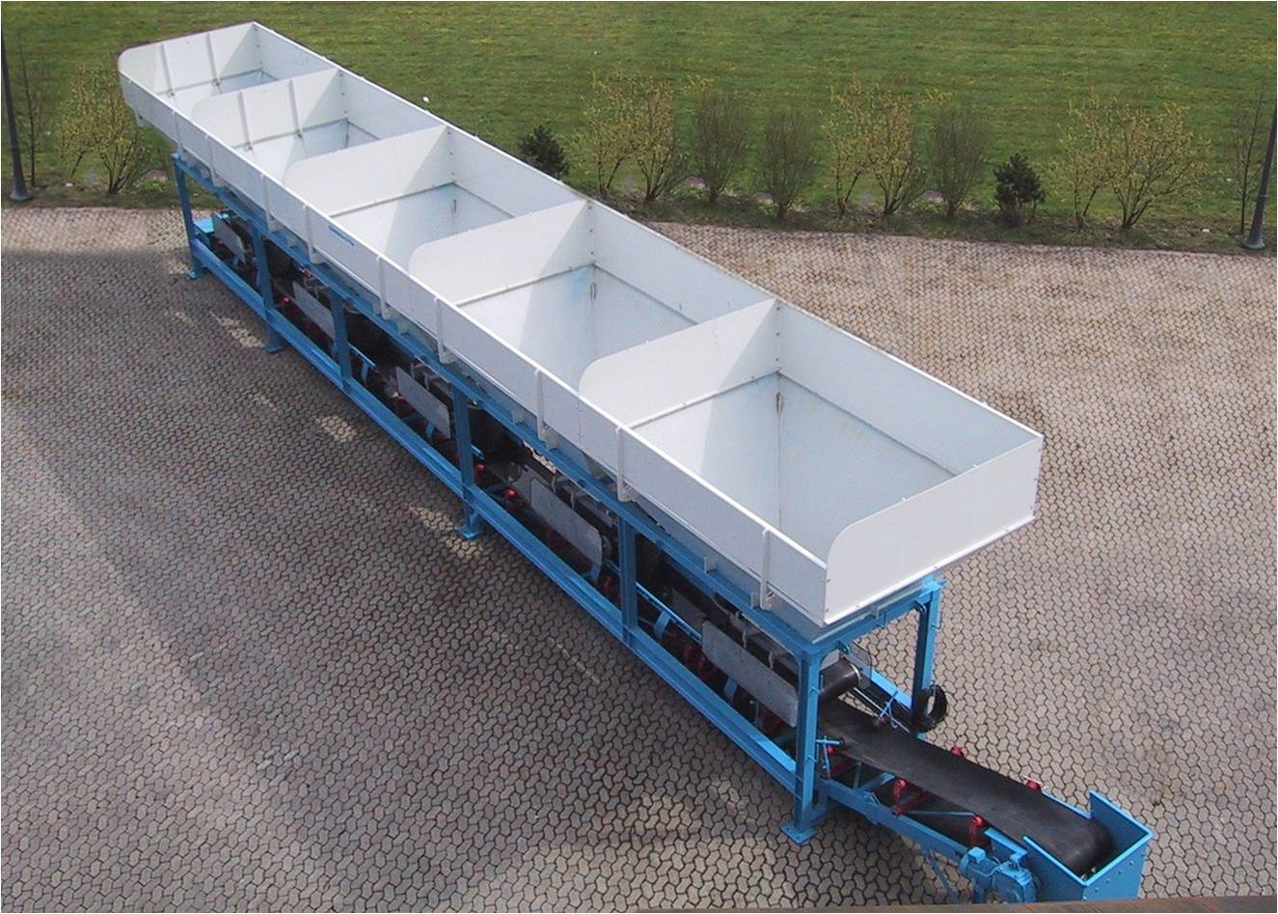
ECO - Cold Feed System
Cold feed system
  Material dosers
  Belt feeder on load sells
  Convering belt

Slide 6
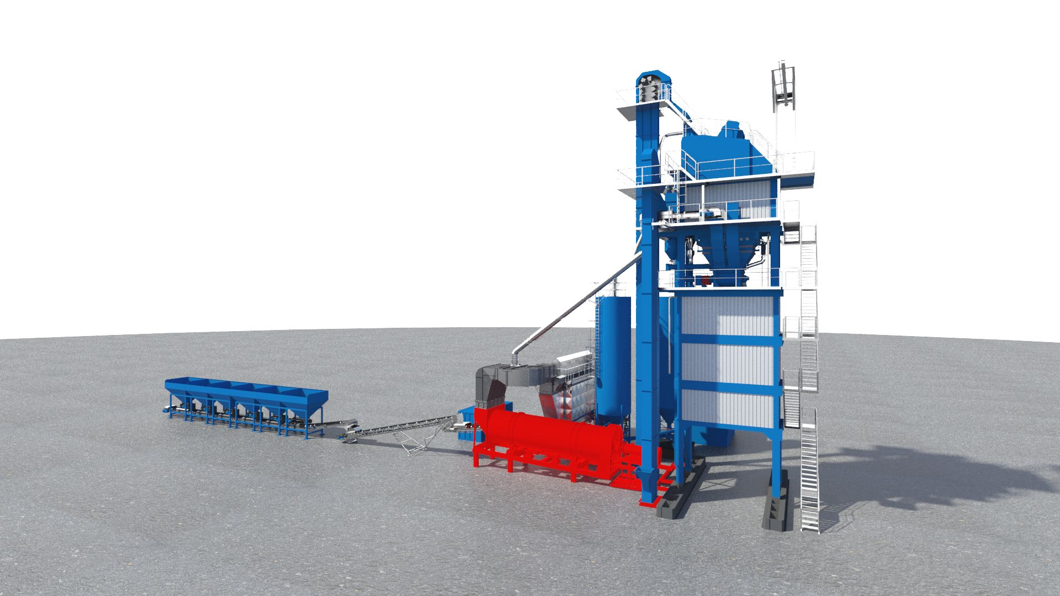
ECO – Drying section
Dryer drum

Slide 7
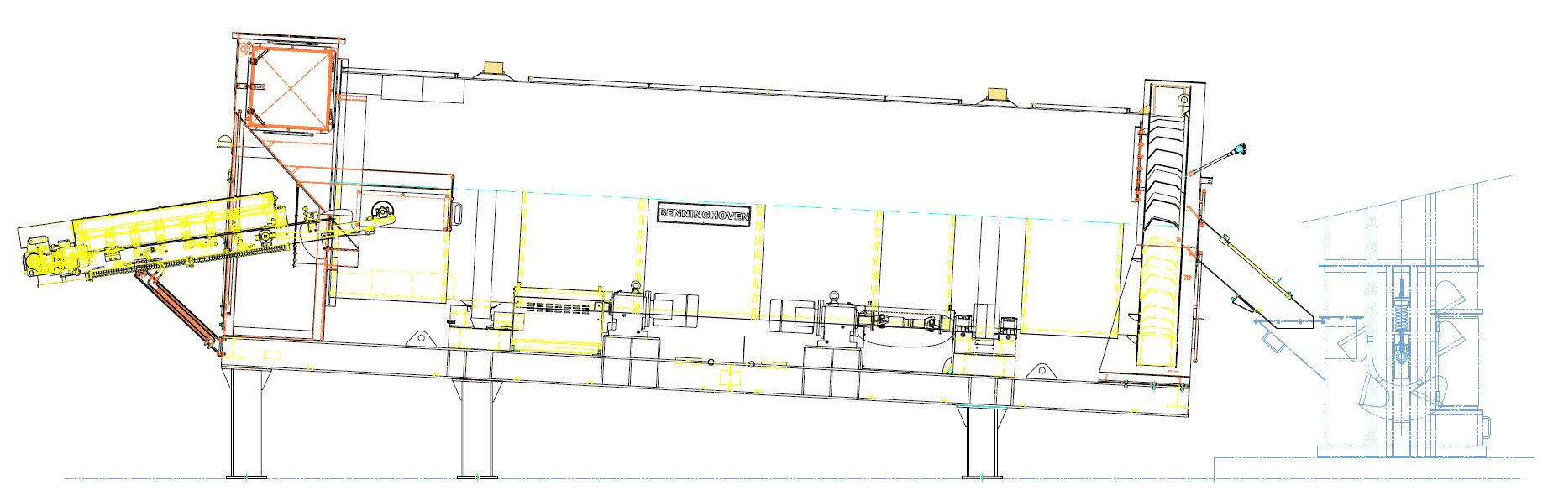
ECO – Dryer drum

Slide 8
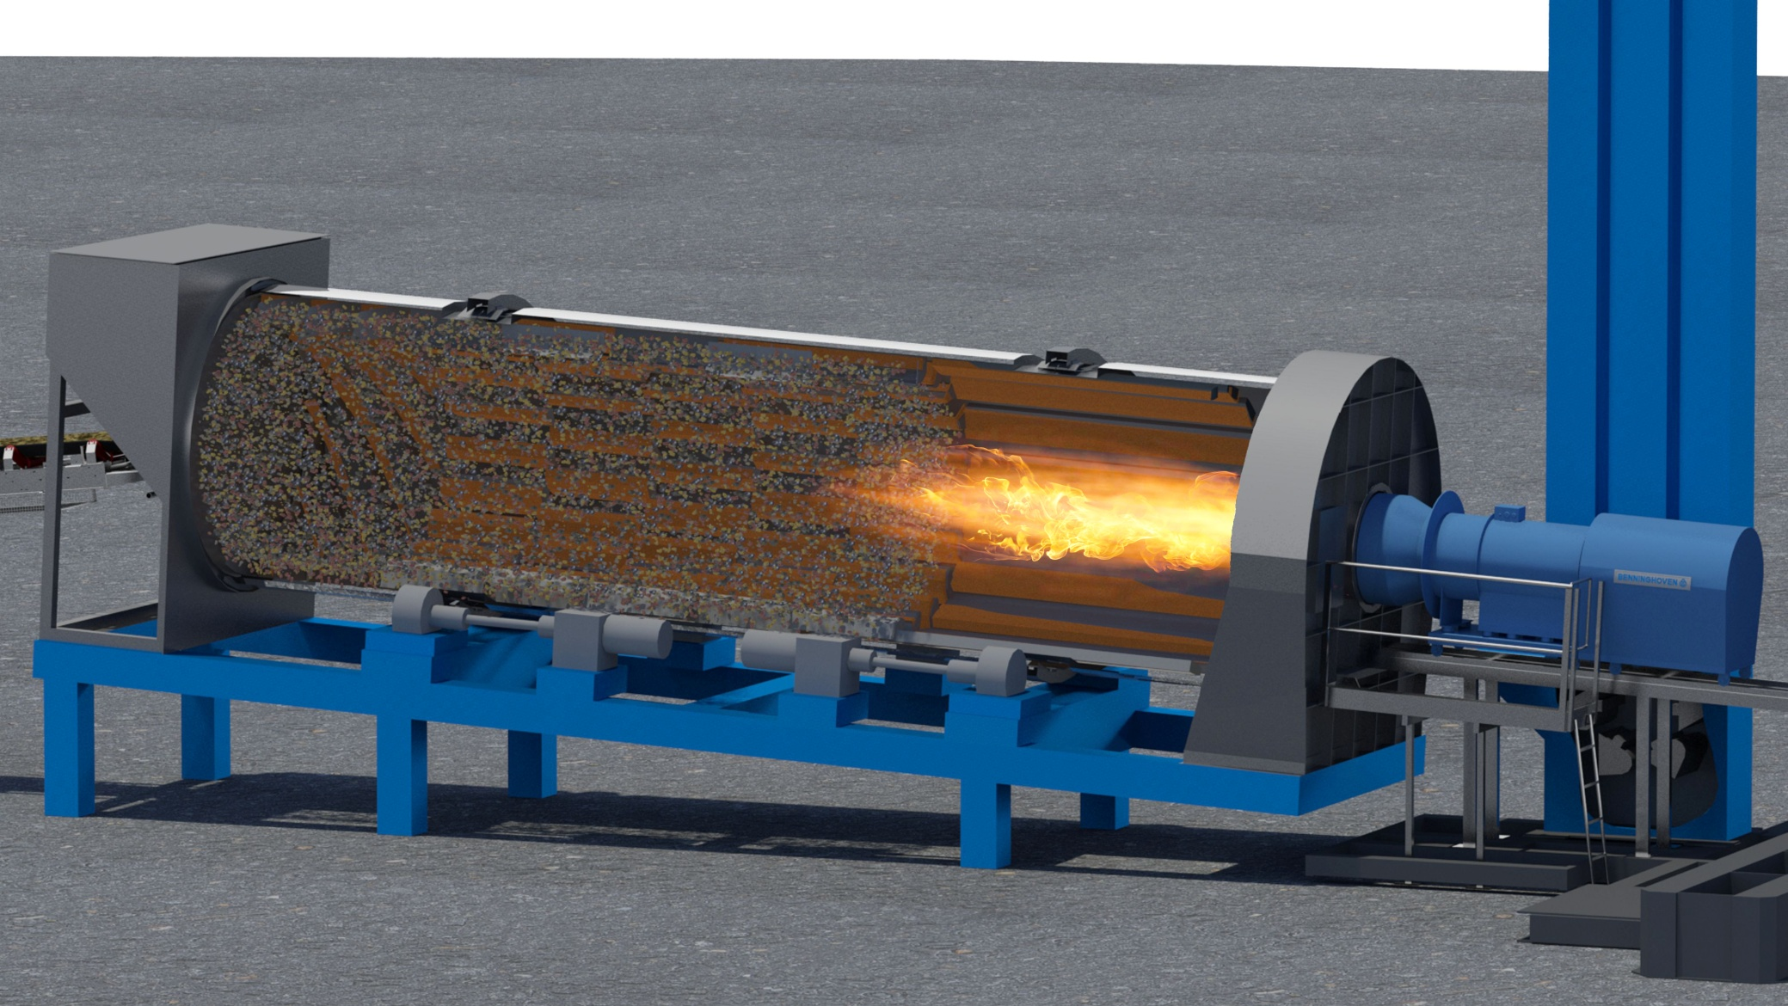
ECO – Drying section
Dryer drum with burner

Slide 9


Slide 10
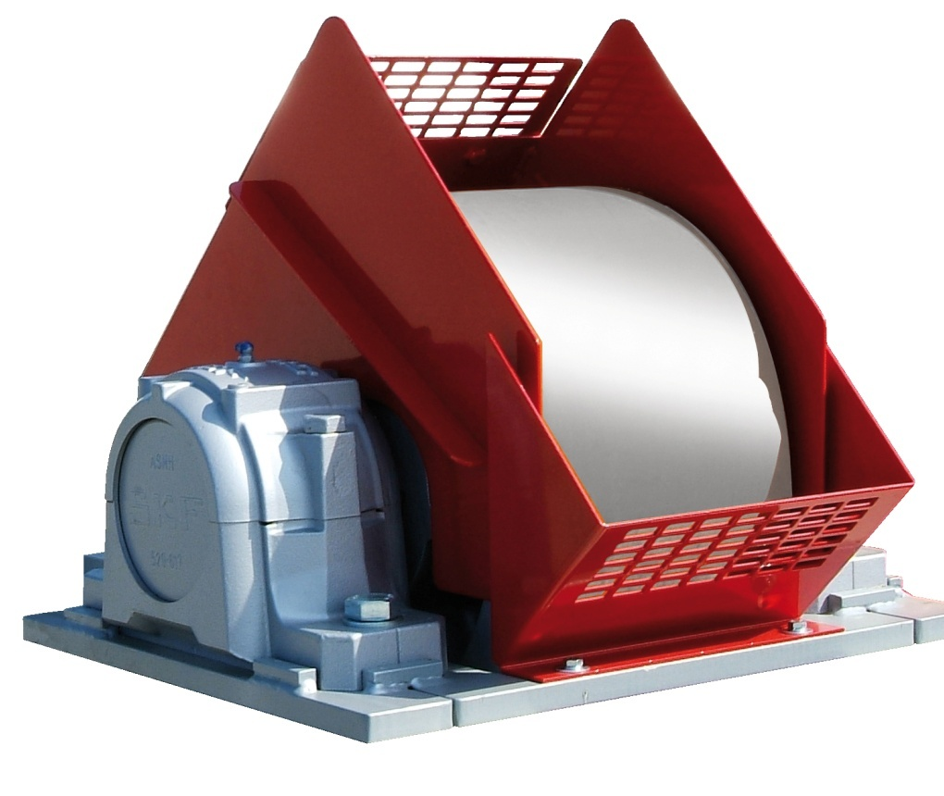
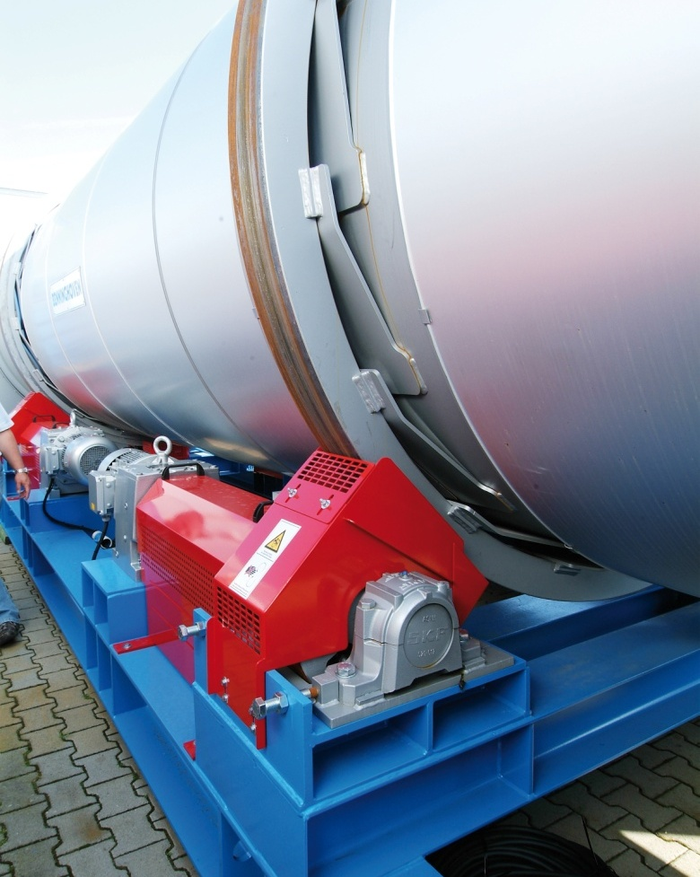
ECO - Dryer Drum
Dryer drum
  Dryer drum with friction wheel drive
  4 drives with a cardan shaft

Slide 11
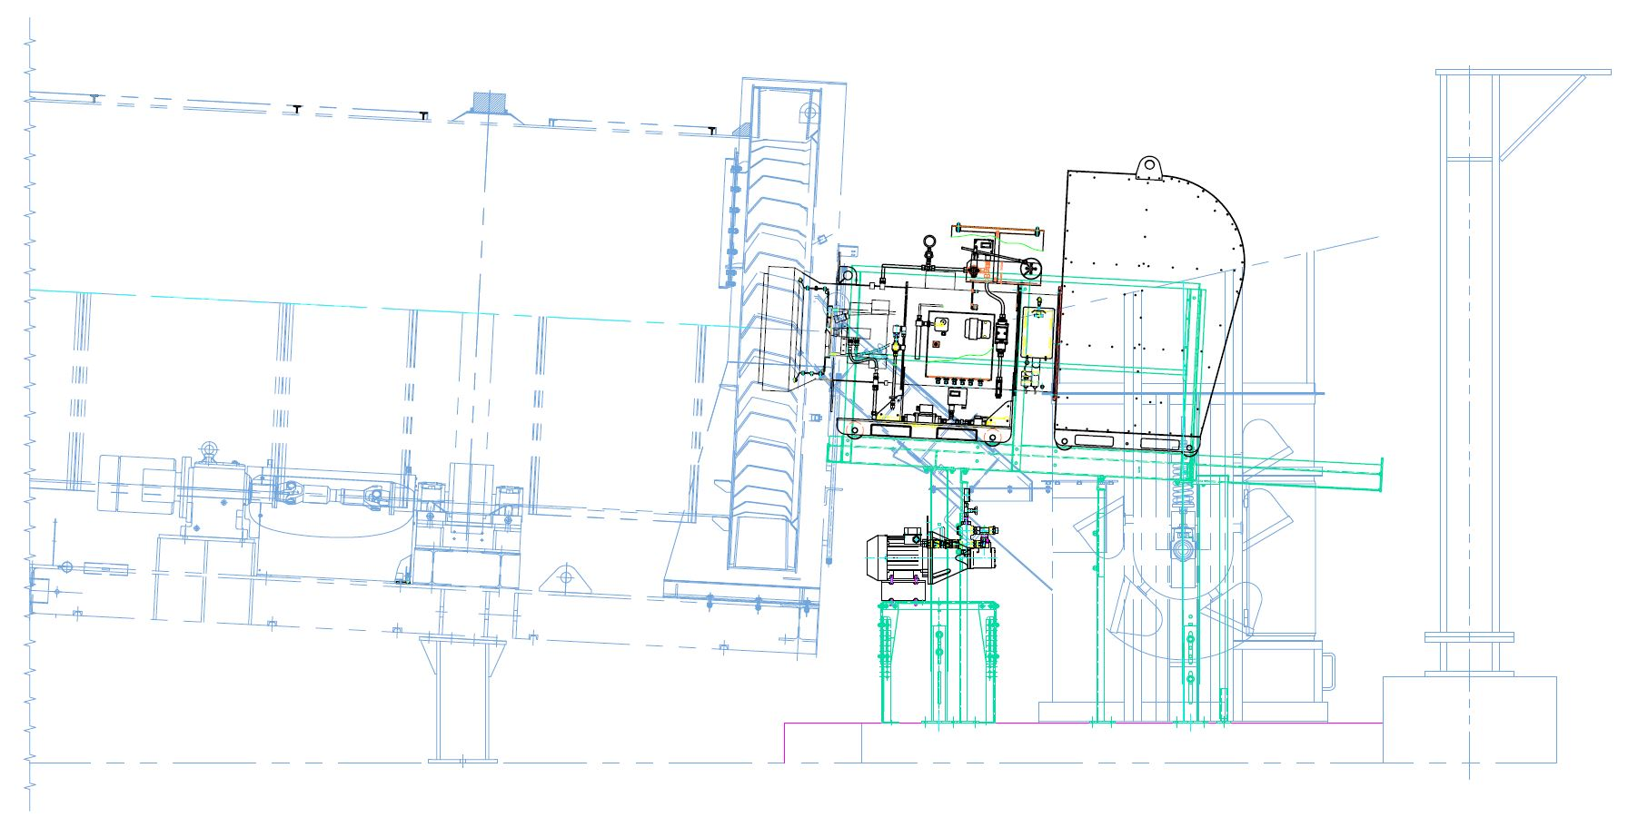
ECO – Dryer drum - Burner

Slide 12
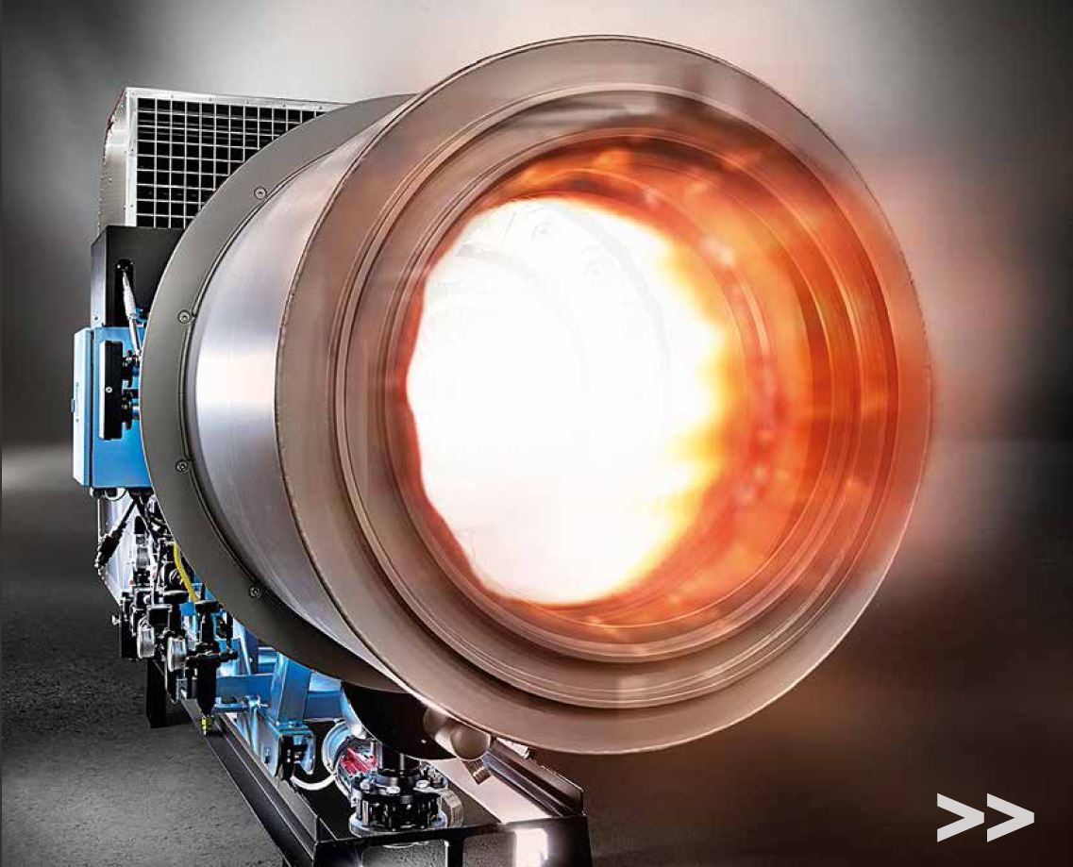
ECO - Burner
Burner
  EVO JET 1-5
  5 Fuels
  Fuel accessibility
  Firingmanager

Slide 13
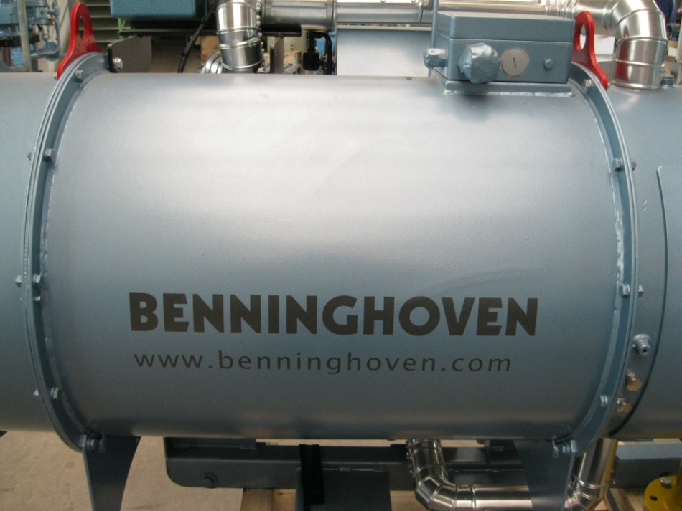
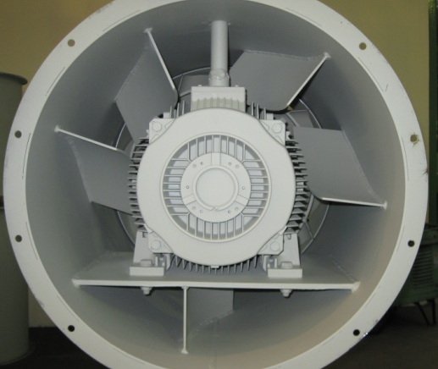
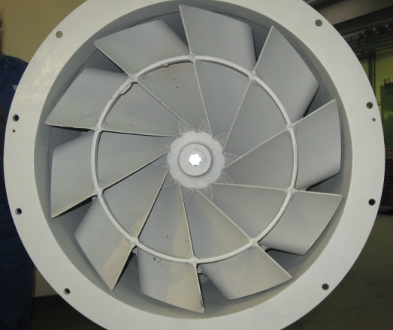

Burner
Ventilation
  Radial/axial fan
  specially shaped baffles
  empirically determined buckets
  best mixing effect

Slide 14
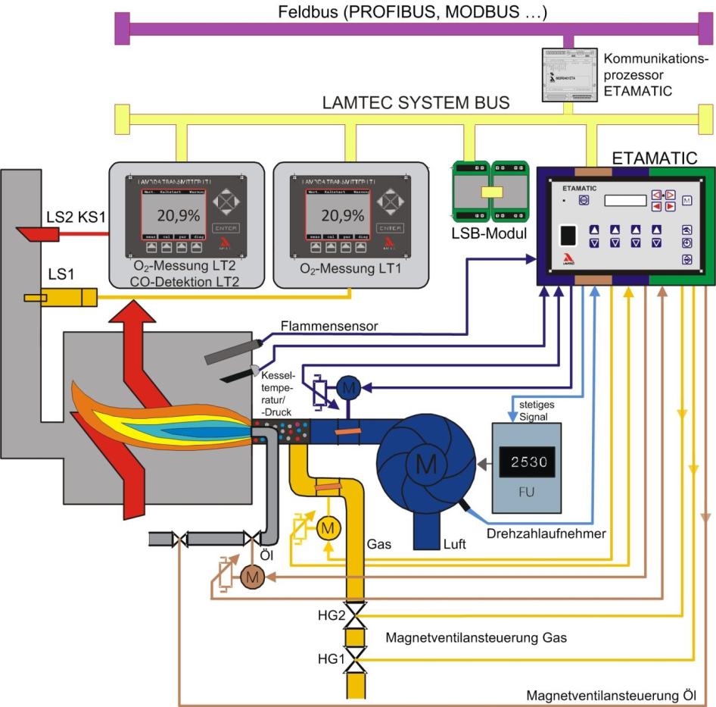
ETAMATIC - Layout and functions
Compound
  Fuel
  Air
  Flame sensor
  Firing
  Pre- & Post ventilation
  Leakage test

Slide 15
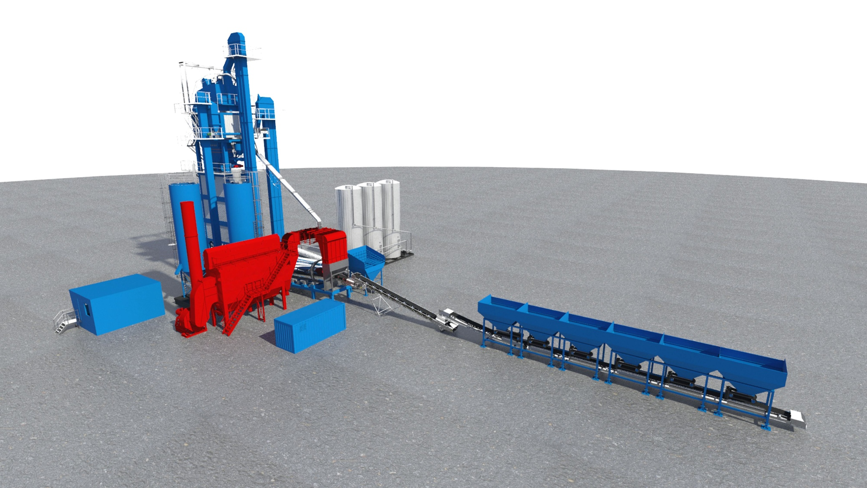
ECO - Dust extraction system
Filter

Slide 16
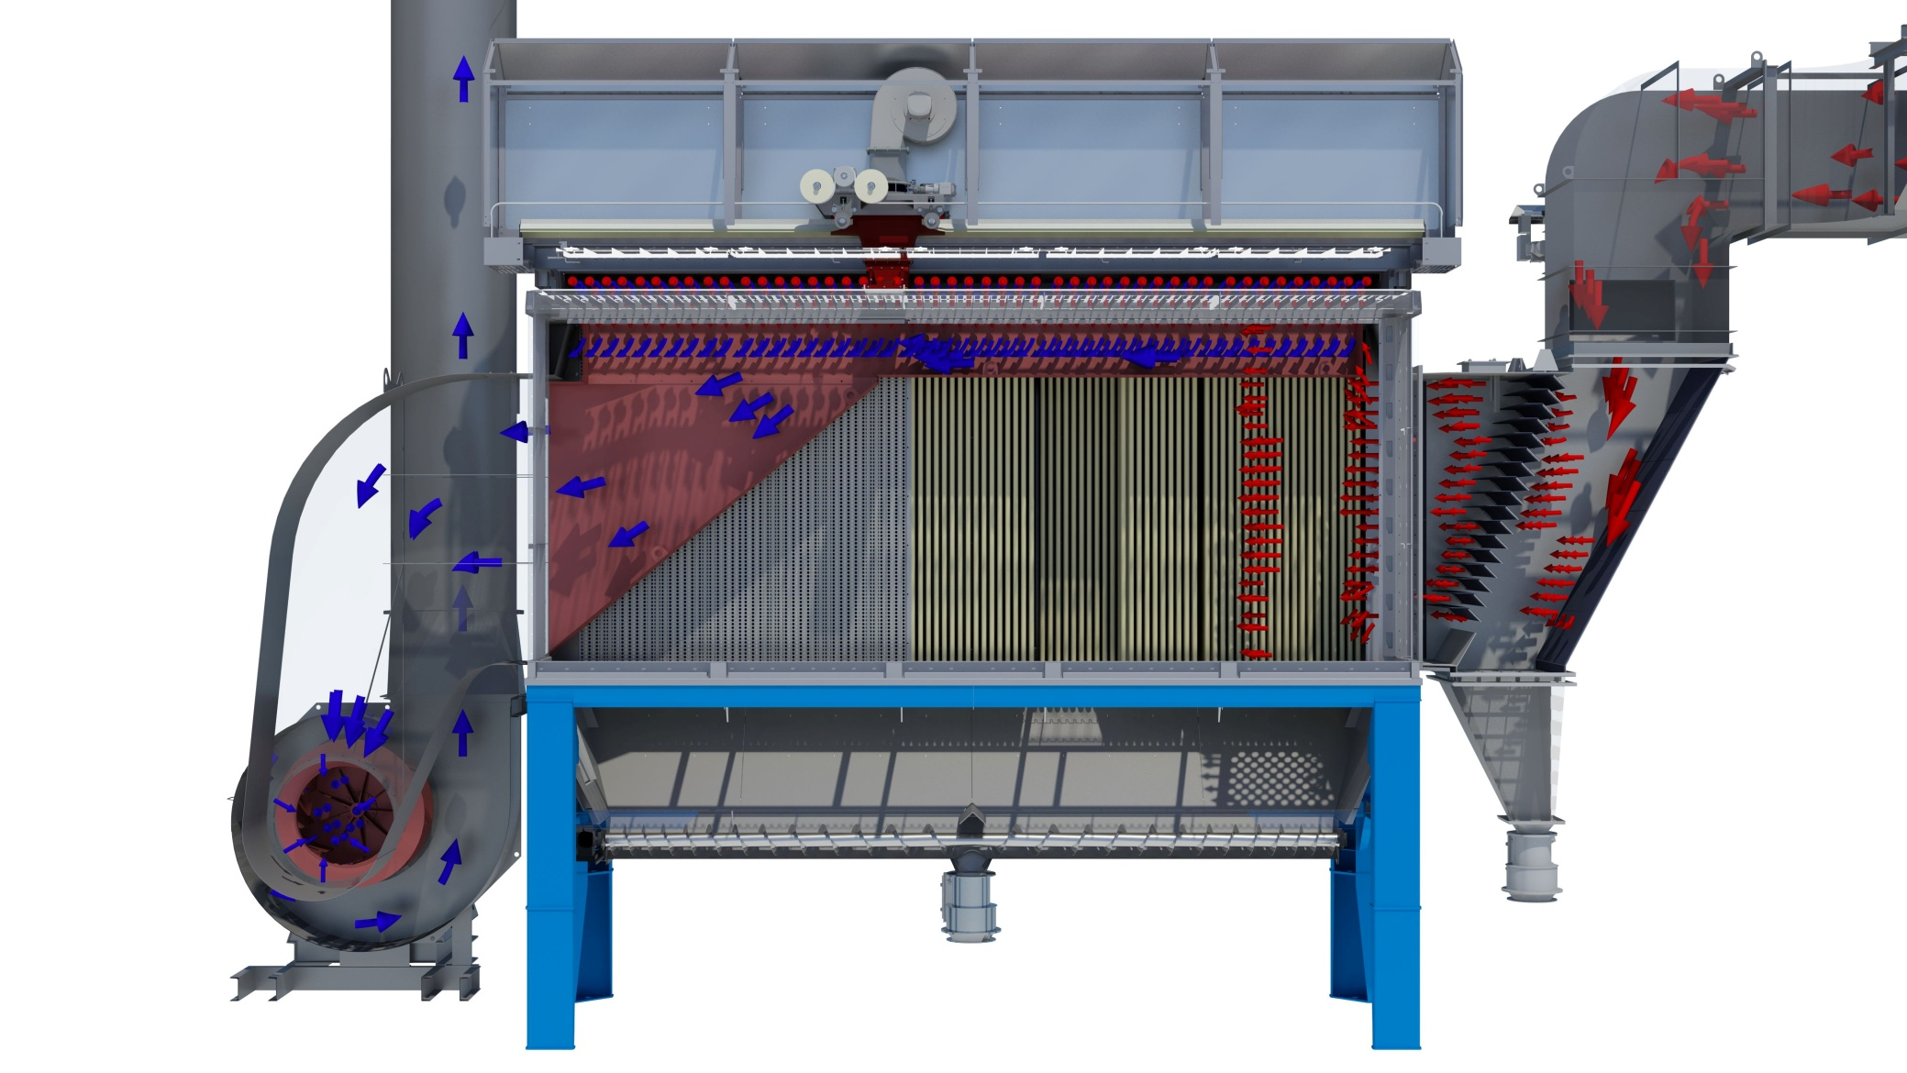
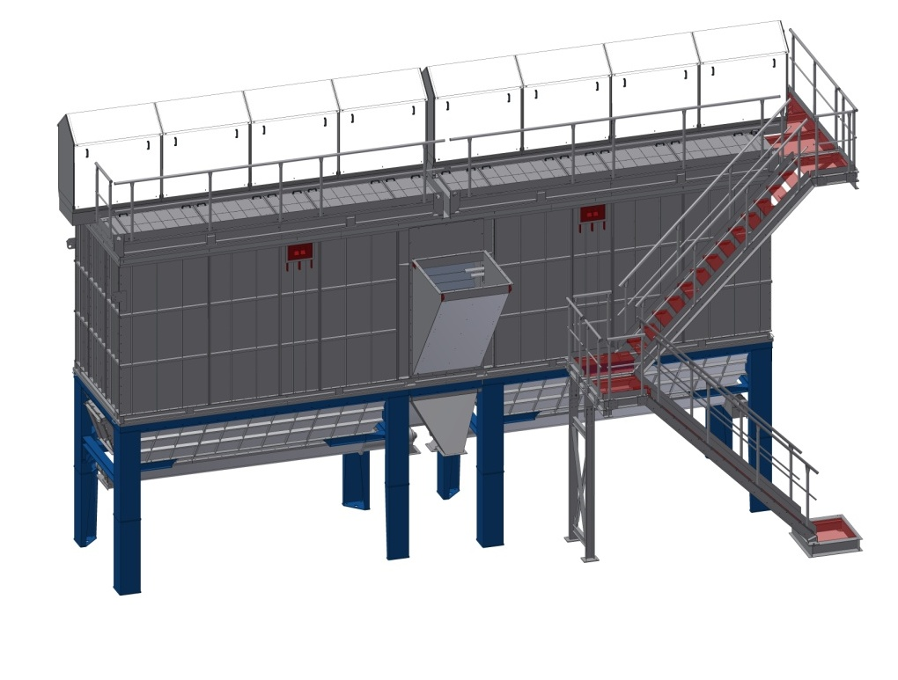
ECO - Bag House
Bag house
  Filter housing
  Pre Skrimmer
  Exhaustor
  Screw

Slide 18
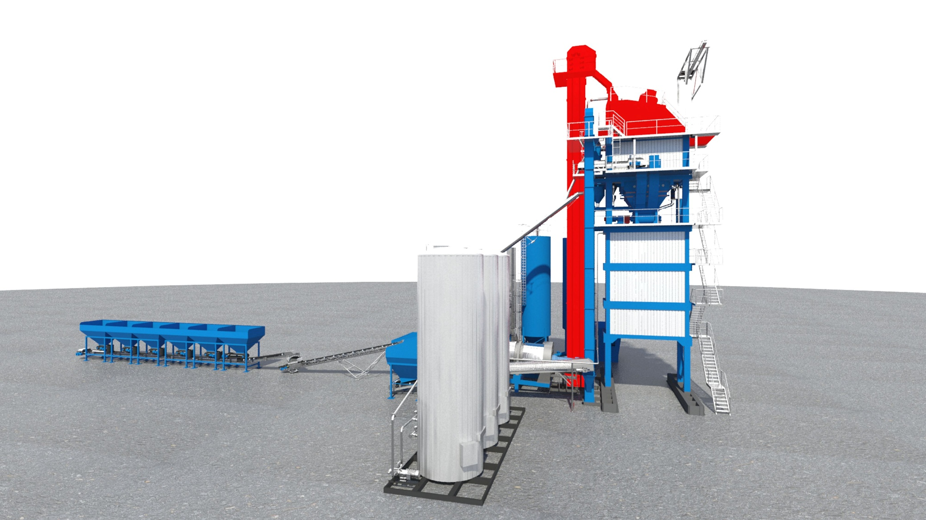
ECO - Mixing tower
Hot elevator and screen

Slide 19
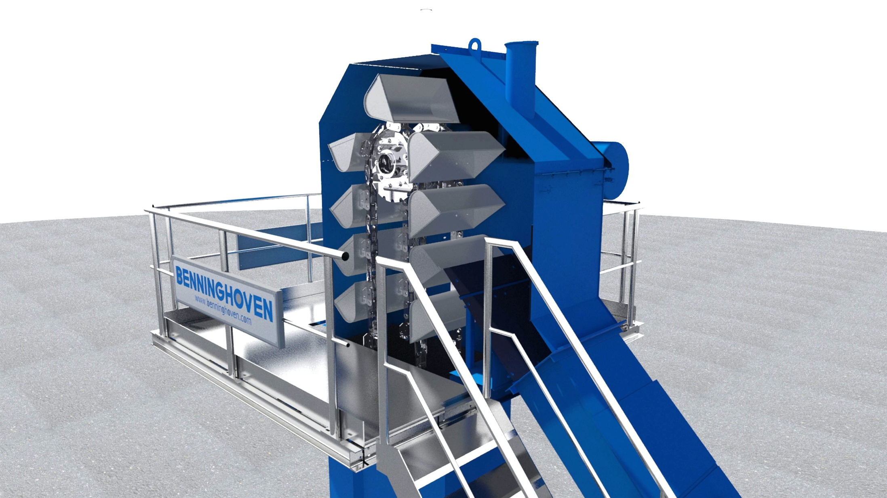
ECO - Mixing tower
Hot elevator with chain and bucket

Slide 20
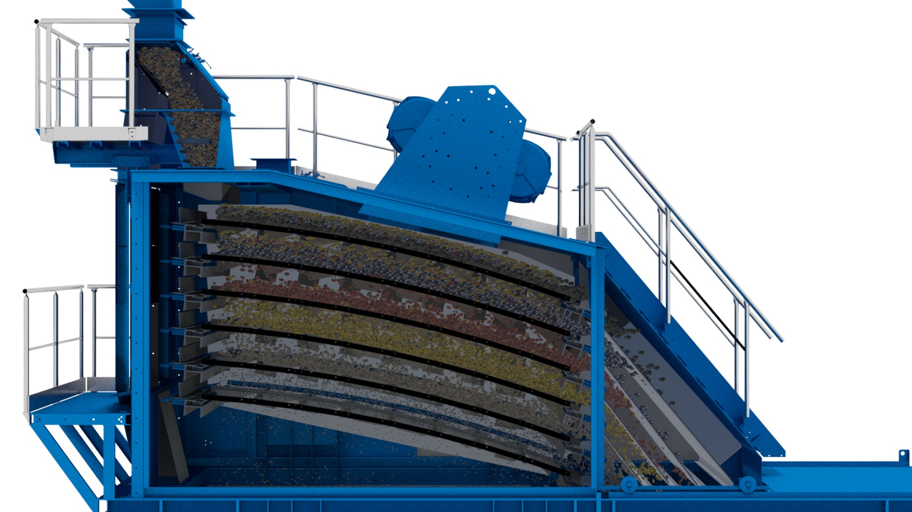
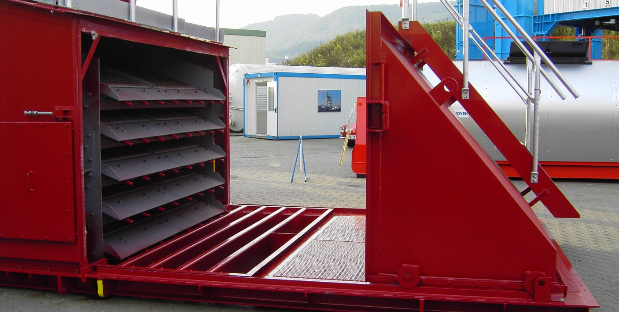
ECO - Screen
Screen / Hot bin section
  Screen
  5-deck Screen
  Vibration motor
  sep. container

Slide 21
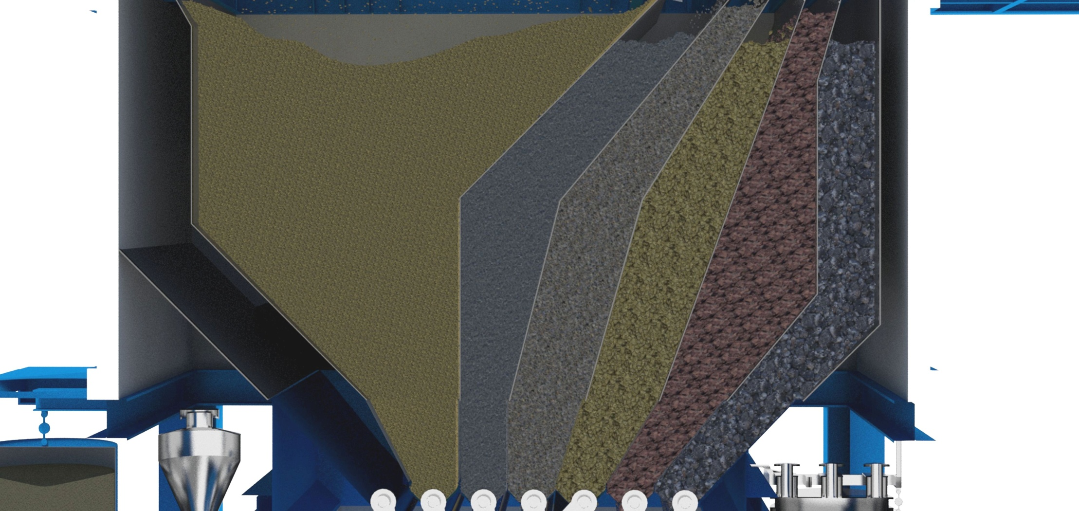
ECO - Mixing tower
Hot material silo

Slide 22
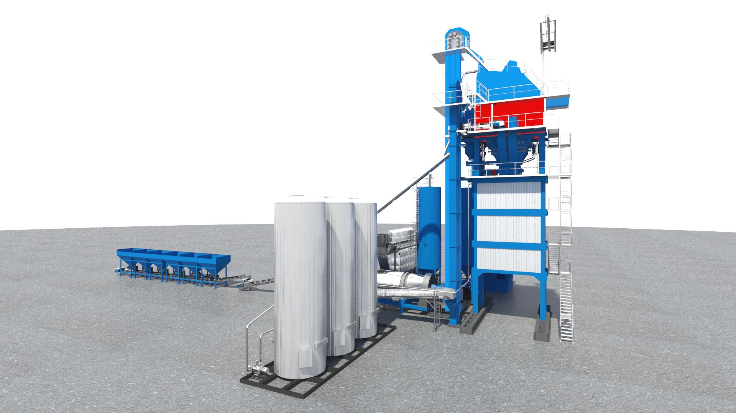
ECO - Hot Bin Section
Hot Bin Section

Slide 23
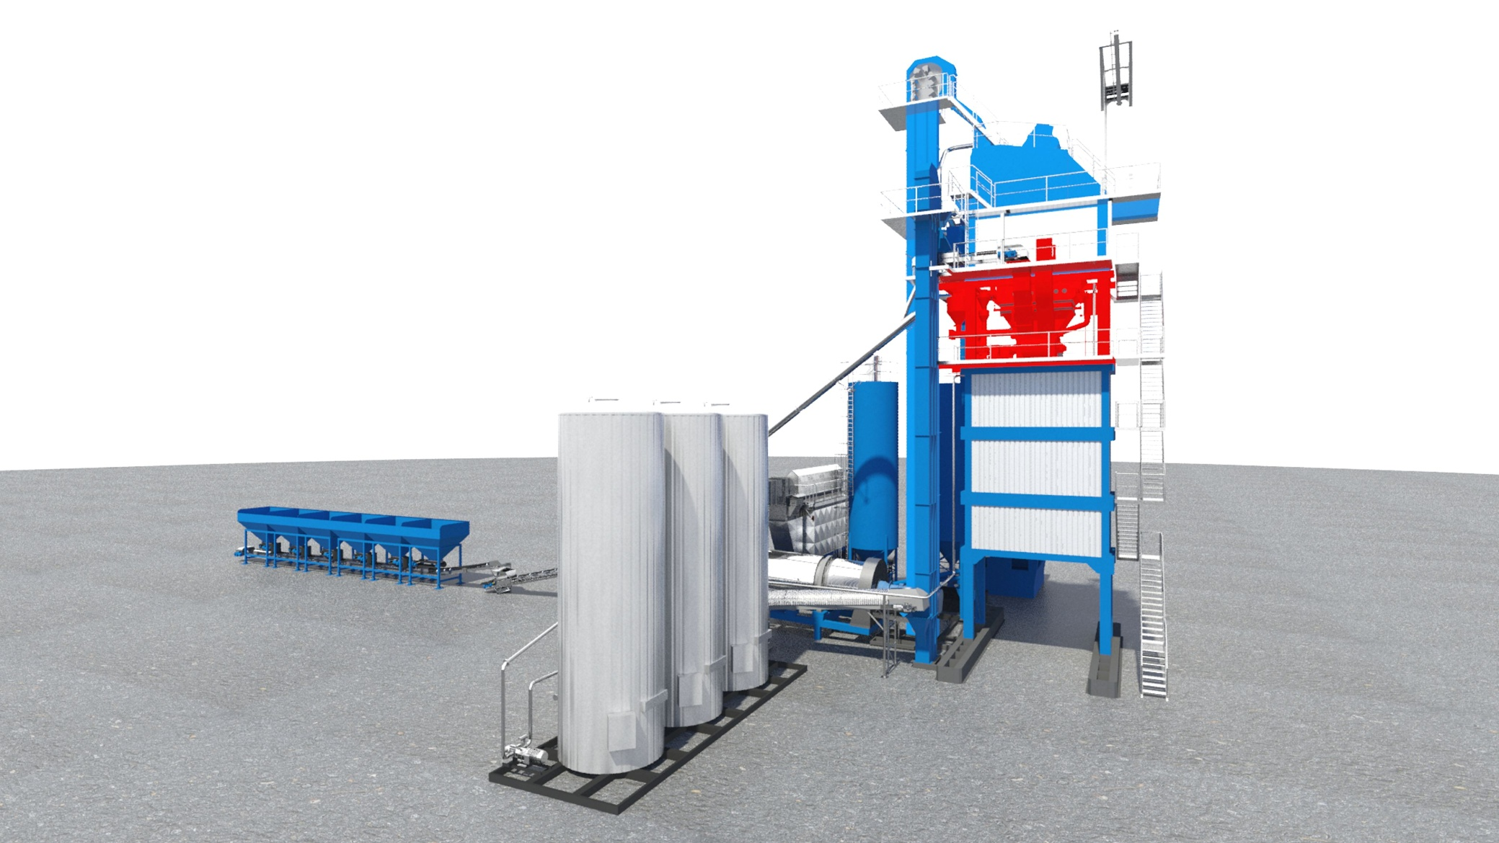
ECO - Mixing tower
Mixing- Weighing section

Slide 24
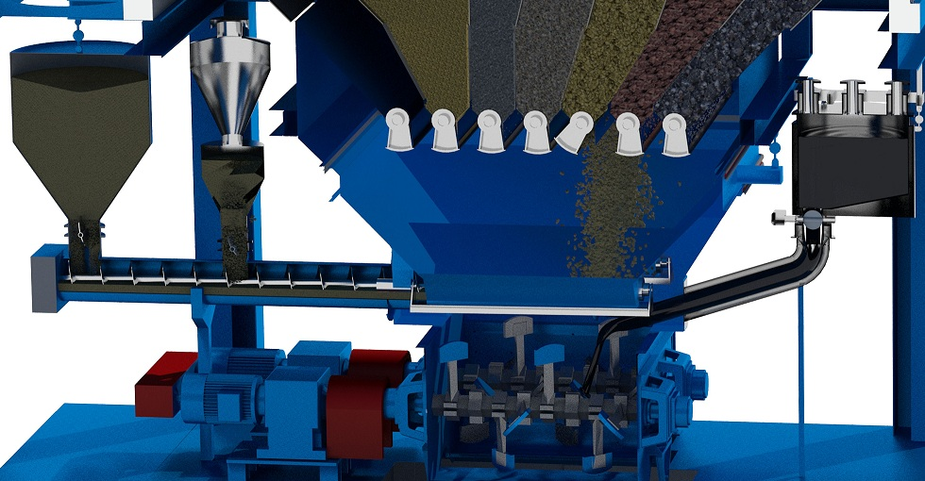
ECO - Mixing tower
Mixing section
  Mineral
  Mineral scale
  Bitumen scale
  Filler scale
  Dosing screw
  Mixer

Slide 25
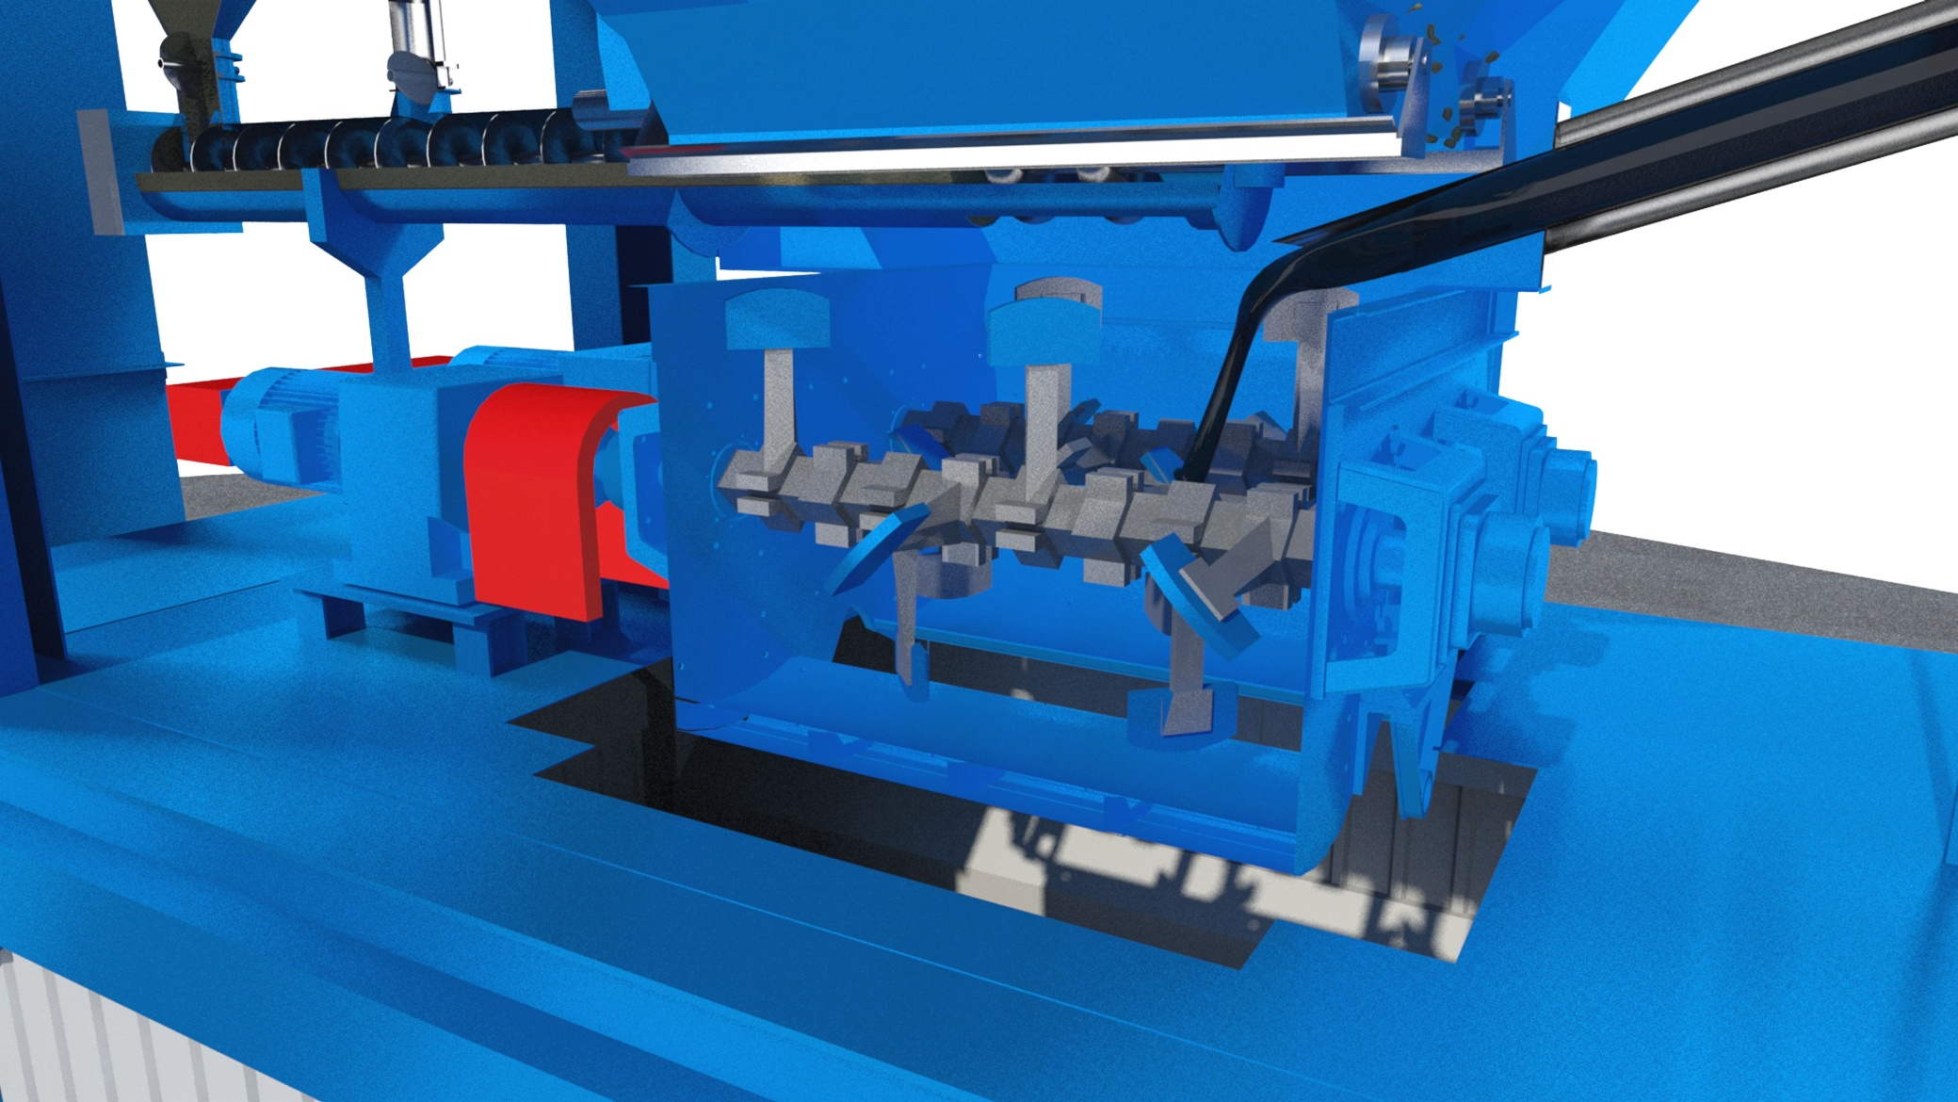
ECO - Mixing tower
Mixer

Slide 27
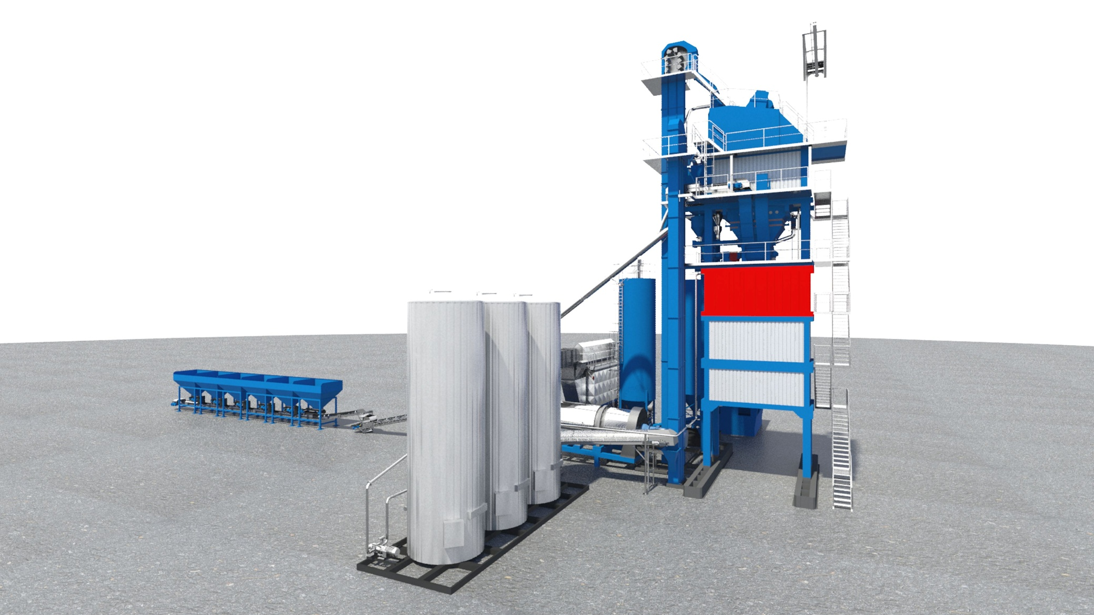
ECO – Mixed material loading silo
Skip

Slide 28
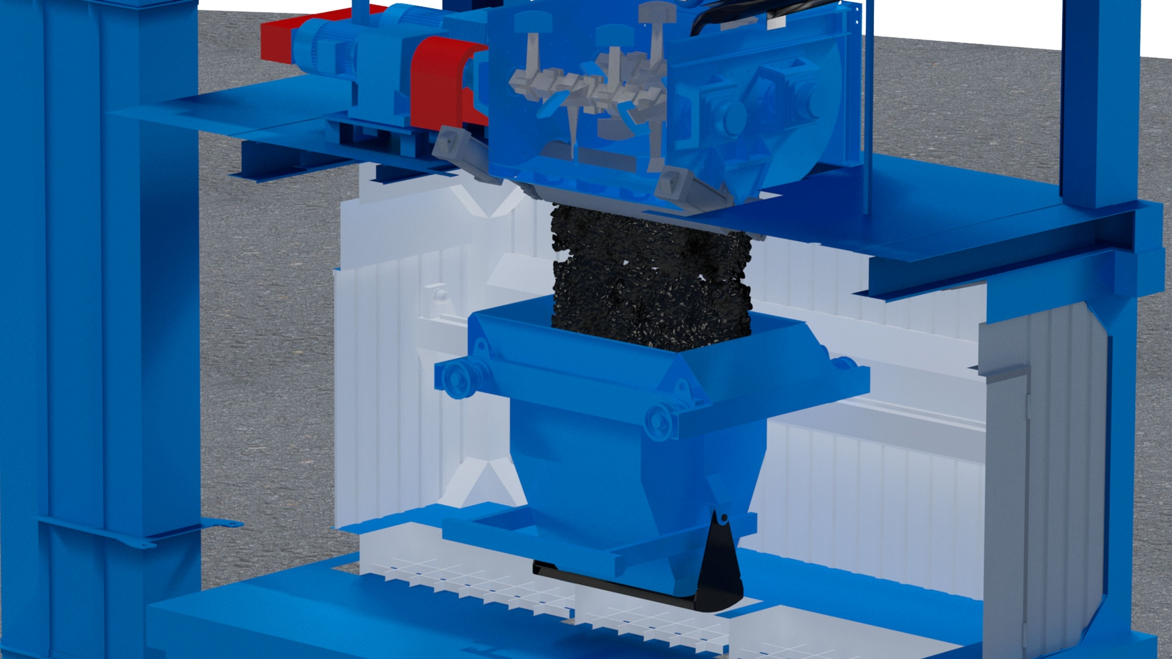
ECO – Mixed material loading silo
Skip

Slide 29
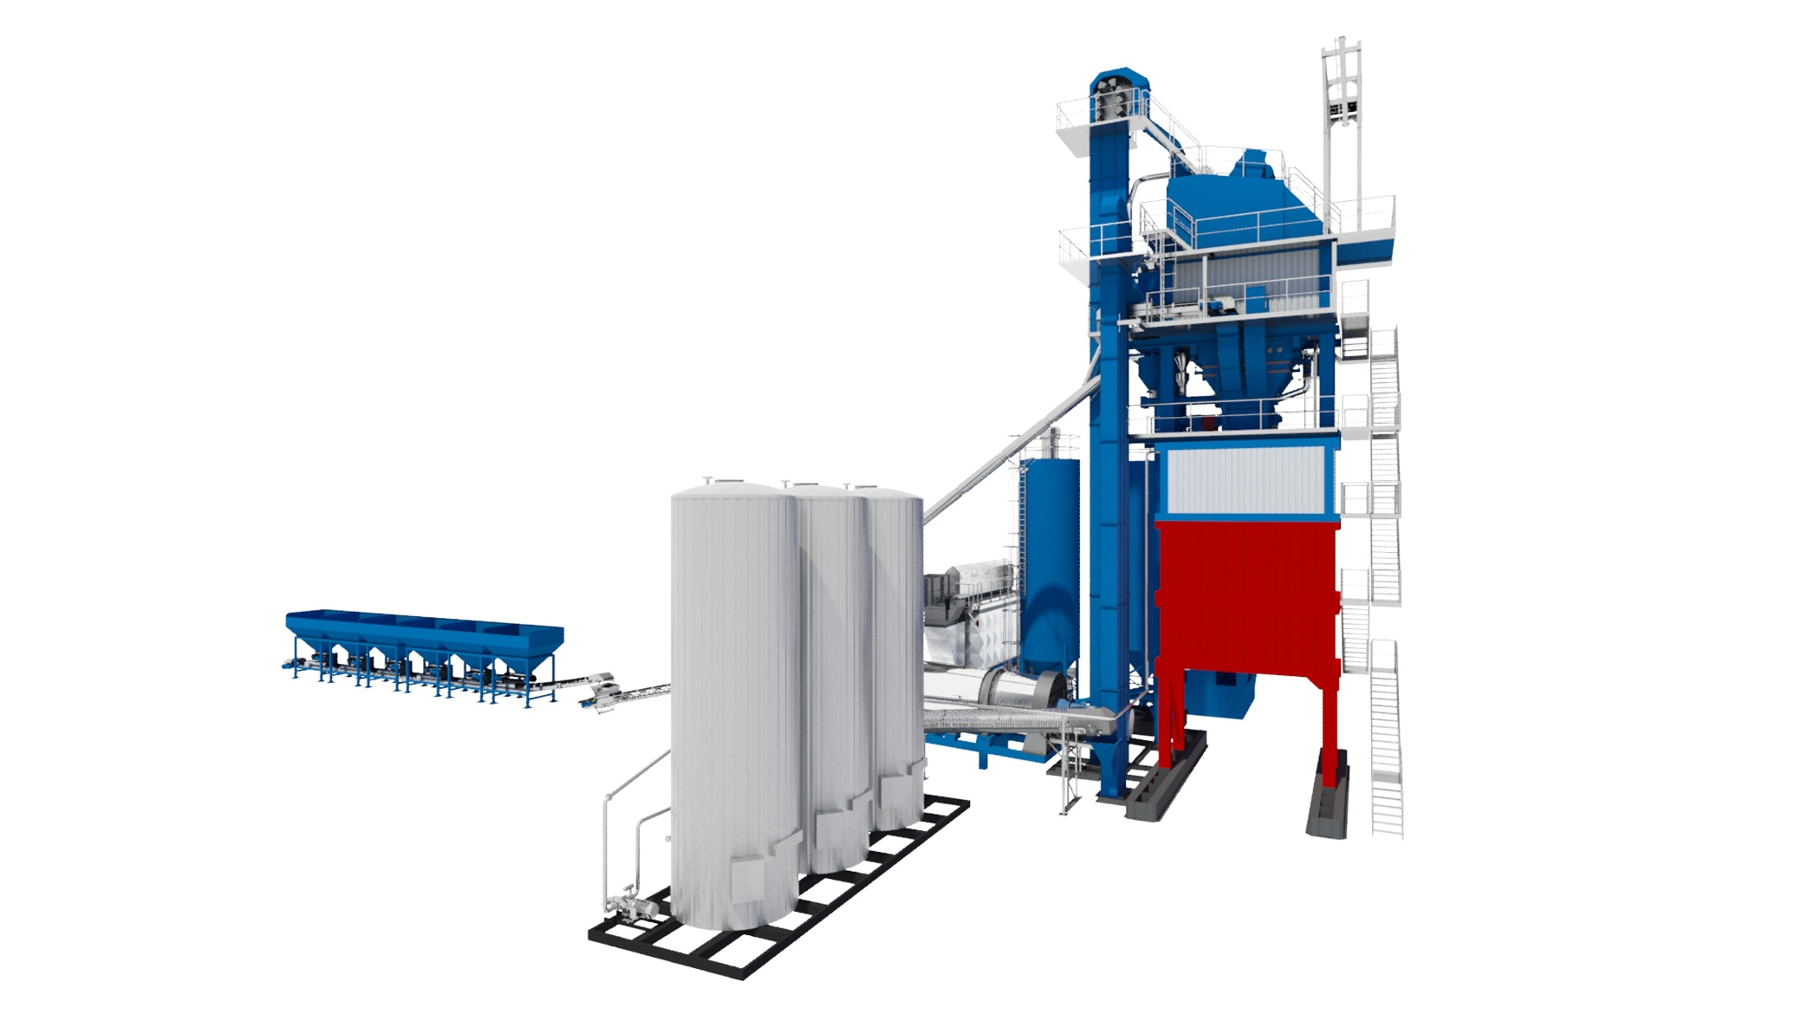
ECO – Mixed material loading silo
Mixed material loading silo with 2 Silos

Slide 30
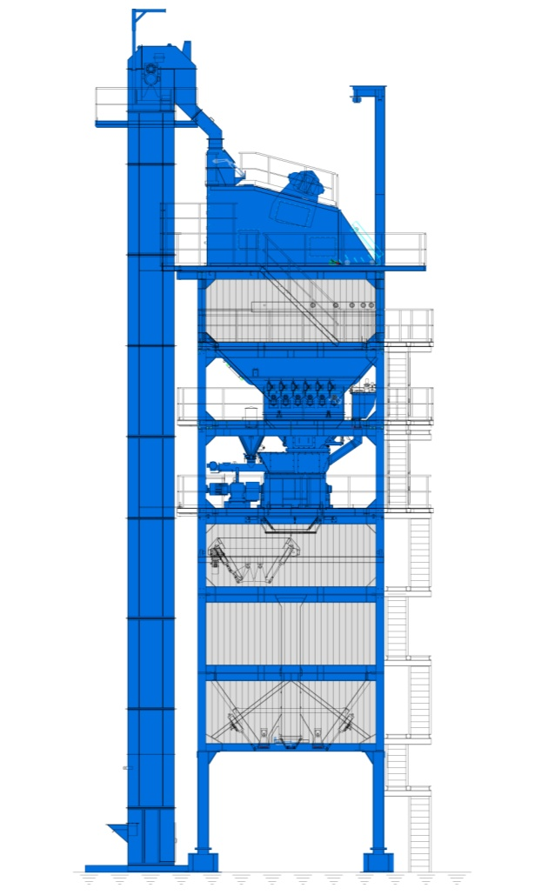
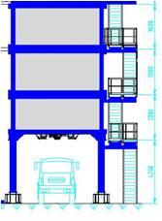
ECO - Mixed Material Silo
Mixed storage silo
  Mixed material silo underneath the mixing tower
  Mixed material silo
  Direct loading

Slide 31
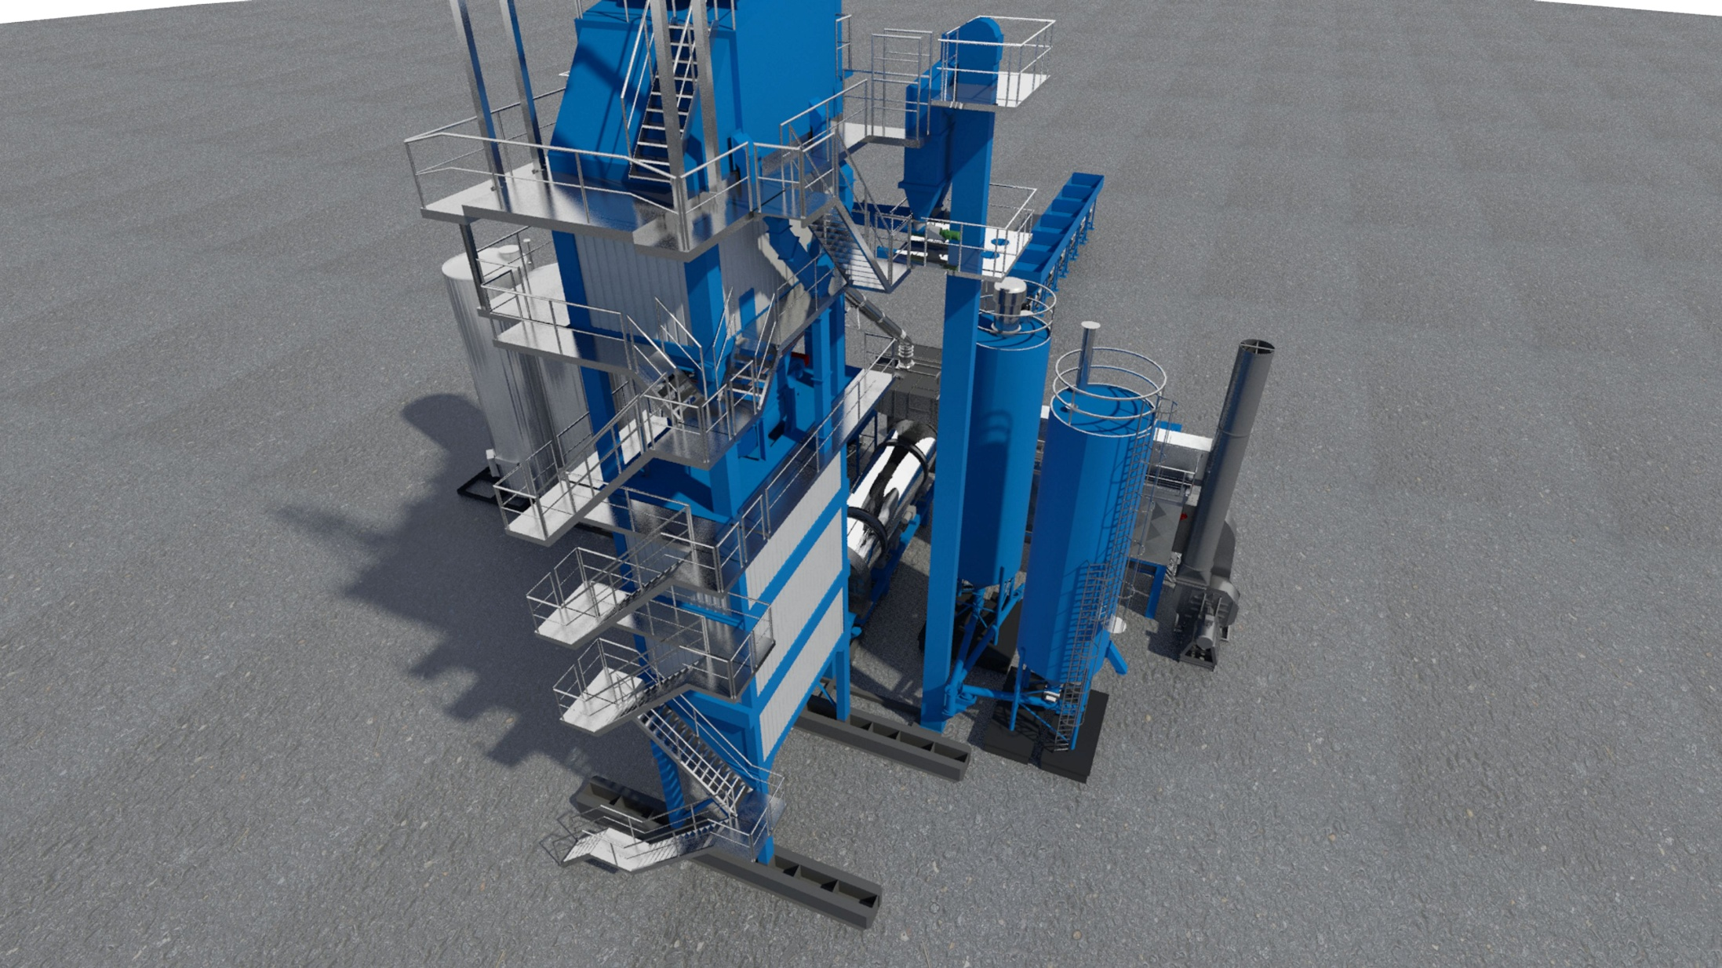
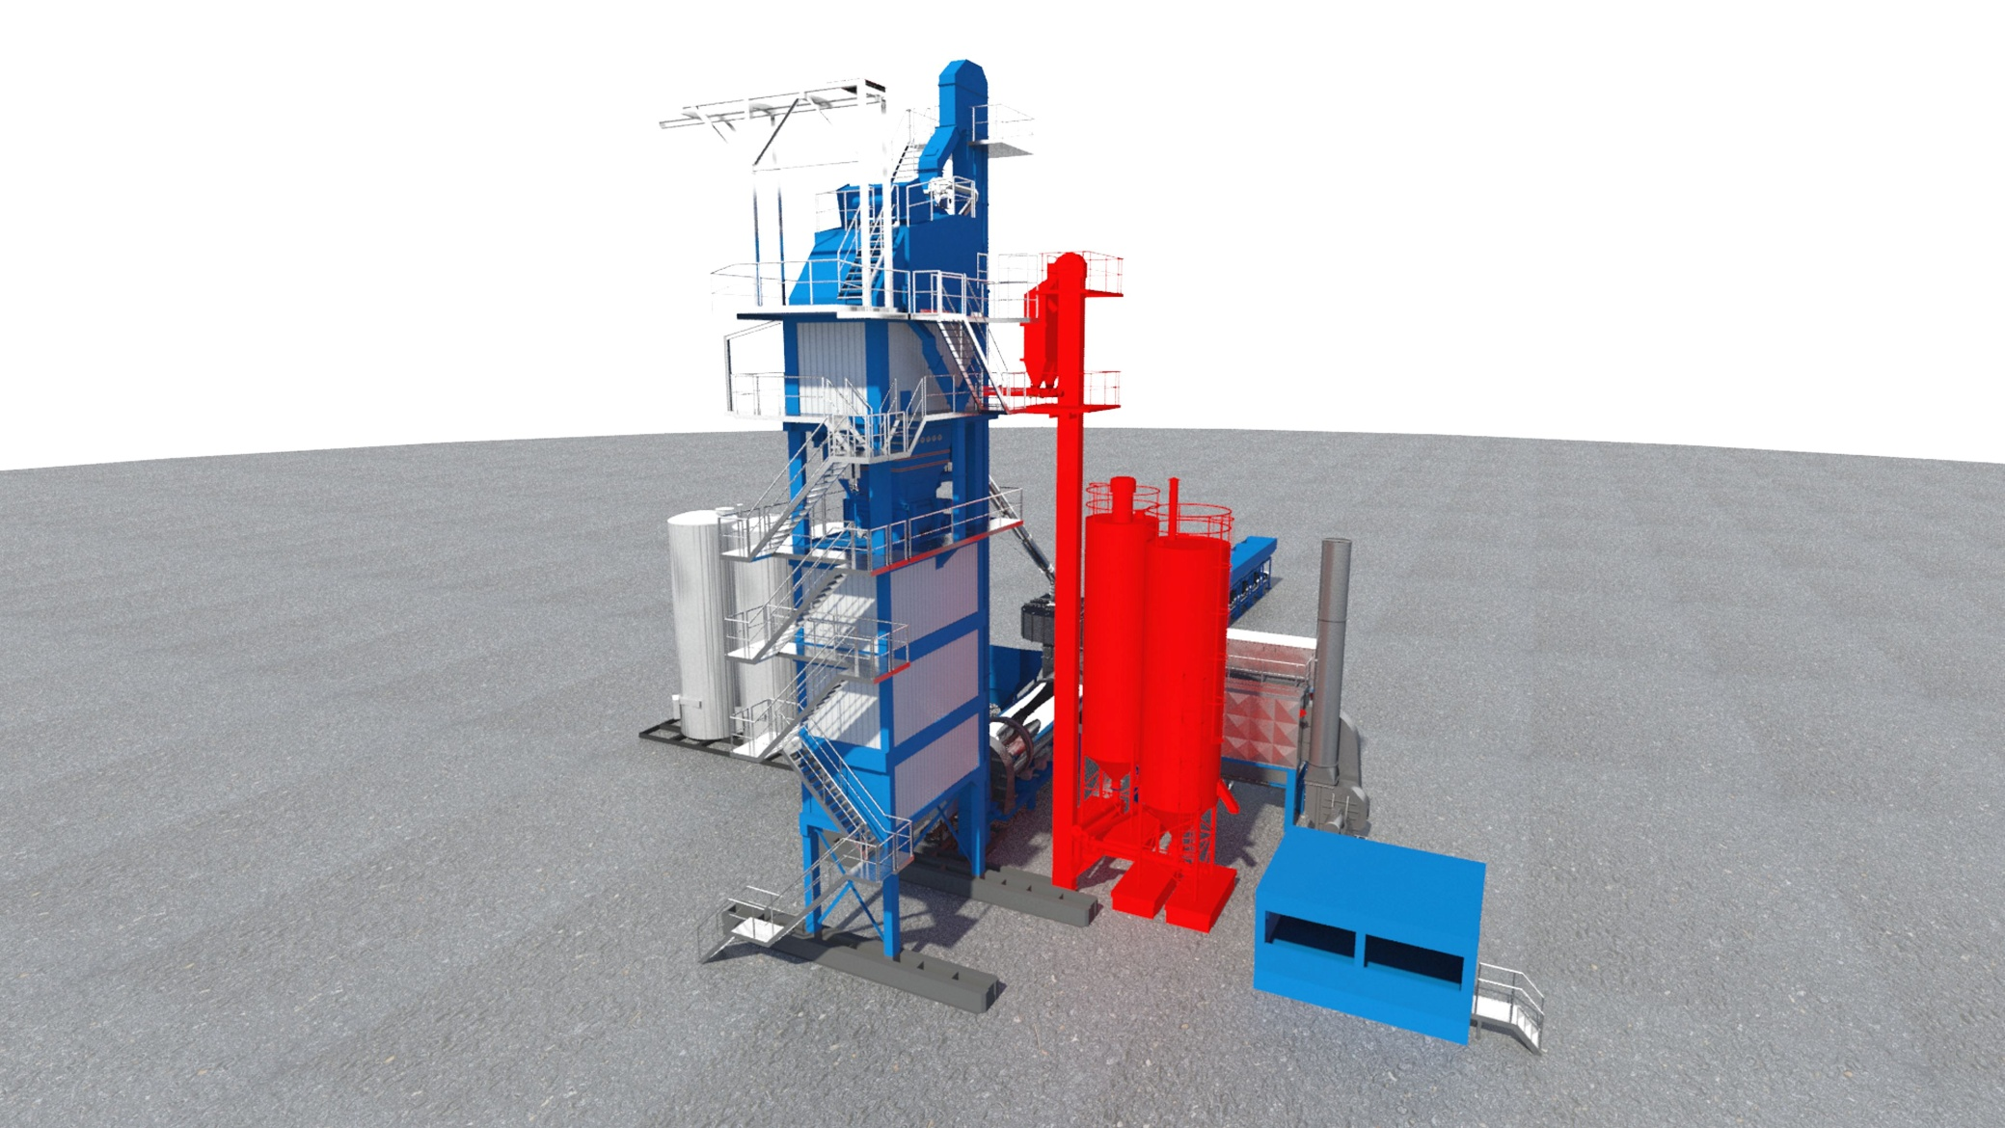
ECO - Filler System
Filler system
  importet filler - and reclaimed filler silo
  filler silos => 60m³
  With double filler elevator and buffer silos

Slide 32
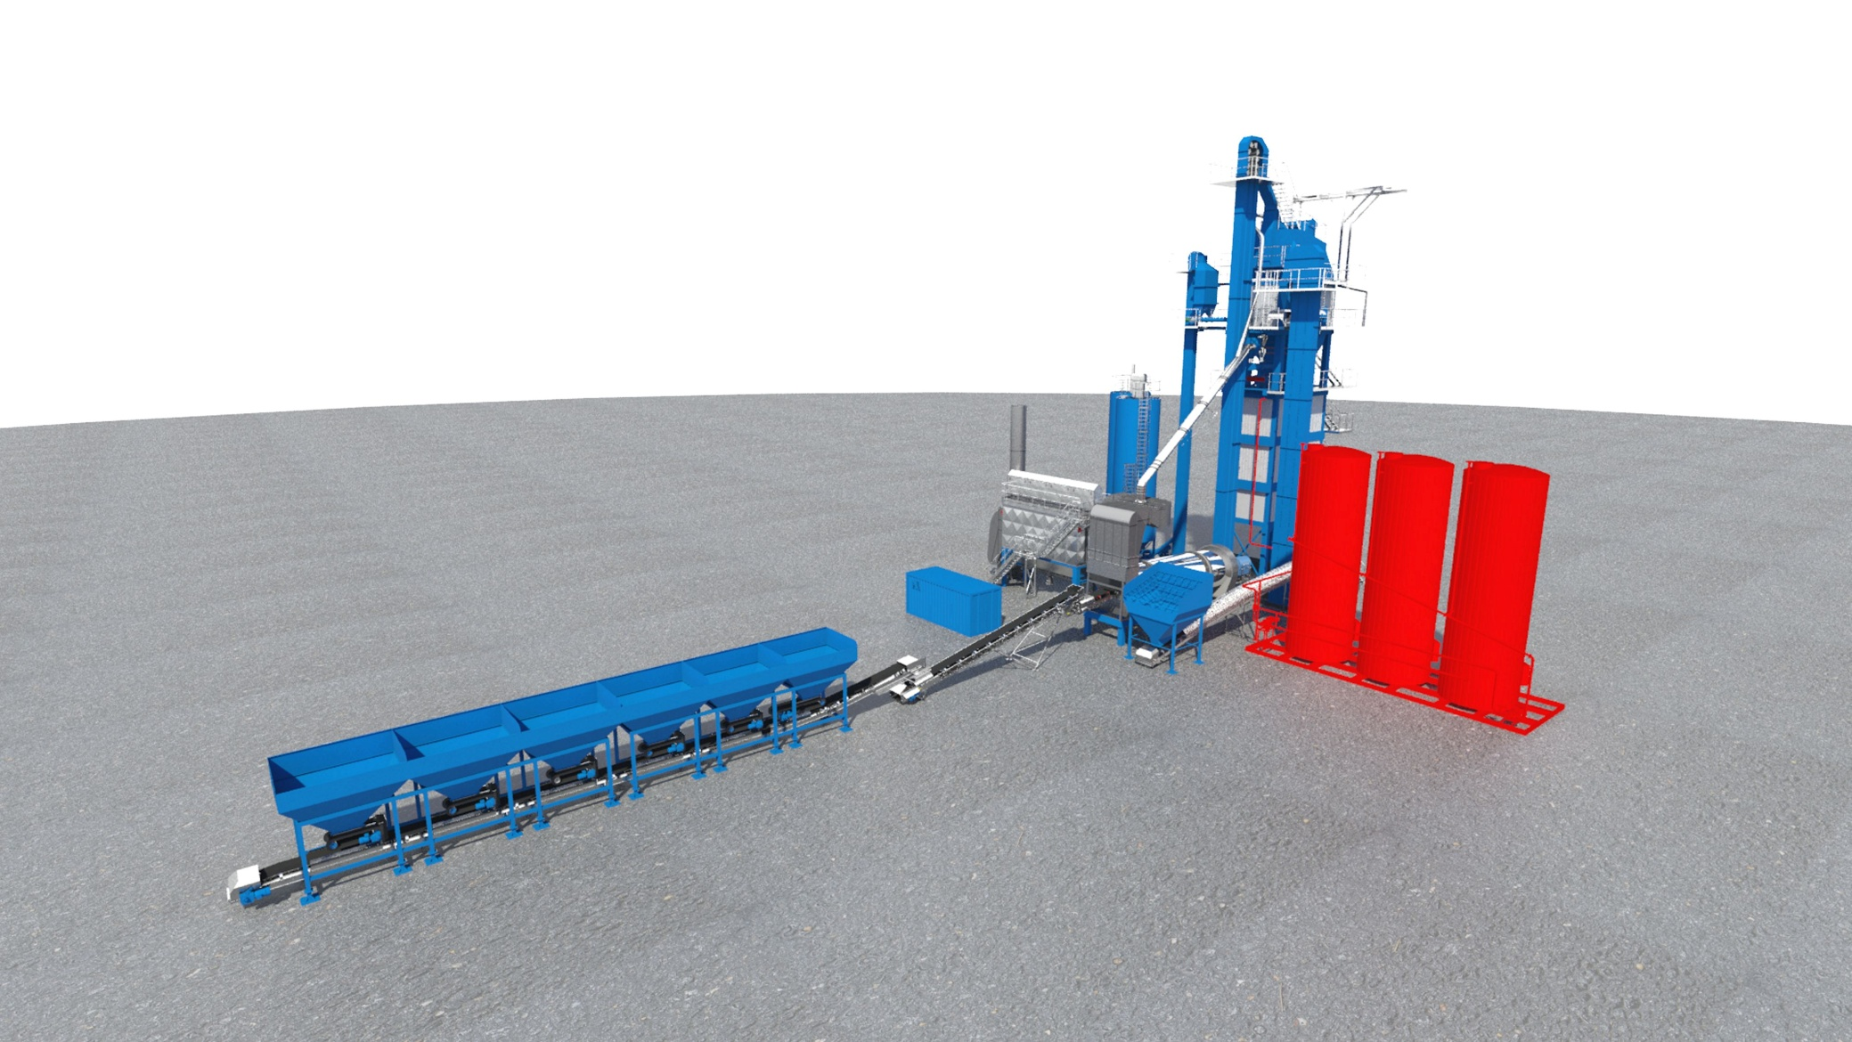
ECO – Bitumen tank system
Bitumen tank system

Slide 33
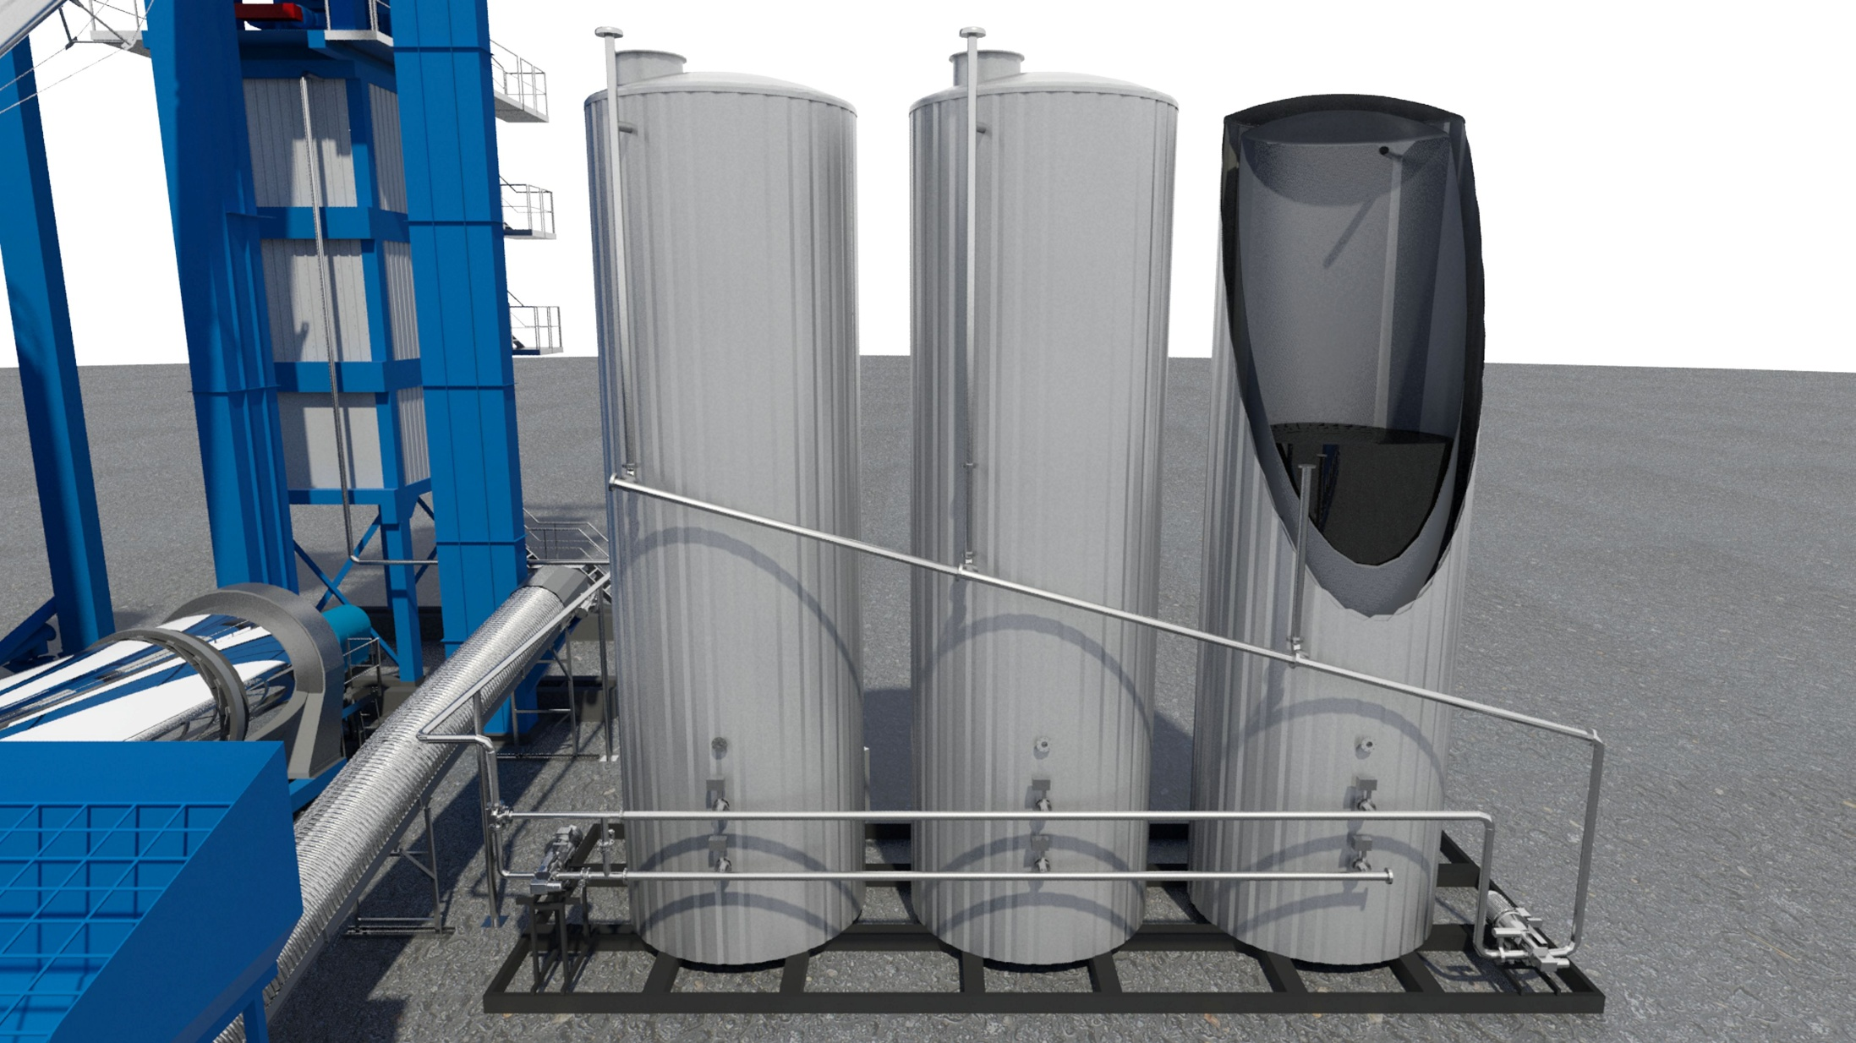
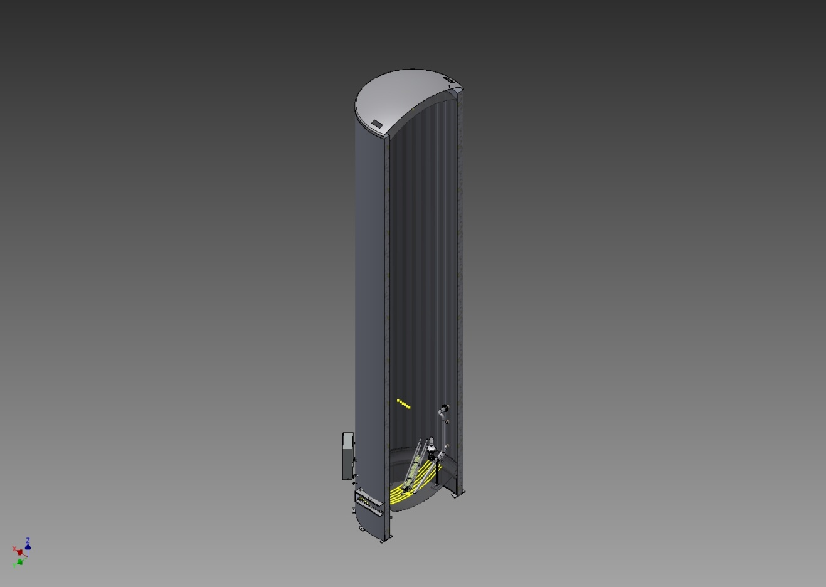
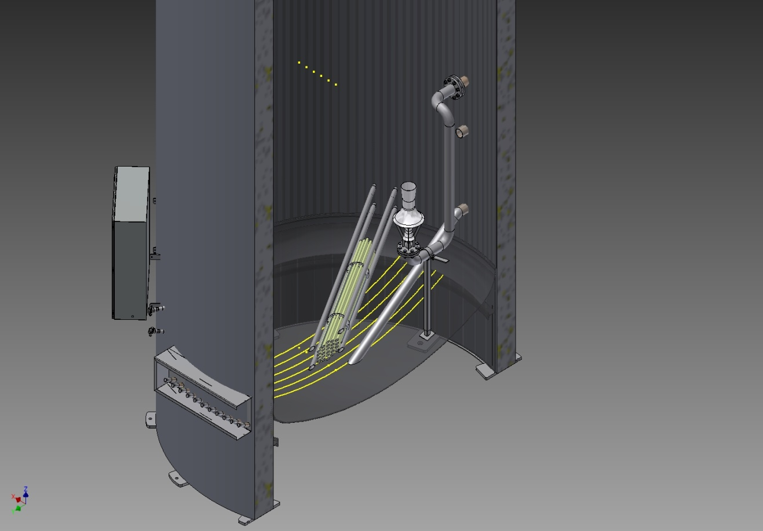
ECO – Bitumen tank system
Bitumen system
  Bitumen tanks 60m³
  Insulation 200mm
  Electric heated: floor heating 12x1kW heating coil 25kW

Slide 34
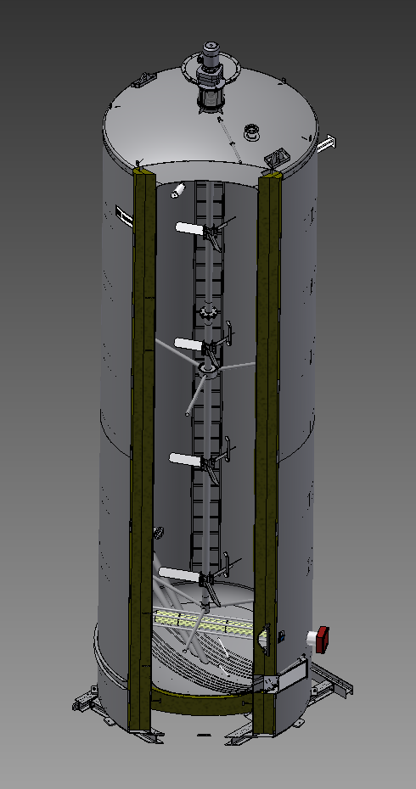
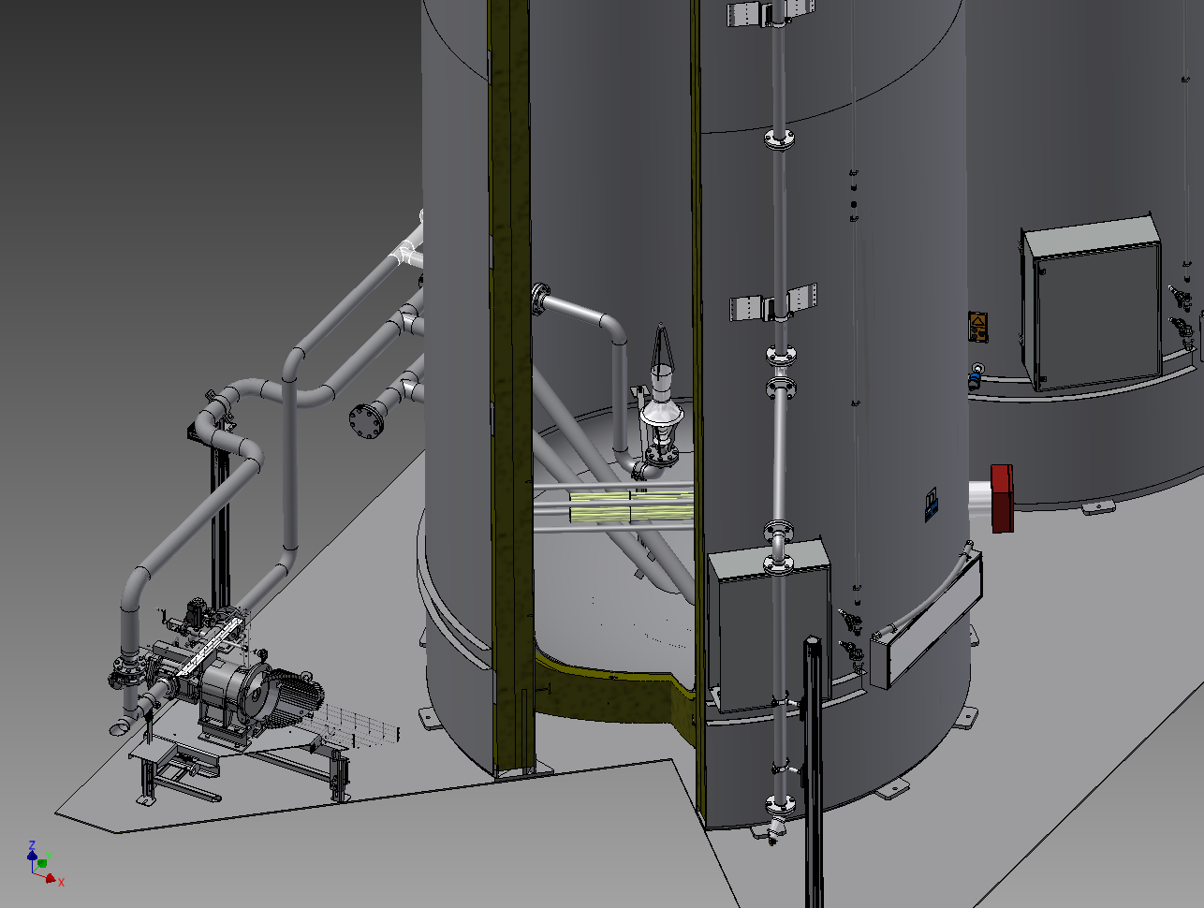
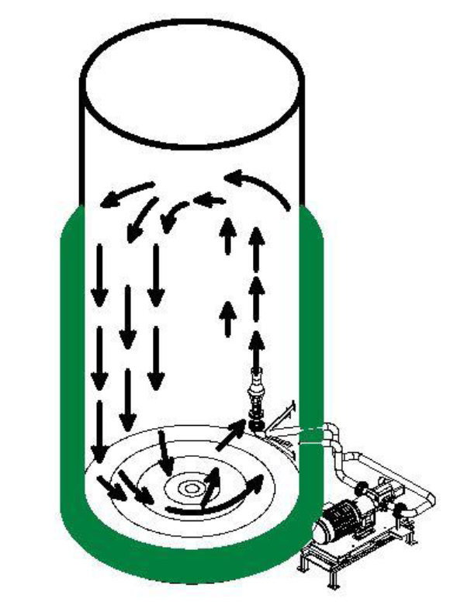
ECO – Bitumen tank system
Bitumen system
  Circulation via a agitator
  Circulation via a jet pump

Slide 35
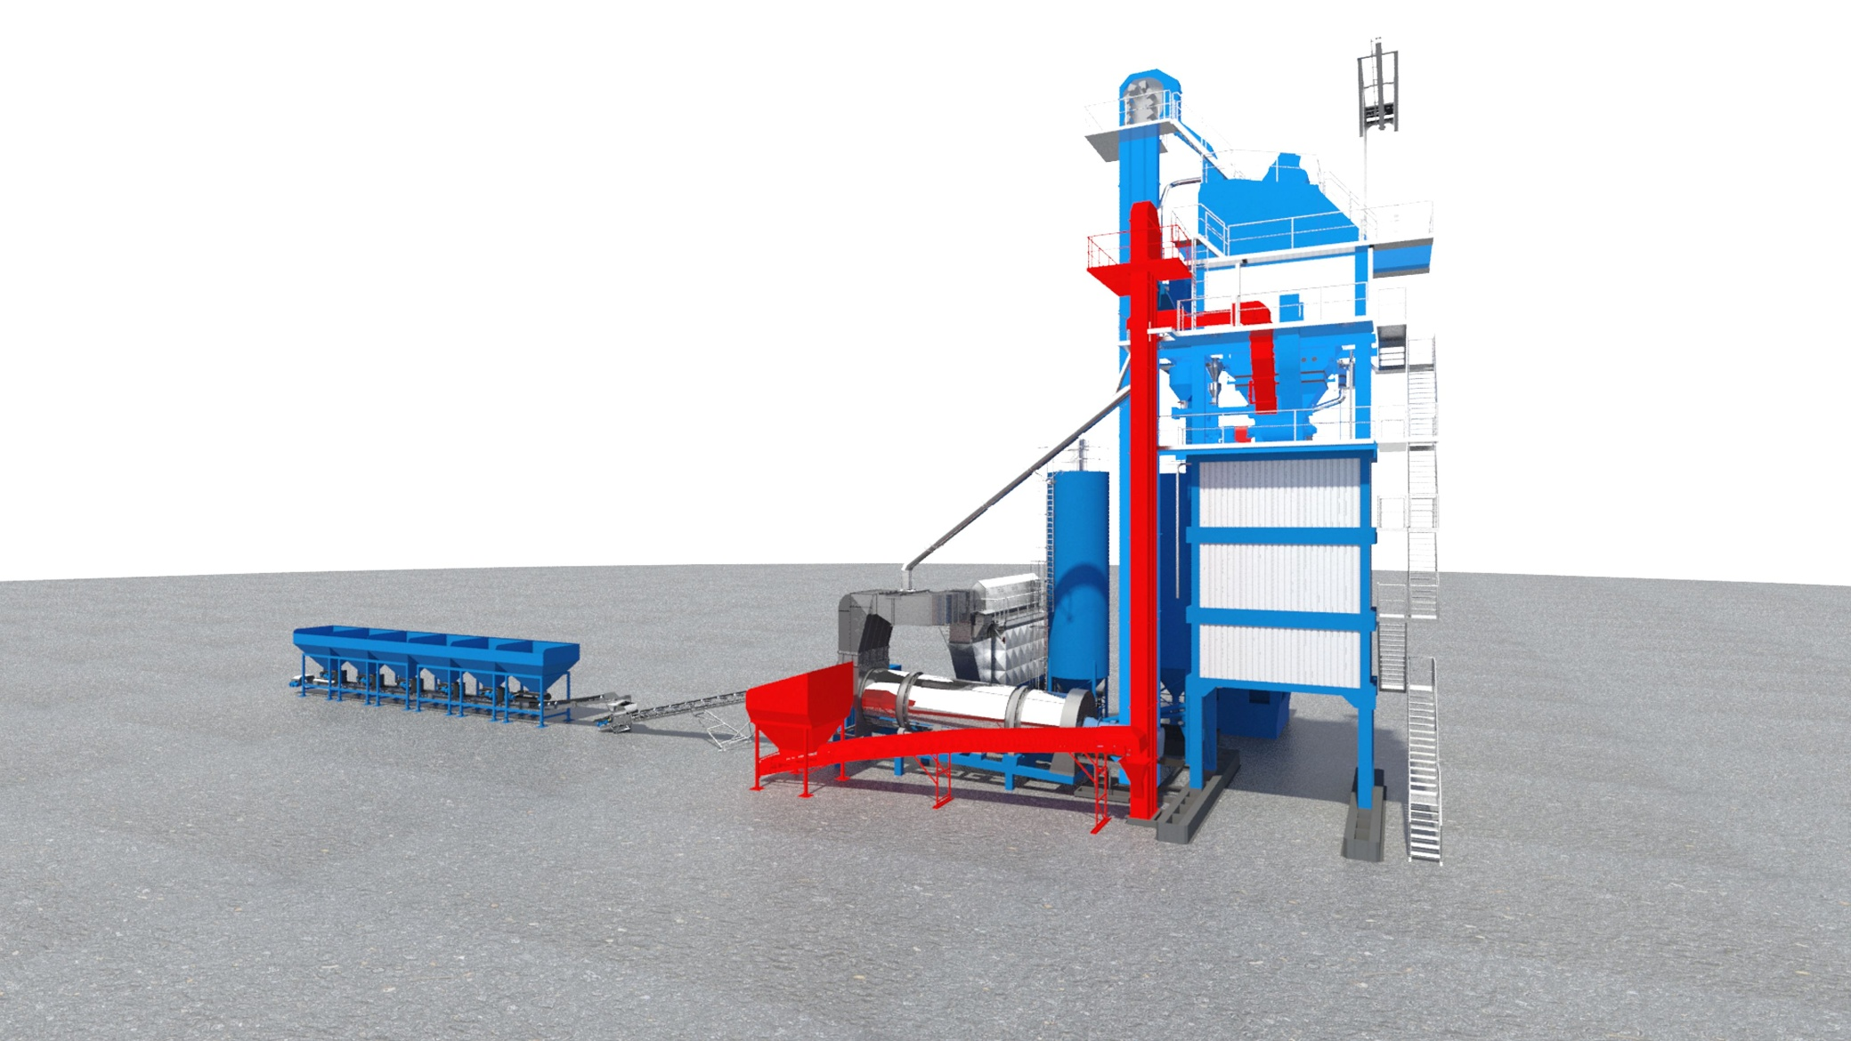
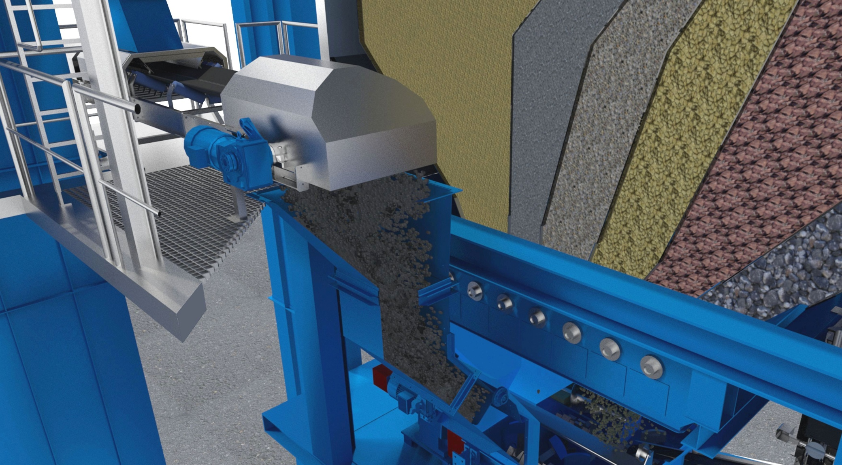
ECO - Cold RC System
Cold RC System
  RC-Doseur
  RC-Elevator
  Weighing belt
  Chute into the mixer
  Adding direct to the mixer

Slide 38
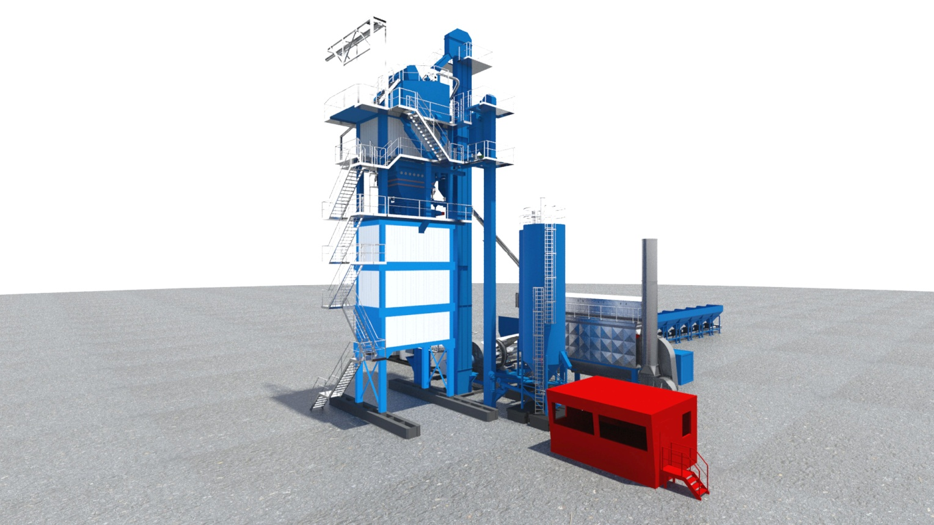
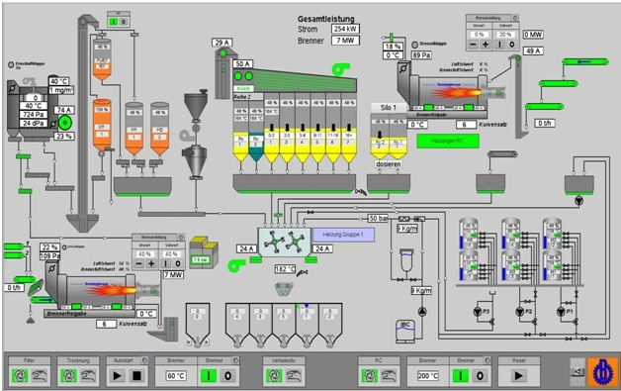
ECO - Plant control system
Controlling
  Control cabin
  Plant control system BLS3000

Slide 39
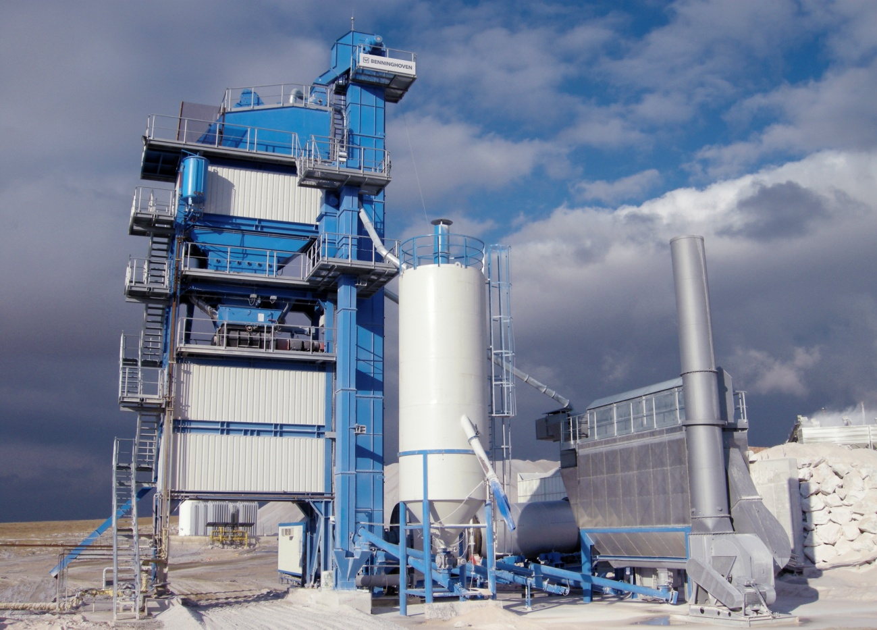
Semi Mobil Container Mixing Plant
Facts
  Aggregate moisture 4%
  Wind load m/s
  Horizontal gravity 0,4 m/s²
  Snow load 0,85 kN/m²

Slide 40
ECO - 2000: Process
Engineering
Semi Container Asphalt Mixing Plant

