Slide 1
Psychological Safety: how to recognise and foster it at work
Patricia Murray, Senior Org Psychologist/Inspector
23 April 2024

Slide 2
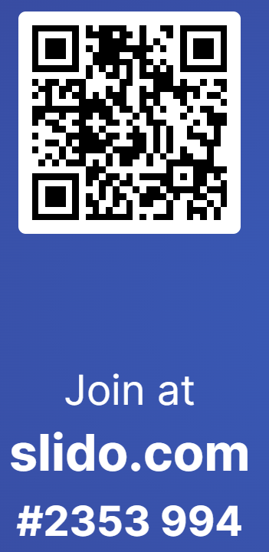
Webinar on Increasing Psychological Safety at Work

Slide 3
Outline of Session
Psychological Safety – evidence from research
Threat, psychological safety - and health
Stress: Brain, mind, and body connections
Threat as the cause of stress: influences perception
Threat, immediate and secondary response and behaviour
Prolonged exposure to unsafe psychological space
Focus on solutions: what you can do
Employer duties – safe and healthy work systems

Slide 4
Focus on you
To gain from session, commit to:
Think of you doing your job now
Reflect thoughts and feelings about you in non work settings
How you ARE is an amalgam of
your appearance to the world,
your relationship to the world at that time
your inner experience of the world, unfolding.
Goal of session for you?
Increased understanding of psychology, insights into you and others, .for improved performance of you for you….to improve your life, either at work or at home or both.
Notes:
We perform and contrive what we showcase. Our mood and feelings to the world alter depending on motivation, cues in the situation and sense of the environment. We are made up of past experiences and how they made us feel, both good and bad.

Slide 5
Psychologically unsafe: Threatened
A disturbing feeling-state (threat) that can last from minutes to months
Driving: the unforeseen sheep, the wet road, the emergency. Stop.
What occurs? (biological/physiological/feedback loop, cognition, emotion)
Primary effect of threat - directly felt
Secondary effects: other similar or related threat –> effects+ imagination/anticipatory effects*
Effects of once-off – critical incidents of traumatic typology
Effects of on-going, micro-stressors, ‘free-floating’
Context influences effects
Context is mediated by YOU….in your work process, team around you, other teams, organisation

Slide 6
Threat…. as we behave* it
Behavioural features associated with feeling threatened are:
High surveillance orientation – seeking cause
Perception of time alters (rushing)
Short cuts in how we operate/what we do
Errors in how we plan and think
Reduction in social emotional consciousness
Reduction in capacity to ‘be’ – see, think, hear, feel*
Notes:
Quote research findings 2-18-2024

Slide 7
Performance outcomes
Threat as distress ->hinders all performance, whenever, wherever.
Interference - sporadic or long lasting
Cue’d to a time/place/situation…..or generalized
Known to self - or unknown (consciousness degenerates)
Wrongly attributed - often to unrelated factors for PS reasons
Reduction in Psychological Safety-> lowered wellbeing state
Reduces capacity for enjoyment and fulfillment directly and indirectly
Notes:
One exception: Optimum stress exposure – challenge/stimulation zone

Slide 8
Assessment for PS: Work-related Stress*
Demands of the job – type of work, variety, levels of, hours of..
Control over the working environment – decision latitude, agency
Support from peers and managers/stakeholders – P Safety and trust in peers and leadership
Relationships – conciliatory or conflictual, trust, P Safety
Role – clear and unambiguous, non conflictual
Change – communication of change and ability to process and prepare
WorkPositiveCI: assesses the Work environment. www.workpositive,ie
Notes:
Explain oppositional linkages: 2 articles, findings and methods

Slide 9
Threat, Stress and Health
Psychosocial Hazards in environment -> ill-health outcomes
Cardiovascular issues (Lancet 2019)
Digestive disorders and long term medication dependency
Hyper tension of varying degrees and long term medication dependency
Depression and/or anxiety disorder
Secondary effects including eating disorders and drink/drug use
Unhealthy but sub clinical conflict-seeking anxiety related acts
Secondary relationship breakdown and difficulties

Slide 10
You
Understanding yourself and how your environment influences your feeling of being threatened or feeling safe
Edmondson on Psychological Safety
Models for developing PS
Models for sustaining it*

Slide 11
1 Minute reflection
Identify to yourself any behaviours you exhibit when stressed
What is the feeling behind them, do you think?
After this session:
Can you identify any of the major causes of work-related stress for your team?
Are they specific to
any specific day of the week
a repeating pattern - ie time of day
a piece of work or type of work
a way of working? (alone/in twos/in big groups etc)

Slide 12
What matters most for Psyche safety
Repeated prolonged exposure to threat
Seriously extreme one off threat
Threat which mirrors your personal circumstances
Little or no active supportive systems in place but minor threat
Support too distant or hard to access and minor random threat
Time pressures regarding case decision making
Lack of management role clarity and responsibility taking
No or low teamwork or collegiality
No relevant, meaningful tailored training for the tasks
No tertiary systems after-the-fact/reporting if things go wrong

Slide 13
Understanding what we know – risk factors
New employee and/or role
Experience at task
Context – time of day/day of week
Rushing/juggling
Culture of cover up/denial/dismissal is oppositional to Psyche Safety
Challenge of :
Hierarchical power misuse
Group think
Old habits die hard

Slide 14
Risk Assessment and Control Measures
A Model for oversight – a framework for your team
A method and rationale
A process and flow
Records and documents
Secure, meaningful work with supportive supervisors and colleagues can dramatically enhance health and safety, wellbeing and performance metrics and opportunities at work

Slide 15
Organisational processes: leadership focus:
Communicating – sharing information, compassion and empathy, listen. (Having regular forum to pass information, and comment)
Sense-making expectations influence sense-making by preferencing frames that make it more likely to see and experience what we expect to see and experience. (Reminders regarding unconscious processes and biased frames)
Facilitating learning –What are the shared protective factors n teams
Making decisions – gather information, seek advice, consult, deciding under duress is nto a good way to decide.
Coordinating working - whoever creates direction, alignment, and coordination ..to work toward a shared purpose or goal.
Systems and processes, formal and informal. (Fostering trust, small work hubs, role sharing)

Slide 16
You can help to set the scene
Put PS on the agenda
As a performance variable
Ask open ended questions of team
Listen to what is being said
Seek solutions with each iteration of query
Be prepared to…change!
Everyone should FEEL safe to behave more safely

Slide 17
Thanks you for listening
Questions and answers?
T: 0818 289 389
E: contactus@hsa.ie
W: www.hsa.ie

