Slide 1
Workplace Incident Statistics
Updated 31/01/2022

Slide 2
2021 Fatality Data

Slide 3
Economic sector |  | Fatalities
A-Agriculture, forestry and fishing | Crop and animal production, hunting and related service activities | 10
 | Forestry and logging | 1
 | Fishing and aquaculture | 0
B-Mining and quarrying |  | 0
C-Manufacturing |  | 5
D-Electricity; gas, steam and air conditioning supply |  | 0
E-Water supply, sewerage, waste management and remediation activities |  | 2
F-Construction |  | 10
G-Wholesale and retail trade; repair of motor vehicles and personal goods |  | 2
H-Transportation and storage |  | 6
I-Accommodation and food service activities |  | 0
J-Information and communication |  | 0
K-Financial and insurance activities |  | 0
L-Real estate activities |  | 0
M-Professional, scientific and technical activities |  | 0
N-Administrative and support service activities |  | 0
O-Public administration and defence; compulsory social security |  | 0
P-Education |  | 1
Q-Human health and social work activities |  | 0
R-Arts, entertainment and recreation |  | 1
S-Other service activities |  | 0
Total |  | 38

Slide 4
2021 Breakdown

Slide 5
2021: Ag, Forestry & Fishing

Slide 6
2021: Construction

Slide 7
2021: Transport & Storage

Slide 8
2021: Manufacturing

Slide 9
2021: Incident Location
Industrial site | 10
Area for storage, loading / unloading | 4
Production area, factory, workshop | 4
Maintenance area, repair workshop | 1
Other industrial area | 1
Farm | 10
Construction site | 7
Public Road | 4
Road Traffic Accident | 3
Other | 1
Service Area | 3
Shop/Sales Area | 1
Teaching Establishment | 1
Other service area | 1
Private house | 2
Sports Facility | 1
Quarry | 1
Total | 38

Slide 10
2017 - 2021 Workplace Incidents

Slide 11
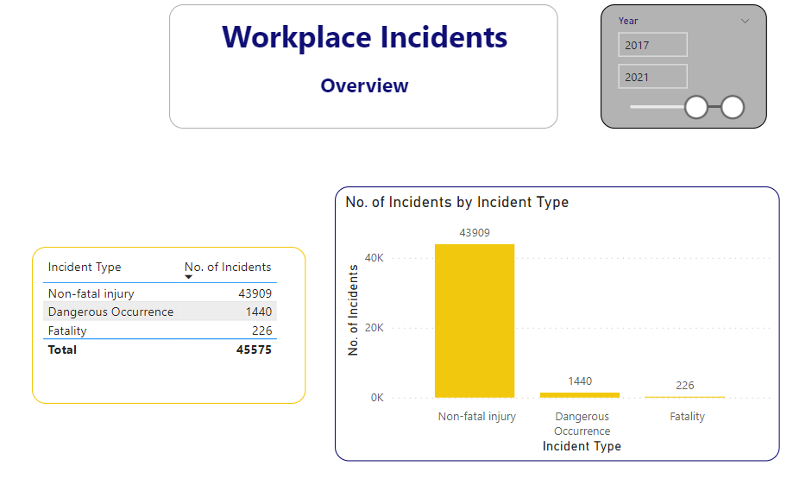
Workplace Incidents: Last 5 Years

Slide 12
2017 - 2021 Fatal Incidents

Slide 13
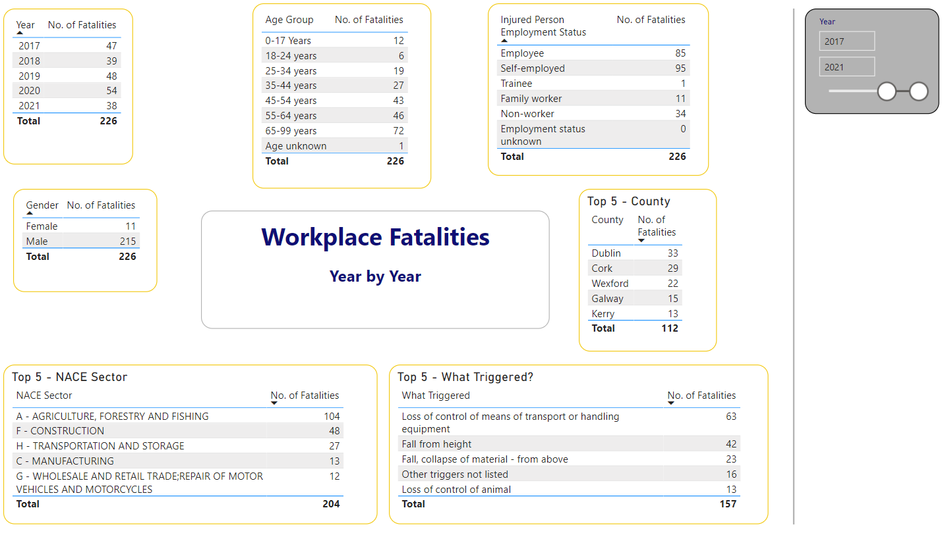
Workplace Fatalities: Last 5 Years

Slide 14
2017 - 2021 Non-Fatal Incidents

Slide 15
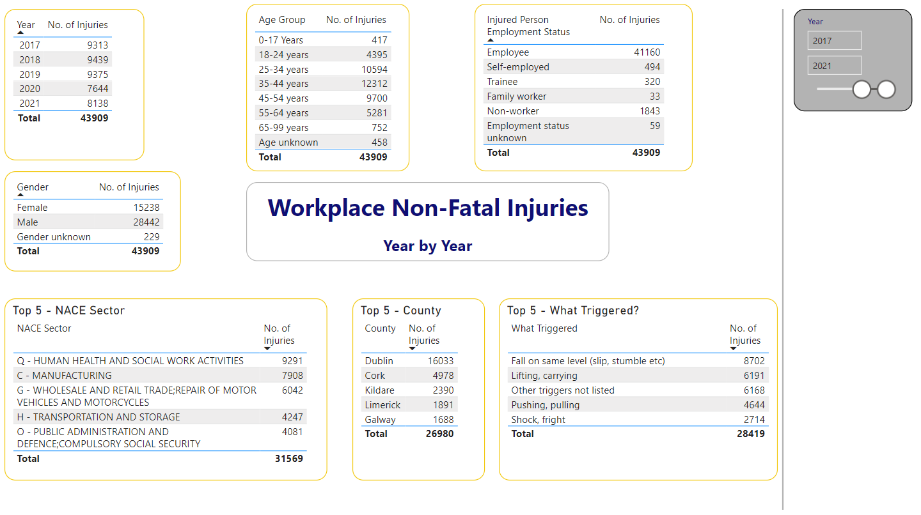
Non-Fatal Incidents: Last 5 Years

Slide 16
2017 - 2021 Dangerous Occurrences

Slide 17
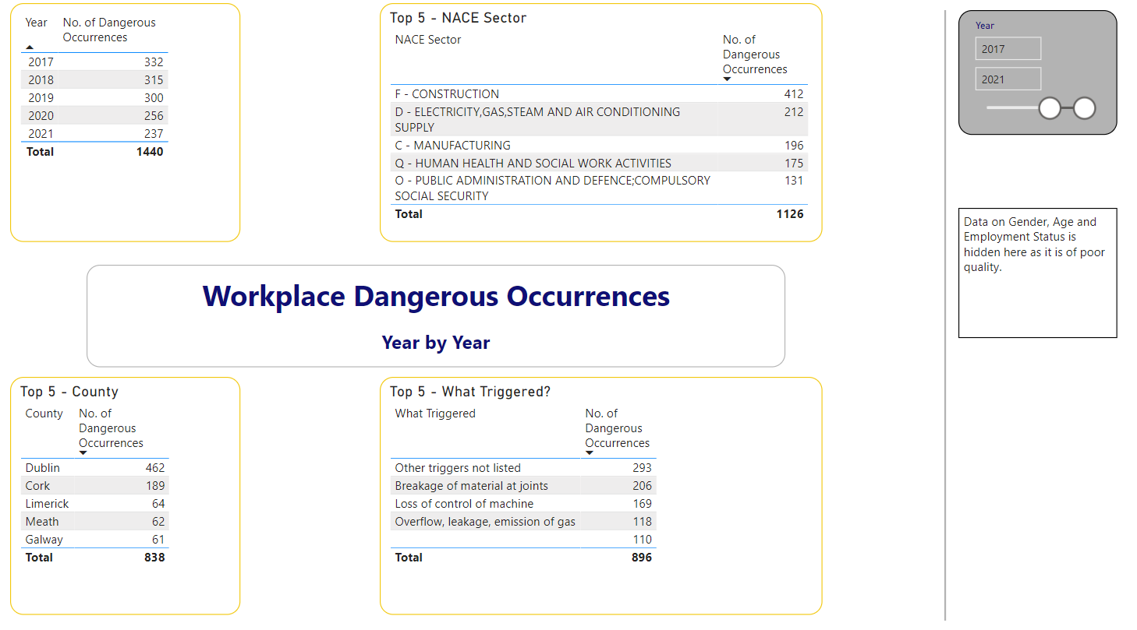
Dangerous Occurrences: Last 5 Years

