Slide 1
Accreditation of Biobanks according to ISO20387
April 2021
Welcome

Slide 2
Introductions
Bríd Burke
Scheme Manager for laboratory accreditation in INAB
Senior Assessment Manager

Slide 3
The purpose of today
Introduction to INAB and accreditation for potential users and stakeholders.
The accreditation process
Approach to preparation for accreditation.

Slide 4
Speakers today
Ms Emma Snapes
A biobanking consultant, Emma Snapes, has over 20 years of experience in creation and management of biological and data collections for different species, including microbial, plant and human, within clinical academia, semi-state and industry environs. An award winning expert in ISO biobanking standard development, Emma is Irish head of delegation to ISO TC 276 WG2 responsible for the publication of ISO20387 and other biobanking standards.
Mr Seán Naughton
Seán Naughton is a Specialist Medical Scientist with the Galway Blood and Tissue Establishment. He has an extensive background in the collection, testing, processing and storage of substances of human origin for human use. Seán is an INAB assessor for the 15189 scheme for medical laboratories, an adjunct lecturer in the College of Medicine,
Nursing and Health Sciences in NUI Galway.

Slide 5
Agenda for today:
Introduction to INAB and accreditation - Bríd
ISO20387 implementation for accreditation- Emma
Where do we start? – Seán
The process of accreditation - Bríd
Q&A – Joanne Coyle (INAB Assessment Manager)

Slide 6
Points to note
Timing for the day
Questions can be submitted through the Q&A panel. Please avoid questions relating to specific cases or individual examples. If you know the person best suited to answer your question, please include the name in the question.
This webinar is being recorded
Attendance is representative of a variety of Biobanking applications (Human, Animal, Plant , Viral and others)

Slide 7
Accreditation structure in Ireland
Department of Business, Enterprise and Innovation
Health and Safety Authority
INAB executive
(Staff 16 )
INAB Board
(External, Decision Making)
INAB is designated as the sole accreditation body for Ireland by DBEI,
as per EU 765/2008

Slide 8
What is accreditation?
Accreditation is the formal attestation of the competence of an organisation to carry out specific tasks according to a harmonised standard.
Independent 3rd party peer assessment
INAB
European Co-operation for accreditation
International Laboratory Accreditation Co-operation.
Accredited once,
accepted everywhere.

Slide 9
Other reasons to become accredited
Assurance of competence of an organisation
Logo or Mark used for marketing purposes.
Implementation of regulations / directives
Removes barriers to trade
Voluntary versus mandatory.

Slide 10
Important to note
Accreditation does not guarantee that every output meets requirements.
It assures competence of the people and system.

Slide 11
Accreditation of Biobanking according to ISO20387
New scheme for INAB from April 2021
New scheme worldwide

Slide 12
Other considerations
The Biobank shall be a legal entity that is legally responsible for all its activities. (section 5)
Legal framework in Ireland as defined by competent authorities.

Slide 13
Scope of accreditation

Slide 14
ISO 20387 Implementation for Accreditation
Emma Snapes BSc. MSc.
BioConsulting

Slide 15
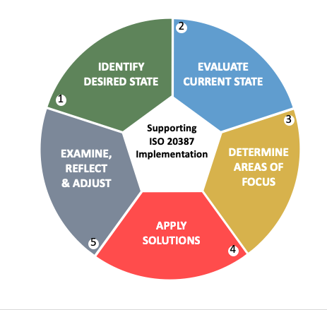
Approaching Implementation
Notes:
I thought that it might be beneficial to consider a how a biobank can approach implementation of ISO 20387, General requirements for biobanking. I thought I’d put myself in the place of someone with a biobank interested in doing exactly this.
Initial steps would include a move to identify what the desired state for your biobank might look like. This could differ hugely from biobank to biobank depending upon on sector or domain of operation, resources available and the biobank’s current mission.
Possible desired states include implementation of whole or in part of the standard to satisfy driving stakeholders. New biobanks could use the standard to address requirements as they arise, and experienced biobanks will at least already have a framework of quality elements upon which to address biobanking specific requirements and related competencies. However, only by addressing all requirements of ISO20387 (complete implementation), can a biobank demonstrate conformity to the standard and move to be assessed for accreditation.
I would look to carefully evaluate my biobank’s current state (2) and use the delta bwteen the desired and current states in order to determine my areas of focus (step3). This is the time to set goals or targets related to standard. These goals should be relevant to my biobank. They weill need to be realistic for my biobank AND they should also align with my biobanks business goals. A resulting implementation plan can then be formulated to address the areas of focus and apply solutions (steps 4) (to bridge the gaps) meeting the requirements and preferentially the recommendations where applicable).
(Step 5 ) I would include a system of monitoring to accompany implementation. Allowing sufficient time and systems to examine, reflect and adjust accordingly will help manage effectively risk during the implementation process.
I will go through each of the steps in more detail but I wished to draw your attention to the fact that ISO 20387 does not exist alone.

Slide 16
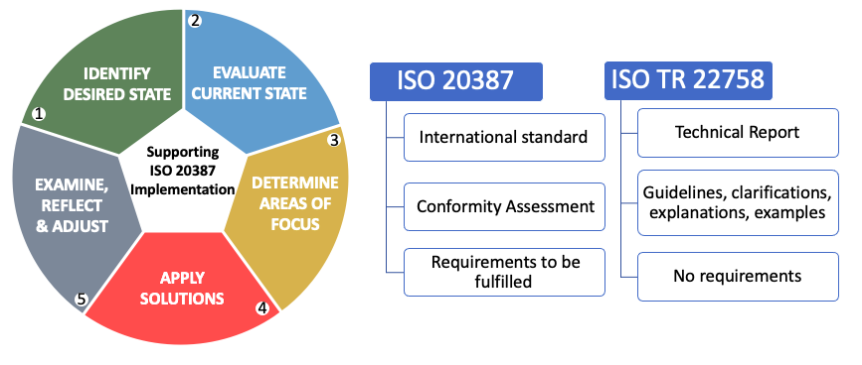
A Guide to Implementation
Notes:
What can help me implement the standard?
Due to the newness of the standard and in recognition of the potential complexity of application across very different species - domains, a technical report – ISO 22758 was written and was published last year to help clarify some elements of the standard.
ISO 20387 is the international standard and a biobank needs to conform to the requirements detailed therein to move to conformity assessment. ISO TR 22758 is a report WIHTOUT requirements. It provides guidelines clarifications explanation nd example to help interpret some of the standard. It simply acts as an aid for implementation of ISO20387 requirements.
Both documents are equally applicable to newly established and existing biobanks.
Conformity assessment of a product or system to a given standard often involves inspection, testing and certification. International Standard ISO/IEC defines conformity assessment as a “demonstration that speciﬁed requirements relating to a product, process, system, person or body are fulﬁlled.”

Slide 17
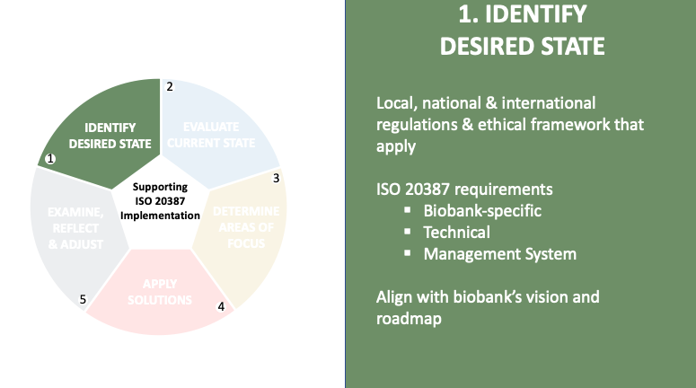
Notes:
Retuning to implementation diagram, Of critical importance to the identification of the desired state, is the constant vigilance that is required to remain in line with the obligations that exist for a biobank: these include local/ regional, national and international regulations such as GDPR among many others, and ethical framework
Many of these can be consider Living documents with updates, changes and amendments created in response to different technologies, and societal changes. A biobank’s legal & ethical framework will form the core structure for the biobank operations. It is worth noting that such regulations and obligations are not included within standards as standards are voluntary.
ISO 20387, as a conformity assessment enabling standard, can be described as having three interdependent and interlinked types of requirements – biobank-specific requirements, technical requirements (often referred to as competence), and Management System Requirements (specifically a Quality Management System). By addressing this trinity of requirements of ISO20387 (complete implementation), a biobank can demonstrate conformity to the standard and move to be assessed for accreditation. Combined implementation of all three elements can result in increased robustness and confidence in biobanking operations and in the resultant biobanking output.
It is possible of course to consider incremental implementation, where a biobank moves to address requirements in a stepwise manner in order to fit with resource availability.
The desired state will need to be aligned to the biobank’s vision & business roadmap to be considered realistic.

Slide 18
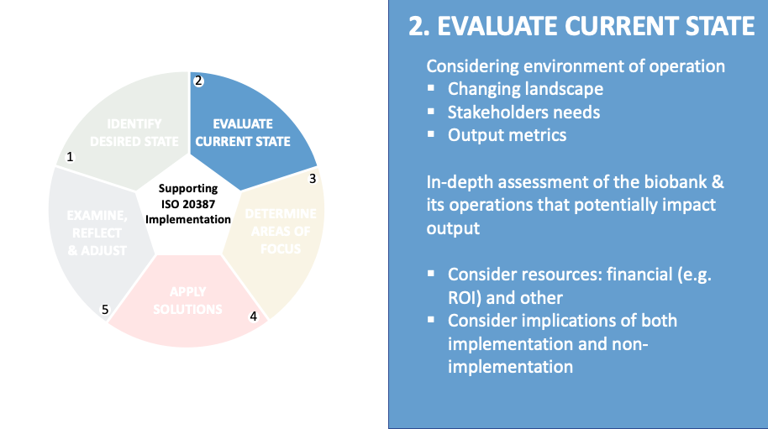
Notes:
It can useful to evaluate my biobank’s current state with respect to its needs and mission but also to what is happening globally. Over the past year or more, we have seen unprecedented global changes which have transformed the landscape in which organizations operate.
Despite the fact that biobanking is a critical cog in research and development, there are limited metrics available to biobanks to help demonstrate a commitment to quality, metrological traceability and interoperability. It can be useful to look for new opportunities to inspire confidence for those stakeholders who most need this. The voice of the patient can become increasingly lost in the years between consultation, consent, collection and final use if in fact their BMaD is used at all.
The biobank can undertake a in depth assessment of its operation, examine all the biological material and associated data (BMaD) collections and determine how contributing processes & activities involved impact on key indicators e.g., FIP & its demonstration
Resources: both financial and non-financial resources. commitment of personnel is also something that should be secured –with a cultural mindset change most capable of supporting a commitment to the process (may apply more to no. 4)
Behaviour will be influenced by the standard’s requirements and recommendations, and their shared values will become one of the driving forces of the organization as it moves forward.

Slide 19
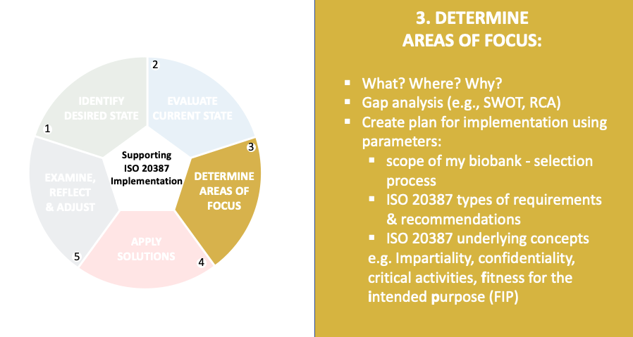
Notes:
Having evaluated both the desired and current states, I am now in a good position to ascertain what to focus on.
ISO22758 “A gap analysis of a biobank’s current practice against the standard requirements can be beneficial,
There are a number of methodologies that can be used for gap analysis, I have provided a couple of examples here, A SWOT analysis is a compilation of your company's strengths, weaknesses, opportunities and threats . A simple tool but can be effective when its used to its full potential. It helps build on what is done well, to address what is lacking, to minimize or mitigate risks, and to take the best possible advantage of chances for success.
Root Cause Analysis is a collective term that describes a wide range of approaches, tools, and techniques that can be used to uncover causes of problems. These and other gap analysis tools can be used to let me know what the gaps are, where they exist and hopefully why are they present:
Such a gap analysis can lead to a plan for implementation of requirements.” (also mentioned in ISO20387).
As for any project, my biobank needs to be aware of the parameters or the defining limits for this plan and
Brid has already explained the biobank will need to define a scope in order create the parameters of operation for implementation. This where the focus for implementation need to be applied
Having examined the current state my biobank is prepared to name the collection (ie BMaD) or collections to focus on and the gap analysis provides the areas for improvement.
It can be performed on different levels
A strategic level – comparing the condition of your business with that of the industry (environment)
Operational level – comparing the current state of your business performance with the state you desire

Slide 20
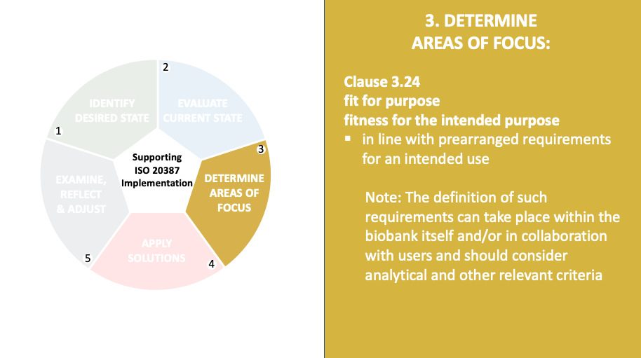
Notes:
Clause 3.24 of ISO 20387 provides a definition and useful note to explain a central underlying concept : fit for purpose or fitness for the intended purpose: in line with prearranged requirements
The ability to deliver of FIP and its demonstration is dependant on a number of factors, such as the biobanking infrastructure itself, the resources (both personnel and others), processes and the knowledge available.
Remember, the goal is FIP (not QMS or a tool

Slide 21
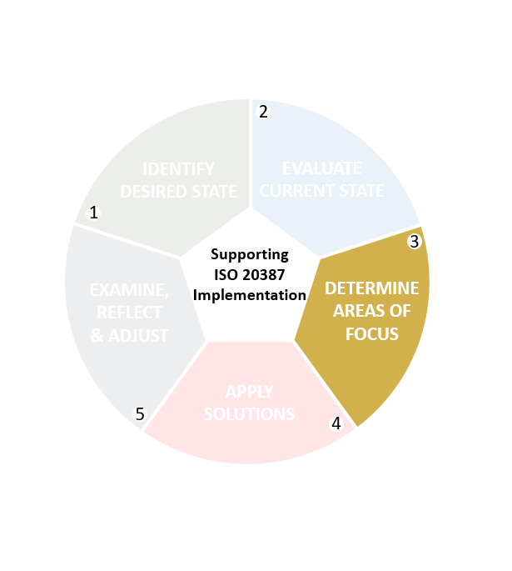



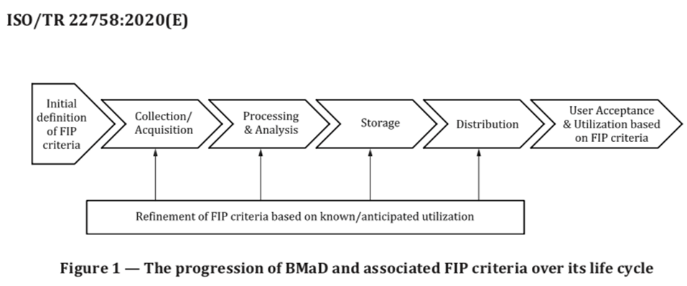
Notes:
Some of the criteria that may be appropriate for consideration are listed here.
And should include predefined obligations, as well as a combination of user defined and biobank advised specifications.
Requirement of FIP for each BMaD need to be considered and initially established first at biobank project design phase but also these need attention throughout various stages of biobanking, particularly where an activity/process can impact on FIP. Figure 1 of the implementation guideline ISO22758 traces the progression of BMaD and the potential for continual revisions of the definition of FIP. During all steps, relevant documentation will be maintained.
While Figure 1 is reresented as a linear progression, stages can be repeated, skipped, or ordered differently within your biobank. The customization of BMaD and its intended end-use can be further supported by continual refinement related to FIP by both the biobank and the user
And where a user is not yet identified FIP can pertain the projected range of intended end-use where a user has not yet been identified). This might involve deploying of biobank resources in the best way to to achieve fitness for purpose for the majority set of uses or even for the primary use
System

Slide 22
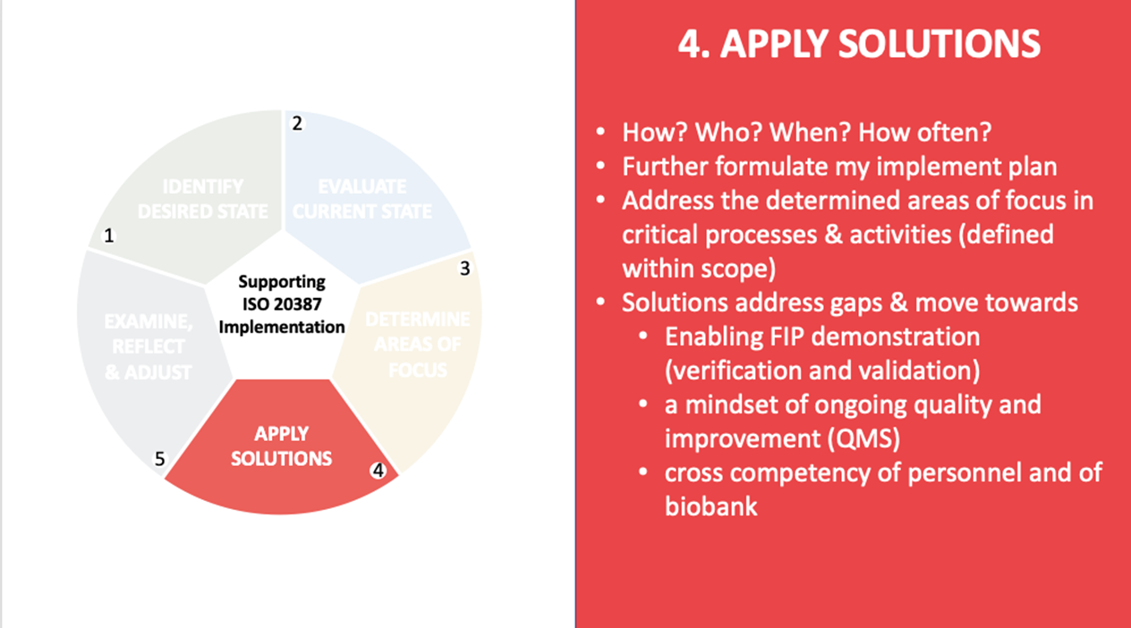
Notes:
This is the time to determine Roles, Responsibilities, and Relationships (or communication platforms)
Once implementation is adopted, effective communication will allow personnel to understand the strategy and their particular role in how it will be performed.
So that ownership on the part of the “implementers” is a real feature for the biobank personnel nurturing a mindset of ongoing quality and improvement
“trust but verify” feedback both from verification and validation processes and directly from personnel implementing the goals is fundamental to the demonstration of conformance.

Slide 23
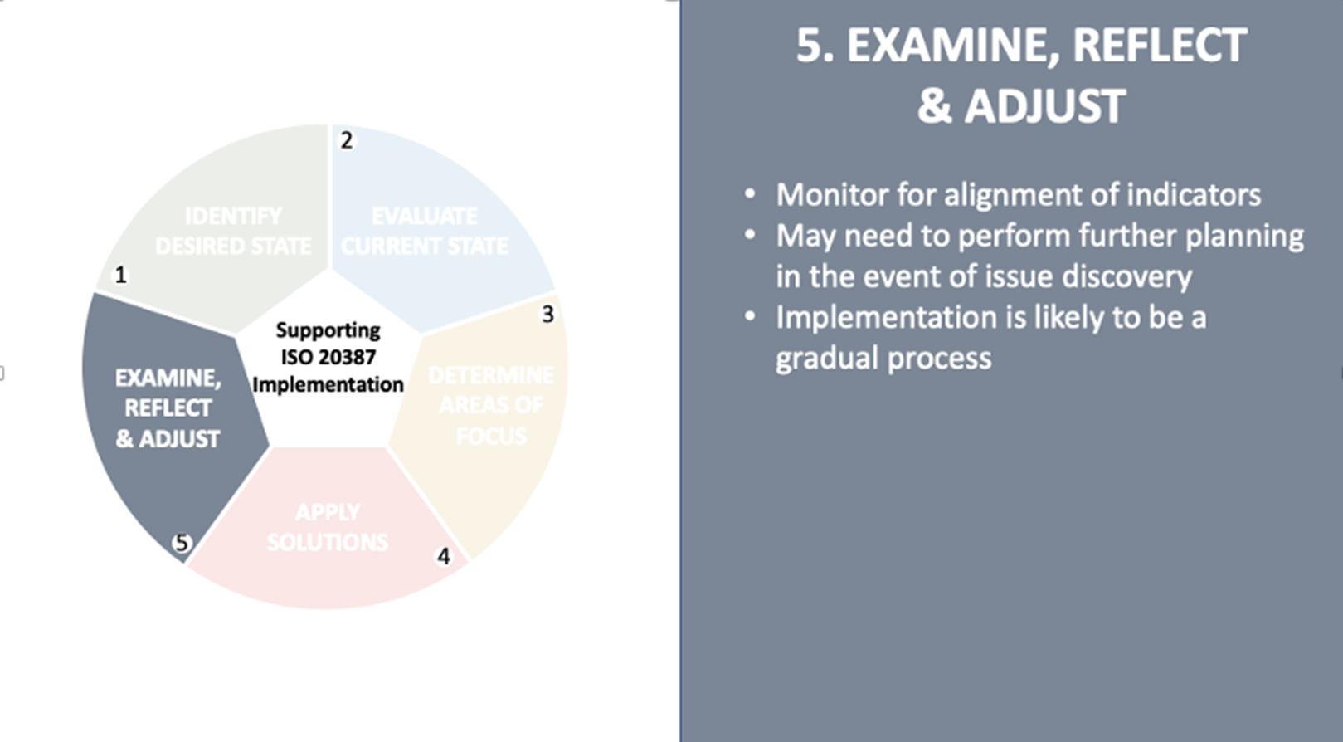
Notes:
Once implementation is underway I would look to monitor progress, and provide continued support – in fact a quality management system that incorporates or enables monitoring through internal auditing will provide a strong foundation to achieving fitness for the intended purpose.
Establish a performance tracking and monitoring system. It is chance to evaluate that implementation is aligned with defined mission and strategic goals of the biobank and its operations.
It is the opportune time to ask if the implementation of the requirements and other changes serve to further increase user confidence:
•Do potential users have a basis to assess FIP?
•Does the Quality Management System (QMS) address quality policies and objectives in processes, enabling demonstration of efficient use of resources, improved risk management, and increased robustness of practices, plans, and records.
•Is technical competence evident?
•Are cooperation, exchange of BMaD and harmonization with other biobanking outputs improved?
Implementation is an iterative process. Processes can change mid-course, and unforeseen issues or challenges can arise. Sometimes, original goals will need to shift as implementation is realised.
It can help to be attentive, flexible during implementation and to communicate the need for this to others involved in the process as a willingness to change or even readjust plans as you oversee implementation can prove more beneficial to blindly adhere to the original goals. Agility within the biobank system may help to support the implementation and therefore could become an important feature of the Quality Management System supporting the biobank. in fact a quality management system that incorporates or enables monitoring through internal auditing will provide a strong foundation to achieving fitness for the intended purpose.

Slide 24
Where Do We Start?
Implementing a Quality Management System for ISO 20387
Seán Naughton

Slide 25
Where Do We Start?

Slide 26
How Do You Eat an Elephant?

Slide 27
… One Bite at a Time!
(Apologies to our vegan and vegetarian friends)

Slide 28
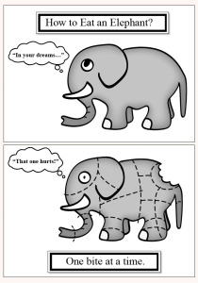
Your ISO Elephant
Your elephant is the accreditation journey.
You cannot achieve it all in one go, but you can focus on having a system to prioritize where you’re going to start.
Identify smaller, independent, achievable tasks.
Complete one and move on to another, building on your previous accomplishments.
Take small bites out of your elephant.
Notes:
In the next few slides, I will brief you on some key elements and principles of building a QMS

Slide 29
Start with a Process Flow

Slide 30
Create a Process Flow
Identify the BMaD (Biological Material and/or associated Data) you want to accredit.
Identify the intended purpose of this BMaD.
Develop a process flow – a diagrammatic expression of the BMaD from collection/acquisition through to storage and distribution / disposal.
Tie this Process Flow to the scope elements for which you want accreditation.
Which scope elements apply to your
processes?

Slide 31
Scope Elements
Acquisition / Collection
Preparation
Preservation
Storage
Testing
Distribution
Other

Slide 32
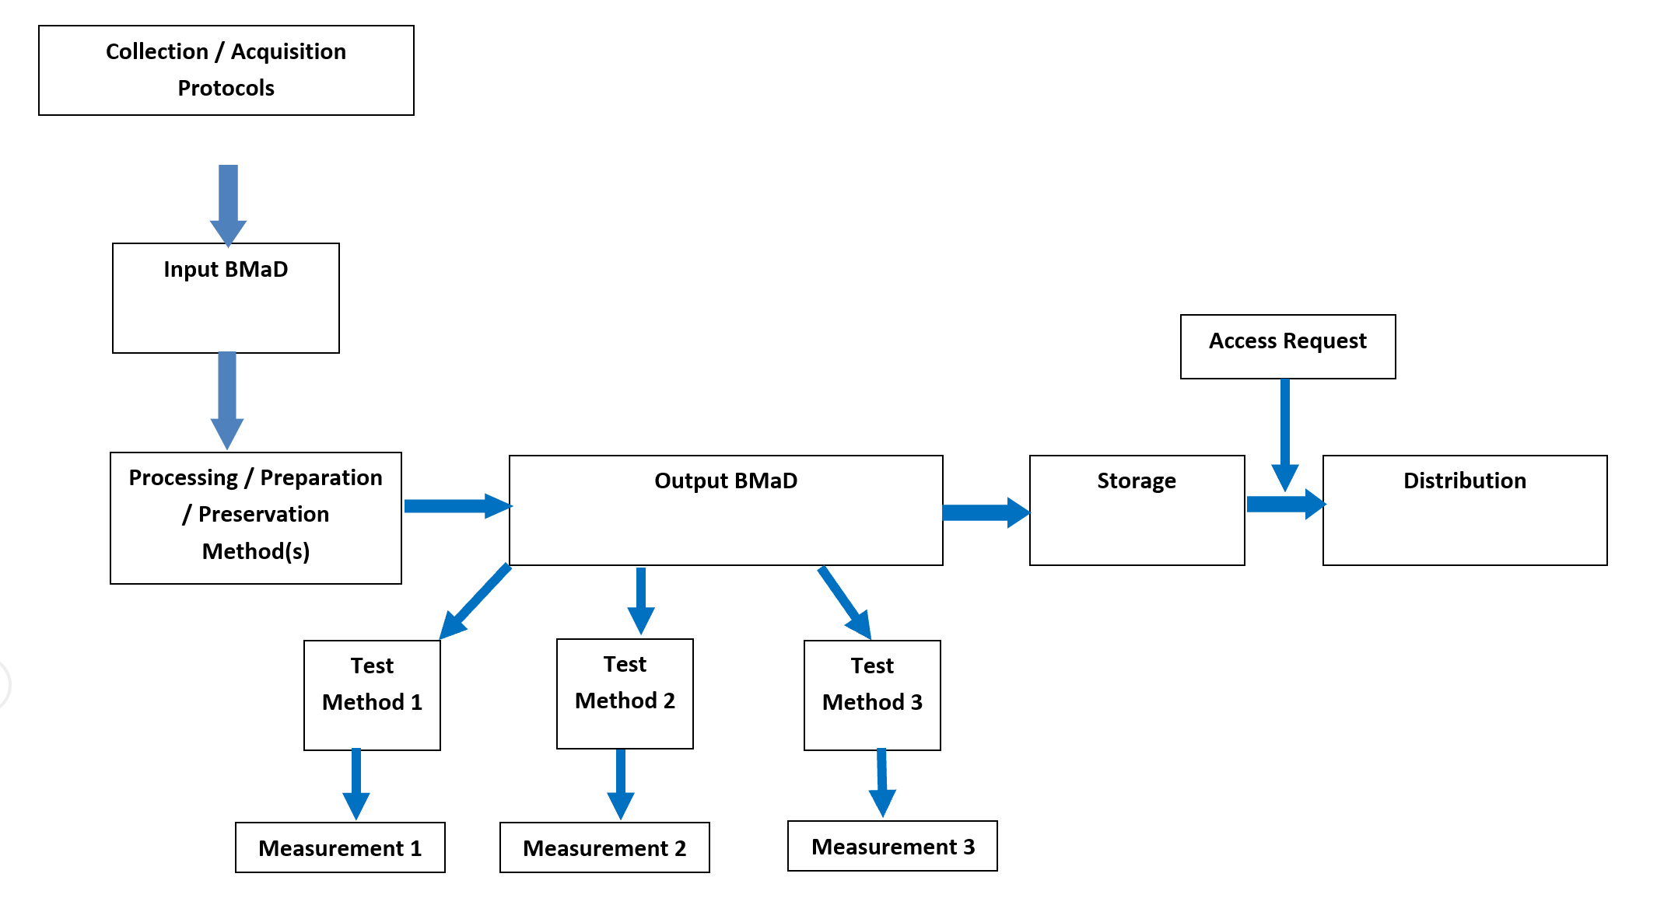
Process Flow Example

Slide 33
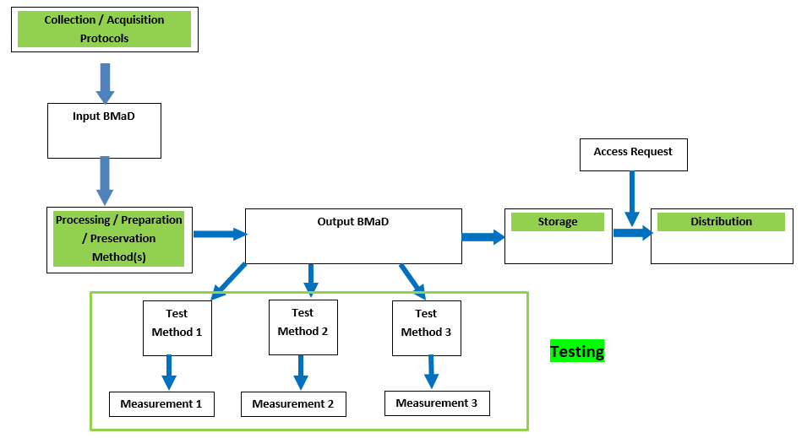
Process Flow with Scope Elements

Slide 34
Now that you have your process flow

Slide 35
Key QMS areas
Lets look at some of the key QMS (Quality Management System) areas to help you get started on your accreditation journey:
1. Document Control
2. Validation and Verification of your Methods
3. Competency
4. Non conforming output and corrective action
5. Internal Audits and Continual Improvement
6. Report Formats

Slide 36
Document
Control

Slide 37
Document Control
What is Document Control?
It is a system that can:
  Ensure documents are reviewed for adequacy and authorised by appropriate personnel.
  Ensure periodic reviews and updating of procedures, reflective of current practice in your facility.
  Review and approve changes, and identifies the current revision of the document (aka ‘Change Control’).
  Uniquely identify all documents.
  Prevent unintended use of obsolete documents / revisions.

Slide 38
Document Control
  There are many examples of document control systems – there are many ways of meeting the standard, and there is no need to re-invent the wheel.
  There is also a requirement
  to control record retention.
  Examples of both include:
  Many software packages allow electronic control of documentation and record retention.
Documents | Records
SOPs | Training Certificate
Work Instructions | Calibration report
Policy Statement | Test results
Presentations | Checklists
External Documents | Meeting Minutes

Slide 39
Document Control
  For each process within your process flow, identify the technical instructions and codify them into SOPs.
  Also identify the instructions for all other aspects of your work from using the Quality System to Staff Training / Competency to addressing risks and opportunities. Codify these instructions also.
  For each process where you record information, codify the record keeping format.
  Ask yourself, how will we ensure the integrity of the QMS such that there are no question marks over the fitness for intended purpose of the BMaD.

Slide 40
Validation and Verification of your Methods and Processes

Slide 41
When to Validate and When to Verify?

Slide 42
Validation
Validation is required for all ‘non-standard’, in-house or ‘modified’ test methods.
“shall be as extensive as is necessary and confirm, through the provision of objective evidence (in the form of performance characteristics), that the specific requirements for the intended use of the examination have been fulfilled.”

Slide 43
Verification
Standard methods and processes (peer-reviewed methods, test kits by manufacturers, equipment operated as per manufacturer’s instruction) all require less extensive testing prior to introduction – they have already been validated, and thus require only verification of their performance characteristics.
“confirmation, through the provision of objective evidence, that specified requirements have been fulfilled”.

Slide 44
What needs to be Validated / Verified?
The Biobank must identify all stages of each BMaD’s lifecycle and the critical activities within each stage of the lifecycle.
CRITICAL ACTIVITIES: having a potential impact on the fitness for the intended purpose of the BMaD.
LIFE CYCLE: consecutive and interlinked processes applied to the BMaD through e.g. collection, accession, acquisition, identification, preservation, long-term storage, quality control, transport, distribution, destruction, disposal.

Slide 45
What needs to be Validated / Verified?
The Biobank must now identify the methods and processes employed during each critical activity and determine if validation or verification is required.
Note: Equipment and software can affect BMaD fitness for purpose.
Bring it back to 1st principles thinking:
  Does this action/event/test result/process/equipment potentially affect the ‘fitness for intended purpose’?
  If so, is the requirement here to validate or verify?

Slide 46
Competency

Slide 47
Competency
Competency
  You must define the level of competence required for your facility and for the particular tasks.
  You set the criteria for competence.
  Can be useful to tie competency to initial training plans. E.g. As you complete training in one section, competency is achieved before progressing to the next training section.
  Can also use education, training, demonstrated skills and experience to deem staff competent initially.

Slide 48
Competency
Competency
  Periodically re-assess staff to ensure maintenance of effective competency.
  Many ways to assess effective competency:
    Witnessing / Observation of work.
    Test / Evaluation of knowledge.
    Review of work performed.
    Performance in external quality assurance schemes.
  Keep evidence.

Slide 49
Non Conforming Output and Corrective Actions

Slide 50
Non Conforming Output & Corrective Actions
When something goes wrong:
  Failure to meet your own or your client’s predefined requirements.
  An SOP was not followed.
  A report not issued.
  Inadequate storage conditions.
  Personnel were not trained / competent.
Non conforming – deviating from a particular requirement (e.g. ISO requirements, your own procedures, INAB requirements).
Specifically relates to ‘non conforming output’.
You need a system for recording and remedying NC output.

Slide 51
Non Conforming Output & Corrective Actions
What to do with an identified NC?
  React – take control and correct it / deal with the consequences
  Evaluate – identify the underlying cause(s)
  Determine – the extent of the NC – do similar NCs exist / have the potential to occur? Are there associated risks and opportunities?
Undertake corrective actions appropriate to the effects of the NC that deal with the underlying root cause.
Keep records of the nature of the NC, actions taken, and the effectiveness of the corrective action

Slide 52
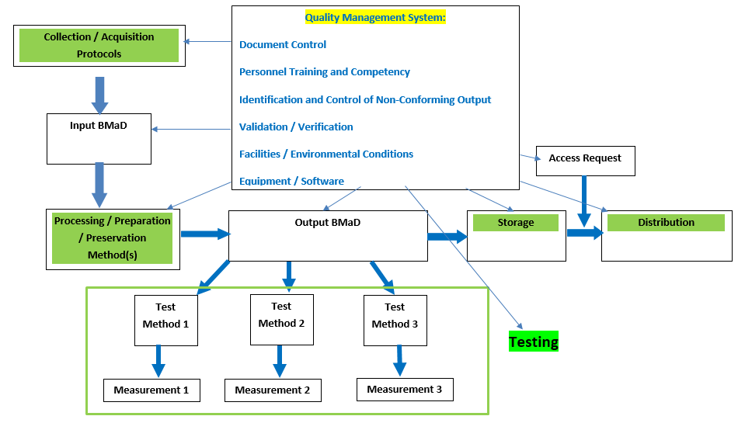
Root Cause & Corrective Actions
While NCs are detected in non-conforming output, the root cause can occur at any point in the process

Slide 53
Root Cause & Corrective Actions
While NCs are detected in non-conforming output, the root cause can occur at any point in the process
Retraining of personnel
Amend procedures
Send notification to clients
Initiate Recall
Increased monitoring / testing

Slide 54
Internal Audits & Continual Improvement

Slide 55
Internal Audits
INAB assessments are a one day snapshot of your quality system.
Internal Audits are a means of identifying deficiencies in your system year round.
At regular intervals audit your system to ensure it adequately meets:
  The requirements of ISO 20387.
  Your own QMS requirements.
  Your own, and your clients, technical requirements.

Slide 56
Internal Audits
Do this by:
  Defining audit criteria in advance.
  Know what you are looking for.
  Ensure impartiality e.g. auditor is independent of the activity being audited.
  Keeping evidence of your audit.
Internal Audit will:
  Identify and correct deficiencies where your system does not meet requirements.
  Help maintain effective accreditation inbetween annual INAB assessments.

Slide 57
Continual Improvement
Refers to continual improvement of the QMS, your products and services.
Identify targets for improvement through:
  Review of staff suggestions
  Review of operational procedures
  Use of policies
  Setting objectives
  Internal and External audit
  Corrective actions arising from NC
  Proficiency testing / external quality assessment schemes
  Data trending (e.g. QC or environmental data)
  Dealing with complaints

Slide 58
Continual Improvement Process
Identify potential sources of any system weakness or error.
Develop plans to implement improvement.
Implement the plan.
• Review the effectiveness of the action through the process of
focused review and audit.
• Adjust the action plan and modify the system in accordance
with the review and audit results.

Slide 59
Report Format

Slide 60
Report Format
Begin to prepare your electronic systems early to ensure reports or certificates can comply.
Can be electronic or hard copy.
Electronic reports can be provided by electronic data transfer or access to an electronic data base.
Reports should include a statement to the user that the report may only be reproduced in full i.e. not abridged or shortened.

Slide 61
Report Format
What must be on the report?
  A title (e.g. Material Certificate, Quality Report)
  Date of Issue
  Unique identifier of report, identification on each page and clear notice of the ‘end of the report’.
  INAB symbol or reference to INAB accreditation.
  Clear identification of any non-accredited activity.

Slide 62
Report Format
What must be on the report? (As applicable)
  Biological material identification / specific properties.
  Any relevant quality information.
  Methods of ID or characterisation of material.
  Testing results and methods used for testing.
  Methods used for collection / acquisition, preparation / preservation.
  Storage conditions.
  Name and function of person authorising report.

Slide 63
Lots to Digest
Very Do-able with Time
Step by Step

Slide 64
Thank You and Best Wishes on Your Accreditation Journey

Slide 65
The Accreditation Process
April 2021
Bríd Burke

Slide 66
Accreditation process
Quality system according to ISO20387 developed, documented, where necessary, and in use
Application to INAB
CRM portal
Scope clarification
Assessment team – Pradeep Agrawal and Maurice Bardsley

Slide 67
Accreditation process
Factual findings
Assessing conformity to ISO 20387 and INAB policies
Consistency with other accreditation bodies in EU.
Added value to the organisation
Competence of assessors, as per the scope of application.
Consistency of assessment and assessors.
Impartial, confidential

Slide 68
Scope of accreditation

Slide 69
Overview of the process
Application assigned to INAB assessment manager
Document review
Pre-assessment
Initial assessment
Witnessed activity in the biobank
Recommendation to the INAB Board
Accreditation awarded
Routine Assessment
Re-assessment, 5 yr cycle
Clearance of non-conformities

Slide 70
Thank you for your attention
Questions?

