Slide 1
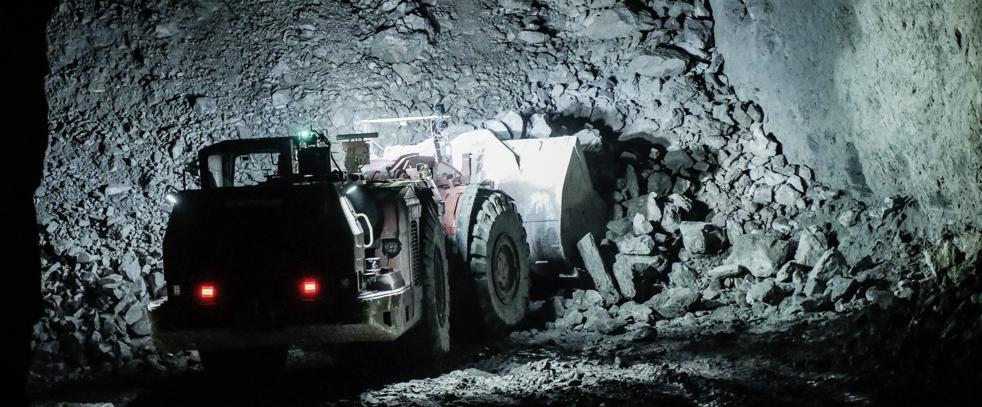
AUTOMATION in mining
SANDVIK Underground mining – load, haul & Drill Automation
Safe & cost effective mining
Brian Carroll
Parts, Service & Warranty Lead and Sales Manager Mining Ireland
Sandvik Mining and Rock Technology
Andreas Simoncic
Business Line Manager Automation, Northern Europe

Slide 2
SAFETY FIRST
Sandvik’s objective is zero harm to our people, the environment we work in, our customers and our suppliers.
PROTECTIVE EQUIPMENT
FIRST AID KIT
ALARM
EMERGENCY NUMBER
EMERGENCY EXIT
ASSEMBLY POINT
Notes:
Sandvik’s objective is zero harm to our people, the environment we work in, our customers and our suppliers. (Go through safety instructions)

Slide 3
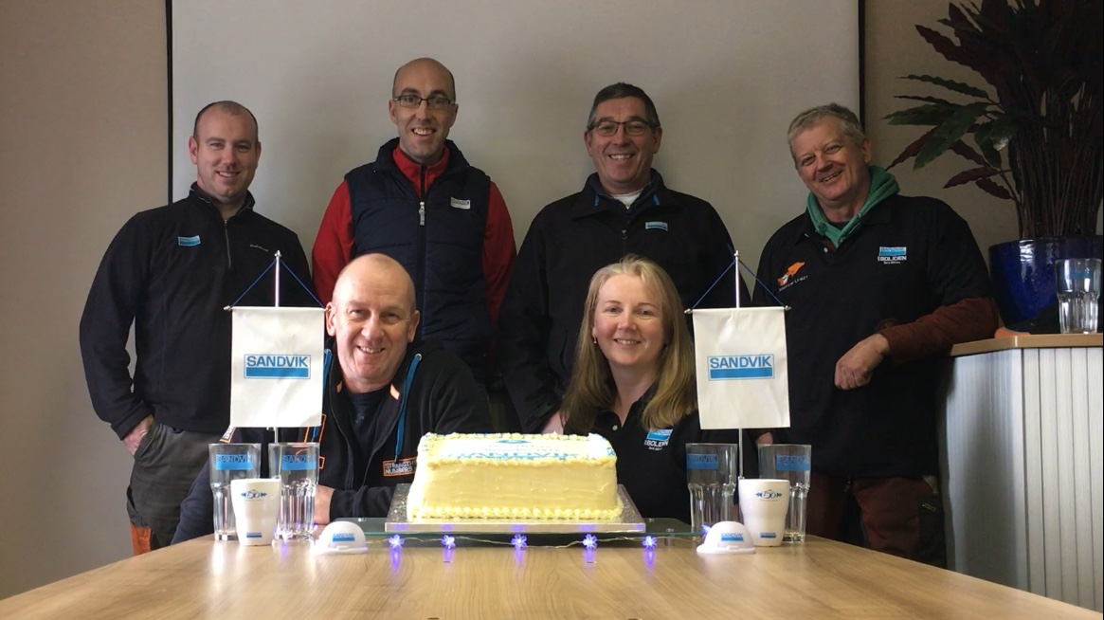
5 years LTI free – 5th Dec 2017
2,122 days to date
Sandvik’s objective is zero harm to our people, the environment we work in, our customers and our suppliers
**Oliver Boland and Tom Pollard missing from photo

Slide 4

Brian Carroll
Employee Stories Video
Parts, Service & Warranty Lead Ireland
Sales Manager Mining Ireland
**Account Manager Boliden Tara Mines
**Portlaoise Facility Manager
Crosspatrick, Kilkenny
(close to The Lisheen Mine and Galmoy Mines projects)
Career:
1999 – Tamrock (Sandvik) – Apprentice Plant Fitter
2003 – Sandvik –Plant Fitter
2005 – Sandvik – Rebuild Facility Workshop Supervisor
2009 – Sandvik – Workshop Manager
2012 – Sandvik – Works Manager Ireland
2015 – Sandvik – Parts Service & Warranty Lead and Sales Manager Mining Ireland

Slide 5
Sandvik Mining & Rock Technology ireland organisation chart
SERVICE, PARTS & WARRANTY LEAD
SALES MANAGER UG MINING
BRIAN CARROLL
BUSINESS SUPPORT ADMINISTRATOR (3 DAY WEEK)
ELEANOR RYAN-CARROLL
PRODUCT MASTER LOAD & HAUL
REGION EUROPE
RICHARD MAHER
LOAD AND HAUL TECHNICIAN
SERVICE & AUTOMATION SUPERVISOR
(TARA MINES)
OLIVER BOLAND
ROCK TOOLS SPECIALIST
(TARA MINES)
DWIGHET MEURSING
UG DRILL AND BOLT TECHNICIAN
iSURE SPECIALIST
(TARA MINES)
SEAN LOUGHMAN
WORKSHOP SERVICE SUPPPORT
(PORTLAOISE)
FRANK HANRAHAN (WS LEAD)
TOM POLLARD
SURFACE DRILL TECHNICIAN CRUSHING & SCREENING TECHNICIAN
(IRELAND)
TBC
5

Slide 6
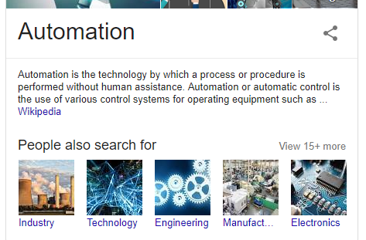
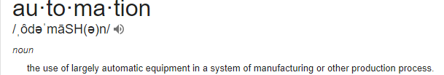
Automation in mining
What is automation?

Slide 7
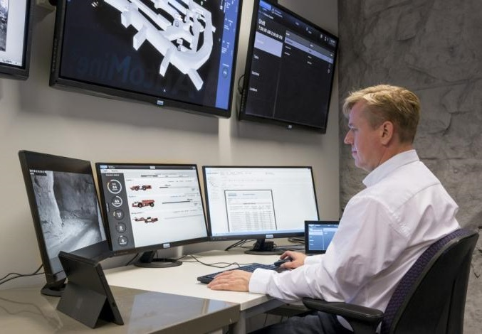
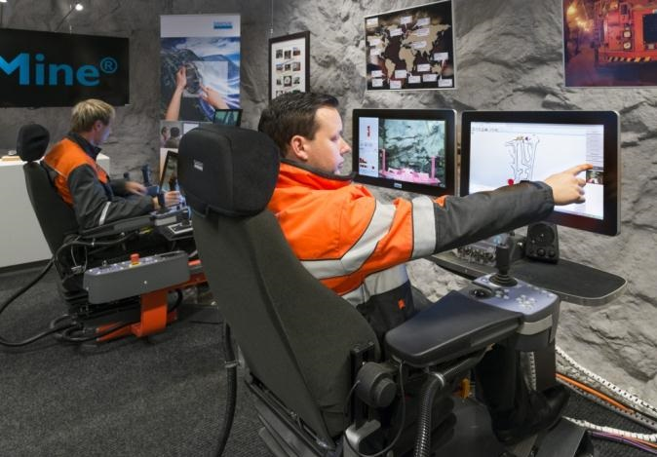
Mining automation PRODUCT FAMILIES
optimine®
AUTOMINE®
Information Management
Teleremote and Autonomous Equipment
Notes:
Firstly, our Mining Automation systems are all about application of automation and Information Management technologies to operate and manage fleets of mining equipment.
We have 2 product families:
OptiMine – Information Management system for managing a fleet of conventional manually operated equipment
AutoMine – systems for teleremote and autonomous equipment

Slide 8
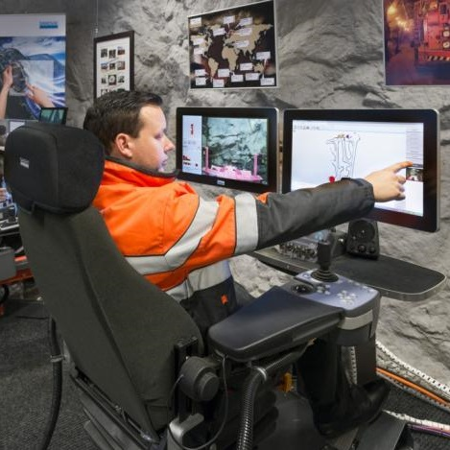

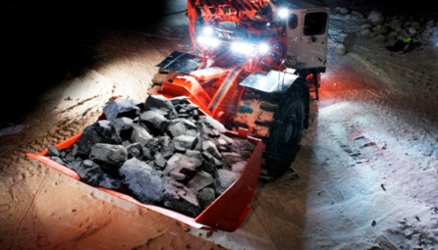
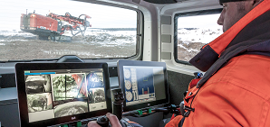
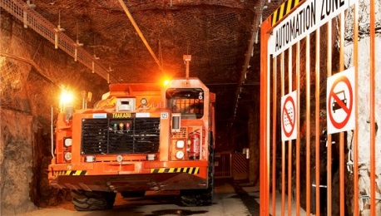
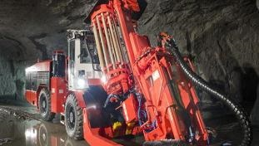
AUTOMINE®
Automation System
Surface Drills
Loaders
Trucks
Underground Drills
Notes:
The AutoMine product family is all about taking the operator off the equipment and enabling operation from a remote and safer location. We have systems for:
Loaders & trucks:
From single unit to fleet automation systems enabling operations to be run from a surface control room
Operators have mainly a supervision role –
For loaders, buckets are loaded with an automated bucket filling assistant function or by teleremote operation, with tramming & dumping fully automated
Similarly for trucks, automated tramming and dumping, operator supervises truck loading by manually operated loaders or controls truck loading with chutes or platefeeders
Underground drills:
Telemote control of production drill rigs in the DL400 series (DL411, DL421, DL431)
Control panels from each rig are duplicated in the control room + a video and communication system is provided to bring the teleremote operation capability.
When combined with one-hole data or full-fan data drilling, a single operator can operate and supervise several rigs. Relocation of rigs between rings is still done from the cabin of the rig.
Surface drills:
Teleremote control of 1 to 3 rigs from a single operator station.
System is compatible with Pantera tophammer & DTH rigs as well as the new DR461i rotary drill

Slide 9
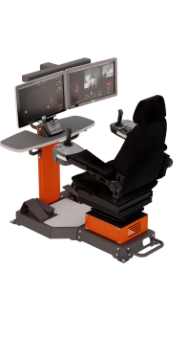


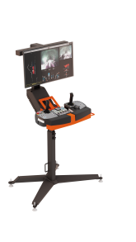
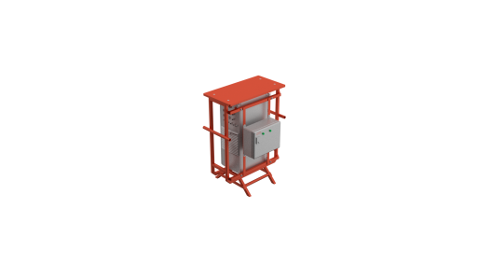
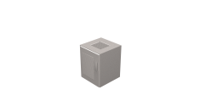

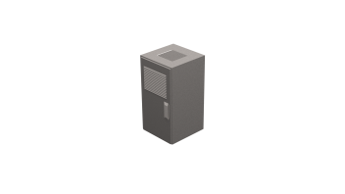
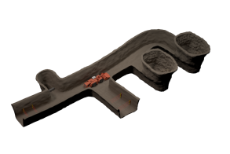


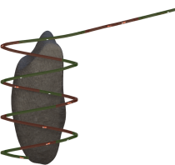
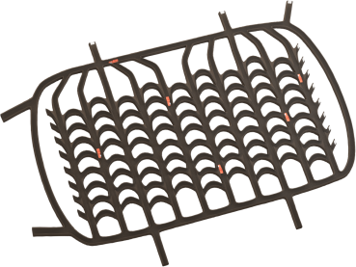



AutoMine™
For Underground Loaders & Trucks
Tele-Remote
Lite
MULTi-LITE
Fleet
Single-machine
Smart Teleoperation
Single-machine
Automation
Multi-machine
Automation
Multi-machine Automation with Fleet Traffic Control
Minimized Onboard Package
Full Onboard Automation Package

Slide 10
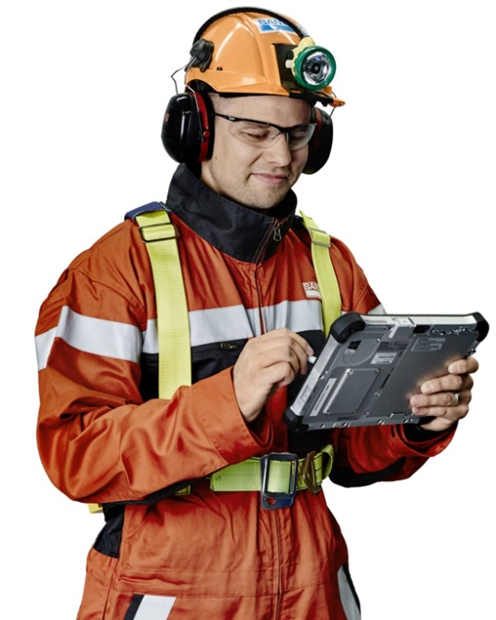
Automation in mining
WhY automatE?
More lower cost & safer tonnes with information and AUTOMATION
PRODUCTION RATE
Automation
Information
Today
0
4
8
12
16
20
24
TIME
Notes:
In addition to increasing safety, this sums up well how Mining Automation systems bring value to our customers:
Today: operations today typically look like this with highly variable output throughout a production day and with resources not being utilised effectively
Information Management: with OptiMine, information management system, output is increased through more effective use of resources
Automation: with AutoMine, automation systems bring a more continuous and increased output with production over shift changes.

Slide 11





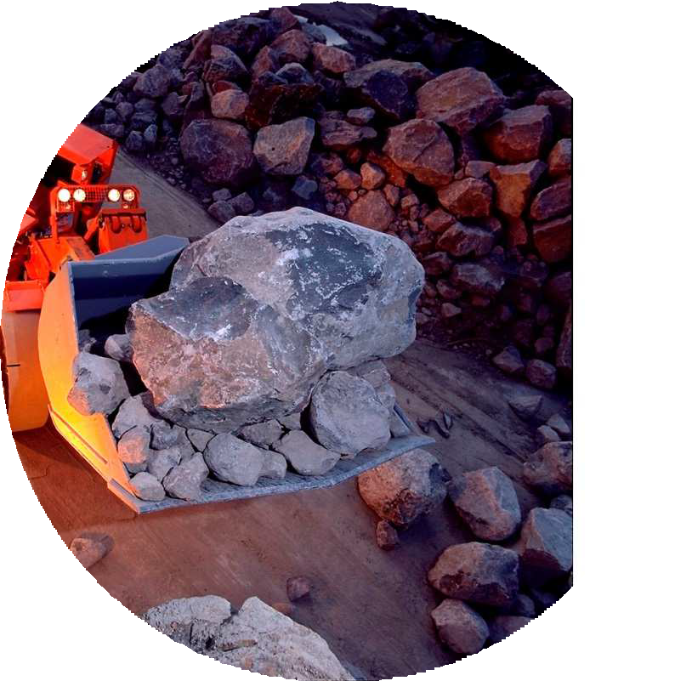











Automation in mining
WHY AUTOMATE?
Utilization
Availability
Transparency Control
Increase Production
CONTINUOUS OPERATION
LESS DOWNTIME
CONSISTENT OUTPUT
HIGH-SPEED PRODUCTION
TRACKING & REPORTING
SAFE, COST EFFECTIVE MINING
Reduce Cost
OPEX
CAPEX
REDUCED DAMAGE
MULTI-MACHINE CONTROL
SMALLER FLEET
EXTENDED LIFETIME
Improve Health & Safety
Exposure
ELIMINATE UG EXPOSURE
AREA ISOLATION
OPERATOR COMFORT
Hazards
Work Environment

Slide 12
Automation in mining
How to automate underground?
Notes:
In addition to increasing safety, this sums up well how Mining Automation systems bring value to our customers:
Today: operations today typically look like this with highly variable output throughout a production day and with resources not being utilised effectively
Information Management: with OptiMine, information management system, output is increased through more effective use of resources
Automation: with AutoMine, automation systems bring a more continuous and increased output with production over shift changes.

Slide 13
Automation in mining
How to automate underground?
Production area
Wi-Fi Access Points
Interface Field Cabinets
Lazer Gate Barrier
Notes:
In addition to increasing safety, this sums up well how Mining Automation systems bring value to our customers:
Today: operations today typically look like this with highly variable output throughout a production day and with resources not being utilised effectively
Information Management: with OptiMine, information management system, output is increased through more effective use of resources
Automation: with AutoMine, automation systems bring a more continuous and increased output with production over shift changes.

Slide 14
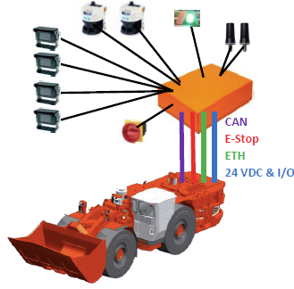
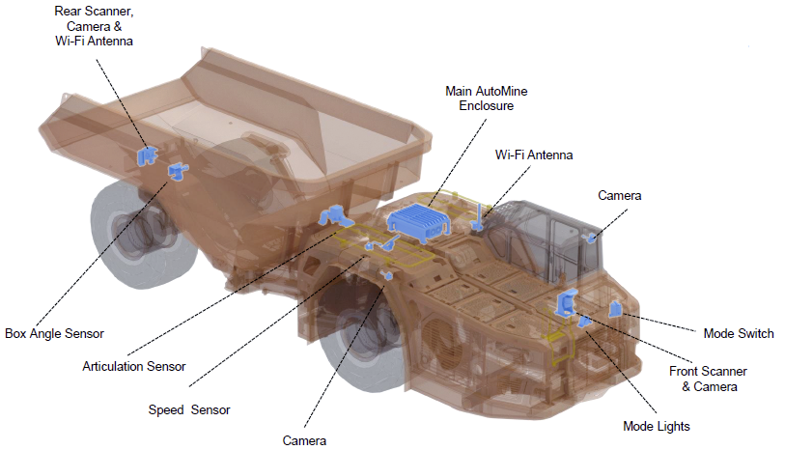
Automation in mining
How to automate underground?
Equipment
Notes:
In addition to increasing safety, this sums up well how Mining Automation systems bring value to our customers:
Today: operations today typically look like this with highly variable output throughout a production day and with resources not being utilised effectively
Information Management: with OptiMine, information management system, output is increased through more effective use of resources
Automation: with AutoMine, automation systems bring a more continuous and increased output with production over shift changes.

Slide 15
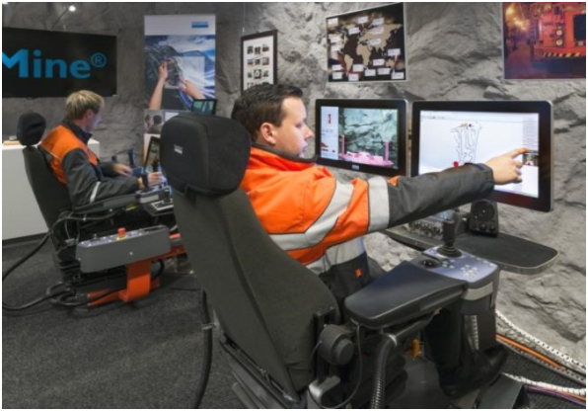
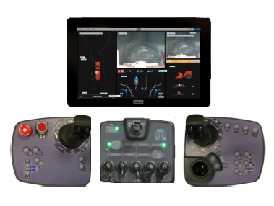
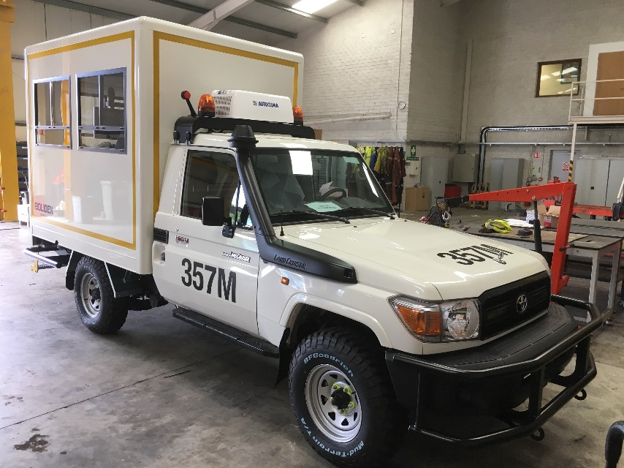
Automation in mining
How to automate underground?
Control station
High Speed Mucking Video
Notes:
In addition to increasing safety, this sums up well how Mining Automation systems bring value to our customers:
Today: operations today typically look like this with highly variable output throughout a production day and with resources not being utilised effectively
Information Management: with OptiMine, information management system, output is increased through more effective use of resources
Automation: with AutoMine, automation systems bring a more continuous and increased output with production over shift changes.

Slide 16
Automation in mining
Key safety benefits
Operator taken away from area of potential danger
Reduced stresses on the operator in working environment
Reduced risks, hazards and dangers for the operator and operations
Area isolated and locked down to prevent any potential incidents (area for machine only, no personnel)
Eliminates exposure to dust and exhaust fumes
Eliminates exposure to noise
Potentially more time on surface in fresh air and sunshine
Notes:
In addition to increasing safety, this sums up well how Mining Automation systems bring value to our customers:
Today: operations today typically look like this with highly variable output throughout a production day and with resources not being utilised effectively
Information Management: with OptiMine, information management system, output is increased through more effective use of resources
Automation: with AutoMine, automation systems bring a more continuous and increased output with production over shift changes.

Slide 17
Automation in mining
The future…
AI (Artificially Intelligent) machines
“Robotic” Equipment working along side reduced UG personnel
More and more personnel working from remote areas (underground or on surface)
Higher skilled IT jobs in the industry
Self analytical equipment diagnosing and alerting of breakdowns before they occur
Healthier and safer workforce
Notes:
In addition to increasing safety, this sums up well how Mining Automation systems bring value to our customers:
Today: operations today typically look like this with highly variable output throughout a production day and with resources not being utilised effectively
Information Management: with OptiMine, information management system, output is increased through more effective use of resources
Automation: with AutoMine, automation systems bring a more continuous and increased output with production over shift changes.

Slide 18
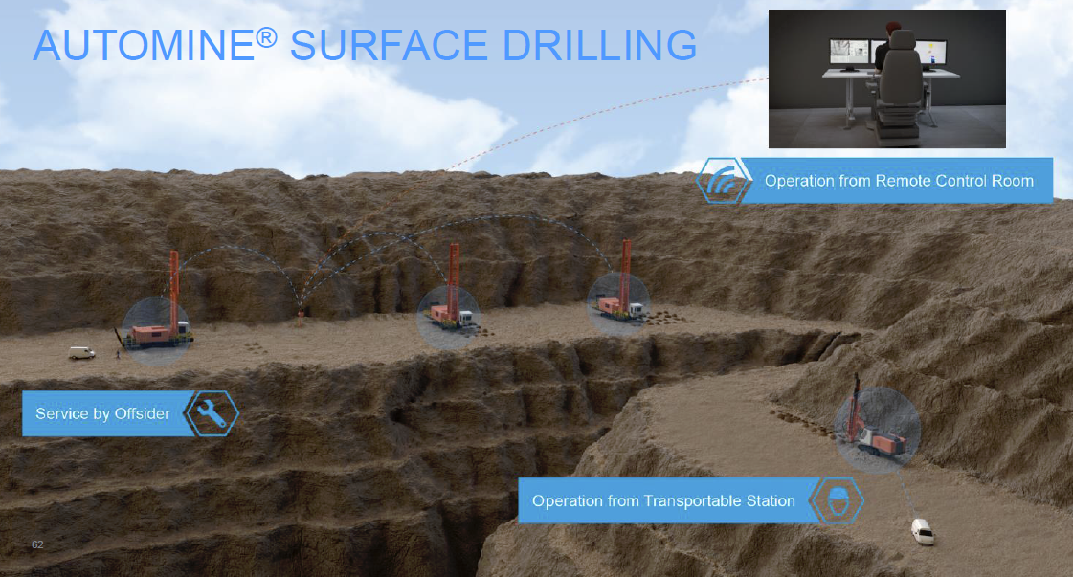
Automation in mining
The future…
Notes:
In addition to increasing safety, this sums up well how Mining Automation systems bring value to our customers:
Today: operations today typically look like this with highly variable output throughout a production day and with resources not being utilised effectively
Information Management: with OptiMine, information management system, output is increased through more effective use of resources
Automation: with AutoMine, automation systems bring a more continuous and increased output with production over shift changes.

Slide 19
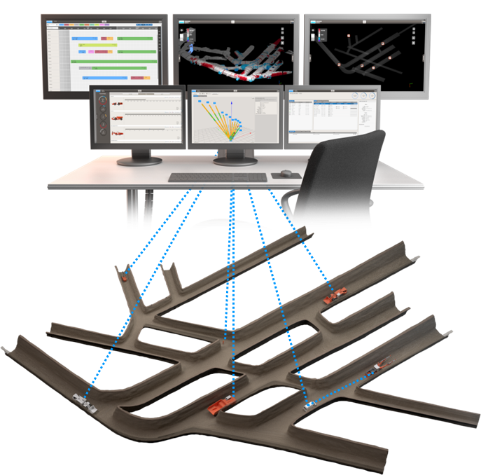
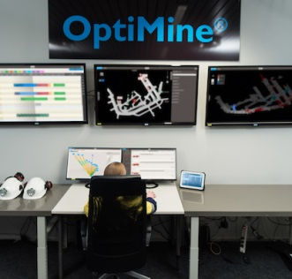
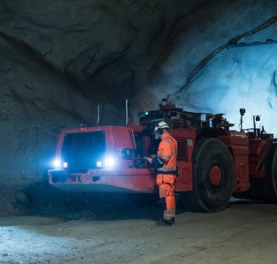
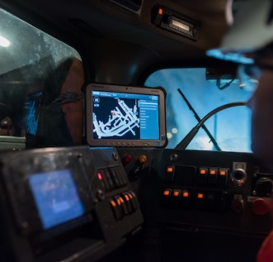
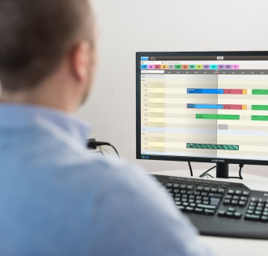
Optimine® – information anywhere anytime

Slide 20













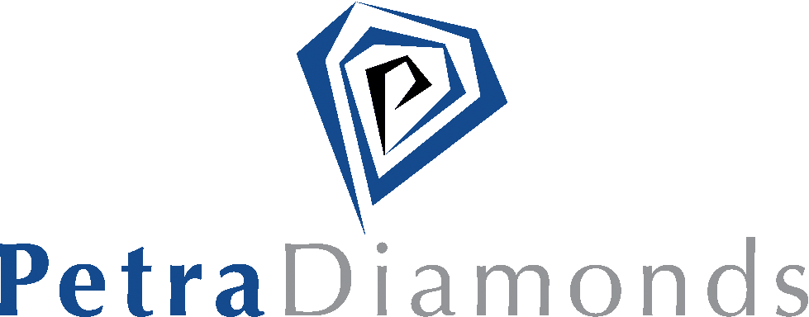


Automine™ L&H references
OVER
1,000 000
HOURS WITH ZERO LTI’s
SINCE
2004
WITH OVER
200
AUTOMINE™ LOADERS
AND TRUCKS

Slide 21
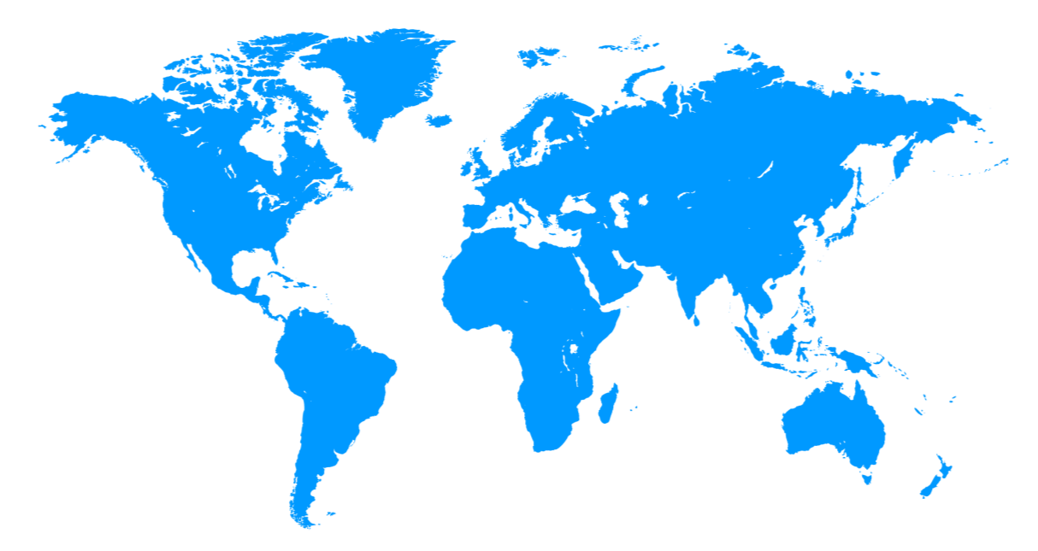















optimine® – references
21

Slide 22
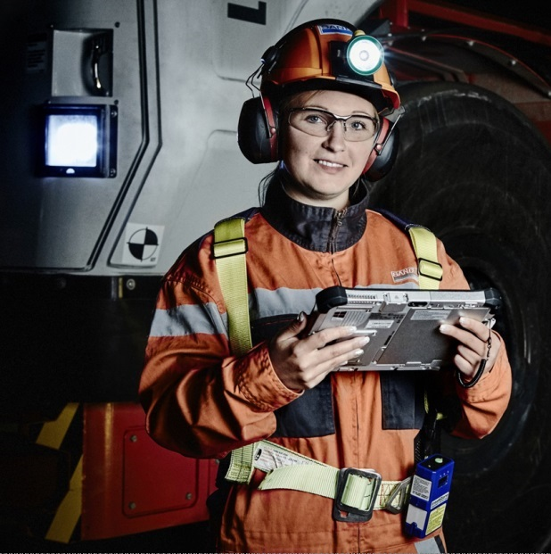
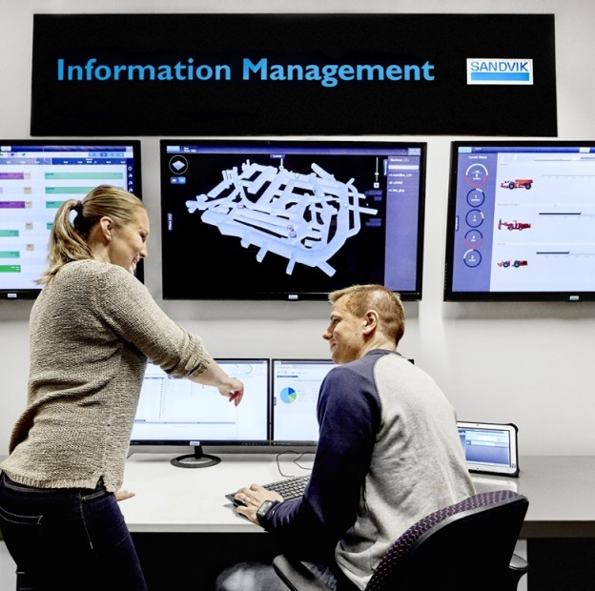
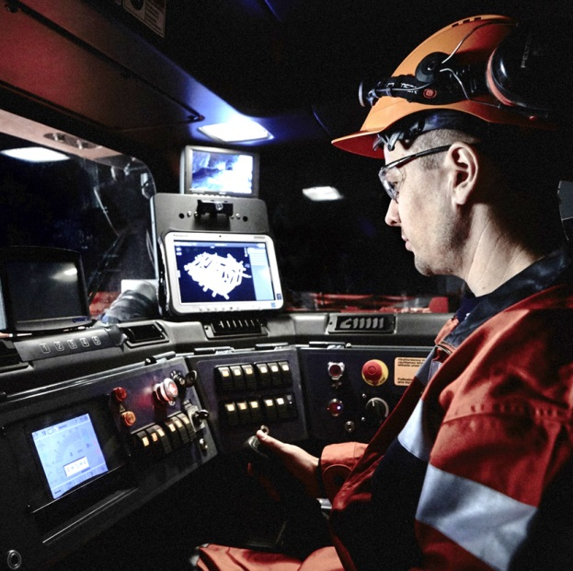
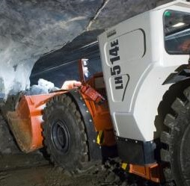
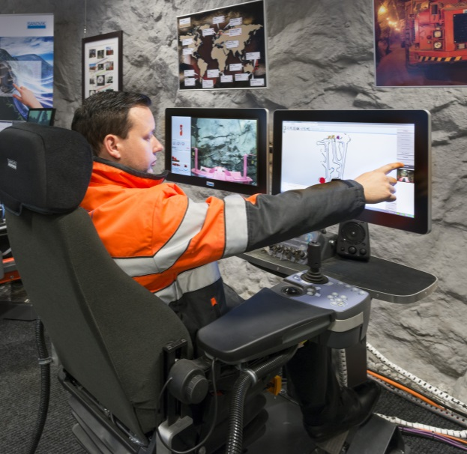
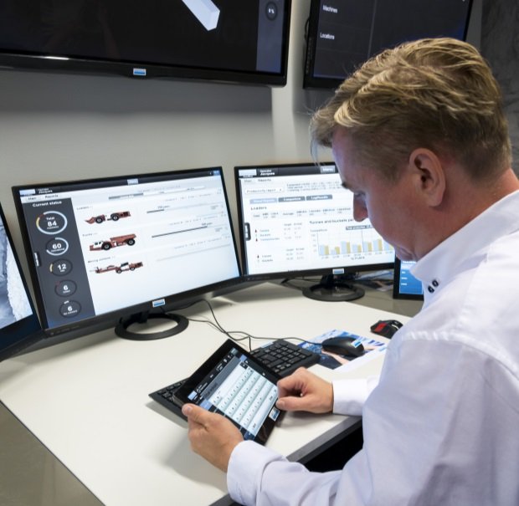

Slide 23
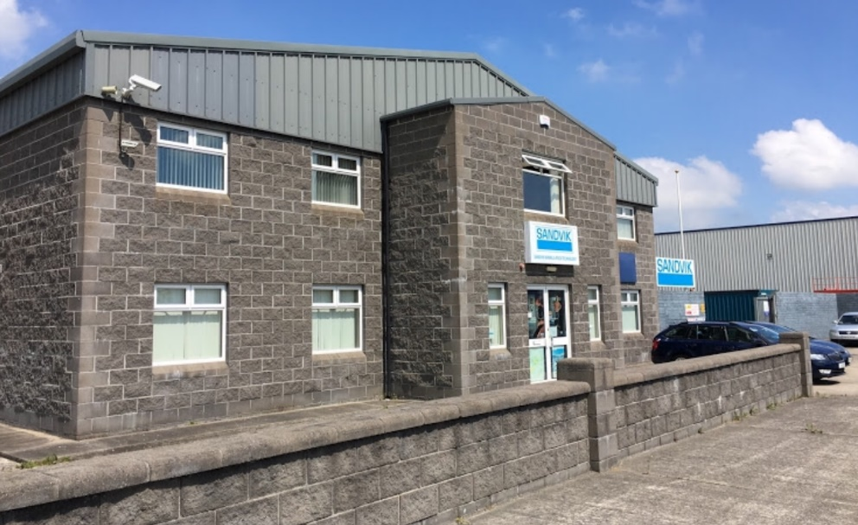
Thank you!
Sandvik Portlaoise (R32 EP03)
I can give further details on any questions or queries at the Sandvik stand or via email @ brian.carroll@sandvik.com

