Slide 1
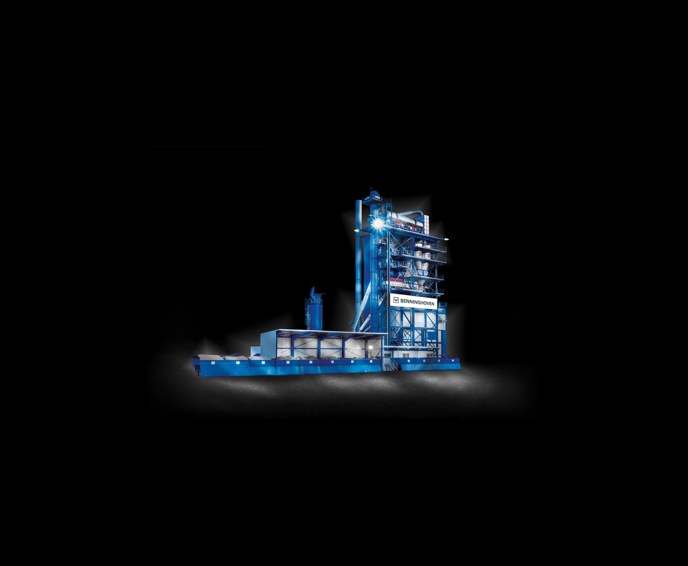
Asphalt Plant process
Hazards associated

Slide 2
Mixing plants
Modern plants are designed to be compliant with;
European Health and Safety legislation
CE Certified
Compliant with enviormental standards
Lifespan of plants over 20 years some safety features may not be included at the design stage on older plants

Slide 3
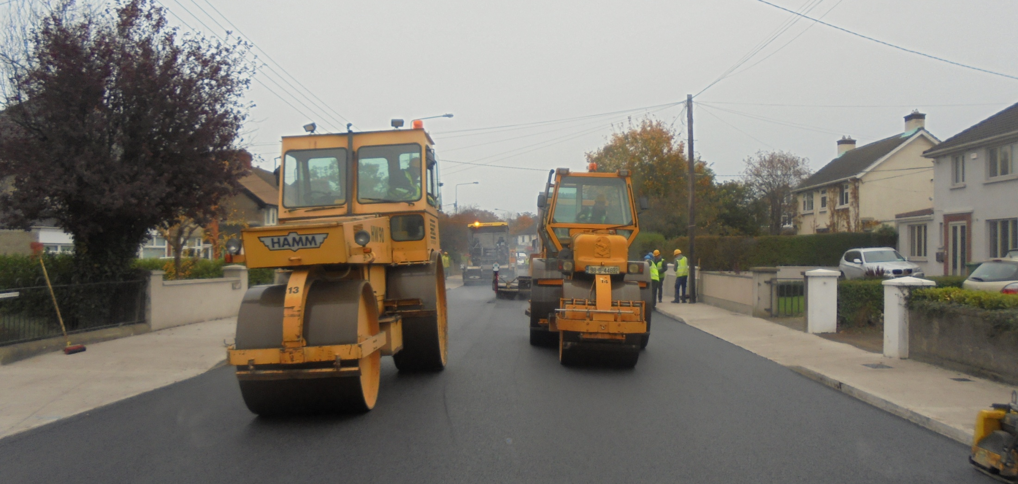
Asphalt batching
What is it and what are the hazards associated with it?

Slide 4
How is asphalt made?
The manufacturing process of asphalt, for use on our roads, is a very simple one.
There are two basic ingredients. The first being aggregates (crushed stone, crushed fines and sand). The second being bitumen.
The bitumen is blended with the aggregates whilst in its liquid state. Most bitumen’s are only liquids when temperatures are elevated in excess of 100ºC.
Bitumen is stored on site at temperatures which typically range 130ºC to 170ºC

Slide 5
What activities are taking place at an asphalt plant?
Receipt and storage of Aggregates & Bitumen
Receipt and storage of Additives
Transportation of Aggregates from stockpiles for mixing – Front End Loaders or via Haulage
Transportation of Additives from storage for mixing – Forklift pallets
Haulage lorries and customer collections
Batching of Hot Mix Asphalt materials

Slide 6
What are the hazards?
Large Vehicle(s) Movements
Conveyors
Hot Materials
Airborne Dust
Slips, Trips and Falls
Manual Handling
Maintenance

Slide 7
Vehicles – What are the risks?
people being struck by or run over by a vehicle;
people being struck by something falling from a vehicle;
people falling from vehicles;
vehicles overturning.

Slide 8
Conveyors – What are the risks
Nip points
Transmission components, couplings & tensioners
Moving edge of the belt – spill or falling objects

Slide 9
Hot Materials – What are the risks?
Burns

Slide 10
Airborne Dust – What are the risks?
Dust arising from the transportation of aggregates .
Dust arising from the drying process
Occupational Health

Slide 11
Slips, trips and falls – What is the risk?
Manual Handling
Personal Injury
Back Injury

Slide 12
Maintenance – What are the issues?
Dealing with heavy plant & equipment
Working at heights
Confined spaces
Possibility of lifting with cranes, hoists, chain blocks,
Isolation

Slide 13
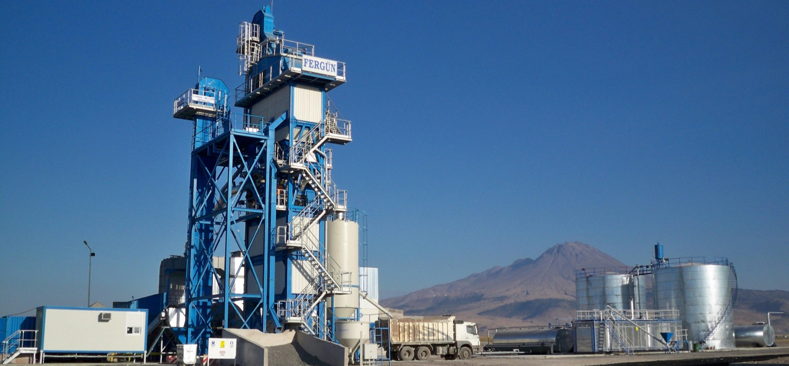
Mixing Plant
ECO 4000 / mixer 4 t / mixing capacity 320 t/h

Slide 14
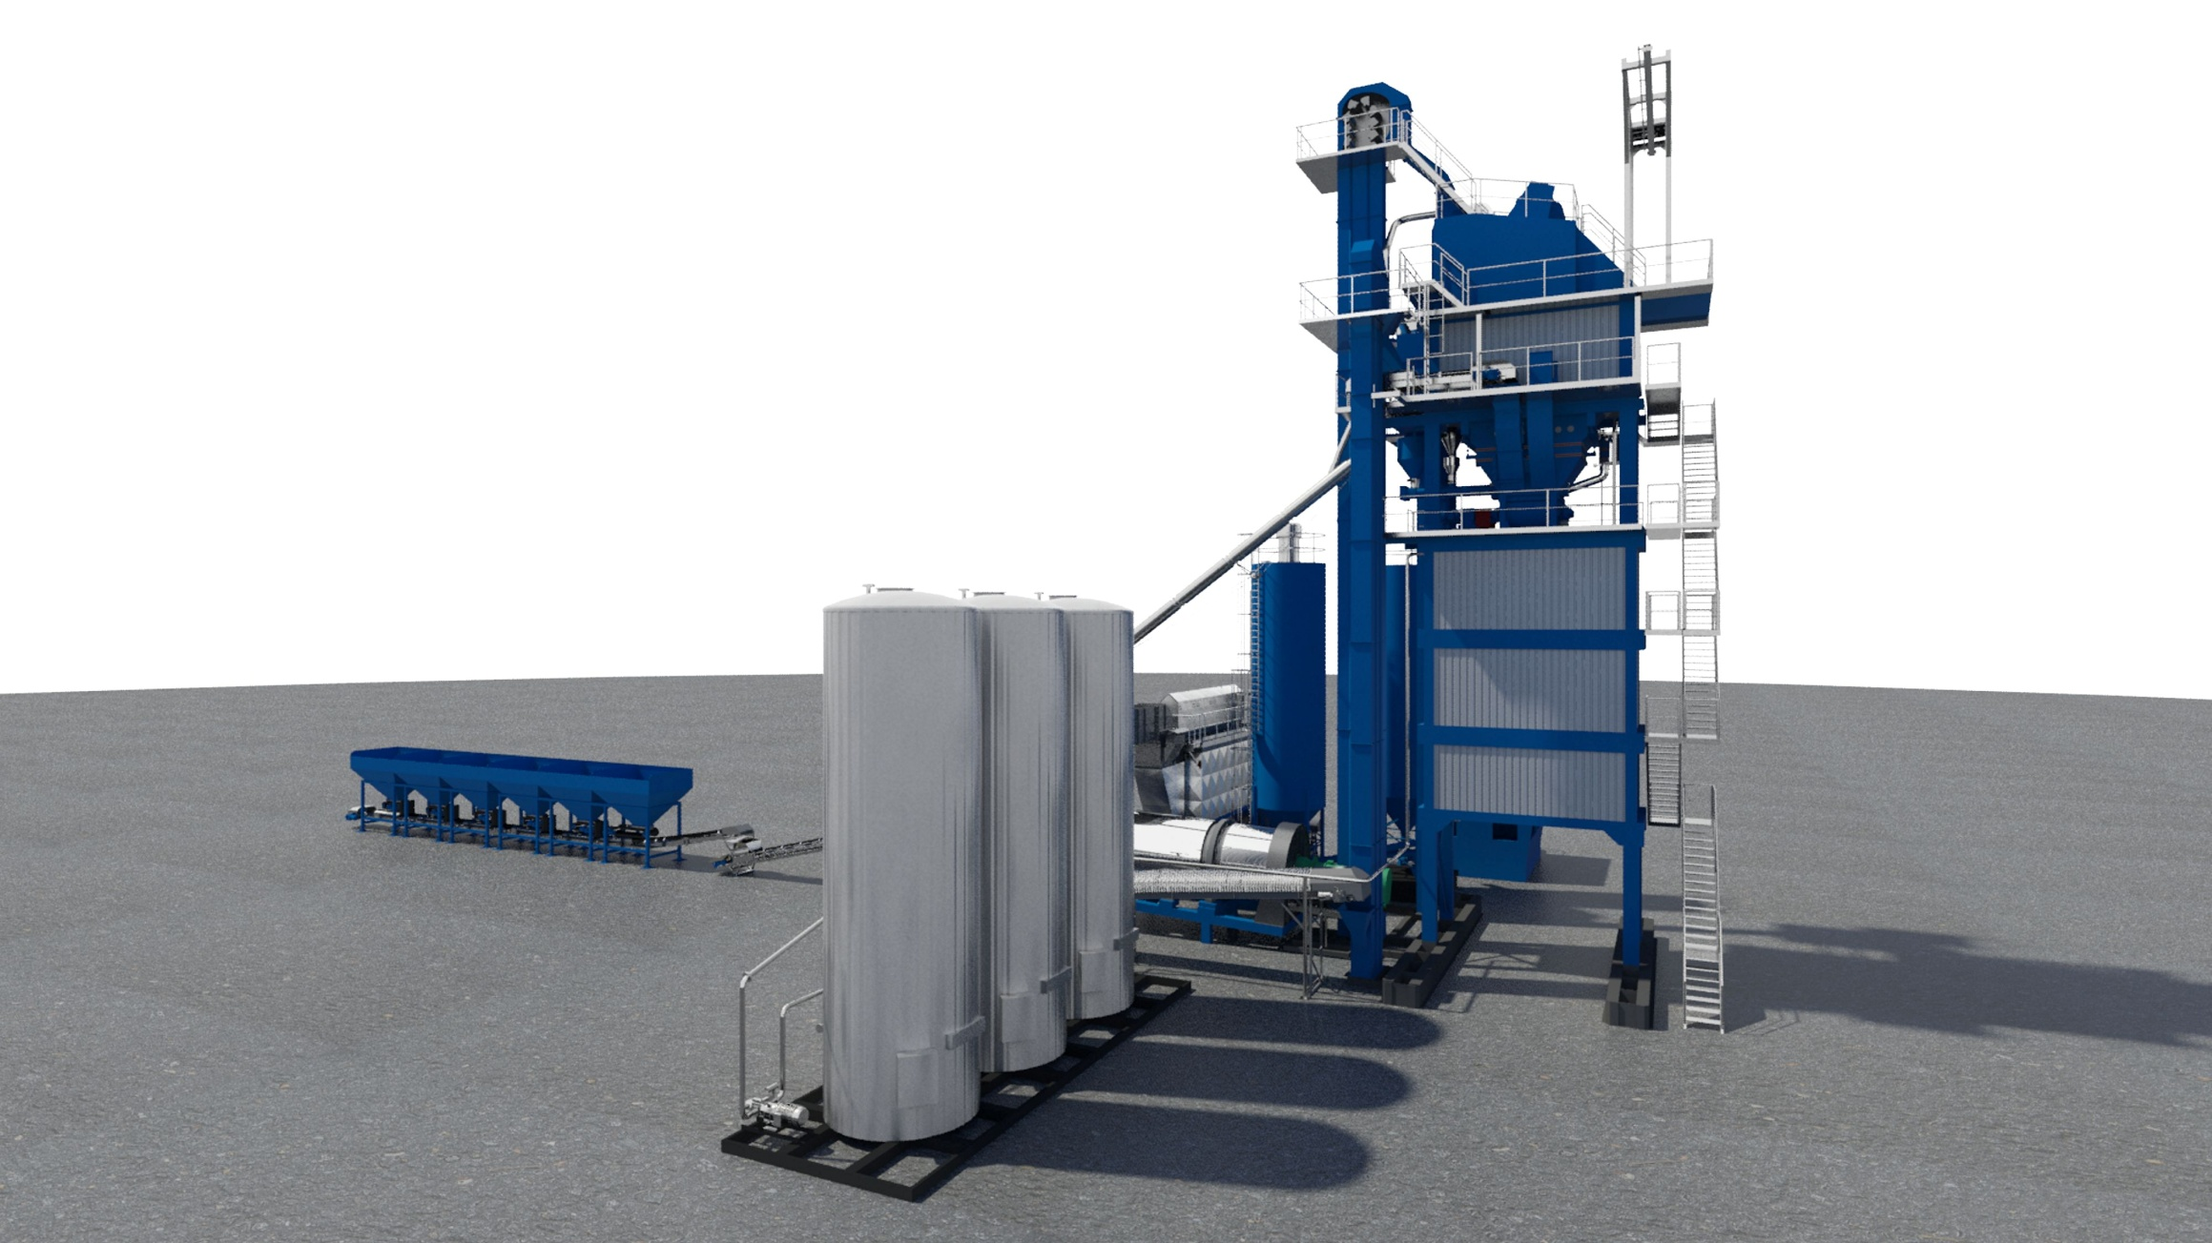
Process
Process designed to be efficient reduce the level of human interaction with moving parts.
Process involves the mixing of hot bitumen with aggregates in pre determined quantities
process requires control of
Heat
Moisture
Dust
Time

Slide 15
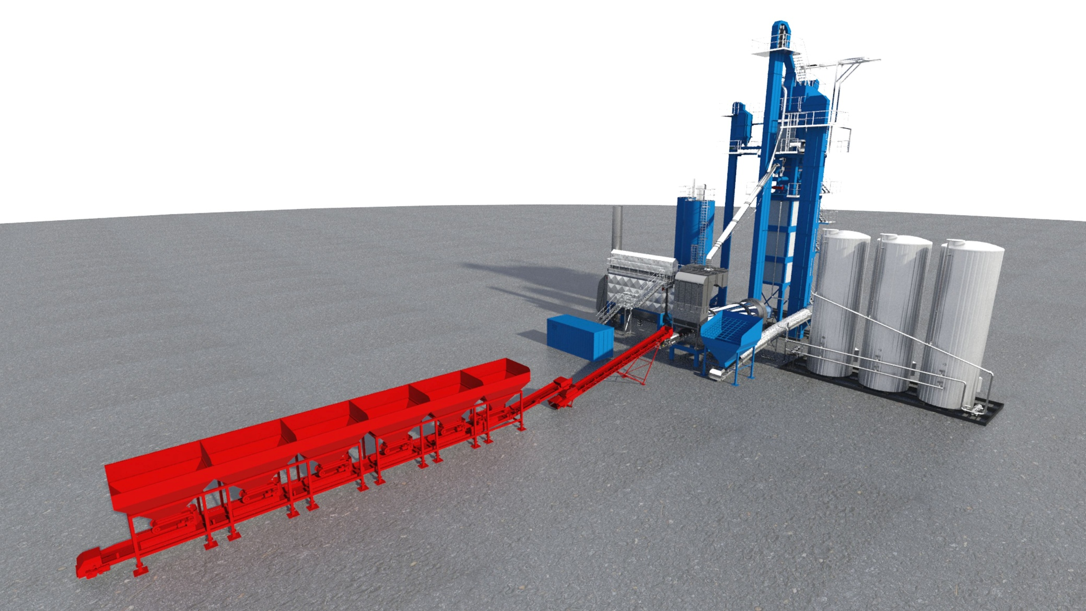
Material storage aggregates
Silos/hoppers loaded by shovel /trucks -plant movement
Drums, conveyors, drives, drives, -guarding pull cords interlocks
Maintenance –isolation, work at heights
Housekeeping- spillages belt scrapers

Slide 16
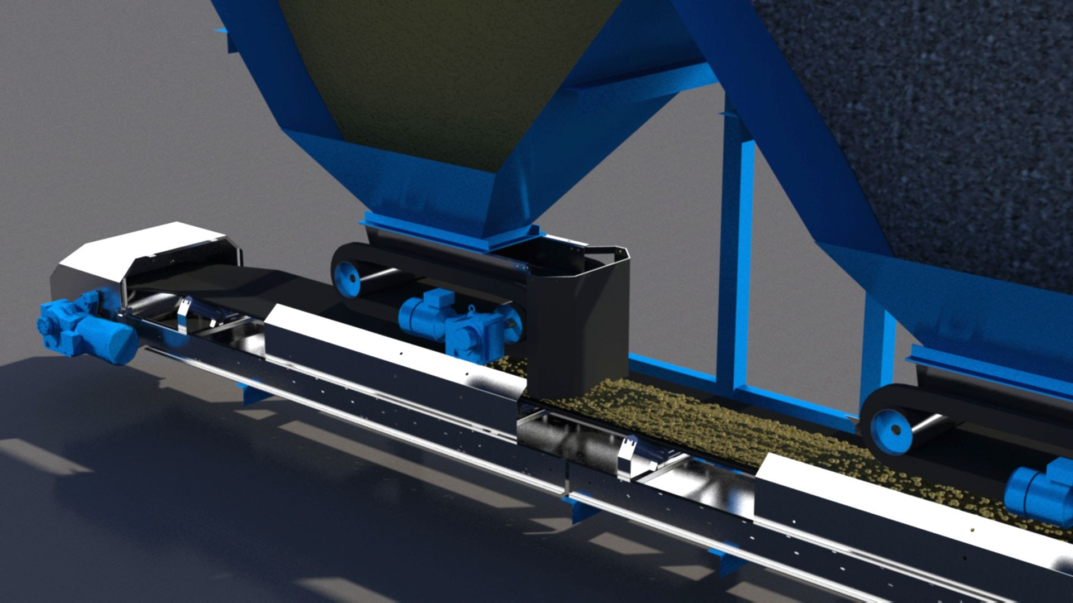
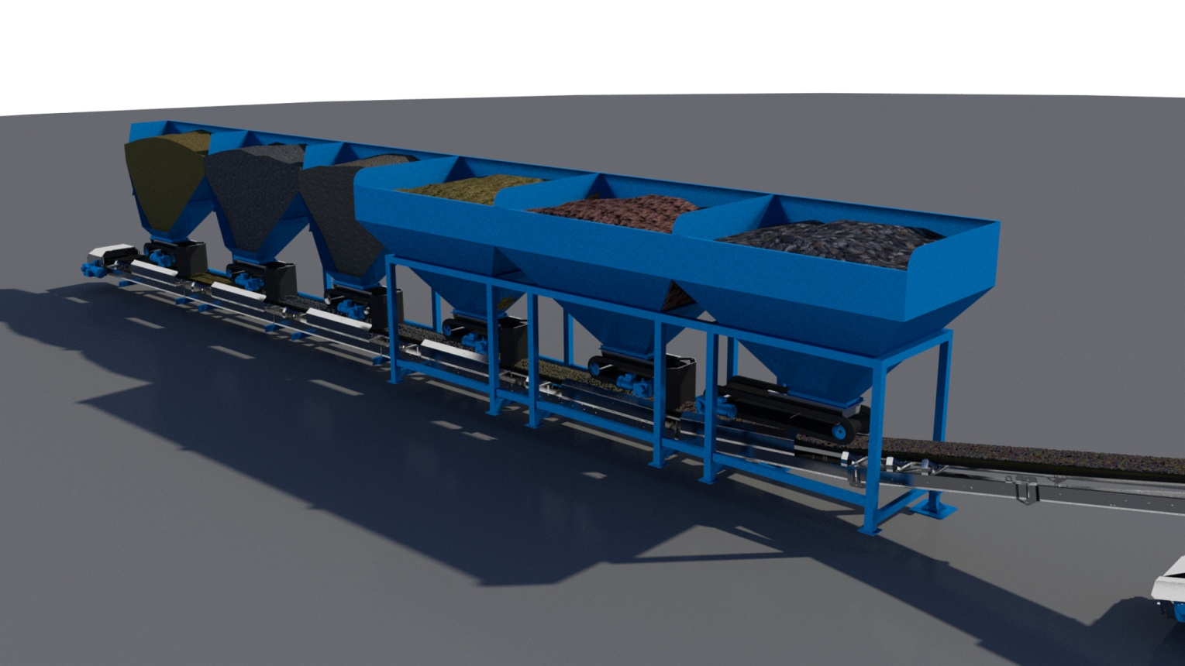
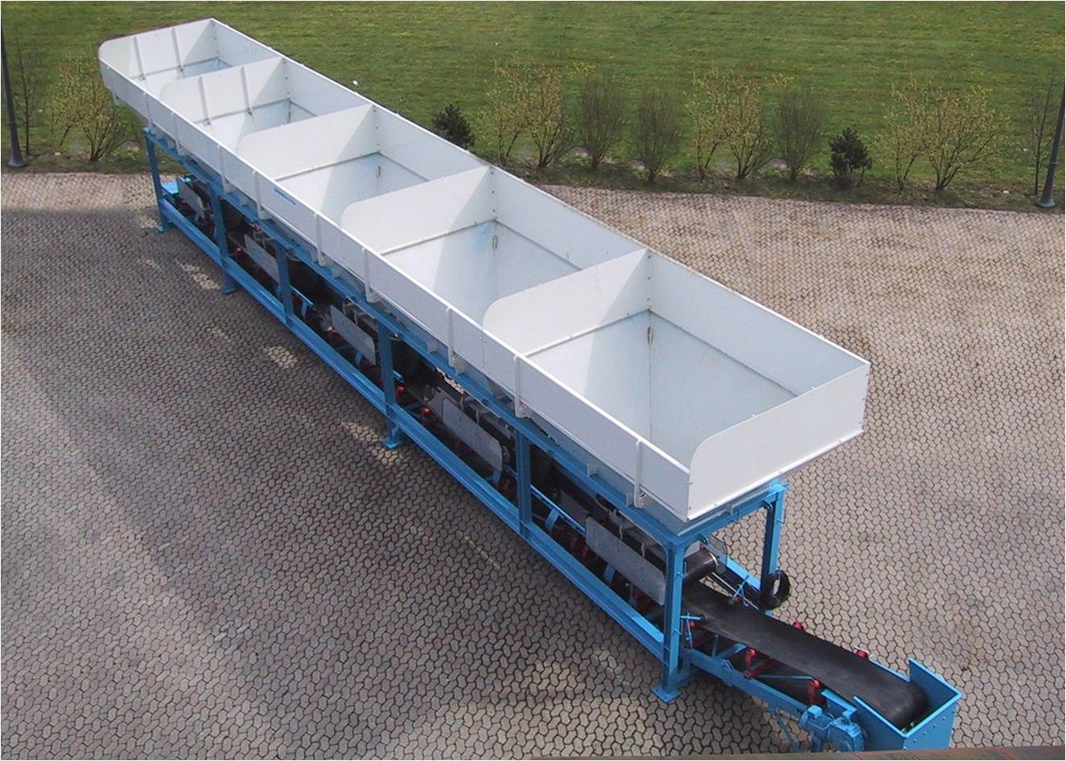
Hoppers/silos
Typical silo guarding
belt and tail drum guards
Feed conveyor guards

Slide 17
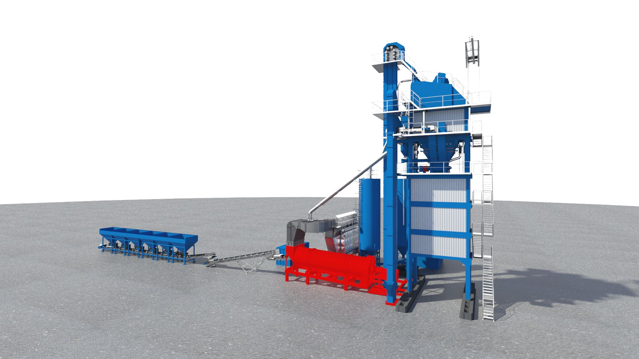
Drying section
Fuel- oil or gas
protection of fuel storage, supply line
–start up sequence, purge cycle
Drive wheels- gaurding interlocks

Slide 18
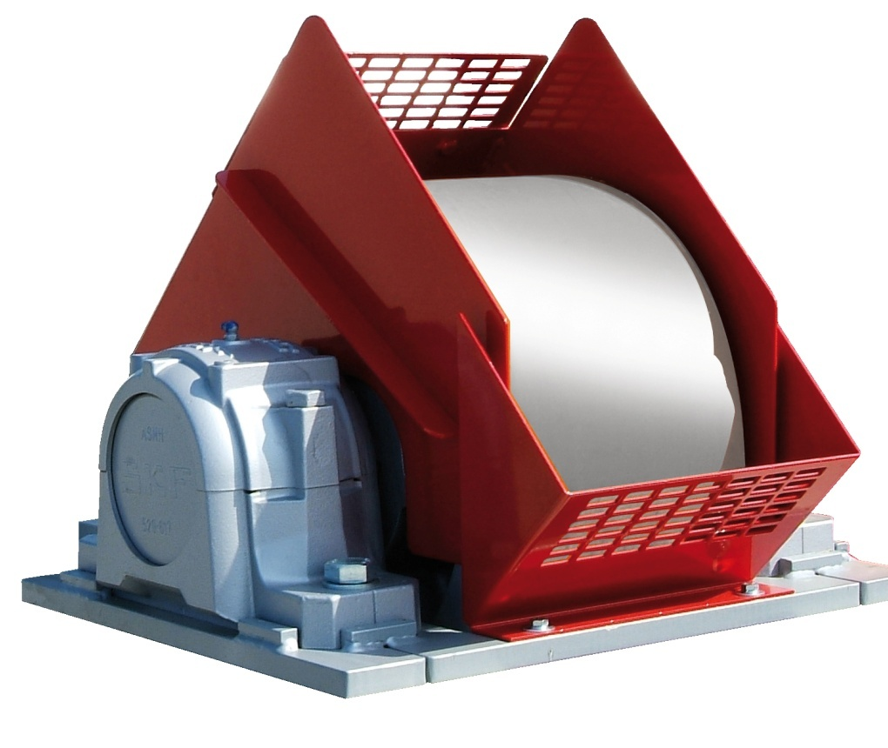
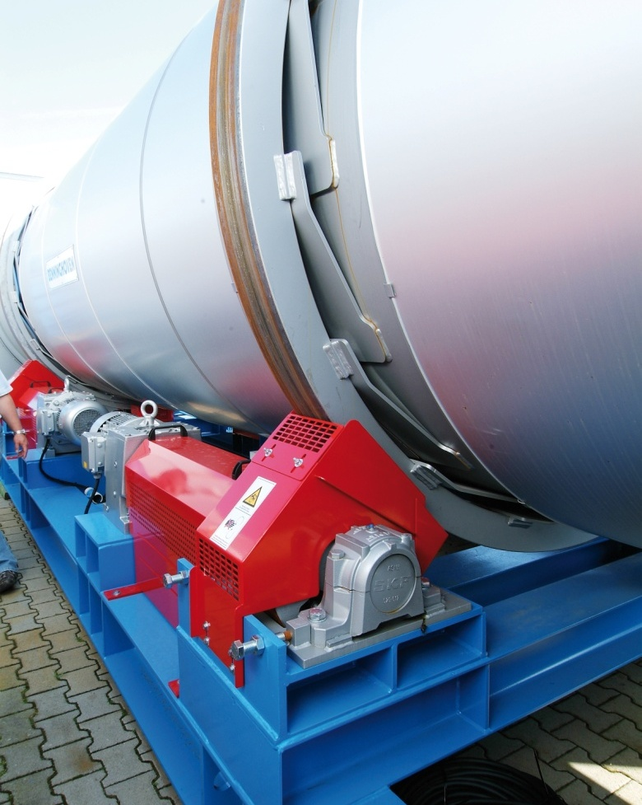
Dryer Drum
Dryer drum
  Dryer drum with friction wheel drive guards

Slide 19
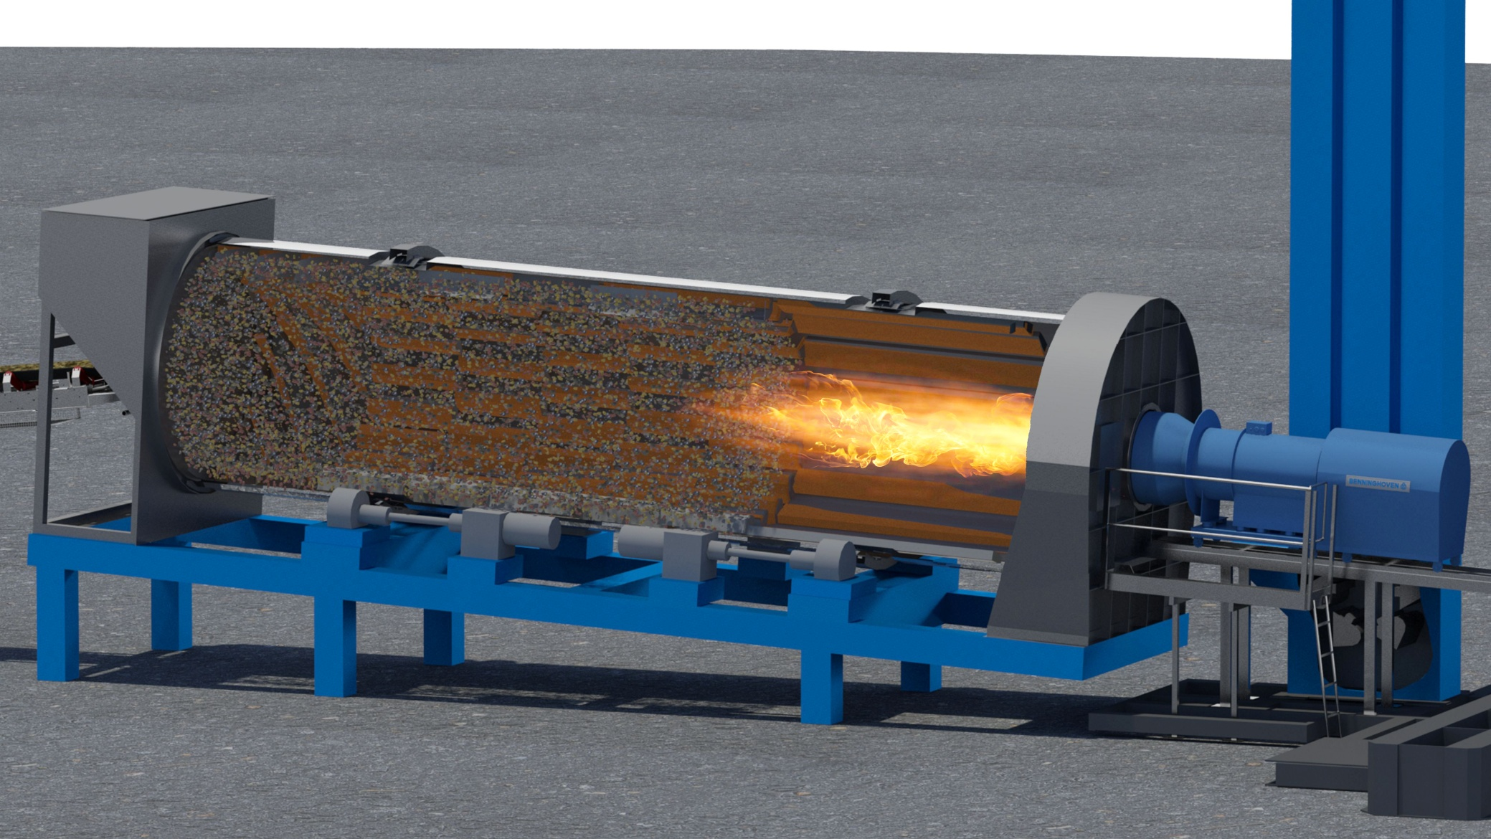
Drying section
Control of burner
Control of exhaust gases
Access
Maintenace within the drum

Slide 20
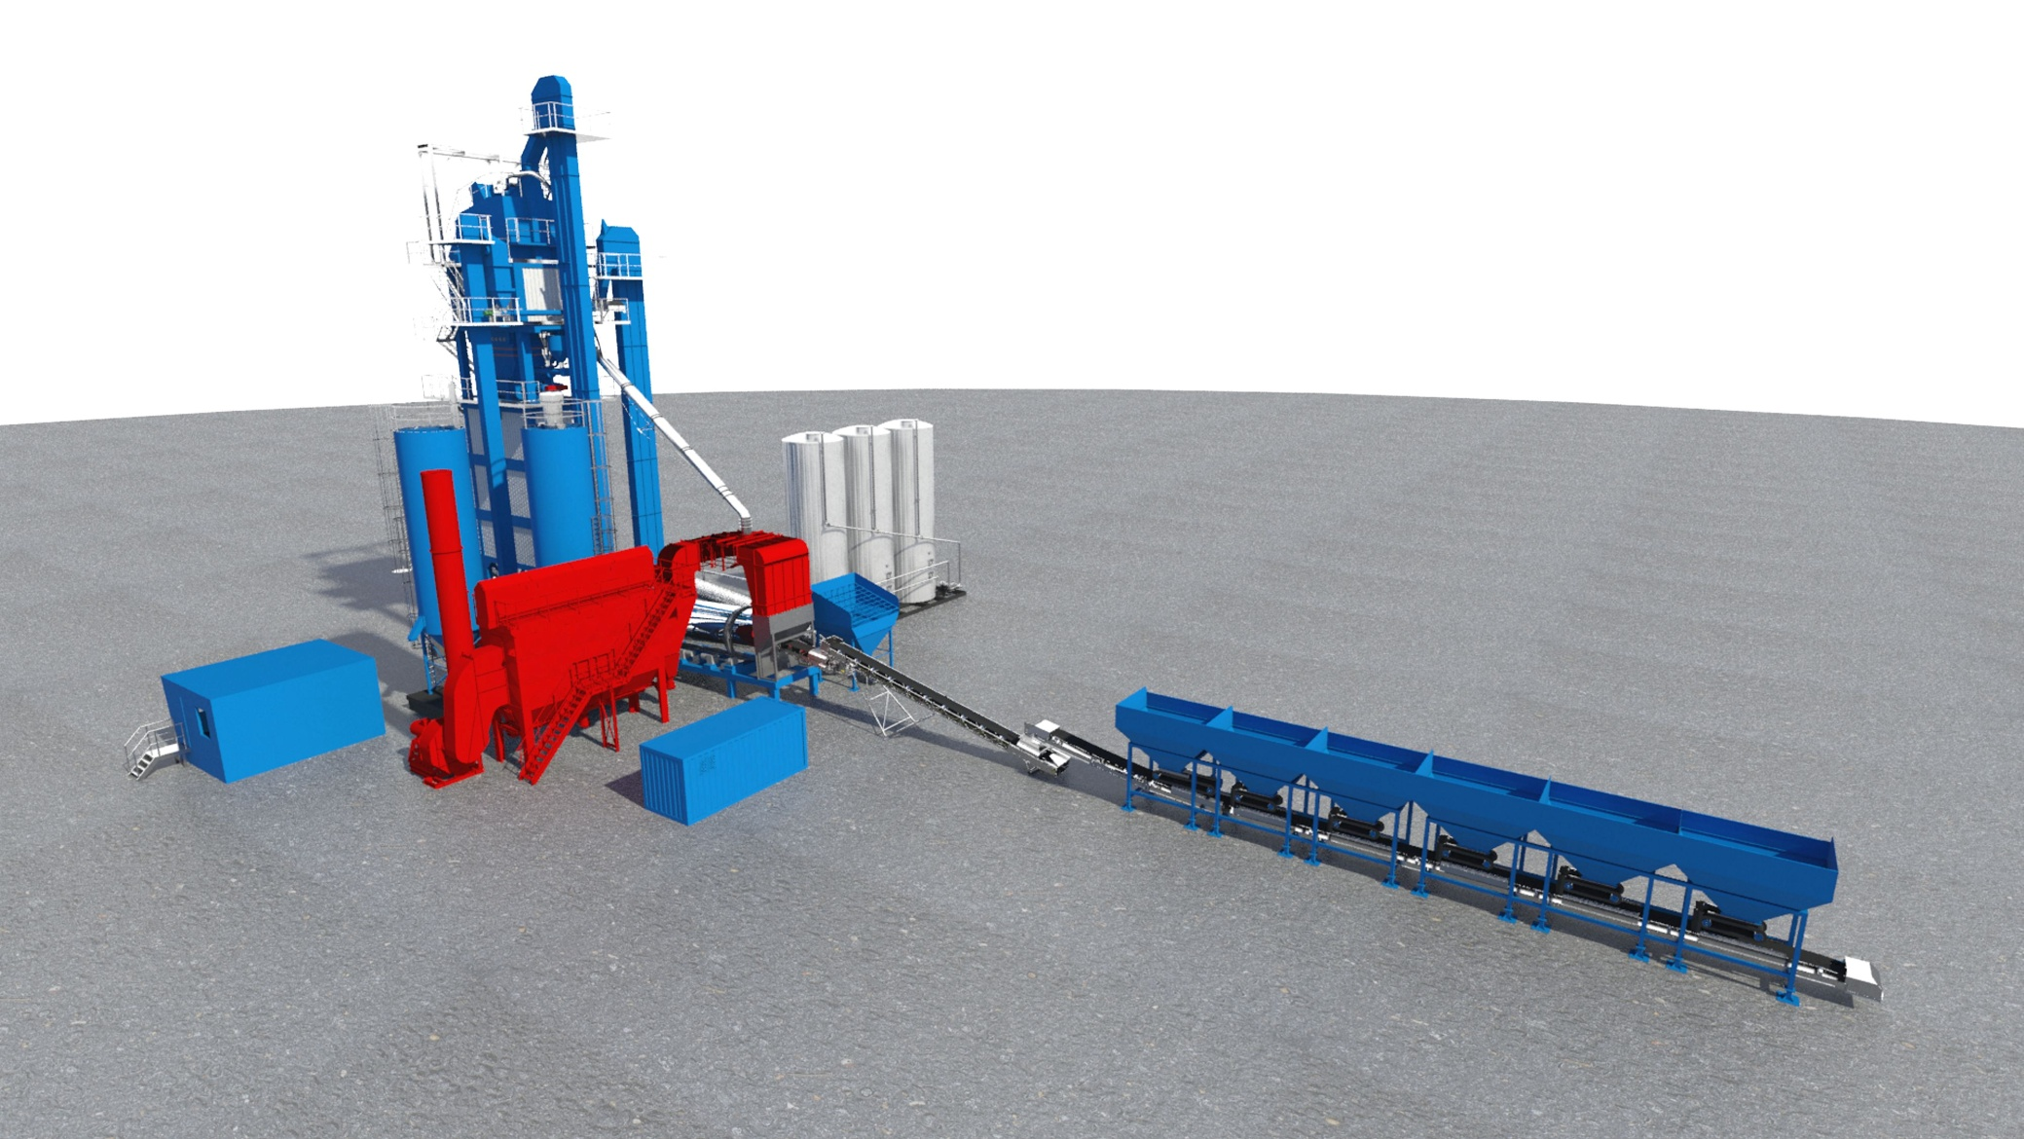
Dust extraction system
Occupational
dust
Enviromental
dust
Maintenace

Slide 21
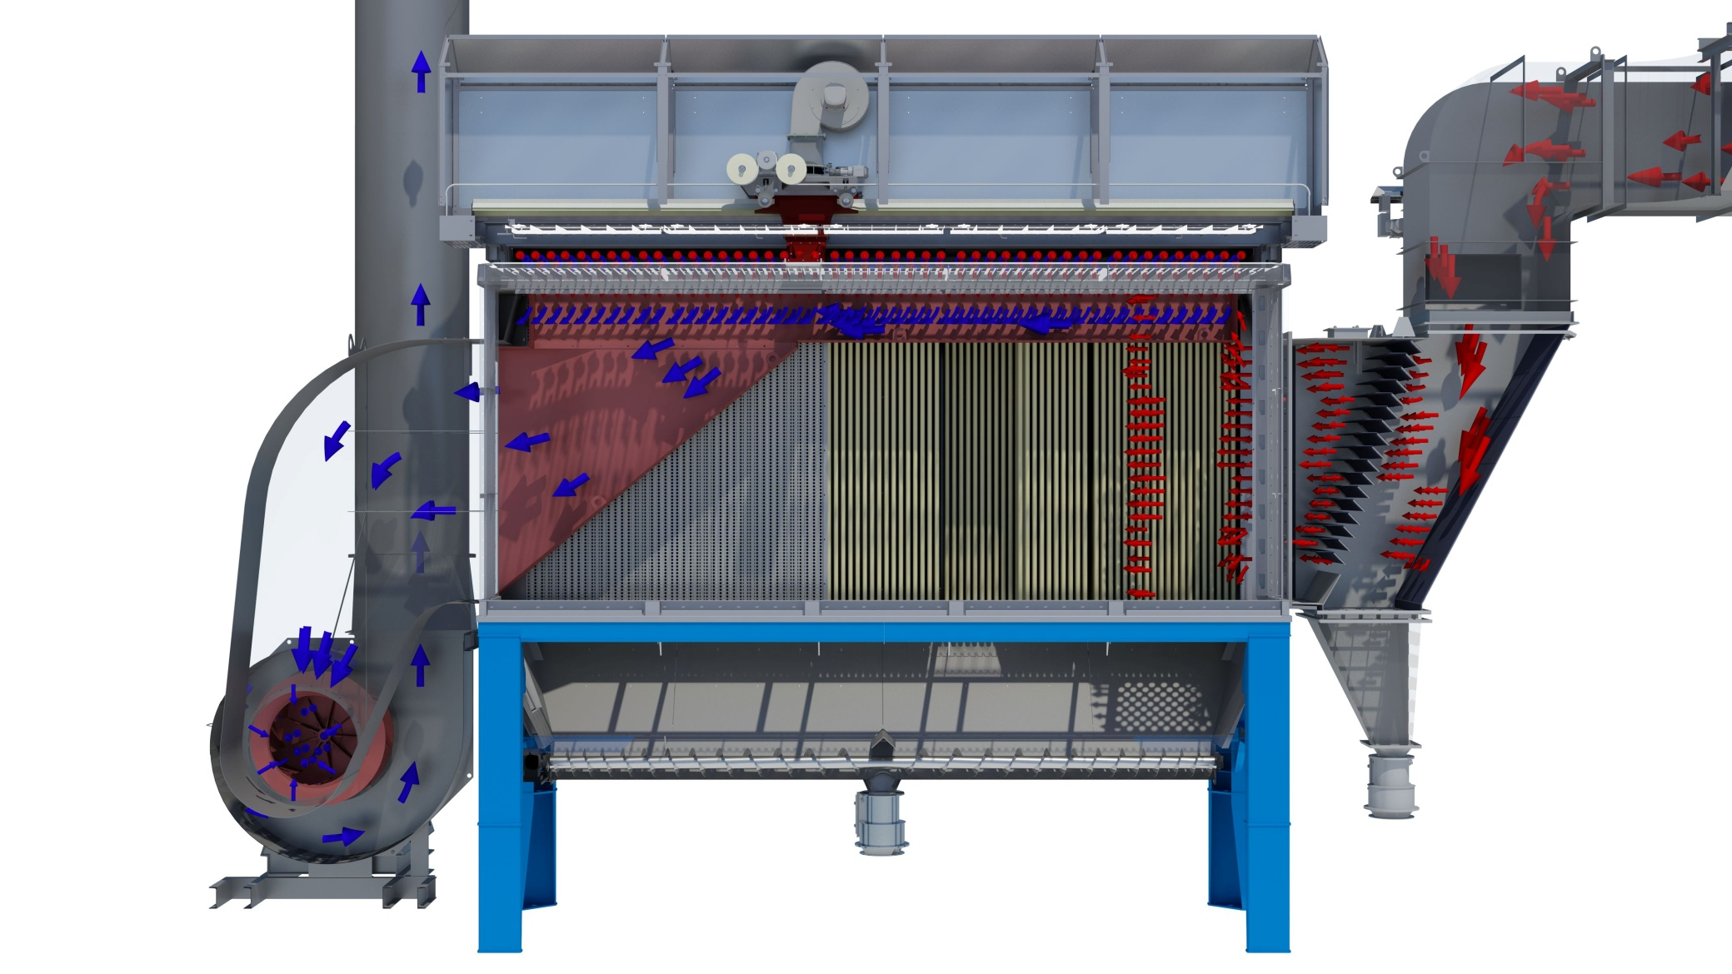
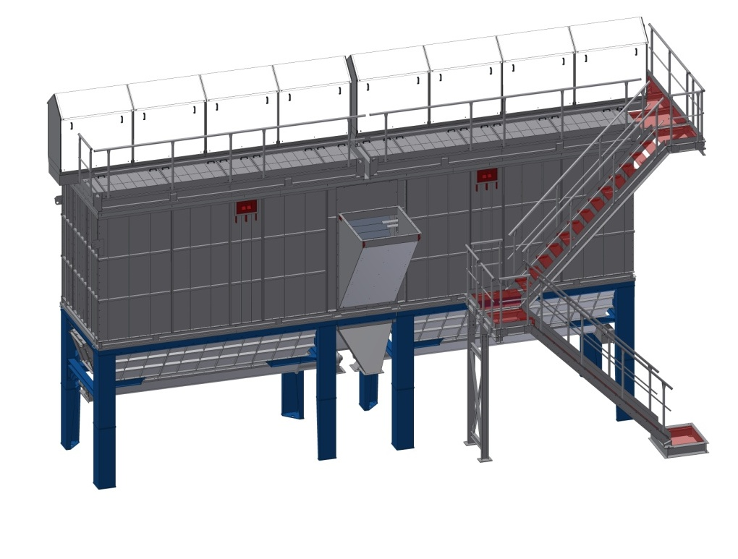
Bag House
Bag house components
  Filter housing –integrity
  Pre Skrimmer
  Exhaust fan- drives gaurds
  Screw- gaurding , maintainance

Slide 22
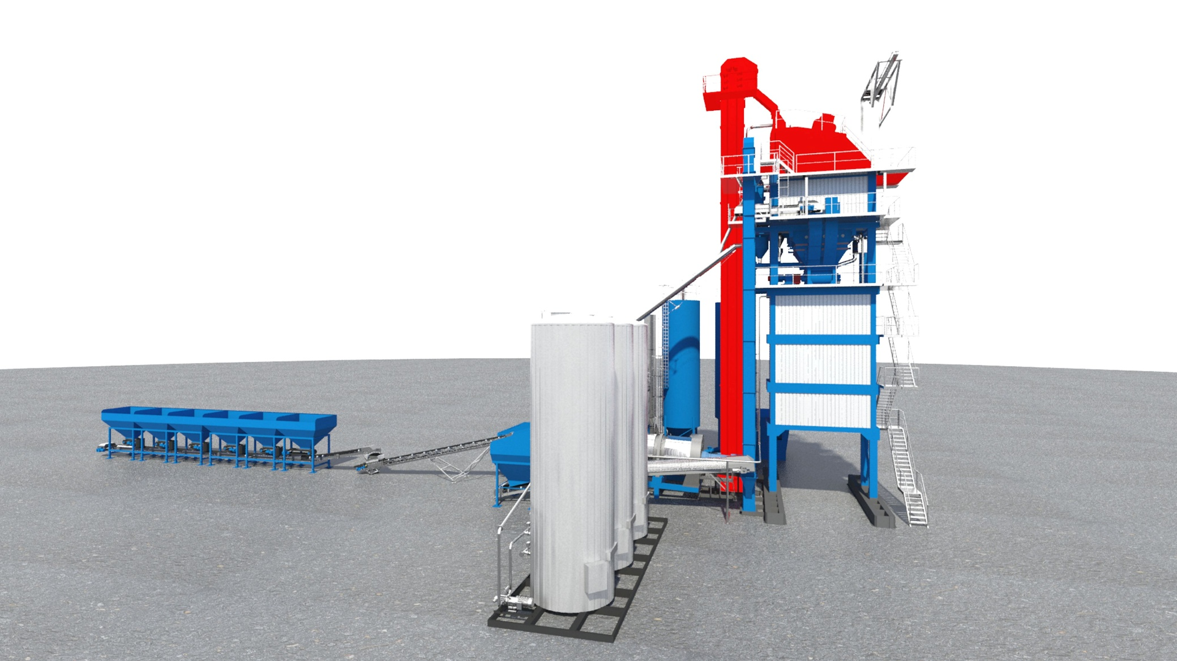
Mixing tower
Hot bucket elevator and screen
Integrity
Access
Platforms walkways, kickboards
Work at heights

Slide 23
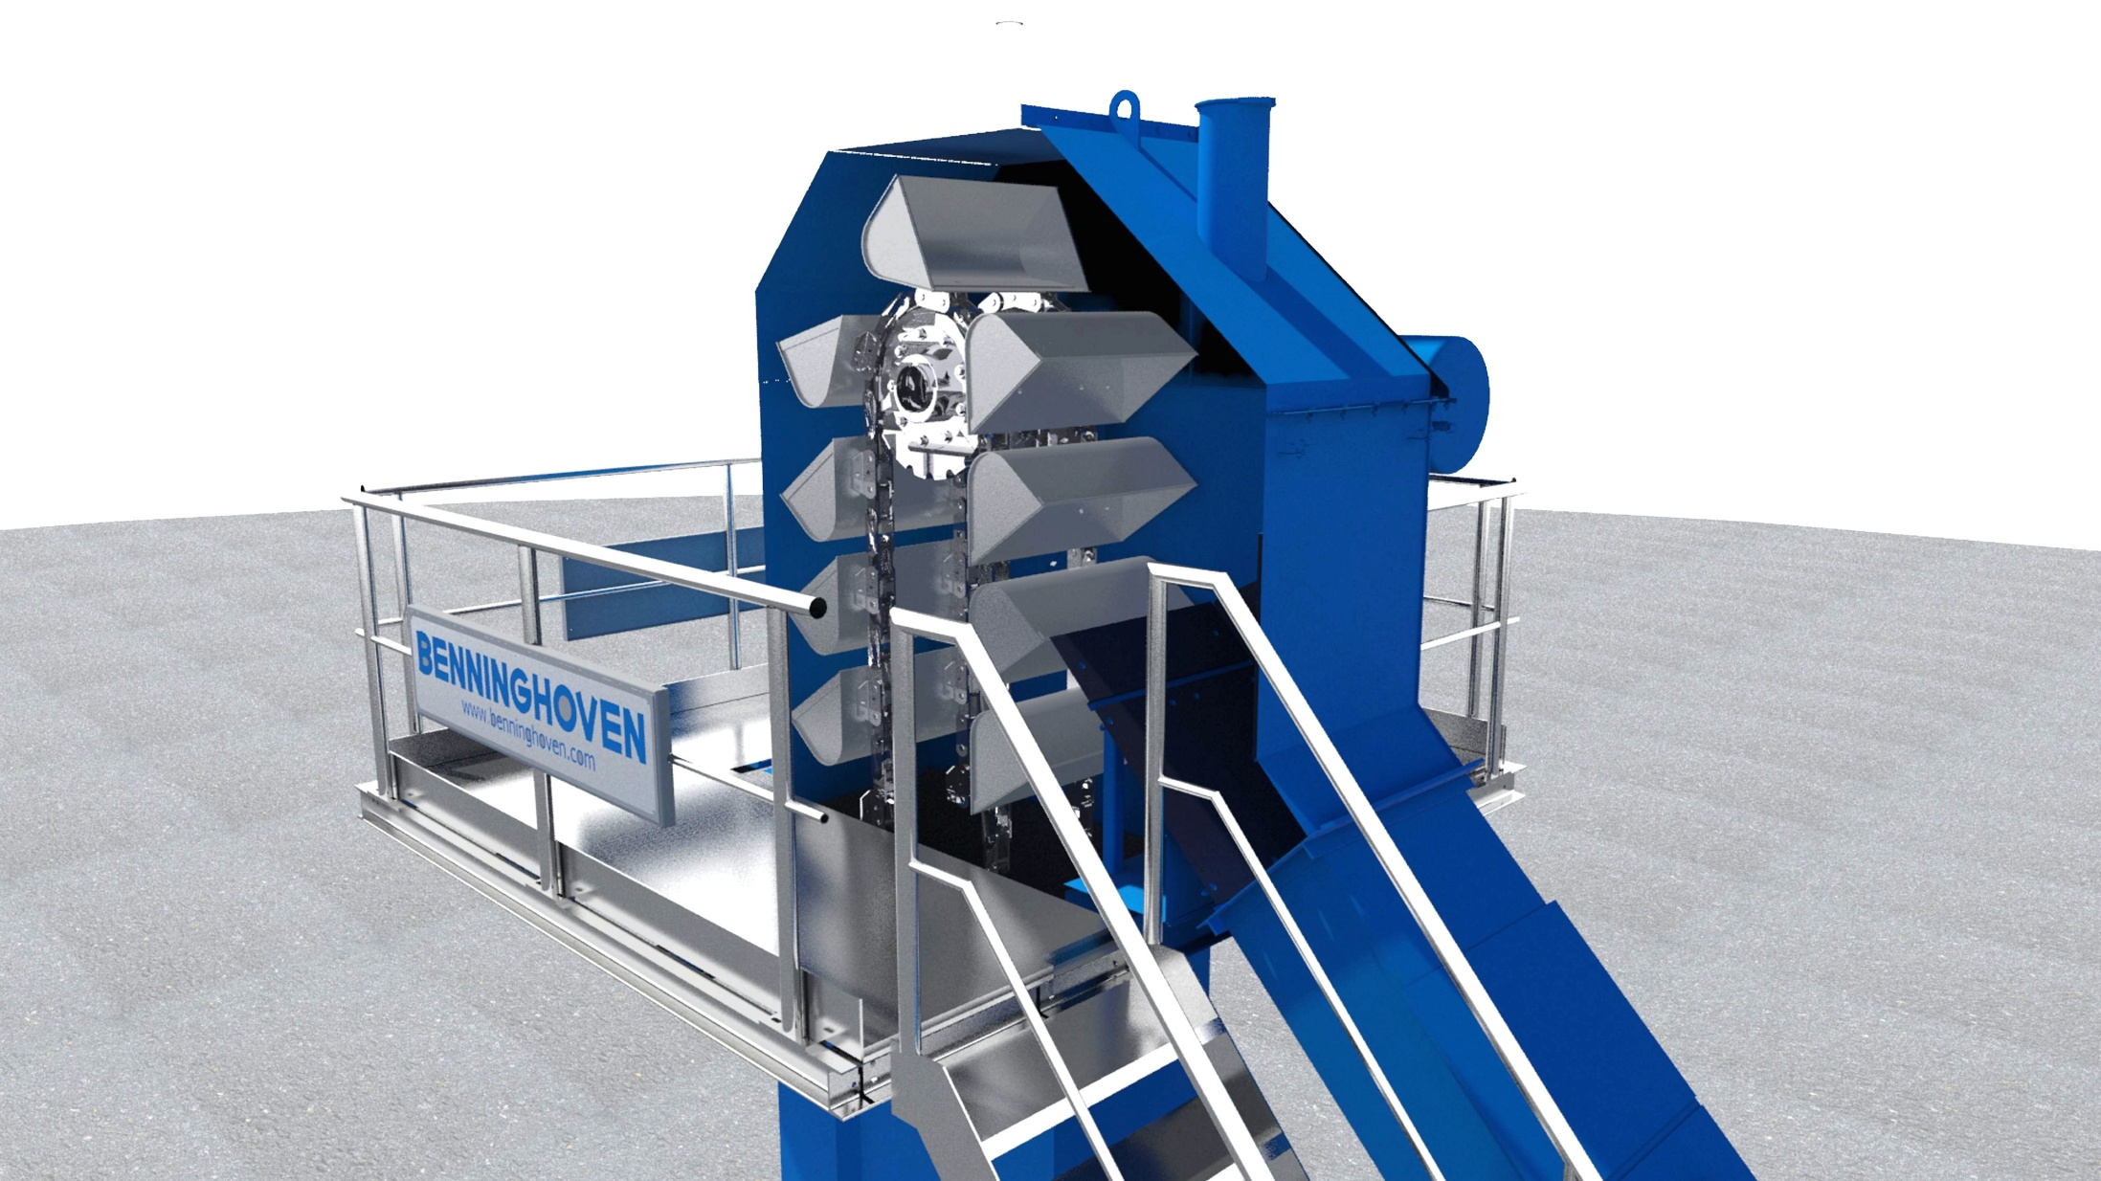
Mixing tower
Hot elevator with chain and bucket
Maintenance
Access
Work at heights

Slide 24
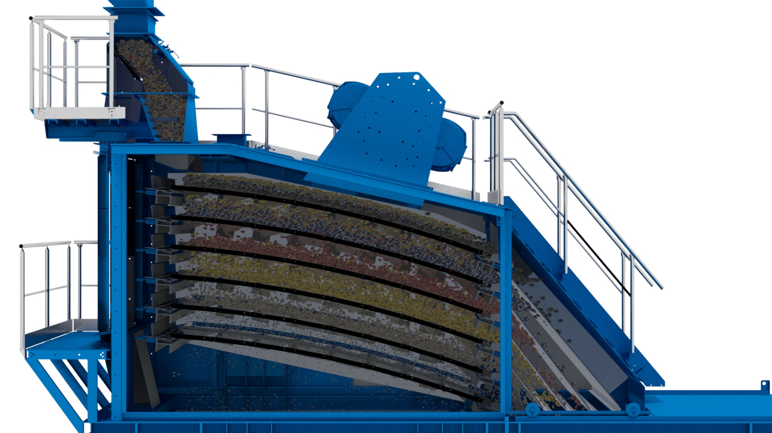
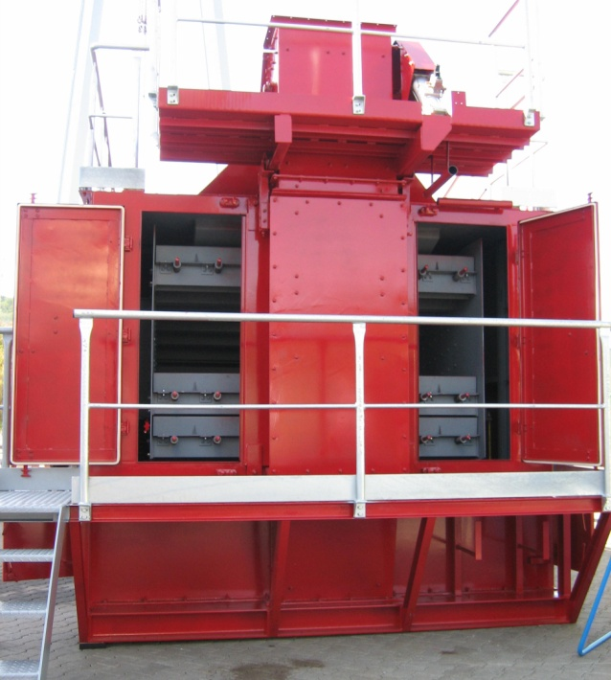
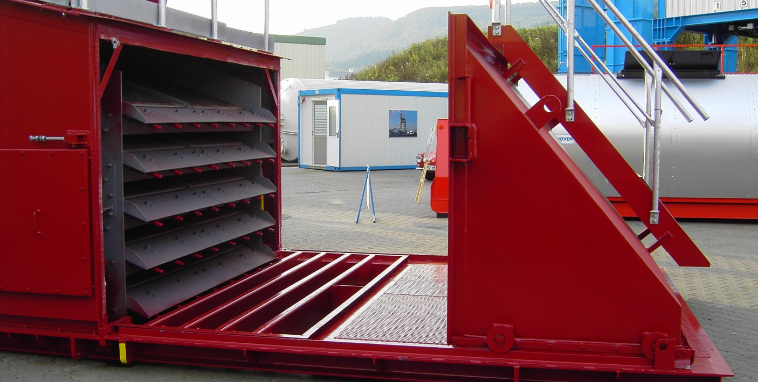
Screen
Screen / Hot Bin Section
  Screen
  Work at heights
  Confined space
  Drives and gaurds

Slide 25
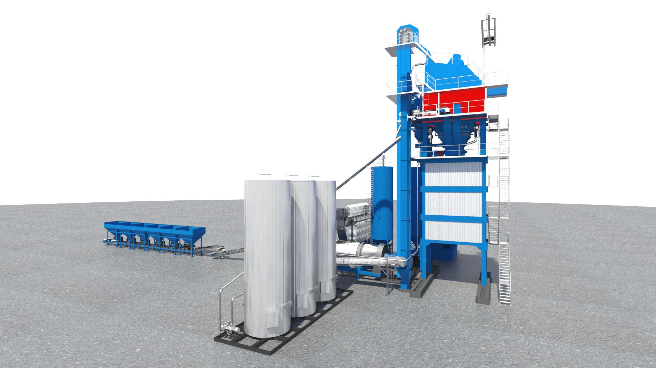
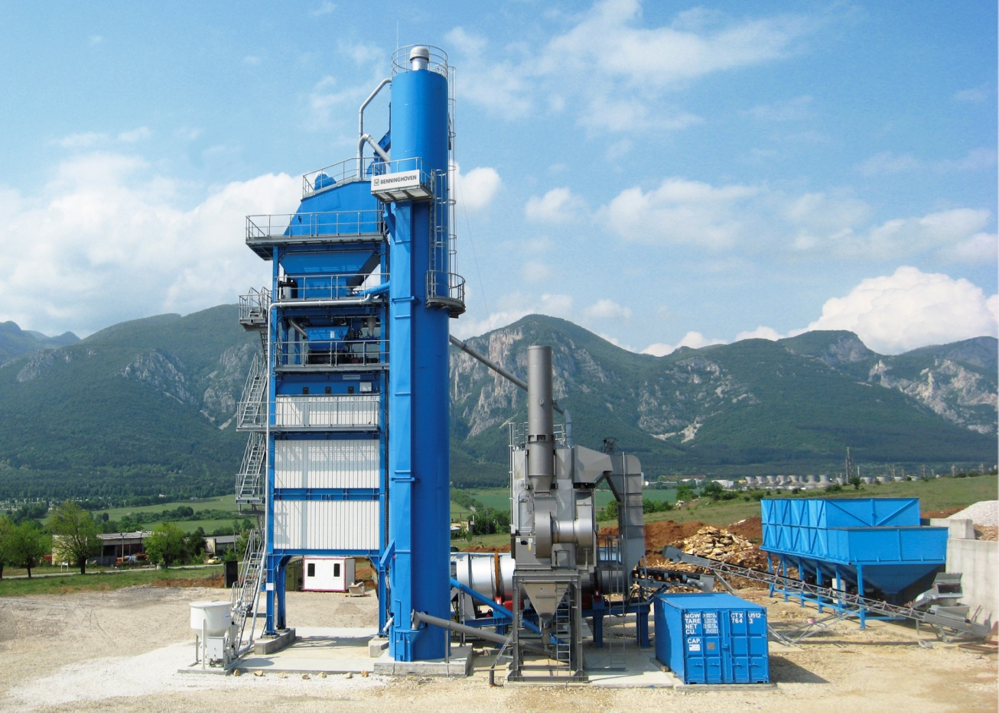
Hot Bin Section
Hot Bin Section
Platforms
Work at heights
Access
Maintenace
Inspection/housekeeping

Slide 26
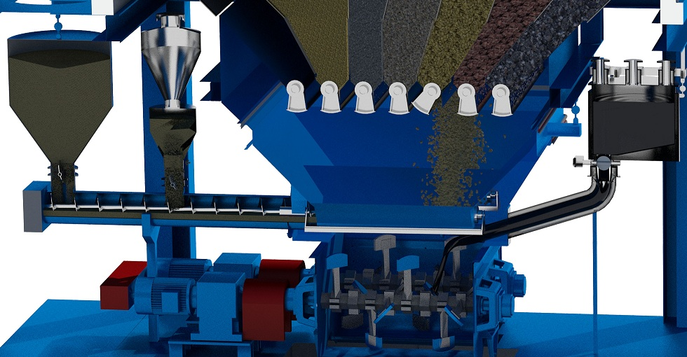
Mixing tower
Mixing Section
Components
  Aggregate storage
  Aggregate weigh
  Bitumen weigh
  Filler weigh
  Dosing screw
  Mixer

Slide 27
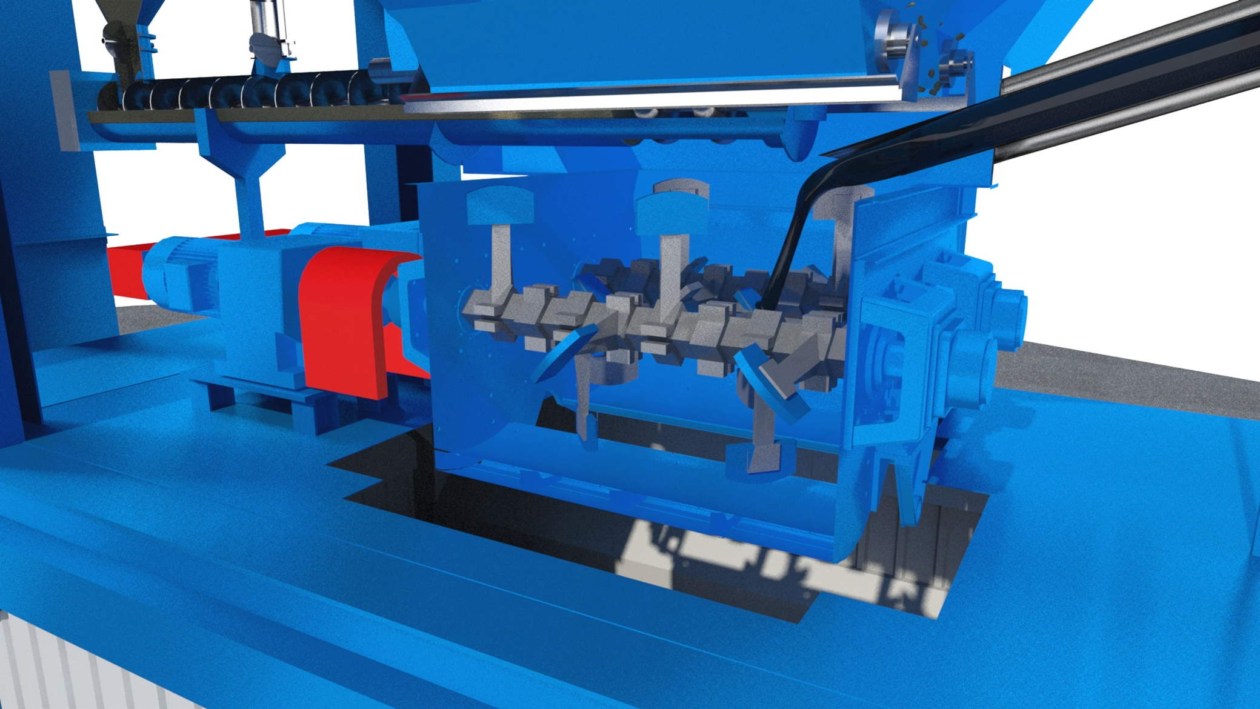
Mixing tower
Mixer box
Gaurding of drives
Platforms walkways
Maintenance
Confined spaces
Protection of pipework
Electrical supply

Slide 28
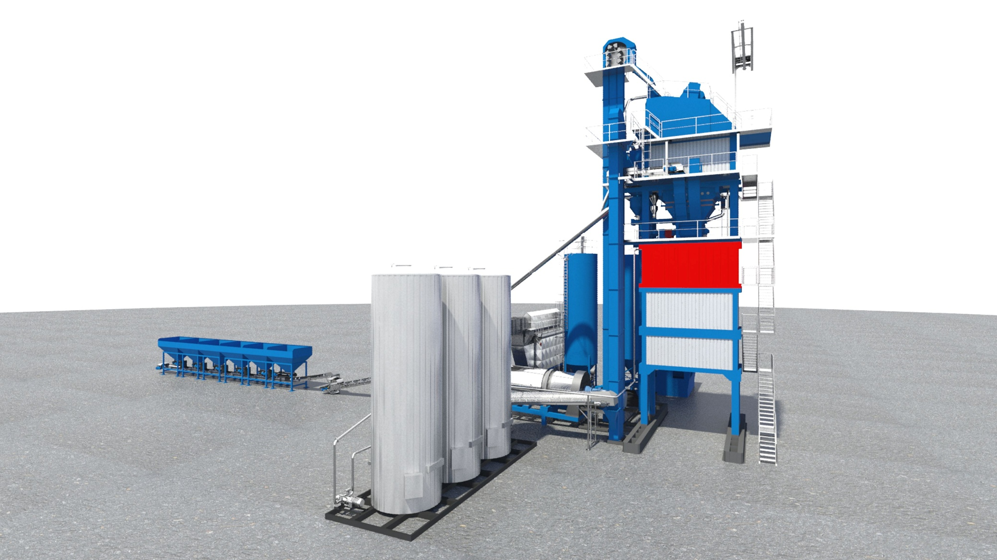
Mixed material loading silo
Skip
Derailment-
Wire ropes -
Hoist
Hot material
Spillages
overfill

Slide 29
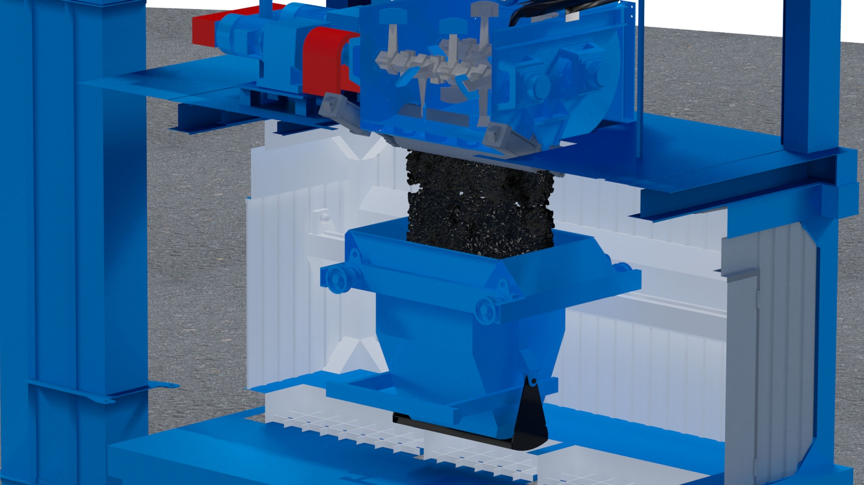
Mixed material loading silo
Skip
control of travel

Slide 30
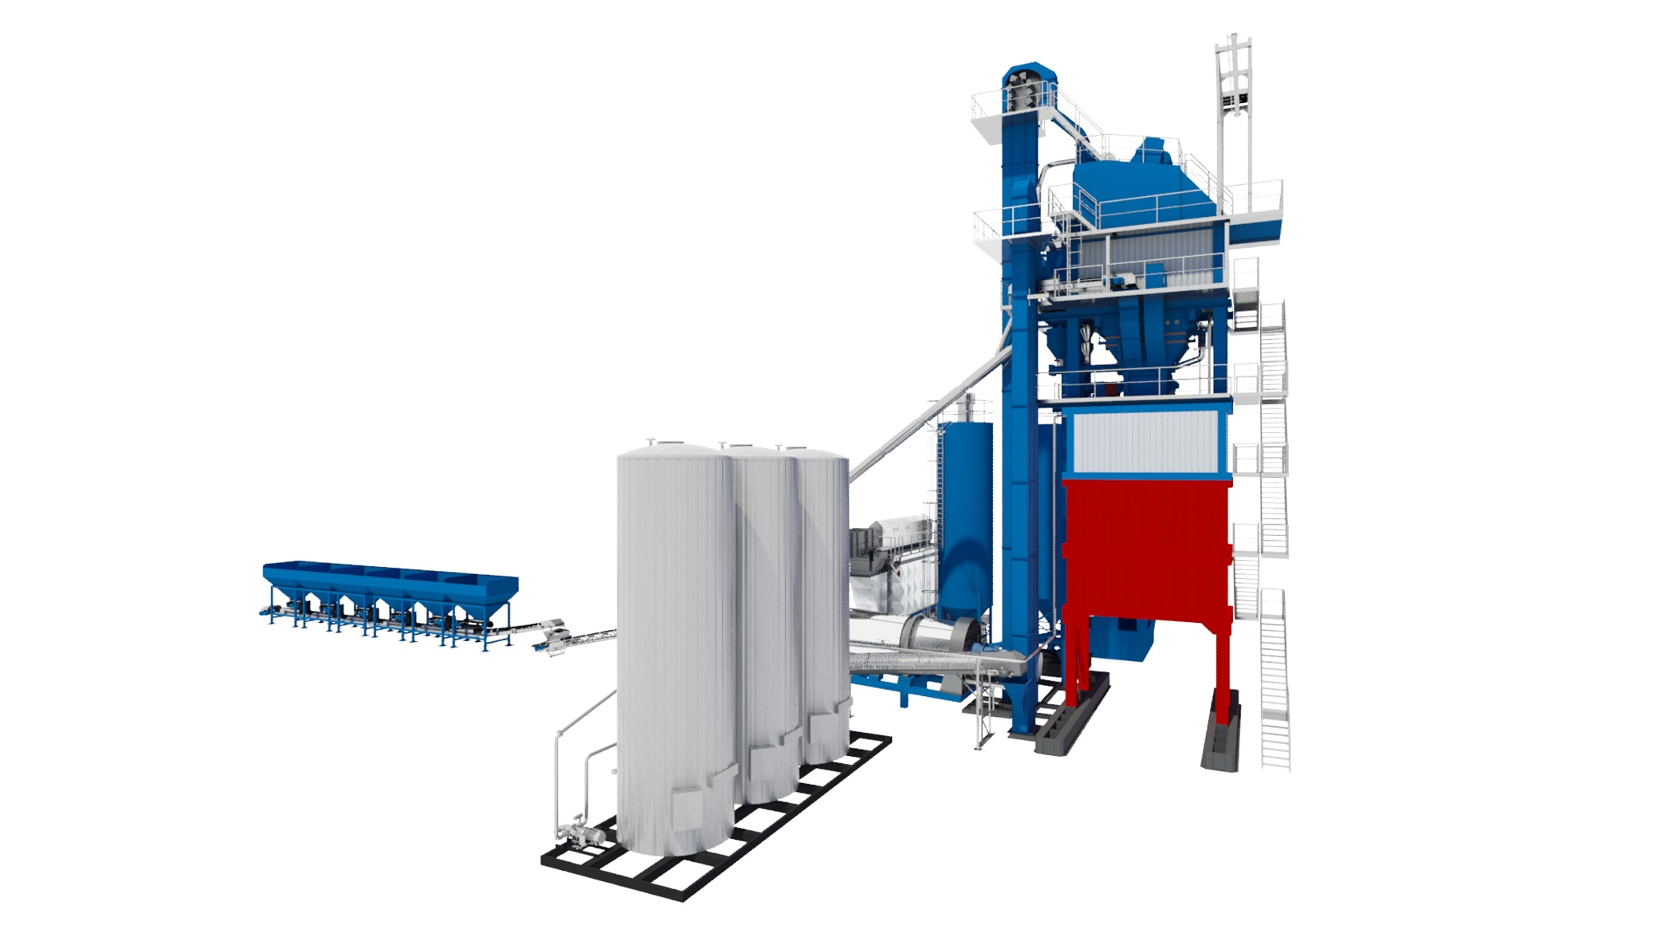
Mixed material loading silo
Mixed material loading
Restrict access in vicinity
Interlocks on gates
Truck movements
Plant operator visibility
Drivers visibility
Maintenance
Walkways platforms
Access

Slide 31
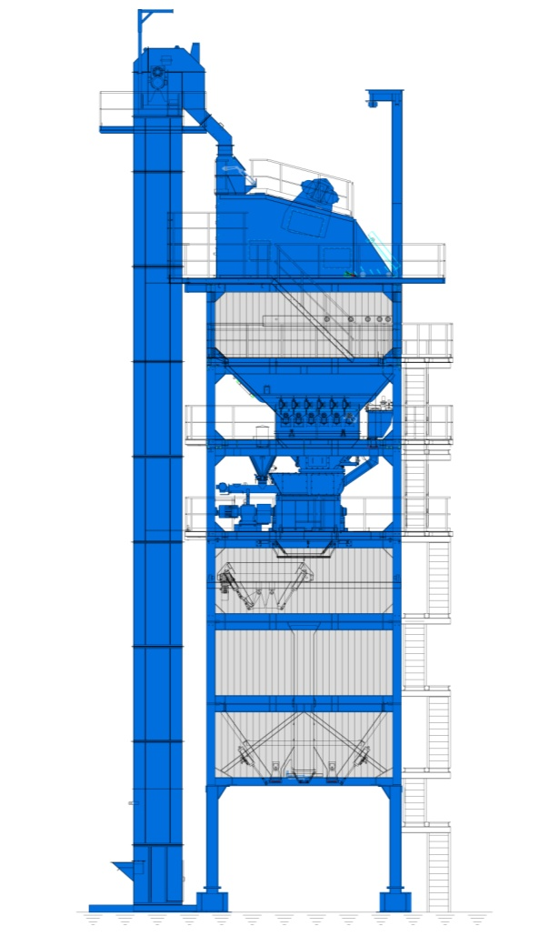
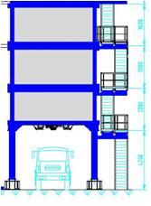
Mixed Material Silo
Mixed storage silo
configurations
  Mixed material silo underneath the mixing tower
  Mixed material silo
  Direct loading

Slide 32
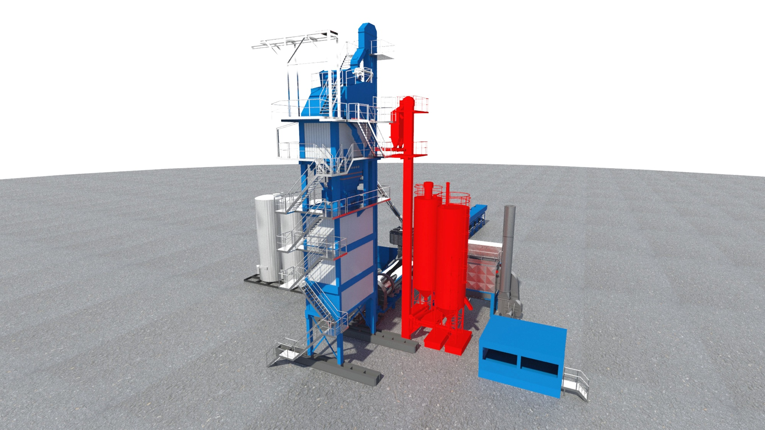
Filler System
Filler system
  import filler
  reclaimed filler
  Pressureised road tankers
  Storage of powder
  Screw conveyors

Slide 33
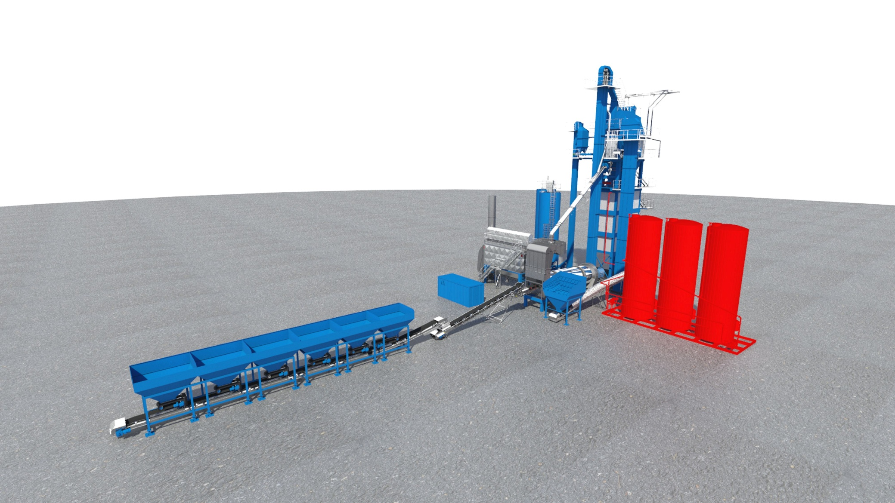
Bitumen tank system
Bitumen tank system
Protection of silos
Heating system
Unloading of bitumen
Pipework
Pumps, guarding

Slide 34
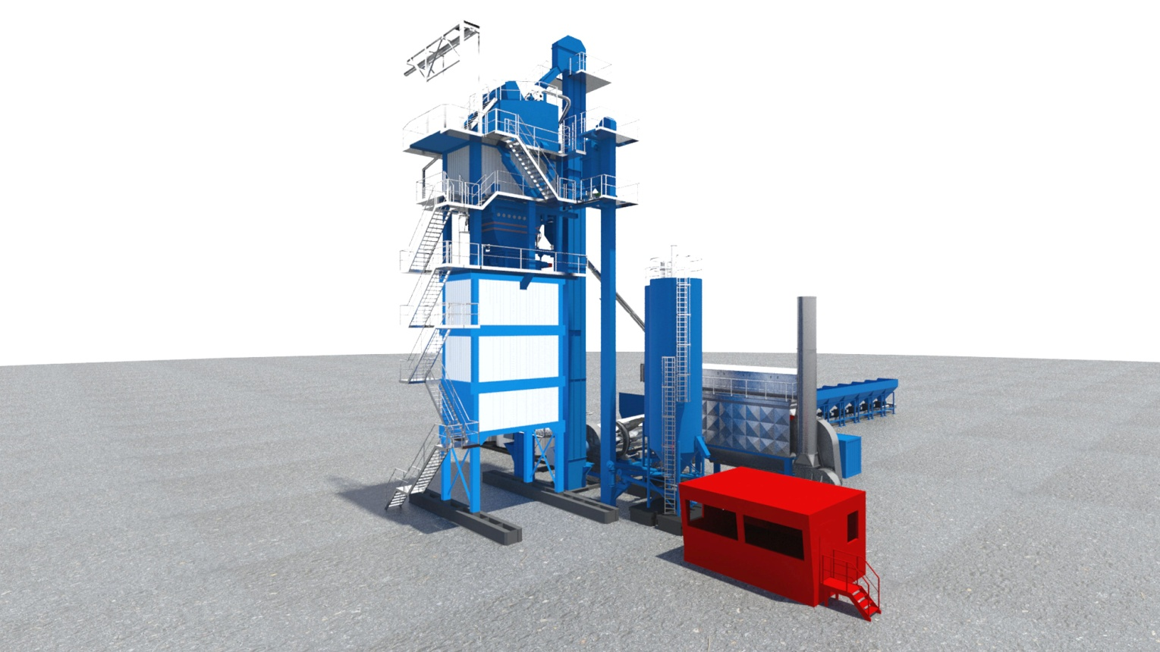
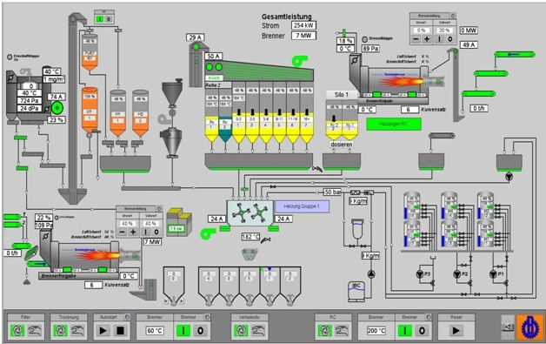
Plant control system
Controlling
  Control cabin
  Enviroment, training, access,visibility
  Switch room
  Access, electrical overloads,
  Housekeeping maintenance
  Plant control system
  Overide,automation safety features

Slide 35
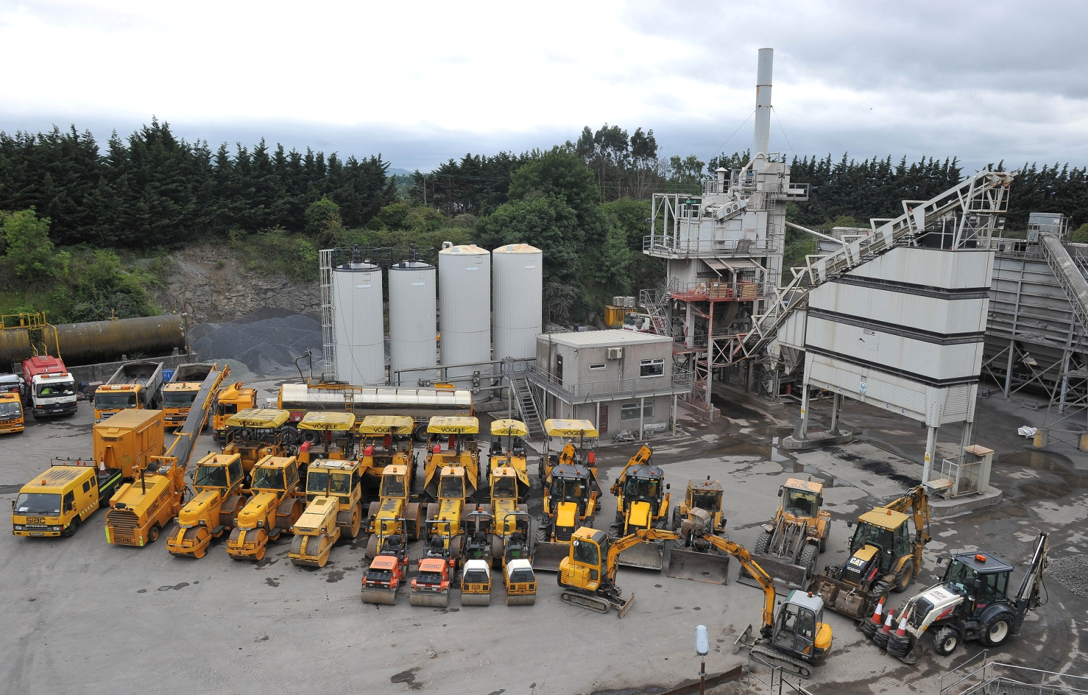

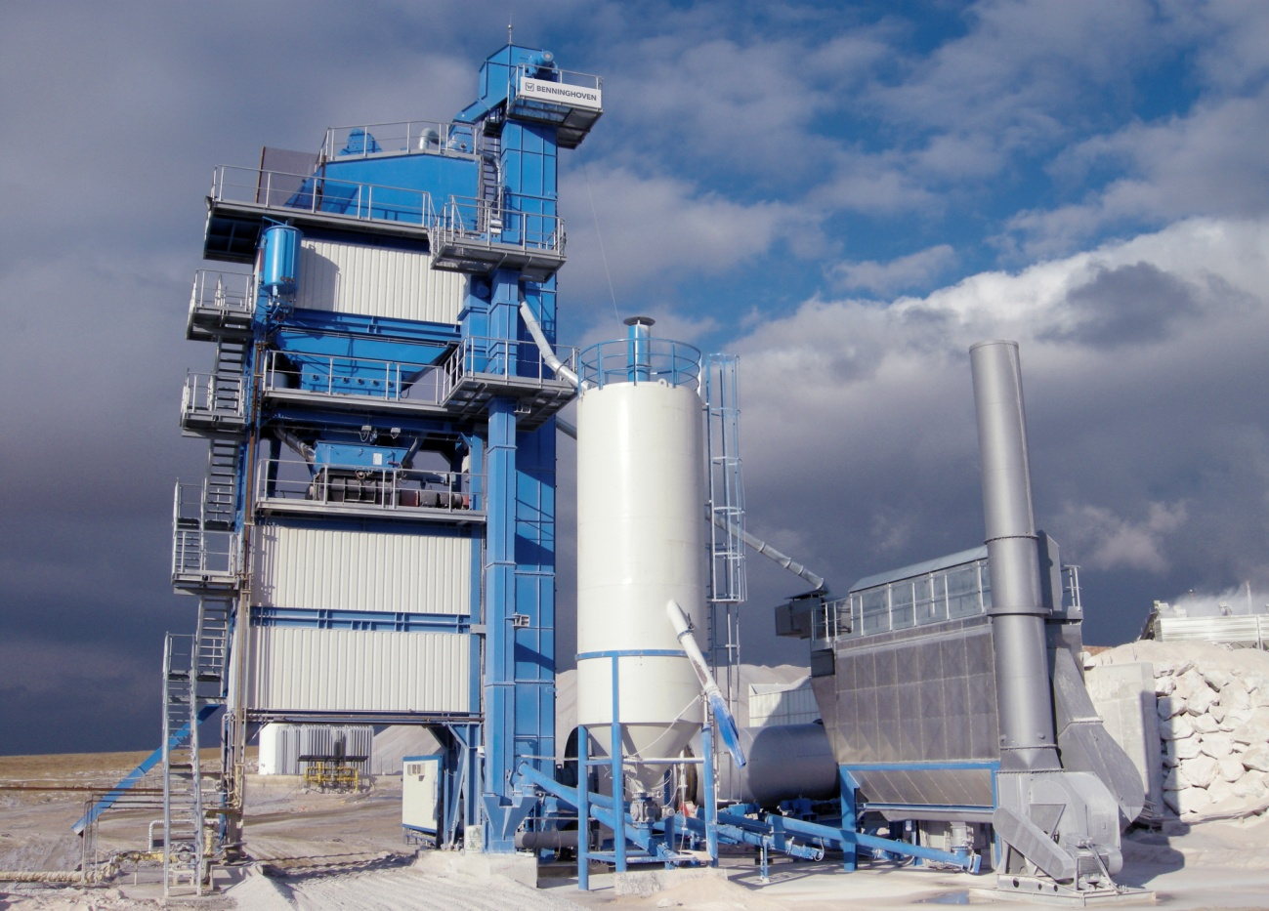
Mixing Plant

